Slide 1
Transcrypta.ai - Audio Transcription and Insights Generation App
Nivetha S S - AI & DS

Slide 2
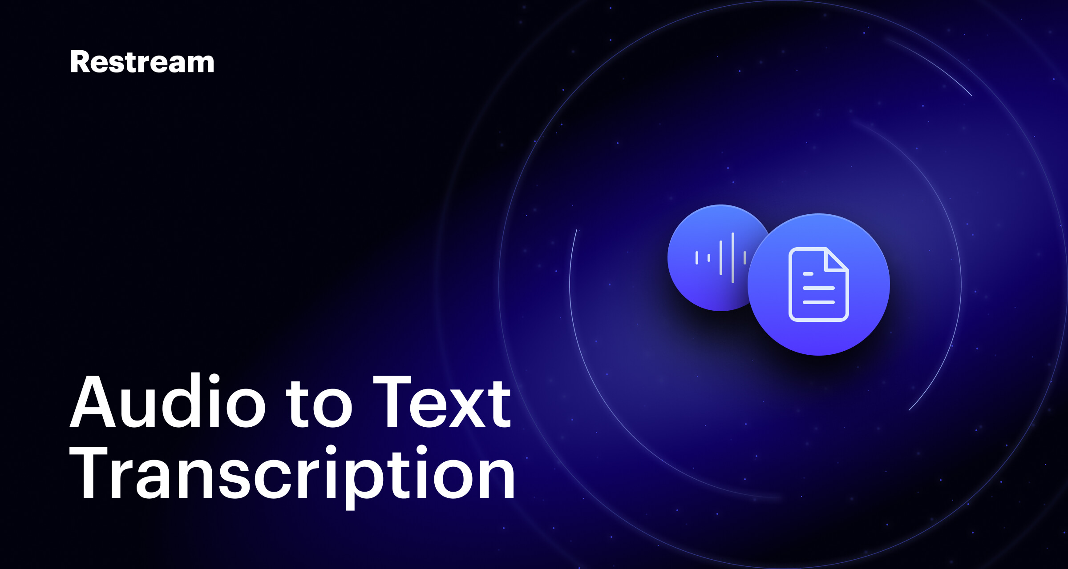
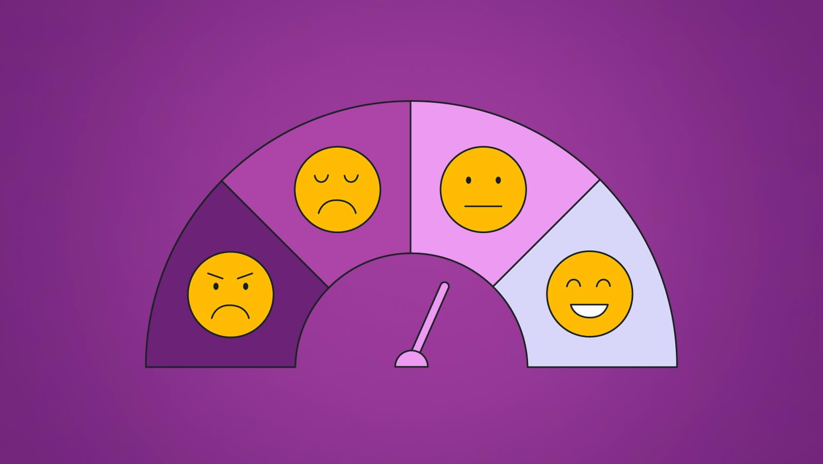
Features Overview
Audio Transcription using Whisper
Sentiment Analysis (VADER, TextBlob)
Emotion Detection (RoBERTa-based model)
Metadata Extraction (Duration, Language, Word Count, Frequency)
Insights Generation and Visualization

Slide 3
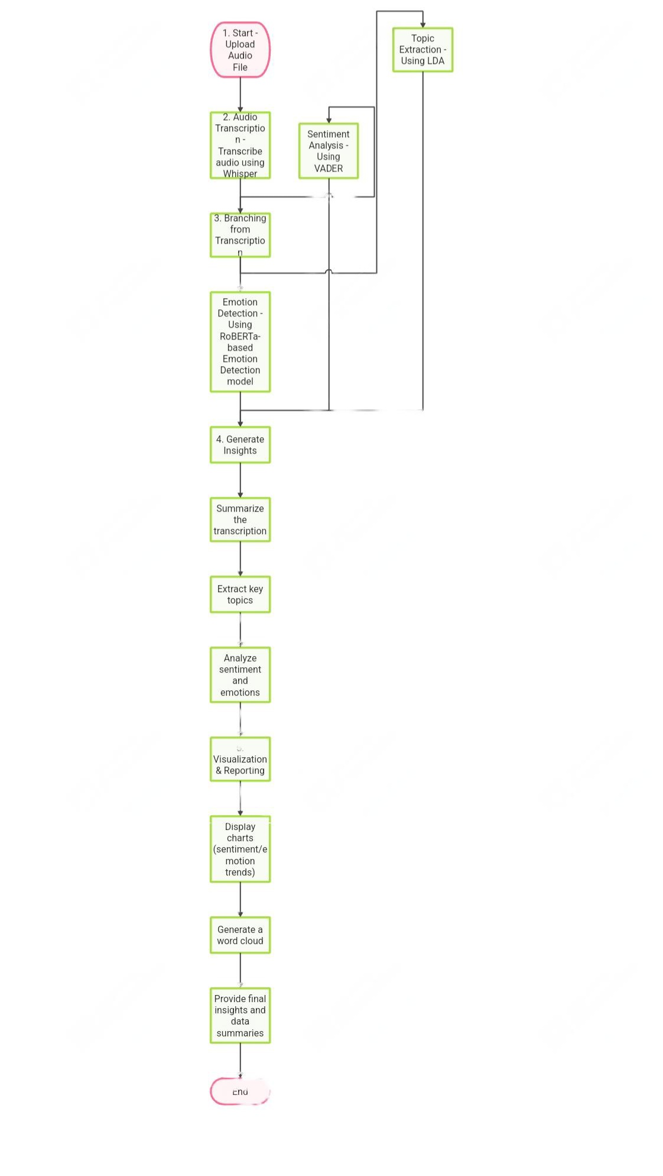
Workflow

Slide 4
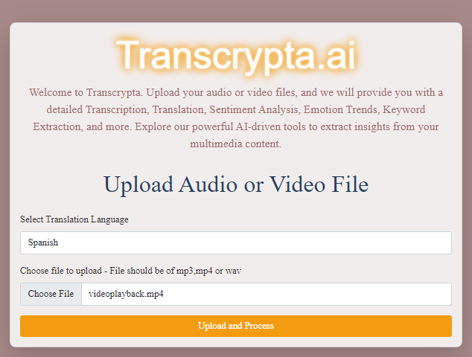
Dataset upload page:

Slide 5
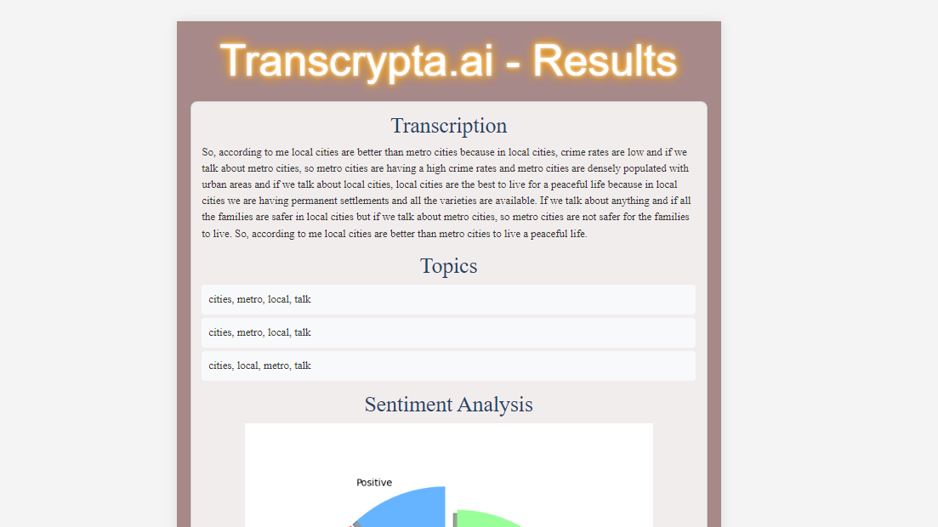
After uploading completed, Results page will open:

Slide 6
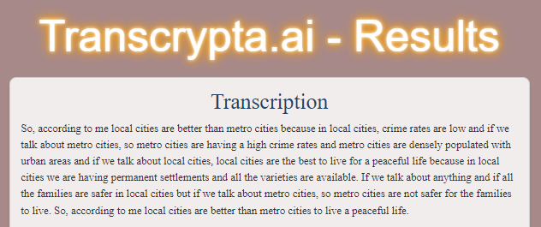
Models Used
Audio Transcription:
Whisper (ASR Model):
Purpose: Converts audio files to text.
State-of-the-art for automatic speech recognition with high accuracy.

Slide 7
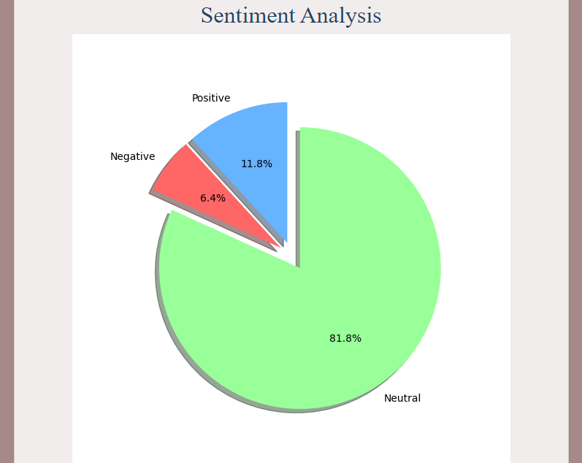
Sentiment Analysis: VADER & TextBlob model: Purpose: Detects the sentiment (positive, negative, or neutral). Lightweight models suitable for text polarity analysis.

Slide 8
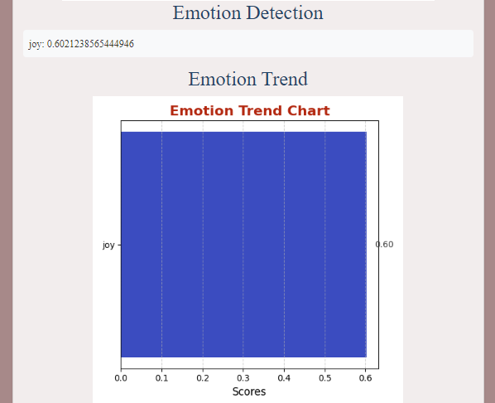
Emotion Detection:
RoBERTa Emotion Model:
Purpose: Classifies text into emotions like happiness, anger, etc.
Pre-trained on emotion-specific datasets for robust emotion classification.

Slide 9
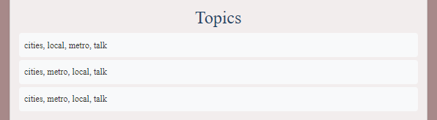
Topic Extraction:
Gensim LDA:
Purpose: Extracts key topics from the transcription.
Provides insights into the main themes of the conversation.

Slide 10

Keyword Extraction:
KeyBERT:
Purpose: Extracts relevant keywords based on sentence embeddings.
Helps in quickly identifying important phrases or terms.

Slide 11
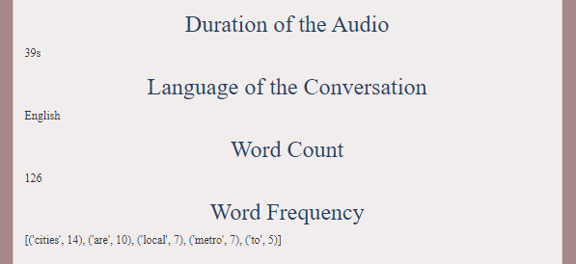
Metadata Extraction:
Librosa:
Purpose: Extracts the duration of the audio and key statistics.
Crucial for analyzing audio properties and word frequency.
Duration of Audio: Helps understand the length of the conversation.
Language of Conversation: Spoken language for translation purposes.
Word Count and Frequency: Overview of the spoken words and their repetitions.

Slide 12

Insights Generation:
Purpose: Extract meaningful information from raw transcription, such as summarization to help users quickly understand the key points of the audio.
Hugging Face Summarization Model:
This model leverages a pre-trained transformer-based pipeline to summarize long texts, extracting the most important information. It condenses input data into concise, coherent summaries, making it easier to digest large volumes of text efficiently.

Slide 13
Conclusion:
This app provides a comprehensive way to analyze audio conversations with
Transcription
Topics generation
Keyword extraction
Emotion Detection
Sentimental Analysis
Insights generation
Metadata Extraction
"From voice to vision—where every conversation tells a story."

Slide 14


Thank you
Presenter name
Email address
Website address

