Slide 1
SPRINT-1 | EDA
ReturnIQ
AI-Powered E-Commerce Return Intelligence and Root-Cause Analysis System
INDUSTRY
STUDENT NAME
E-Commerce
Nivetha M
STUDENT ID
COURSE
AF05313369
AIML
BATCH CODE
ORGANIZATION
ANP-D7444
Anudip Foundation

Slide 2
Industry Overview
SELECTED INDUSTRY
Why data analysis matters here
E-Commerce
Reveals where delivery delays and failures happen
Links customer reviews to the logistics experience
Helps compare products, categories and sellers fairly
Turns raw complaints into evidence for root-cause work
E-commerce is the buying and selling of goods online. Each order passes through many stages: product listing, seller fulfilment, payment, shipping, delivery and customer feedback. Customers can raise complaints or request returns at any of these stages.
99,441
112,650
3,095
397,333
orders analysed
order items
sellers
NCH grievances

Slide 3
Problem Statement
The problem
Why it matters
Who is affected
Customers face wrong, defective, damaged or missing products, delivery delays, non-delivery and refund or replacement problems
Causes can sit in the product, seller, fulfilment, delivery or claim stage
Return systems process requests but do not explain why problems occur
Repeated returns and complaints raise costs and hurt customer trust
Low review scores damage seller and platform reputation
Without root-cause insight, the same issues keep recurring
Customers: poor experience, delays, refund disputes
Sellers: returns, bad ratings, lost sales
Logistics partners: delivery performance under scrutiny
Platform and business teams: investigation workload and cost
NCH data: 212,120 of 397,333 grievances (53.39%) fall in return-related categories such as wrong, defective, non-delivered or missing products.

Slide 4
Project Objectives
1
Understand the data
Load, inspect and integrate the Olist, Online Retail II and NCH datasets into an analysis-ready form.
2
Clean and engineer features
Fix quality issues and create delivery, logistics, freight and order features for later modelling.
3
Analyse delivery and customer experience
Measure delays, review scores and their relationship across categories, sellers, distance and transit speed.
4
Identify complaint and return signals
Study NCH complaint categories and Online Retail II negative quantities as return or cancellation signals.
5
Prepare for the ML stage
Document patterns and recommendations, without treating correlations as proof of causation.

Slide 5
Proposed Solution & Analysis Questions
Analysis questions
Proposed solution
Q1
How are orders spread across statuses, and how many deliveries are late?
ReturnIQ is an AI-powered system that analyses order, product, seller, delivery, payment, review and complaint data to find likely root causes of returns and complaints, and shows them on an admin dashboard. Sprint-1 covers the EDA that comes first.
Q2
Do late deliveries go with lower review scores?
Q3
Which categories and sellers show higher delay or lower reviews?
How Python helps
Pandas merges and aggregates tables, NumPy computes distances, and Matplotlib shows the patterns.
Q4
Do seller-customer distance and transit speed relate to delays?
Q5
How do price, freight and multi-item orders behave?
Tools: Python | Jupyter Notebook | NumPy | Pandas | Matplotlib
Q6
Which NCH complaint categories and retail return signals are most common?

Slide 6
Dataset Information
Olist Brazilian E-Commerce Public Dataset | Source: Kaggle | Format: CSV | 9 tables
Online Retail II
Table | Rows | Cols | Important columns
Customers | 99,441 | 5 | customer_id, unique_id, zip, city, state
Geolocation | 1,000,163 | 5 | zip prefix, latitude, longitude
Order Items | 112,650 | 7 | order_id, product_id, seller_id, price, freight
Payments | 103,886 | 5 | payment type, installments, value
Reviews | 99,224 | 7 | review_score, comment, dates
Orders | 99,441 | 8 | order_status, purchase / delivered / estimated dates
Products | 32,951 | 9 | category, weight, dimensions
Sellers | 3,095 | 4 | seller_id, zip, city, state
Translation | 71 | 2 | category name (PT to EN)
UCI ML Repository | XLSX
525,461 rows x 8 cols
Invoice, StockCode, Description, Quantity, InvoiceDate, Price, Customer ID, Country. Negative quantities flag possible returns.
NCH Complaints
National Consumer Helpline | CSV
12 rows x 3 cols (11 after cleaning)
Complaint category and grievance count. Aggregate data, not individual records.
Integrated Olist
Built in Notebook 02
112,650 rows x 71 cols
One row per order item with delivery, logistics and review features.
All sources are public datasets. Total Olist order items: 112,650.

Slide 7
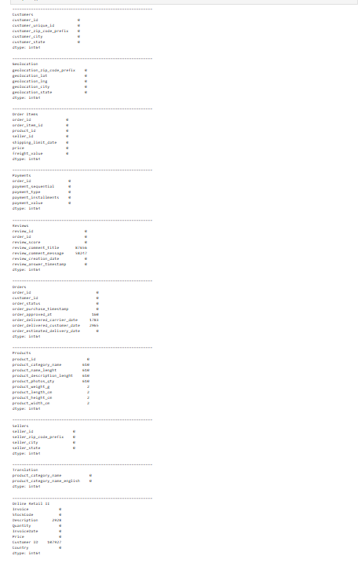
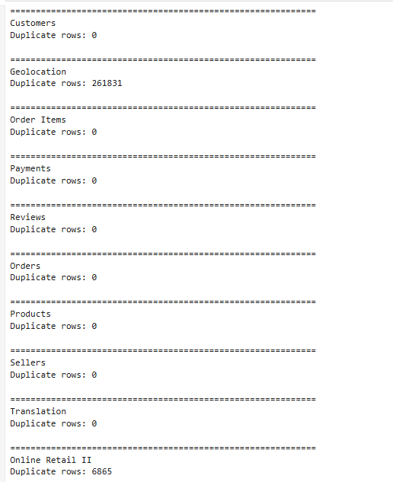
Data Collection & Understanding
Collection
Public datasets loaded with Pandas in 01_Data_Loading.ipynb: 9 Olist tables, Online Retail II and the NCH file.
Data types
Olist date columns load as text and are converted to datetime. Online Retail II: Quantity int64, Price float64, InvoiceDate datetime64.
Missing values
Reviews: title 87,656, message 58,247
Orders: approved 160, carrier 1,783, customer 2,965
Products: category 610
Online Retail II: Description 2,928, Customer ID 107,927
Duplicates
Geolocation 261,831; Online Retail II 6,865; all other tables 0.
df.duplicated().sum()
df.isnull().sum()

Slide 8
Data Cleaning & Transformation
Duplicates
Data types
NOTEBOOK OUTPUT | Geolocation duplicates
Dropped 261,831 exact duplicate Geolocation rows and 6,865 Online Retail II rows.
Converted 5 order and 2 review date columns with pd.to_datetime; checked review scores are 1-5.
Original rows: 1000163
Cleaned rows: 738332
Rows removed: 261831
Duplicates remaining: 0
Invalid values
Missing values
NOTEBOOK OUTPUT | Invalid dates and durations
166 carrier dates before purchase set to NaT; 3,681 zero-price and 3 negative-price retail rows removed; NCH Grand Total row removed.
610 missing categories set to Unknown; size and weight filled with median; no-payment orders set to 0; meaningful gaps kept with availability flags.
Invalid carrier dates fixed: 166
Invalid shipping prep durations: 1364
Invalid transit durations: 50
Negative durations remaining: 0
Integration
New features
NOTEBOOK OUTPUT | Final integrated data
Left-joined products, sellers, orders, customers, aggregated payments and reviews, and geolocation: 112,650 rows x 71 columns.
delivery_days, delay days, is_delayed, transit_days and speed, distance_km (Haversine), freight ratio, order_item_count, order_total_value.
Final shape: (112650, 71)
Duplicate rows: 0
Online Retail II: (514912, 8)
Zero / negative price: 0 / 0

Slide 9
Exploratory Data Analysis
97.82%
6.59%
10.49 days
16.82%
items delivered
delivered items delayed (7,265)
average delay when late
items with freight ratio >= 0.50
Review group vs delay
Transit speed vs delay
Distance vs delay
Group | Items | Delayed %
Low (1-2) | 17,930 | 24.84%
Average (3) | 9,429 | 7.98%
Good (4) | 21,198 | 3.34%
Excellent (5) | 63,151 | 1.85%
Speed | Items | Delayed %
Fast | 18,749 | 1.35%
Normal | 34,975 | 1.17%
Slow | 56,235 | 11.74%
Distance | Items | Delayed %
Near | 20,993 | 4.35%
Medium | 15,581 | 4.93%
Far | 36,958 | 6.35%
Very Far | 38,564 | 8.27%
More findings
Libraries and methods
Multi-item orders: avg value 290.44 vs 150.75; avg review 3.55 vs 4.16
Top category: bed_bath_table (11,115 items); 3,095 sellers analysed
Delay correlates with delivery_days (0.60) and transit_days (0.57)
Pandas: groupby, agg, value_counts, describe, merge, pd.cut
NumPy: radians, Haversine distance, inf checks
Matplotlib: charts saved to Visualizations/
All tables above are observed patterns, not causal effects

Slide 10
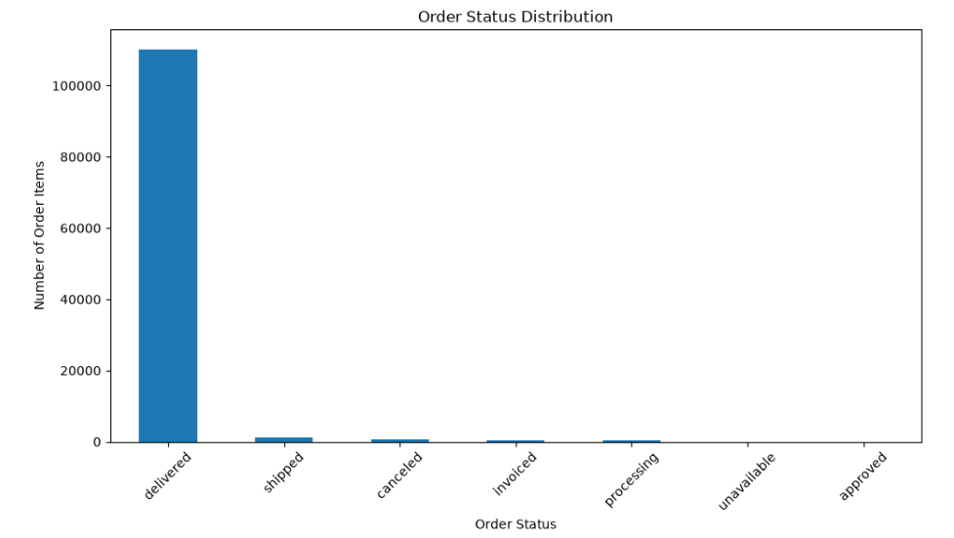
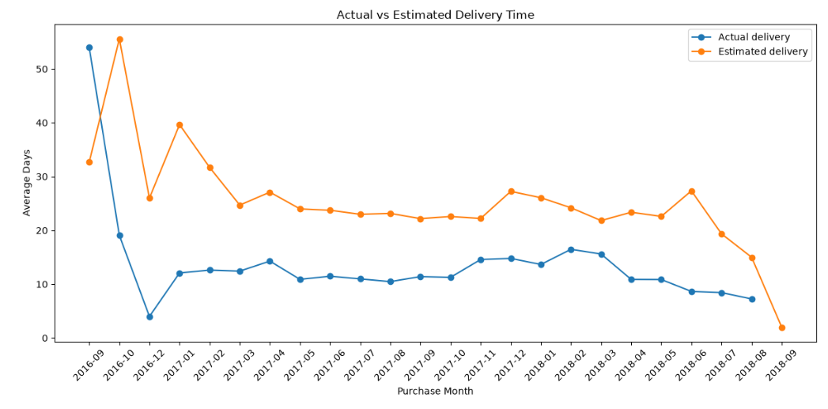
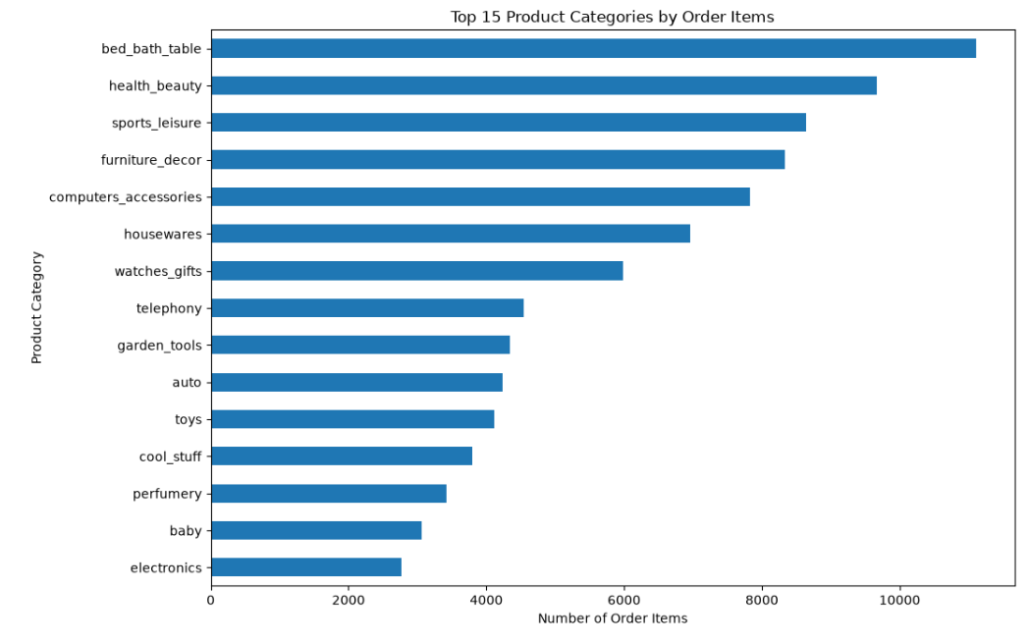
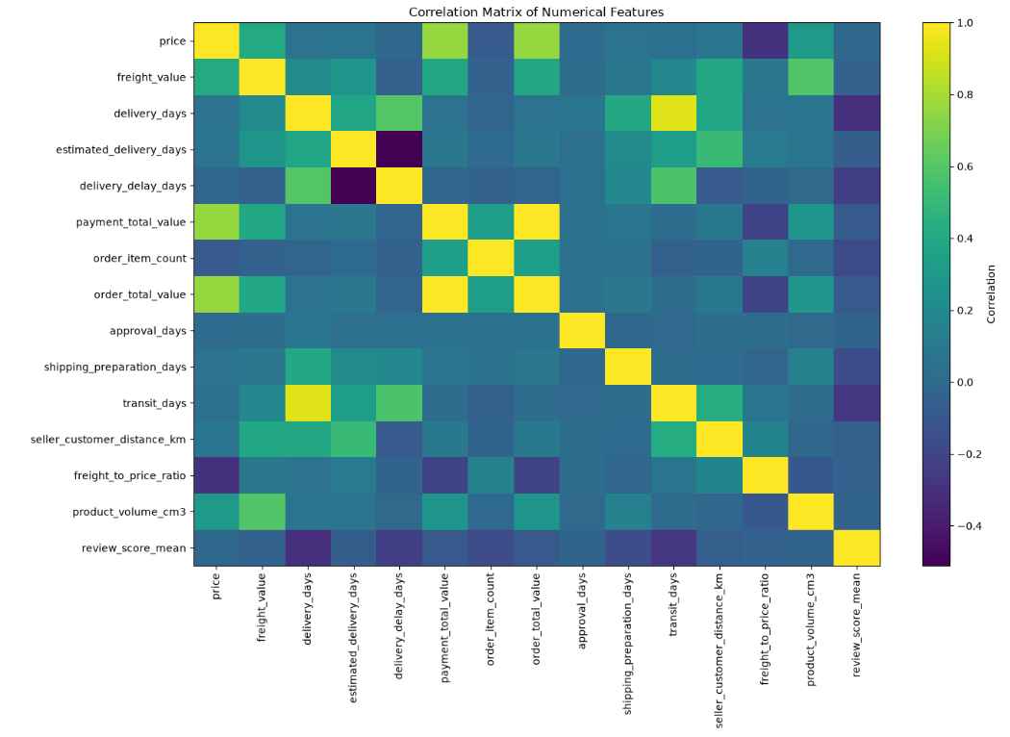
Data Visualization (Matplotlib)
Order Status Distribution
Actual vs Estimated Delivery Time
Purpose: See the order fulfilment mix.
Shows: Order items by status.
Insight: Delivered items dominate (97.82%); other statuses are tiny.
Purpose: Compare promised and real delivery speed.
Shows: Average days by purchase month.
Insight: From late 2016, actual delivery stays below the estimate.
Top 15 Product Categories
Correlation Matrix
Purpose: Find the highest-volume categories.
Shows: Order items per category.
Insight: bed_bath_table leads (11,115), then health_beauty and sports_leisure.
Purpose: Spot related numeric features.
Shows: Heatmap of 15 features.
Insight: Delay links to delivery and transit days; review score falls as delivery days rise. Not causal.

Slide 11
Key Insights & Recommendations
Key insights (from the data)
Recommendations
Delivered orders make up 97.82% of 112,650 order items
92.09% arrived early; 7,265 items (6.59%) were late, by 10.49 days on average
Low review groups had 24.84% delayed items vs 1.85% for excellent
Slow transit showed 11.74% delay vs 1.35% (Fast) and 1.17% (Normal)
Very Far shipments: 8.27% delayed vs 4.35% for Near
16.82% of items have freight at least 50% of price
Multi-item orders: higher value (290.44), lower reviews (3.55)
NCH: 53.39% of 397,333 grievances are return-related
Monitor late and slow-transit shipments
Investigate long-distance routes and high-delay categories
Judge sellers only with enough order volume
Review low-rated categories and sellers with their delivery patterns
Use NCH categories to guide root-cause checks
Use these EDA findings to choose ML features and targets carefully

Slide 12
Conclusion
What was achieved
Major findings
Loaded and validated 3 datasets
Cleaned and integrated Olist into 112,650 x 71 features
Completed EDA with 4 Matplotlib chart sets
Delays are rare (6.59%) but concentrated in slow-transit and far shipments
Late deliveries go with low reviews
Return-related complaints are over half of NCH grievances
How it helps
Future scope
Shows where to look first: transit, distance, categories, sellers
Separates observed patterns from causes
Gives investigators evidence-based starting points
Define ML targets from valid labels
Build a root-cause model and seller risk view
Add the admin dashboard and review-text analysis

