Slide 1

Learning Chess from Data
Tom Ron
Niv Mizrahi
https://github.com/nivm/learningchess

Slide 2
Everyone wants to make computer play Chess smarter..
We just want to make computer play chess

Slide 3
What's on our mind?
Can a computer learn Chess just by looking on Chess games?
Game on - given a board state, is a specific move legal?
Game over - given a board state, is it Chess-mate?
If those are possible, what else can we learn empirically?
Work on progress

Slide 4
Undressing chess
2 parties
Game end – one winner or tie
8 X 8 board
Different pieces have different unknown properties (moving, eating other pieces, promotion, getting eaten..)

Slide 5
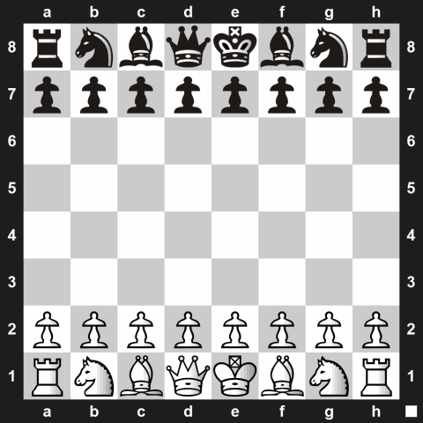
Dataset
Data based on algebraic chess notation

Slide 6
Dataset
Ignoring meta data (players, ranking, location, etc.)
103925 games – full or partial description
8,302610 moves -
Pawn | 22001860 | Rook | 1352388
Bishop | 1290920 | Knight | 1462645
King | 996128 | Queen | 1003169

Slide 7
Stack
Chess - parsing chess algebric notation data.
PyLab – Numpy, Scipy, Matplotlib
Used Map-Reduce architecture but the data is small enough to process all on single machine

Slide 8
Simple move
Have we seen that move – board status + move before?
Yes – Good, No – Try again
Consumes a lot of memory and running time – 10^80 estimated chess moves

Slide 9
Simple move 1.0
For each move output move x, y difference. Aggregate all the moves of specific piece.
White Pawn moves from b2 to b4 -
X diff – 0, Y diff – 2
Relative black and white adjustments.

Slide 10
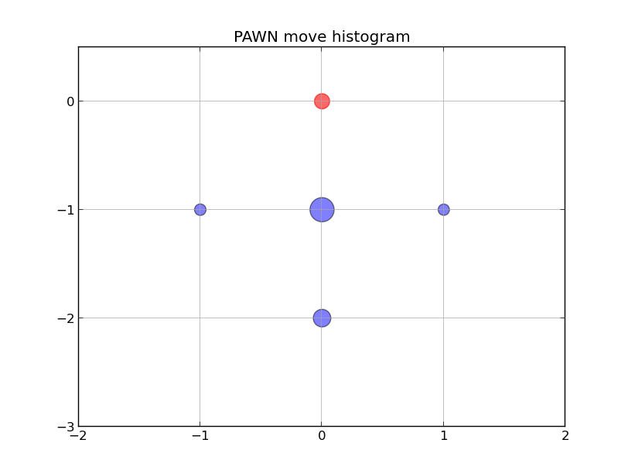

Slide 11
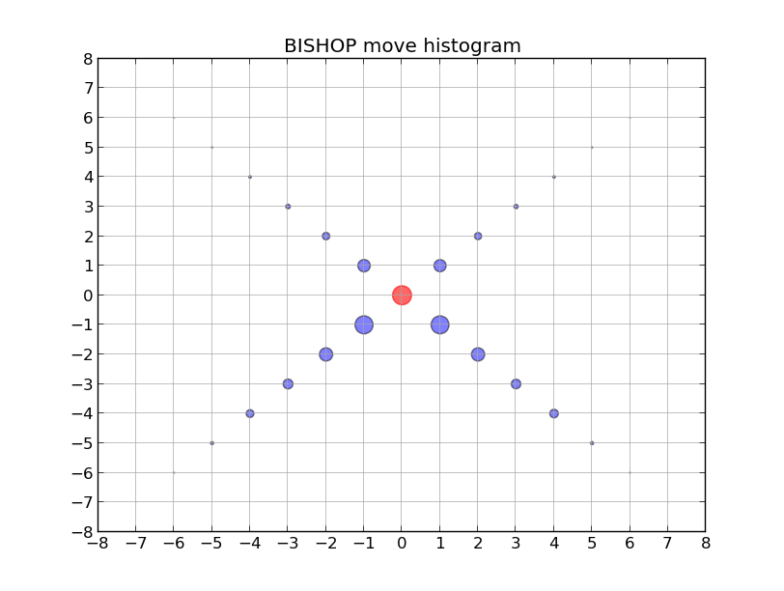

Slide 12
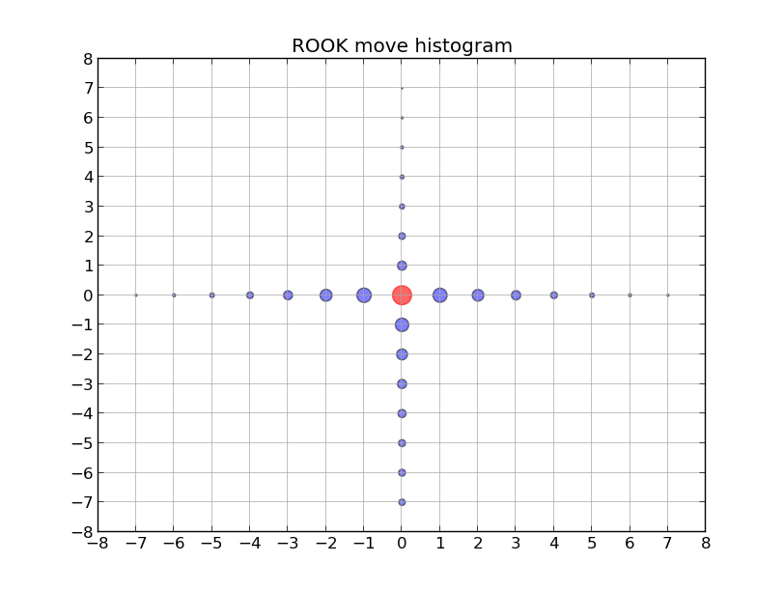

Slide 13
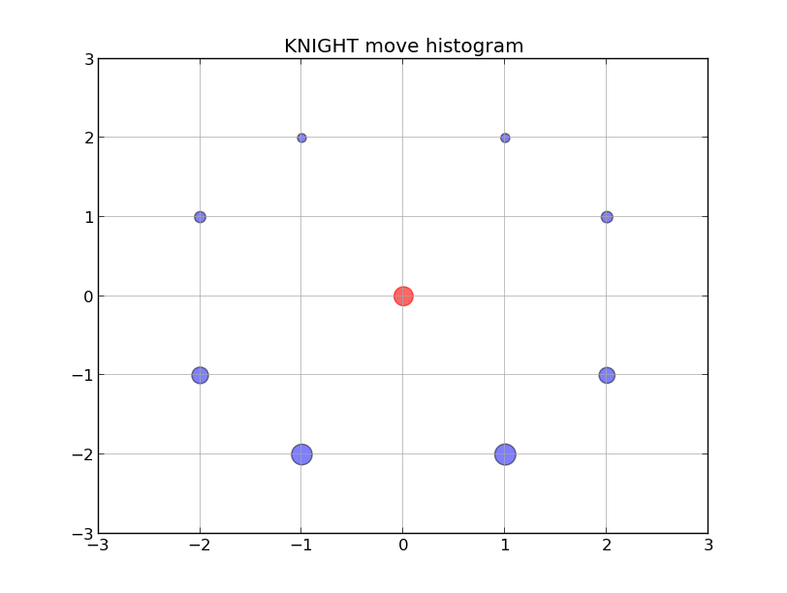

Slide 14
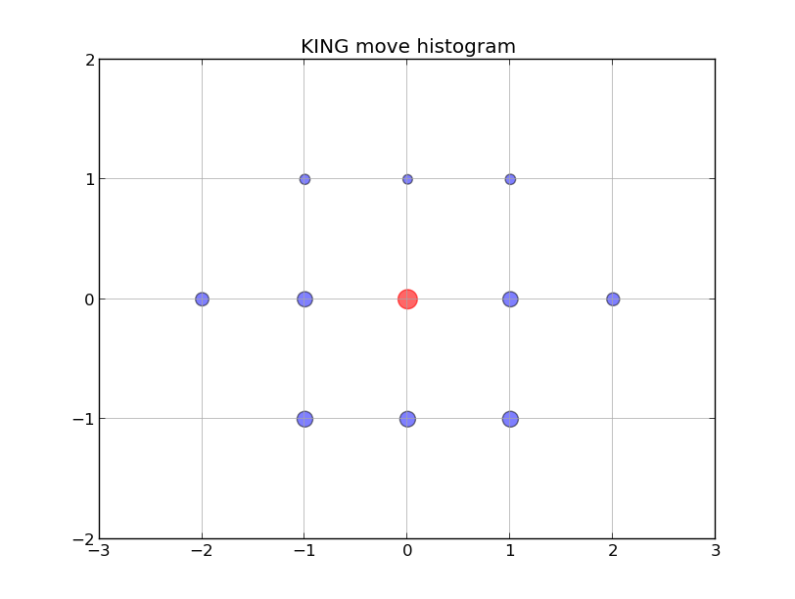

Slide 15
Simple move 1.0
Pros –
Good for common moves.
Getting better as data size grows (diminishing return)
Time and memory efficiency

Slide 16
Simple move 1.0
Cons –
Does not take into account board status.
Not good for rare move
Conclusion - almost always necessary condition but not sufficient

Slide 17
Simple move 2.0
For each move output move diff + surround histogram of radius 1
Options – occupied, free, out of the board
0 | 1 | 2
3 | B,R,K,N,Q,P | 5
6 | 7 | 8

Slide 18
Simple move 2.0
Pros -
Efficiency
Takes surrounding into account
Cons –
Assume different moves are independent of one another \ history.
Less generalized.

Slide 19
Simple move 2.0
Piece | Move diff | Relative location | Content
Queen | (-2, -2), (-3, -3), (-4,-4), (-5, -5), (-6,-6), (-7, -7) | 0 | Free
Free | 1 | 2
3 | Q | 5
6 | 7 | 8

Slide 20
Simple move 2.0
Piece | Move diff | Relative location | Content
Queen | (-7,7) | 2 6 | Out of the board Free
0 | 1 | Out of the board
3 | Q | 5
Free | 7 | 8

Slide 21
Simple move 2.0
Piece | Move diff | Relative location | Content
King | (2,0) | 5 | Free
0 | 1 | 2
3 | K | Free
6 | 7 | 8

Slide 22
Simple move 2.0
Piece | Move diff | Relative location | Content
Pawn | (0,2), (0,1) | 7 | Free
0 | 1 | 2
3 | P | 5
6 | Free | 8

Slide 23
Simple move 2.0
Piece | Move diff | Relative location | Content
Knight
0 | 1 | 2
3 | N | 5
6 | 7 | 8

Slide 24
Learning checkmate
Checkmate – game over
Datasets – 10k, 30k, 800k
Training set – 40%, test set – 60%
50-50 True-False samples
Classifier – SVM with linear kernel

Slide 25
Classification crash course
SciPy
Data
Feature
extraction
Classification
Classification
Feature_1,...,Feature_n, class
1,0,3,4.2,True
2,5,-3,20,False
…
5,-4,3,-10,False
Train
Predict

Slide 26
Features
First try – simple count features
Total - # pieces on the board
White - # white pieces on the board
Black - # black pieces on the board
The total amount of pieces of each type
The total amount of pieces of each type of each side

Slide 27
Results
Predicted Classes
Correct classification -
- Checkmate – 0.82
- Not checkmate – 0.59
Wrong classification -
- Checkmate – 0.18
- Not checkmate – 0.41
Accuracy – 0.705
Not Checkmate
Checkmate
0.59
0.41
Not Checkmate
0.18
0.82
True Classes
Checkmate

Slide 28
Features
Second try – previous features feature + First degree neighbors
# empty \ same \ other pieces around each piece, each side
Out of the board is not counted
Boolean features -
Single side > other side, mostly empty, ..

Slide 29
Results
Predicted Classes
Correct classification -
- Checkmate – 0.86
- Not checkmate – 0.87
Wrong classification -
- Checkmate – 0.14
- Not checkmate – 0.13
Accuracy – 0.865
Not Checkmate
Checkmate
0.87
0.13
Not Checkmate
0.14
0.86
True Classes
Checkmate

Slide 30
Features
Third try – previous features feature + Second + Third degree neighbors
300~ features

Slide 31
Results
Predicted Classes
Correct classification -
- Checkmate – 0.91
- Not checkmate – 0.88
Wrong classification -
- Checkmate – 0.09
- Not checkmate – 0.12
Accuracy – 0.895
Not Checkmate
Checkmate
0.88
0.12
Not Checkmate
0.09
0.91
True Classes
Checkmate

Slide 32
Future
Test several types of classifiers
Integrate out of the board into the count
Found out who won – multi class classification – white won, black won, no checkmate
Chess classifier
Complex move detection – history arguments
More efficient parsing
Scaling

Slide 33
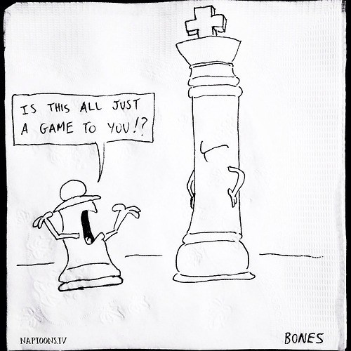
Q & A
Thank you!
http://cheezburger.com/8067088640

