Slide 1

Learning Chess from Data
Niv Mizrahi,
Tom Ron

Slide 2
Abstracting chess
2 parties
Each games end with one winner or tie (several conditions can lead to tie)
8 X 8 board
Given set of pieces,
Pieces may have different unknown properties

Slide 3
What's on our mind?
Can a computer learn Chess just by looking on Chess games?
Given a board state – is a specific move legal?
Given a board state – is it Chess-mate?
It those are possible, can we also learn Physics empirically?

Slide 4
Dataset
Data based on algebraic chess notation
Ignoring meta data (players, ranking, location, etc.)
X games – Y ended with
N moves
A chess conditions, B checkmate conditions

Slide 5
Stack
Chess
PyLab – Numpy, Scipy, Matplotlib
Used Map-Reduce architecture but the data is small enough to process all on single machine

Slide 6
Simple move
Have we seen that move – board status + move before?
Yes – Good, No – Try again
Consumes a lot of memory and running time – 10^80 estimated chess moves.

Slide 7
Simple move 1.0
For each move output move diff – x, y difference.
Pros – good for common moves. Getting better as data size grows (diminishing return), consumes very little memory.
Cons – does not take into account the board status (skip over pieces), not good for rare moves.
Almost always – necessary condition but not sufficient

Slide 8
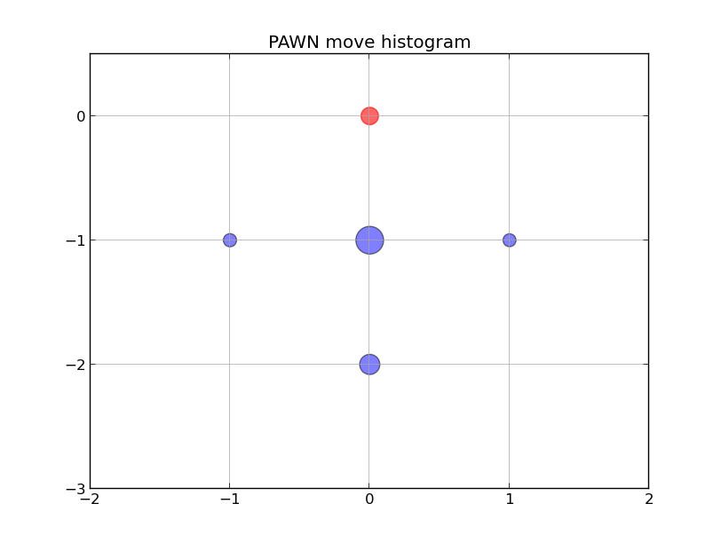

Slide 9
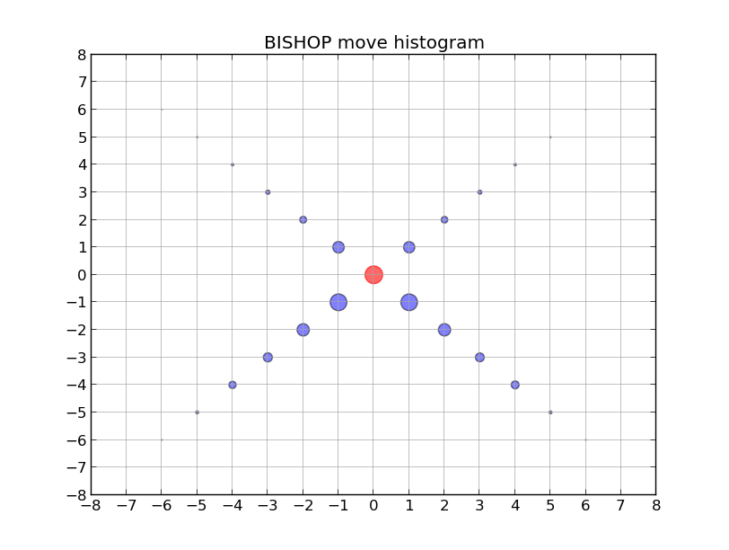

Slide 10
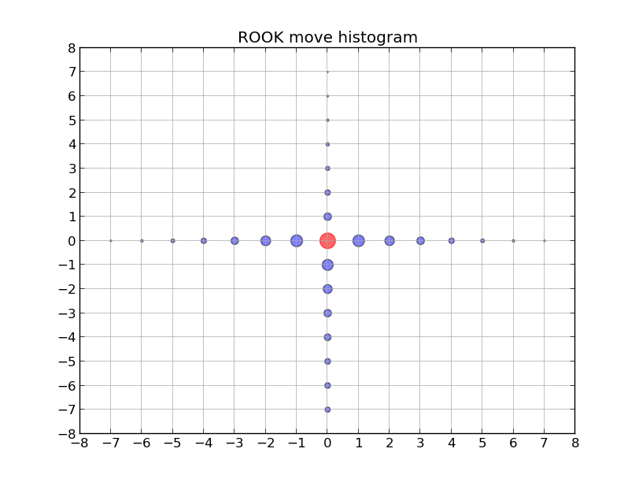

Slide 11
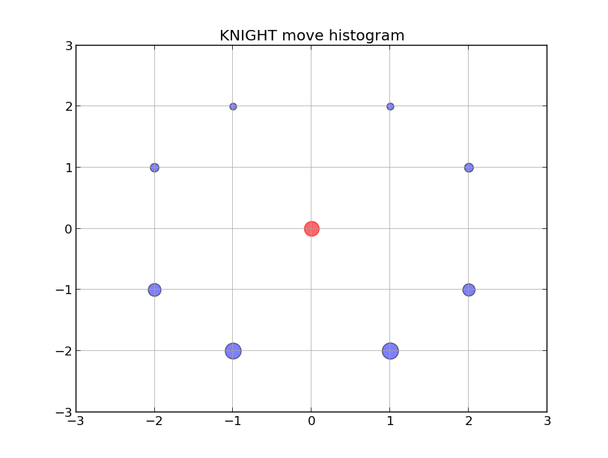

Slide 12
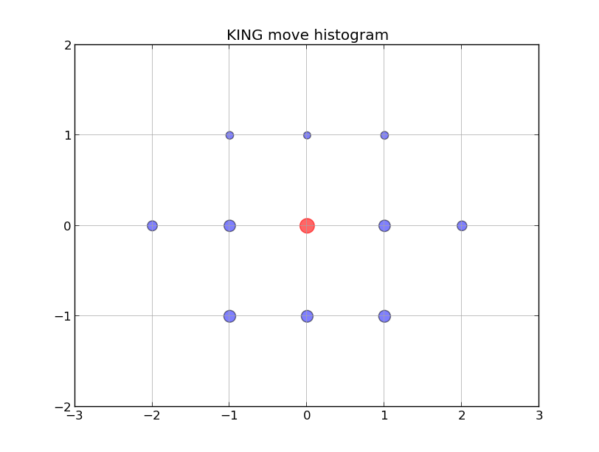

Slide 13
Simple move 2.0
For each move output move diff + surround histogram of radius 1
Pros – Efficient on both memory and run time. Takes the surrounding into account.
Cons – Assume different moves are independent of one another \ history – good for most cases but not for castling, en passant, etc.

Slide 14
Simple move 2.0
0 | 1 | 2
3 | B, R, K, N, Q, P | 5
6 | 7 | 8

Slide 15
Simple move 2.0
Piece | Move diff | Relative location | Content
Queen | (-2, -2), (-3, -3), (-4,-4), (-5, -5), (-6,-6), (-7, -7) | 0 | Free
Free | 1 | 2
3 | Q | 5
6 | 7 | 8

Slide 16
Simple move 2.0
Piece | Move diff | Relative location | Content
Queen | (-7, 7) | 2 6 | Out of the board Free
0 | 1 | Out of the Board
3 | Q | 5
Free | 7 | 8

Slide 17
Simple move 2.0
Piece | Move diff | Relative location | Content
King | (2,0) | 5 | Free
0 | 1 | 2
3 | K | Free
6 | 7 | 8

Slide 18
Simple move 2.0
Piece | Move diff | Relative location | Content
Pawn | (0,2), (0,1) | 7 | Free
0 | 1 | 2
3 | P | 4
6 | Free | 8

Slide 19
Simple move 2.0
Piece | Move diff | Relative location | Content
Knight
0 | 1 | 2
3 | N | 4
6 | 7 | 8

Slide 20

Learning checkmate
Features:
Number of pieces on the board
Number of pieces in each party
Number of pieces of each type
Is Queen in the board
Is King on the board
Number of surrounding pieces by type and distance (1-3)

Slide 21
Learning checkmate
Features distribution (highlights):
ddd

Slide 22
Learning checkmate
Results:
90% ...

Slide 23
Slide Title
Product A
Product B
Feature 1
Feature 2
Feature 3
Feature 1
Feature 2
Feature 3

