Slide 1

Learning Chess from Data
Niv Mizrahi,
Tom Ron

Slide 2
Everyone wants to make computer play Chess smarter..
We just want to make computer play chess

Slide 3
What's on our mind?
Can a computer learn Chess just by looking on Chess games?
Game on - given a board state, is a specific move legal?
Game over - given a board state, is it Chess-mate?
If those are possible, what else can we learn empirically?

Slide 4
Abstracting chess
2 parties
Game end – one winner or tie
8 X 8 board
Given set of pieces
Different pieces have different unknown properties

Slide 5
Dataset
Data based on algebraic chess notation
Ignoring meta data (players, ranking, location, etc.)
103925 games – full or partial description
8,302610 moves -
Pawn | 22001860 | Rook | 1352388
Bishop | 1290920 | Knight | 1462645
King | 996128 | Queen | 1003169

Slide 6
Stack
Chess
PyLab – Numpy, Scipy, Matplotlib
Used Map-Reduce architecture but the data is small enough to process all on single machine

Slide 7
Simple move
Have we seen that move – board status + move before?
Yes – Good, No – Try again
Consumes a lot of memory and running time – 10^80 estimated chess moves.

Slide 8
Simple move 1.0
For each move output move x, y difference.

Slide 9
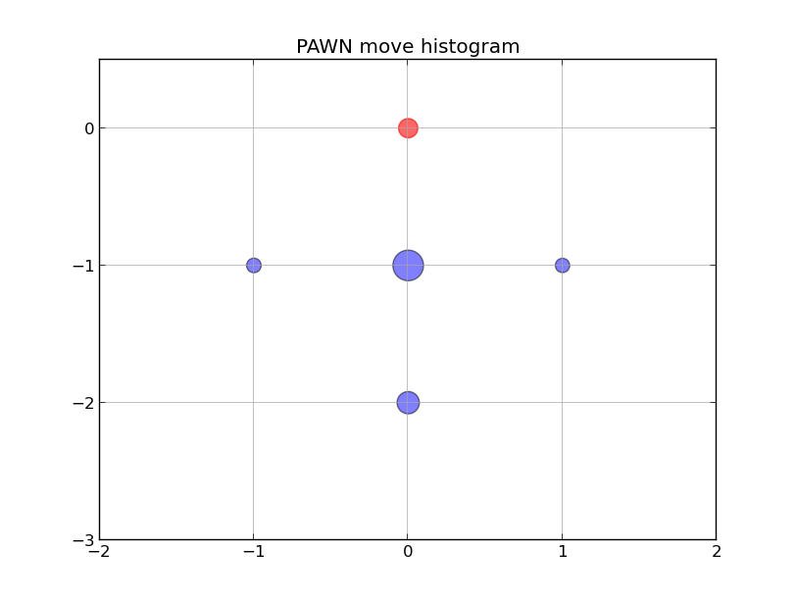

Slide 10
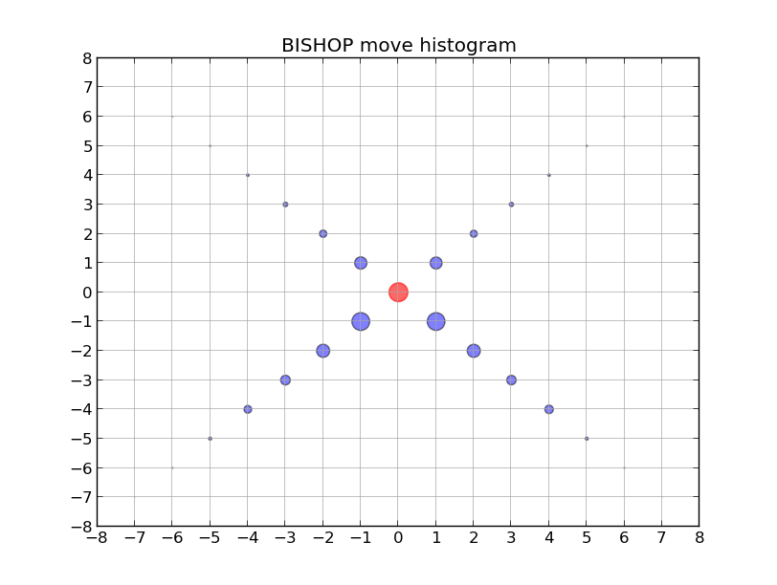

Slide 11
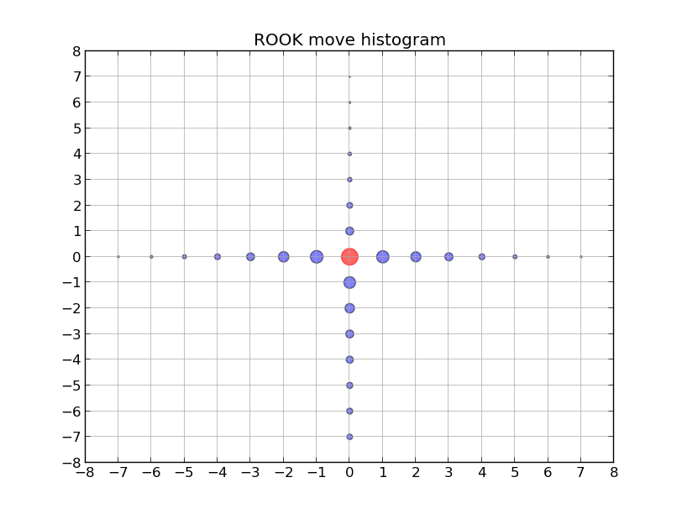

Slide 12
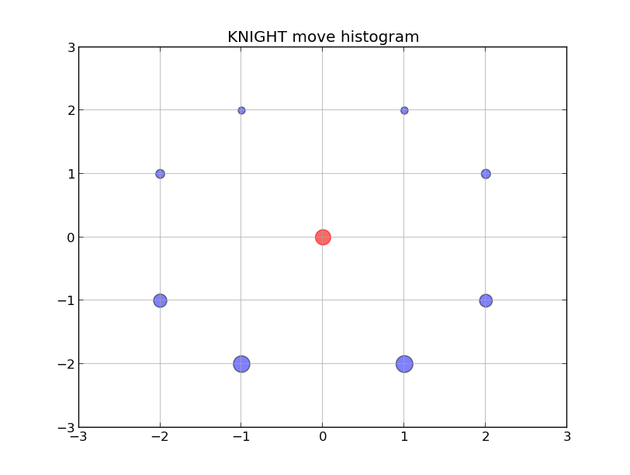

Slide 13
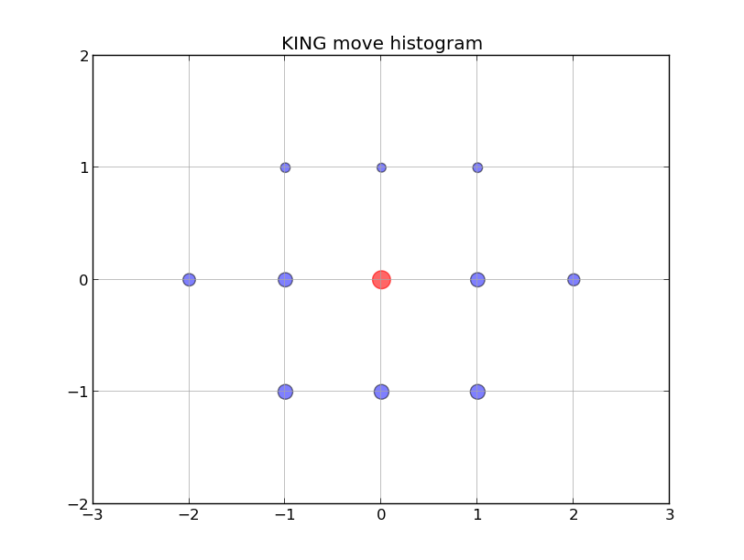

Slide 14
Simple move 1.0
Pros –
Good for common moves.
Getting better as data size grows (diminishing return)
Time and memory efficiency

Slide 15
Simple move 1.0
Cons –
Does not take into account board status.
Not good for rare move
Conclusion - almost always necessary condition but not sufficient

Slide 16
Simple move 2.0
For each move output move diff + surround histogram of radius 1
0 | 1 | 2
3 | B,R,K,N,Q,P | 5
6 | 7 | 8

Slide 17
Simple move 2.0
Pros -
Efficiency
Takes surrounding into account
Cons –
Assume different moves are independent of one another \ history.
Less generalized.

Slide 18
Simple move 2.0
Piece | Move diff | Relative location | Content
Queen | (-2, -2), (-3, -3), (-4,-4), (-5, -5), (-6,-6), (-7, -7) | 0 | Free
Free | 1 | 2
3 | Q | 5
6 | 7 | 8

Slide 19
Simple move 2.0
Piece | Move diff | Relative location | Content
Queen | (-7,7) | 2 6 | Out of the board Free
0 | 1 | Out of the board
3 | Q | 5
Free | 7 | 8

Slide 20
Simple move 2.0
Piece | Move diff | Relative location | Content
King | (2,0) | 5 | Free
0 | 1 | 2
3 | K | Free
6 | 7 | 8

Slide 21
Simple move 2.0
Piece | Move diff | Relative location | Content
Pawn | (0,2), (0,1) | 7 | Free
0 | 1 | 2
3 | P | 5
6 | Free | 8

Slide 22
Simple move 2.0
Piece | Move diff | Relative location | Content
Knight
0 | 1 | 2
3 | N | 5
6 | 7 | 8

Slide 23

Learning checkmate
Features:
# Piece on the board
# Pieces of each party
# Pieces of each type
Is Queen in the board
Is King on the board
# Surrounding pieces by type radius 1-3

Slide 24
Learning checkmate
Features distribution (highlights):
ddd

Slide 25
Learning checkmate
Results:
90% ...

Slide 26
Slide Title
Product A
Product B
Feature 1
Feature 2
Feature 3
Feature 1
Feature 2
Feature 3

