Slide 1

Machine Learning
Since it is reasonable to think that there could be a linear relationship between a player’s market value and how good they are(rating).
Then we can create model applying linear regression.
We used scikit learn.

Slide 2
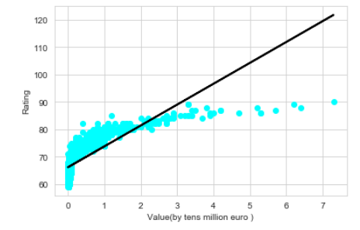
Predict rating by value
Linear Regression
It may seem like our model isn’t very good .That’s because the predictions seem to be pretty accurate for those players with a value lower than €30M.
Those players represent 99.33% of the total players !
We have 52% accuracy with that method.

Slide 3
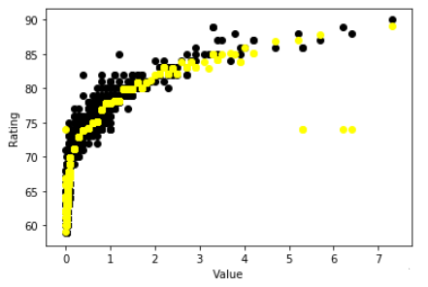
Predict rating by value
Support Vector Regression
We Use the Support Vector Regression
implementation with a radial basis function .
We increase our accuracy, we got 89% accuracy with that method.

