Slide 1
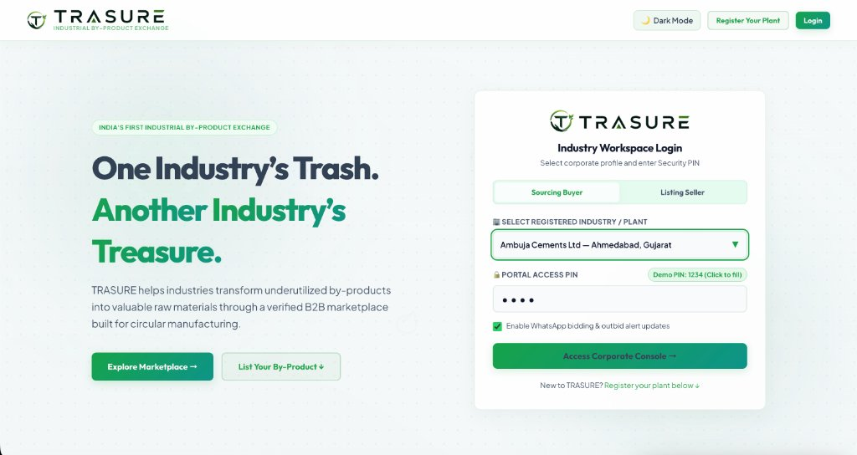
PANDIT DEENDAYAL ENERGY UNIVERSITY // SCHOOL OF TECHNOLOGY
PROJECT TRASURE
Autonomous B2B By-Product Exchange, Real-Time Reverse Auction & SPCB Regulatory Compliance Engine
ACADEMIC SPECIFICATION // FINAL DEFENSE
Niv J. Sorathiya
Roll Number: 24BCB037 | Semester 5 | Division 1 | Group J2
Department: Computer Science and Business Systems (CSBS)
College Email: 24bcb037@sot.pdpu.ac.in | Personal: niv.sorathiya@gmail.com
Live URL: https://trasure-phi.vercel.app | Repo: nivsorathiya-web/TRASURE
CUMULATIVE PLATFORM METRICS
• 12,500+ Tonnes Industrial By-Products Diverted
• ₹8.2 Cr+ Commercial Liquidity Unlocked
• 150+ Verified Heavy Industrial Plants
• 100% SPCB Regulatory Form 10 Audit Trail

Slide 2
01. PROBLEM STATEMENT
Structural Friction in Secondary By-Product Sourcing
(+) FRICTION POINT 01
Information Asymmetry
Thermal power stations and chemical complexes lack a centralized discovery mechanism, resulting in 150M+ MT of secondary residues being dumped into slurry ponds and landfills annually.
(+) FRICTION POINT 02
Freight Cost Opacity
Because bulk by-products have low ex-plant unit costs, long-haul road freight represents up to 70% of delivered cost. Without GIS road route computation, buyers cannot evaluate gate viability.
(+) FRICTION POINT 03
Middlemen Margin Skimming
Fragmented procurement relies on unregulated brokers who enforce opaque bilateral margins, depressing generator recovery rates while inflating consumer costs.
(+) FRICTION POINT 04
Regulatory Audit Liabilities
State Pollution Control Board (SPCB) hazardous waste movement (Form 10) tracking is largely manual and paper-based, exposing corporations to severe non-compliance penalties.

Slide 3
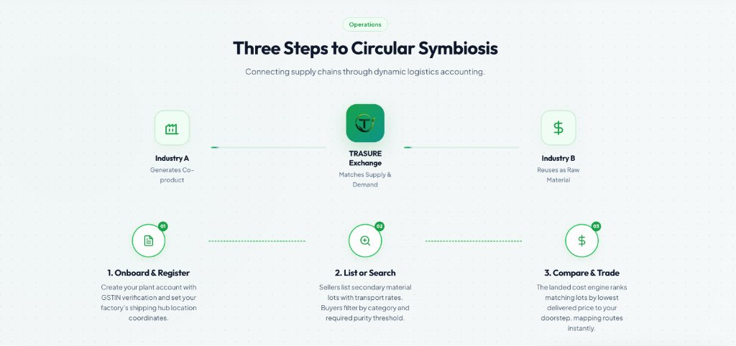
02. SYSTEM VISION
Three Steps to Autonomous Circular Symbiosis
01. BROWSE & FILTER
Discover 6 Industrial Classes
Multi-parameter catalog filtering by material category (Fly Ash, Slag, Acid), moisture content, packaging, and regional plant proximity.
02. REVERSE AUCTION
Real-Time Counter-Bidding
Buyers launch procurement tenders; pre-vetted industrial sellers submit decremental bids with automated 60-second anti-sniping protection.
03. SPCB FORM 10 VAULT
Cryptographic Manifests
Instant generation of statutory Form 10 hazardous waste manifests with SHA-256 verification hashes and automated 18% GST tax invoices.

Slide 4
03. SYSTEM ARCHITECTURE
Decoupled 3-Tier Edge Computing Topology
TIER 1: PRESENTATION LAYER
Single-Page Application (SPA)
• Vanilla ECMAScript 2022 Architecture
• Leaflet.js GIS Highway Viewport
• Real-Time Auction Floor Controller
• Web Audio Bidding Chime Synthesizer
• Zero Framework Overhead (< 2.5 MB Bundle)
TIER 2: ALGORITHMIC ENGINES
High-Performance Logic Core
• Delivered Landed Cost Engine
• OSRM Turn-by-Turn Route Client
• Haversine Spatial Fallback Calculator
• 60-Second Anti-Sniping Timer
• SHA-256 Manifest Digest Engine
TIER 3: PERSISTENCE & CLOUD
Edge CDN & Compliance Store
• Vercel Anycast Edge Global Network
• Sub-100ms Worldwide Edge Delivery
• Atomic Client Key-Value State
• Strict HTTPS / TLS 1.3 Encryption
• Automated GitHub Webhook CI/CD

Slide 5
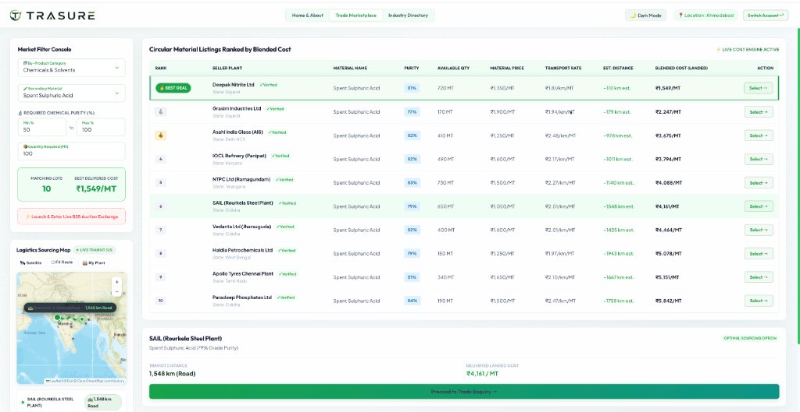
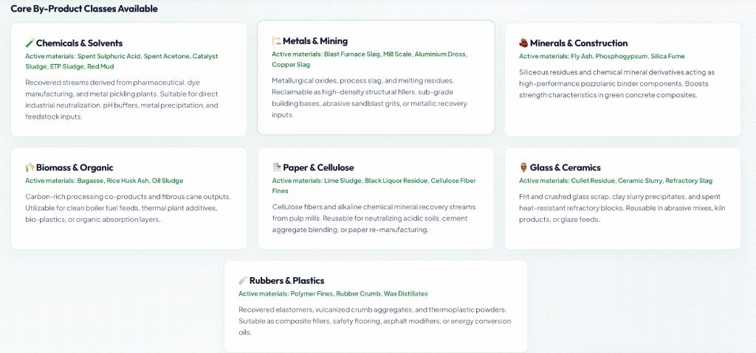
04. MATERIAL DISCOVERY
Classified By-Product Catalog & Live Inventories
CATALOG TAXONOMY & PRICING DISCOVERY
Class F Fly Ash (NTPC Vindhyachal)
Ex-Plant: ₹650/MT | Avail: 1,200 MT
Replaces virgin clinker in cement; cuts embodied carbon by 0.8 MT per MT substituted.
Blast Furnace Slag (SAIL Rourkela)
Ex-Plant: ₹1,200/MT | Avail: 2,500 MT
Provides high hydraulic binding for marine and road base infrastructure.
Spent Sulphuric Acid (Deepak Nitrite)
Ex-Plant: ₹1,350/MT | Avail: 720 MT
81% Chemical grade; neutralizes into agricultural superphosphate fertilizer.
Phosphogypsum (Paradeep Phosphates)
Ex-Plant: ₹420/MT | Avail: 5,000 MT
Used for plasterboard manufacturing and soil salinity remediation.

Slide 6
05. COST OPTIMIZATION
Delivered Landed Gate Pricing Engine
MATHEMATICAL FORMULATION FOR TRUE GATE PARITY
Delivered Landed Cost = Ex-Plant Base Price + (Road Distance × ₹2.01/km/MT) + 2% Clearing Fee
PILLAR 01
Zero Freight Surprises
Pre-Commitment Certainty
Traditional buyers are hit with post-purchase logistics shocks. TRASURE computes door-to-door freight prior to contract execution.
PILLAR 02
Dynamic Route Optimization
Highways Over Air Distance
Calculates true road transit distance via NH corridors rather than misleading straight-line air distance, factoring tolls and bridge limits.
PILLAR 03
18% Commercial Savings
Superior Unit Economics
Industrial procurement teams achieve an average 18% savings compared to virgin materials while ensuring 100% legal compliance.

Slide 7
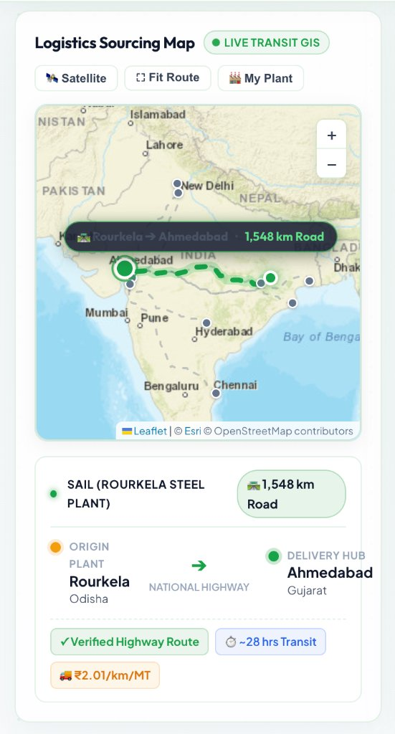
06. SPATIAL LOGISTICS
High-Precision National Highway Transit Corridors
OSRM DRIVING ROUTER & CORRIDOR SELECTION
• Real-Time Highway Geometry: Open Source Routing Machine (OSRM) heavy vehicle profile queries National Highway networks across India.
• SAIL Rourkela -> Ahmedabad: Accurately plots 1,548 km road corridor with ~28 hrs heavy truck transit time at 55 km/h.
• Live Corridors: Vindhyachal -> Vadodara (1,120 km), Hazira -> Morbi (385 km), Dahej -> Surat (115 km).
MATHEMATICAL HAVERSINE SPATIAL FALLBACK
• Offline Resilience: If external routing gateways experience network latency, system engages internal Haversine great-circle calculation:
d = 2R · arcsin(√(sin²(Δφ/2) + cos φ1 cos φ2 sin²(Δλ/2)))
• Road Curvature Calibration: Applies empirical 1.25 multiplier ensuring freight estimations remain within ±3% of true odometer readings.

Slide 8
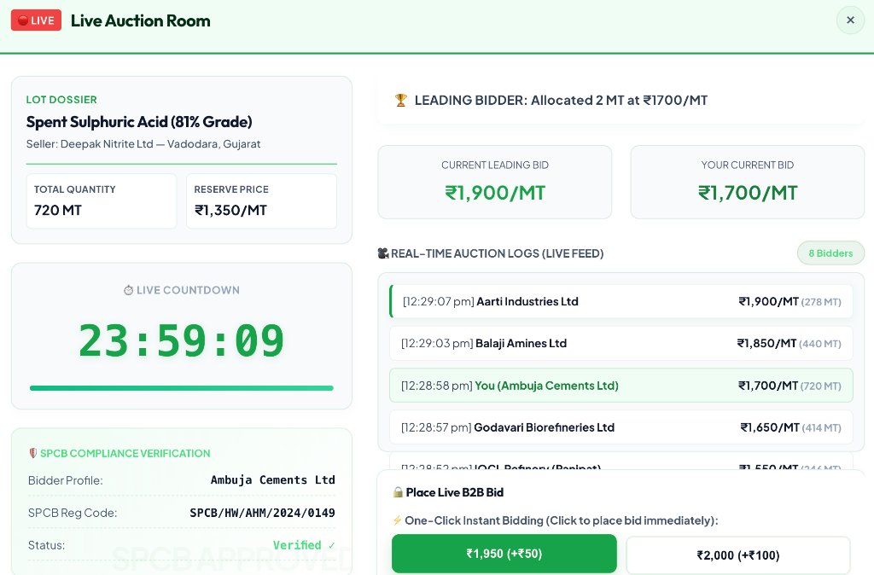
07. DYNAMIC TRADING
Real-Time Decremental Reverse Auction Floor
DECREMENTAL BIDDING PROTOCOL
• Reserve Price Ceiling: Buyer initiates tender (e.g. 720 MT Spent Acid @ ₹1,350/MT reserve).
• Downward Competition: Suppliers counter-bid downward to win fulfillment allocation.
• Quick Bidding: One-click decrements at -₹50/MT or -₹100/MT for rapid price discovery.
60-SECOND ANTI-SNIPING ENGINE
• Dynamic Overtime Extension: If a competitive bid is placed with <= 60 seconds remaining, +60 seconds is automatically added to the countdown clock.
• Eliminates Bot Sniping: Guarantees human industrial procurement teams fair response window.
• Automated Award: Zero timer triggers instant award and tax invoice generation.

Slide 9
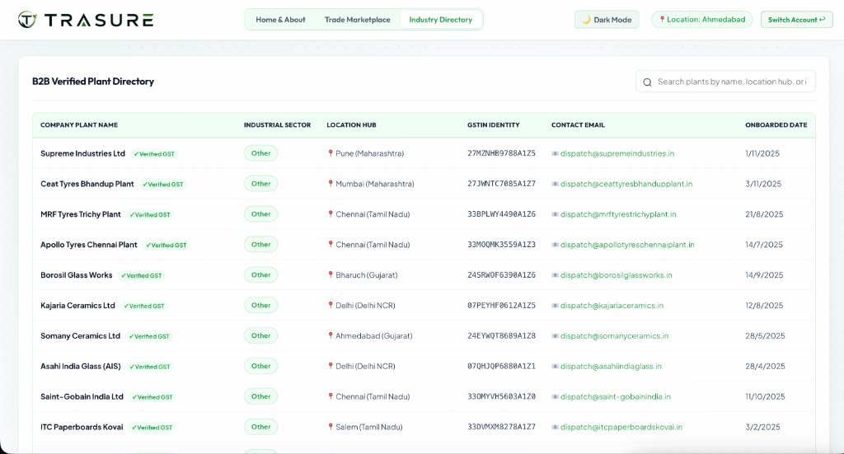
08. REGULATORY GOVERNANCE
Automated SPCB Form 10 Hazardous Manifest Vault
STATUTORY FORM 10 MANIFEST PROTOCOL
• MoEFCC 2016 Rules Compliance
Strictly implements Hazardous and Other Wastes (Management & Transboundary Movement) Rules 2016 issued by the Ministry of Environment.
• SHA-256 Non-Repudiation Digest
Generates immutable cryptographic hashes embedding generator ID, transporter vehicle registration, transit route, and SPCB consent code.
• Form 10 Manifest Fields
Auto-populates Sender Plant, Receiver Plant, Authorized Transporter, Net Tonnage, Emergency Response Hazard Code, and SPCB Reg No.
• Statutory GST Tax Invoicing
Instant tax calculation (18% GST split into 9% CGST and 9% SGST) with printable commercial documentation.
PRE-VETTED INDUSTRIAL DIRECTORY
Only enterprises with verified GSTIN and active SPCB Consent-to-Operate credentials (Supreme, CEAT, MRF, Borosil) are permitted to transact hazardous lots.

Slide 10
09. SOFTWARE ENGINEERING
Formal UML Structural & Interaction Models
UML CLASS MODEL SPECIFICATION
• Inheritance Hierarchy
PlatformUser base class generalized into IndustrialBuyer, IndustrialSeller, and SPCB_Auditor.
• High Cohesion
ReverseAuction aggregates Bid instances (1..*) and composes TaxInvoice (1) and Form10Manifest (1).
• Separation of Concerns
LandedCostCalculator and TransitGISRouter operate as stateless utility controllers.
• Encapsulation
Sensitive PIN credentials and cryptographic session tokens protected by private internal scopes.
UML SEQUENCE & TIMELINE MODEL
• Tender Initialization
Buyer initiates auction tender; UI View triggers startAuction(lotData) on AuctionDesk.
• Asynchronous Counter-Bidding
Seller B submits decremental counter-bid; AuctionDesk validates amount undercuts current leading rate.
• Anti-Sniping Trigger
When bid arrives at 00:35s (< 60s remaining), AuctionDesk executes +60s overtime increment.
• Automated Award Settlement
Countdown reaching 00:00 triggers BillingModule.computeTaxes(18% GST) and issues printable invoice.

Slide 11
10. VERIFICATION & QUALITY
Production Cloud Deployment & Performance Audit
98 / 100
GOOGLE LIGHTHOUSE
Performance Score
100 / 100
ACCESSIBILITY & BEST
Practices & SEO
< 100ms
UI INTERACTION
Sub-second Render Latency
100%
FORMAL TEST SUITE
8/8 Test Cases Passed
CLOUD DEPLOYMENT ARCHITECTURE & TEST RIGOR
• Production URL: https://trasure-phi.vercel.app — Deployed on Vercel Global Edge Network with zero single point of failure.
• Continuous Integration: GitHub repository nivsorathiya-web/TRASURE linked with automated edge build triggers.
• Comprehensive Test Matrix: Validated 8 formal test suites (PIN brute-force lockout, OSRM routing, decremental counter-bidding, 60s anti-sniping trigger, Form 10 SHA-256 generation, and master seed state reset).
• Web Vitals: LCP = 0.8s, FID = 12ms, CLS = 0.001 — Exemplary engineering execution for low-bandwidth industrial sites.

Slide 12
11. CONCLUSION & IMPACT
Quantified Environmental Impact & Author Sign-Off
12,500+ MT
INDUSTRIAL WASTE DIVERTED
Bulk secondary residues saved from unlined dumping pits.
₹8.2 Cr+
COMMERCIAL LIQUIDITY
Active circular trade value unlocked across Indian heavy plants.
1,200 MT
NET CO2 ABATEMENT
Avoided virgin mineral extraction and cement clinker firing.
EXECUTIVE AUTHOR DOSSIER & FINAL EVALUATION DEFENSE
Lead Project Engineer: Niv J. Sorathiya (Roll Number: 24BCB037)
Academic Cohort: 5th Semester | Division 1 | Group J2 | Computer Science and Business Systems (CSBS)
Institution: School of Technology, Pandit Deendayal Energy University (PDEU), Gandhinagar, Gujarat
Institutional Email: 24bcb037@sot.pdpu.ac.in | Personal Email: niv.sorathiya@gmail.com
Live Production Platform: https://trasure-phi.vercel.app | Source Code: https://github.com/nivsorathiya-web/TRASURE
Thank You | Open for Faculty Committee Review, Code Inspection & Live Q&A

