Slide 1
Sec-svm
Final Project by:
Niv tal
Avraham Haimov

Slide 2
Introduction
Malware in an application is a crucial part of malware detection, almost every person has a personal device and/or work device which uses Android OS.
Drebin is a tool for malware detection that analysis the application code and uses weights to divide the categories in the shape of malware patterns.
Sec-svm is an improvement to Drebin. This model gives more efficient weights (even to benign categories!) to the divided categories where Drebin is excluding them from the final analysis.

Slide 3
Our goal
The goal of this project is to find breaches in Sec-svm algorithm by obfuscating the system and reviewing that Sec-svm won't recognize the application as malware.
This Work is on an existing malware apps that Sec-svm detects as a malware .
The method is to avoid detection by split several code lines inside an application and re-attach them so that Sec-svm won't recognize the malware lines.
Checking that the functionality of the application won't be harm by our attack.
Fixing the feature analyzer in a way that Sec-svm model will detect (in a generic way) our attack of cutting and re-attaching the string lines.

Slide 4
Starting point
After we finished the Literature review on Malware detection, Drebin and Sec-svm, we tried to develop a code that converts from Drebin dataset to Sec-svm dataset to reduce processed running time but we recognized that Drebin won't refer to the same features as Sec-svm as we said in the introduction, so there was no improvement to run time. Also, this helped us realize the difference between the models.
we’ve been introduced to Sec-svm feature extraction code and the families that the model reference. This tool helps to get all the features rather benign or malware from several apps to a single JSON file that Sec-svm can use as a dataset.
Then we got Sec-svm code and train-test dataset that we can give Sec-svm to process and deliver the accuracy and recall score for detection.

Slide 5
Work process
The first step of the work is getting the basic requirements to work with applications and application files. We needed to understand and install Emulator, apktool, jarsigner, and smali syntax.
Created a script that loops on each apk file in a given directory and executes the following steps: 1. Decodes the app with apktool 2. Execute scan_and_replace.py script on each smali file and put our attack lines instead of each string line. 3. Build the application after the attack is inserted. 4. Signing the application with keytool and jarsigner.

Slide 6
Work process
Started planning the attack process, within the steps: reverse engineering on java split and append code sample to smali so we can get the manipulation main string that we replace with normal smali string line. When we first started with the append method, we observed that the application won't build and sign correctly because the append used StringBuilder which causes problems, so we switch to concat which uses String and that resolve the problem.
Each method of the application that is written in samli is having a maximum number of registers to hold. When we tried to add +1 local register to a method that already had more than 16 local registers we came across a problem that we exceed the maximum number so the next step was to overcome this with current registers that we can use just to cut proposes and without intervening the normal process of the method. Also, some strings were problematic to change so we exclude them from the changing process. (‘/t’ ‘/r’ etc.)

Slide 7
Work process
Poster planning – for demonstration day at 8.6.21 we had to present a poster that summarizes the introduction, main goal, and the process that we did so far. The poster is attached to Github.
After that, we needed to enlarge the number of apps that we worked on within sec-svm and our attack. We got a source of 4000+ malware applications that we can test out attacks on. Also, we got a sha256 text file that helps us with finding the application after feature extraction.

Slide 8
Work process
Developed a scheme that will help us get reliable and consistent results from sec-svm. The scheme is happening 5 times and saving the Sec-svm results each time:
Running Sec-svm on the dataset and labels that we have in train/test and saving the results of the run
We merge the dataset into one file and labels as well and then split them to 80% train and 20% test.
locating applications in the new test folder as malware (if the label in that spot is marked by 1) and organizes them into one directory.
Executes our attack on the founded application folder from the previous step(not always).
Feature extraction from the manipulated application from the previous step to one JSON file.
Run the wanted script to work with the 20% test dataset rather if we want the results before the attack-only malicious, after the attack-only malicious, or after the attack-malicious and benign shuffle, respectively with our newly created JSON file from the previous step.
In the final step we swap the 4 new files (train dataset and labels, test dataset, and labels) with the existing 4 files in train/test.

Slide 9
Scripts
scan-and-replace.py – Gets a directory and runs recursively on each smali file. The script working on each method scopes and searching for local registers he can use for splitting the string if the locals number is above 16. if the method not exceeding the maximum locals number we just add +1 the locals and continue the string change. After we checked that we can perform the string change from the perspective of locals numbers and specifically exclude of string type (‘/t’, regex pattern of computer addresses, etc.) we cut the string to 2 and then “concat” it together again for obfuscation.
merge_and_split.py – Gets dataset of test+labels and dataset of train+labels. Performs a merge to one big dataset and matching labels, then shuffles and splits (while maintaining order) to 80% train and 20% test for future Sec-svm analysis.

Slide 10
Scripts
find_mal.py – This script going through the new test labels and picks the malware spots in the JSON (mark as 1), then going to the new test dataset and picks the sha256 (generated unique key of the app) key and gets from the txt file which we got (drebin_shas256.txt) the actual app name. Then we organize all the founded apps in one directory and perform our attack on those applications.
mainMenu.py – This script is called from fined.py and loops on each application that we found in the previous script and Executes the following: decodes the app, execute scan_and_replace.py and finally - build and sign the application afterward.

Slide 11
Scripts
mal_feature_ext.py – This script gets all the manipulated founded apps that we found in fined.py and performs feature extraction. The output is one JSON that contains the features of those post-attack apps.
replace_mal.py – This script uses the new JSON file that we got from the previous script and then scanning the new test label places of 1’s and replaces respectively a feature from our new JSON instead of a malware feature in the new test dataset. After all the replacements we want to run Sec-svm again on the newly created dataset, so we replace the train and test old JSON files with the newly created JSON files.
only_mal.py – This script behaves like replace_mal.py but without the feature replacement at the end and taking only malicious apps from the test dataset.
only_mal_with_attack.py – This script behaves like replace_mal.py with feature replacement but taking only malicious apps from the test dataset.

Slide 12
Results
For reliable model accuracy results, we were asked to do several types of model runs, with 5-loop runs and splitting the train and test dataset in a random way on each loop iteration. The types that we worked on are:
Original feature extraction and before the attack (shuffled train-test dataset)
Original feature extraction and after the attack (shuffled train-test dataset)
Original feature extraction and before the attack (20% test-malicious, 80% train-shuffled)
Original feature extraction and after an attack (20% test-malicious, 80% train-shuffled)
Improvement feature extraction and after an attack (shuffled train-test dataset)
Improvement feature extraction and after an attack (20% test-malicious, 80% train-shuffled)
In the next slides, we will present AVG of each type of run with 5 results.

Slide 13
Results
AVG ACC_SCORE | Type of Model run
0.9817417332322785 | 1) Original feature extraction and before the attack (shuffled train-test dataset)
0.9324917746674831 | 2) Original feature extraction and after the attack (shuffled train-test dataset)
0.7596068075209216 | 3) Original feature extraction and before the attack (20% test-malicious, 80% train-shuffled)
0.716718878732844 | 4) Original feature extraction and after an attack (20% test-malicious, 80% train-shuffled)
0.9513135279950091 | 5) Improvement feature extraction and after an attack (shuffled train-test dataset)
0.7590800275903617 | 6) Improvement feature extraction and after an attack (20% test-malicious, 80% train-shuffled)

Slide 14
Conclusion
As we can see by the AVG results we have several conclusions:
If we compare the shuffled dataset before and after the attack with the original feature extraction (1 and 2) we can see a downgrade because of our attack. [0.9817417332322785 <--> 0.9324917746674831]
If we compare the 20-test malicious dataset before and after the attack with original feature extraction (3 and 4) we can see a downgrade again, because of our attack. [0.7596068075209216 <--> 0.716718878732844]
If we compare the shuffled dataset after attack with and without improvement feature extraction (2 and 5) we can see an upgrade because of our attack detection. [0.9324917746674831 <--> 0.9513135279950091]
If we compare the 20-test malicious dataset after attack with and without improvement feature extraction (4 and 6) we can see an upgrade because of our attack detection. [0.716718878732844 <--> 0.7590800275903617]

Slide 15
Conclusion
According to the previous slide results we can see that splitting and re-attaching strings in smali files within the application code can cause the Sec-svm model to be consistently less accurate and miss out some malicious applications.
Also, we can see that if we add our attack to the families that Sec-svm model refers to, an upgrade to the accuracy is occurring because of the attack detection.
In conclusion, Sec-svm model is a big improvement from the Drebin detection system within the detection process, but it also has breaches like we just presented.

Slide 16
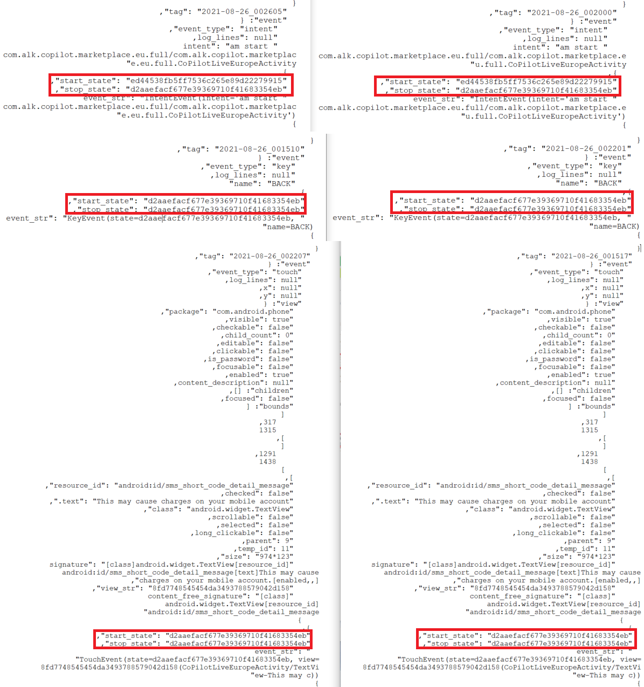
Testing Functionality
Tested application functionality after attack and before attack and compared the events between them using Droidbot. We took sample of 50 application and the functionality reserved. The testing was based on the state number and chronological order of the events created.

