Slide 1

Notes:
_background: #001f3f

Slide 2


Slide 3


Slide 4


Slide 5
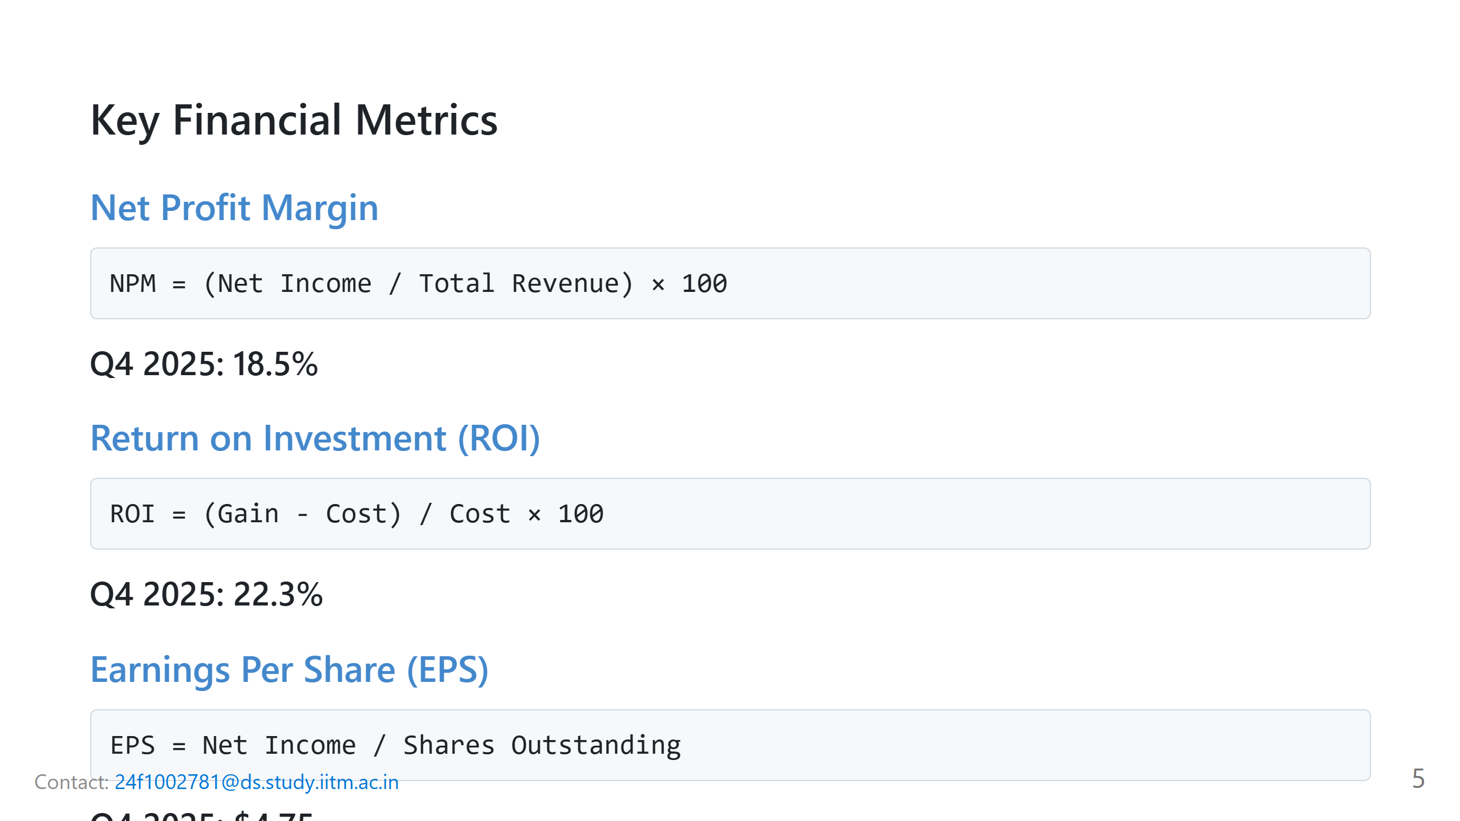

Slide 6
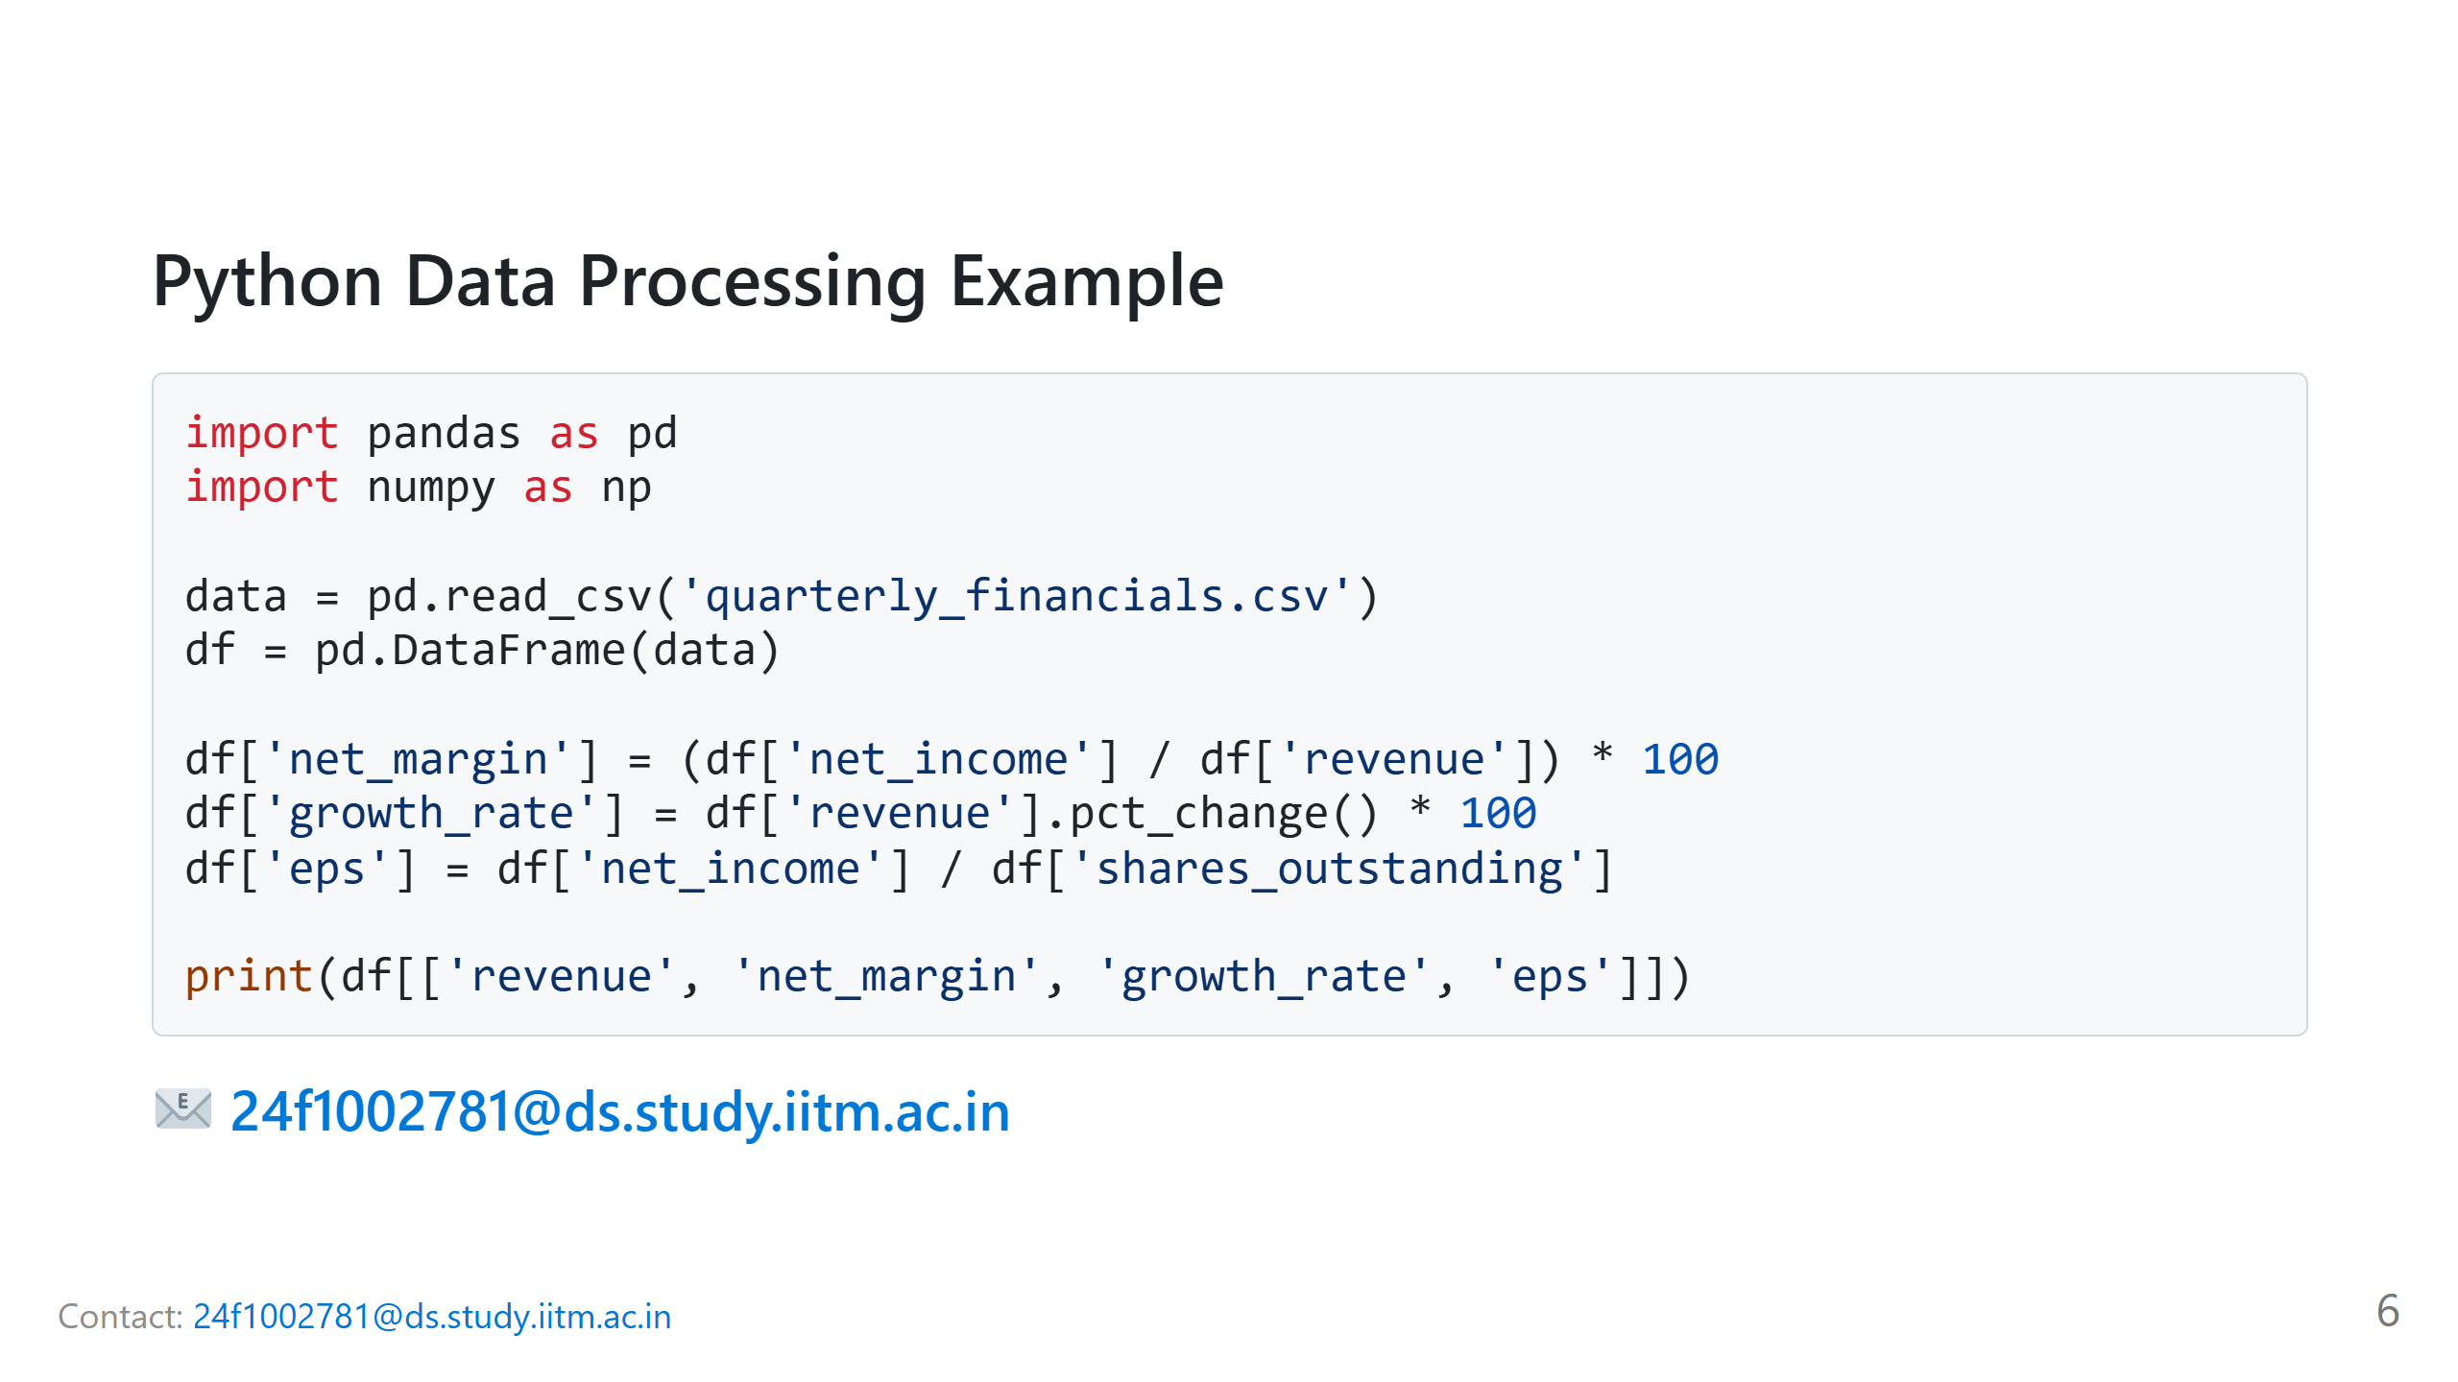

Slide 7
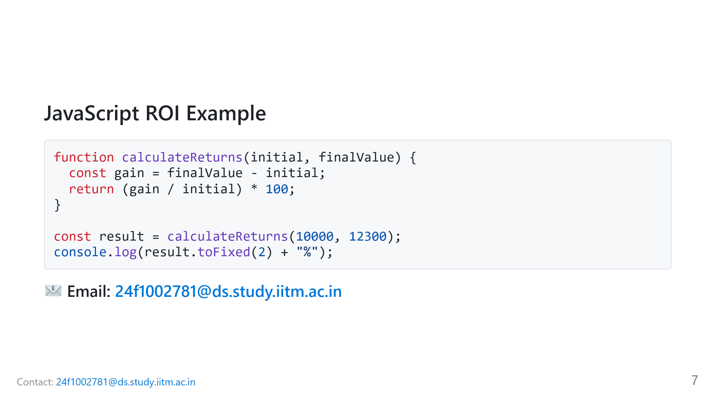

Slide 8


Slide 9


