Slide 1
Data analysis
Niv Yosef – 206100968
Omer Etzion – 311128847
Learning with explanations

Slide 2
Part a

Slide 3
Overview
FeedbackModel
default_label
default_explanation
laws
teacher
teacher
laws
0…*
Teacher (abstract)
X
features_labels_dict
Law
explanation
label
discriminative_feature
Teacher1
Teacher4
Teacher3
num_of_teachers
sample_percentage
teachers
Teacher2
teachers
0…*

Slide 4
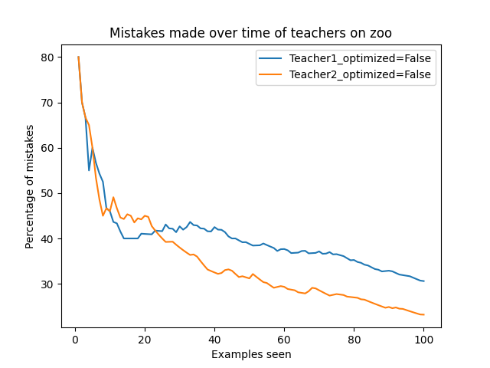
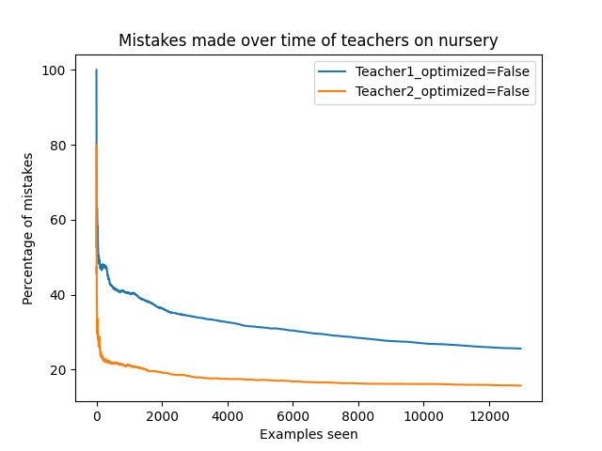
Results of teachers 1,2 on zoo and nursery datasets

Slide 5
Decision lists of teachers 1,2 on zoo and nursery datasets
Zoo:
Teacher1:
Run1, Run2, Run3, Run4, Run5
Teacher2:
Run1, Run2, Run3, Run4, Run5
Nursery:
Teacher1:
Run1, Run2, Run3, Run4, Run5
Teacher2:
Run1, Run2, Run3, Run4, Run5

Slide 6
Conclusion: teacher2 performs consistently better than teacher1

Slide 7
Part b

Slide 8
The new dataset
The dataset: wifi_localization
Explanation: predicts the location of a smartphone (1 of 4 rooms) based on the strength of 7 different wifi signals
Number of instances: 2000
Number of attributes per instance: 7
Labels: 1 - 4

Slide 9
Improvements to the algorithm
feedbackModel.predict2(): If an example doesn’t fit any law – guess the best fitting law instead of the default label. - improves performance
Teacher3:
Array of Teacher2s.
Each teacher gets a random subset of the dataset.
Each Teacher2 gives a “discriminative score” to the discriminative feature it suggests.
Teacher3 returns the feature that had the max sum of “discriminative scores” .

Slide 10
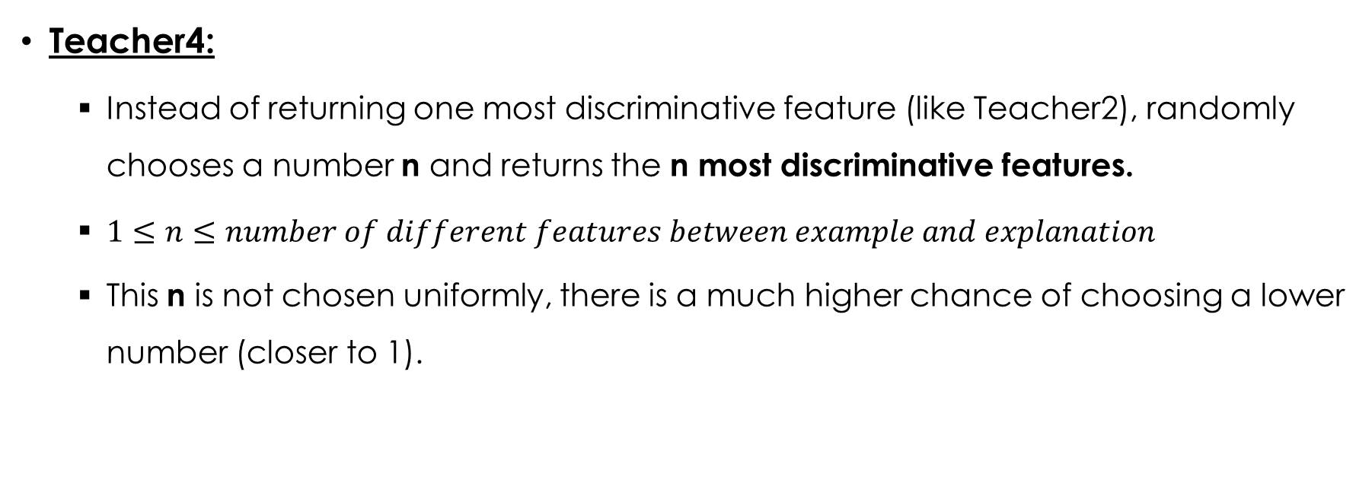
Improvements to the algorithm
Teacher4:
Instead of returning one most discriminative feature (like Teacher2), randomly chooses a number n and returns the n most discriminative features.
$1≤n≤number of different features between example and explanation$
This n is not chosen uniformly, there is a much higher chance of choosing a lower number (closer to 1).

Slide 11
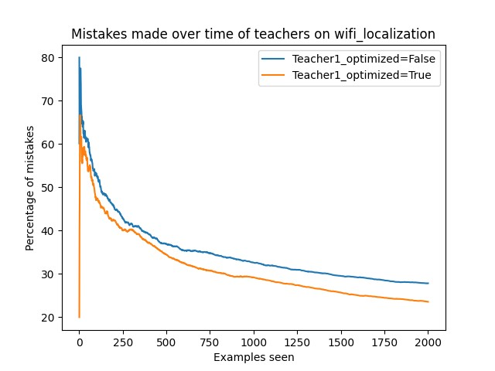
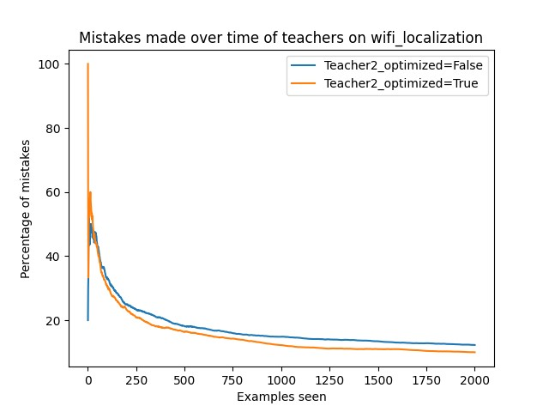
Average Results Of teachers 1, 2 on WIFI_localization dataset

Slide 12
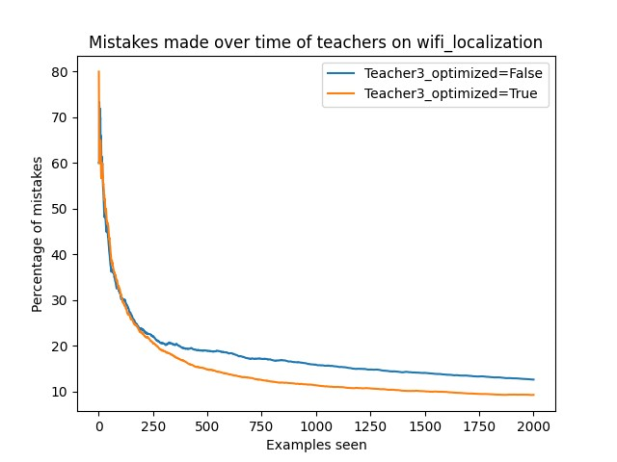
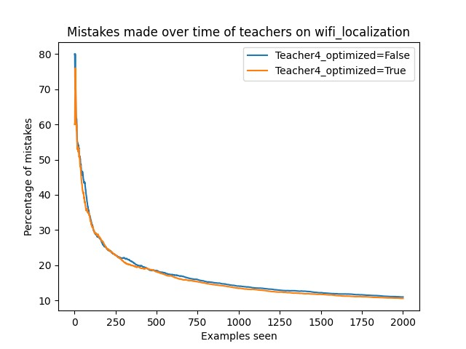
Average Results Of teachers 3, 4 on WIFI_localization dataset

Slide 13
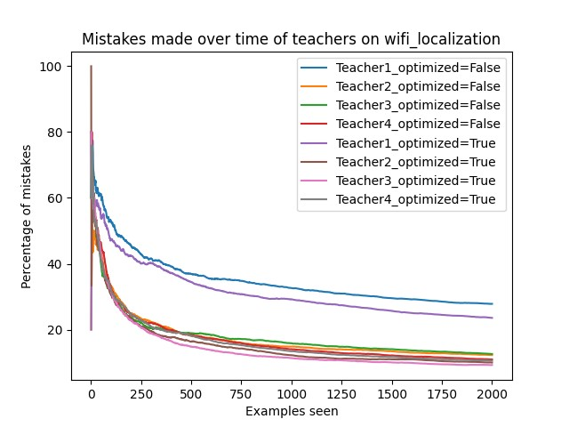
Average Results Of All teachers on WIFI_localization dataset

Slide 14
conclusion
The predict optimization improved the performance of the model, no matter which teacher was used.
Teacher3 and Teacher4 did not improve the performance consistently enough to be noticeable.
The best performing variation is Teacher3 with the predict optimization.
If we don’t consider runtime.
Compared to Teacher2 with the predict optimization, the improvement is marginal, but the runtime is considerably longer for Teacher3 (~3x longer).
If runtime is a factor, Teacher2 with the predict optimization will be a better choice.

