Slide 1
Data analysis
Niv Yosef – 206100968
Omer Etzion – 311128847
Learning with explanations

Slide 2
Part a

Slide 3
Overview
FeedbackModel
teacher
laws
0…*
Teacher (abstract)
Law
Teacher1
Teacher4
Teacher2
teachers
Teacher3
0…*

Slide 4
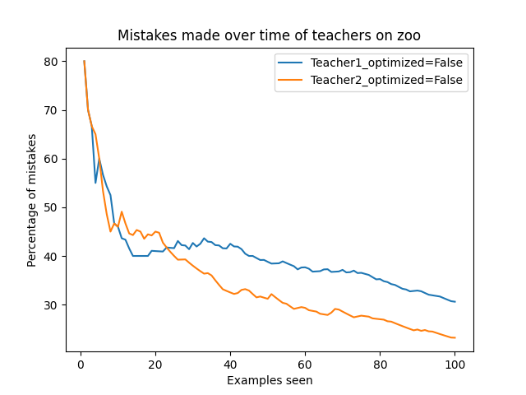
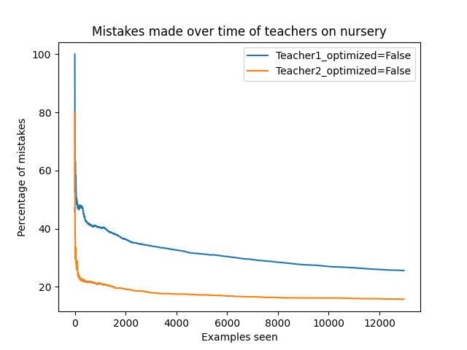
Results of teachers 1,2 on zoo and nursery datasets

Slide 5
Decision lists of teachers 1,2 on zoo dataset

Slide 6
Decision lists of teachers 1,2 on Nursery dataset

Slide 7
conclusion

Slide 8
Part b

Slide 9
The new dataset
The dataset: wifi_localization
Explanation: predicts the location of a smartphone (1 of 4 rooms) based on the strength of 7 different wifi signals
Number of instances: 2000
Number of attributes per instance: 7
Labels: 1 - 4

Slide 10
Improvements to the algorithm
feedbackModel.predict2(): If an example doesn’t fit any law – guess the best fitting law instead of the default label. - improves performance
Teacher3: - improves stability
Array of Teacher2s.
Each teacher gets a random subset of the dataset.
Each Teacher2 gives a “discriminative score” to the discriminative feature it suggests.
Teacher3 returns the feature that had the max sum of “discriminative scores” .

Slide 11
Improvements to the algorithm
Teacher4: - improves stability
Instead of returning one most discriminative feature (like Teacher2), randomly chooses a number n and returns the n most discriminative features.
This n is not chosen uniformly, there is a much higher chance of choosing a lower number (closer to 1).

Slide 12
Results Of teacher3 on WIFI_localization dataset

Slide 13
Results Of teacher4 on WIFI_localization dataset

Slide 14
Average Results Of All teachers on WIFI_localization dataset

Slide 15
conclusion

