Slide 1
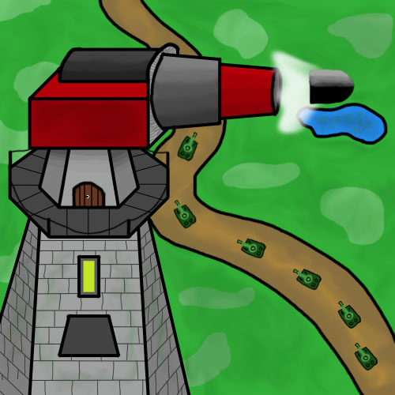
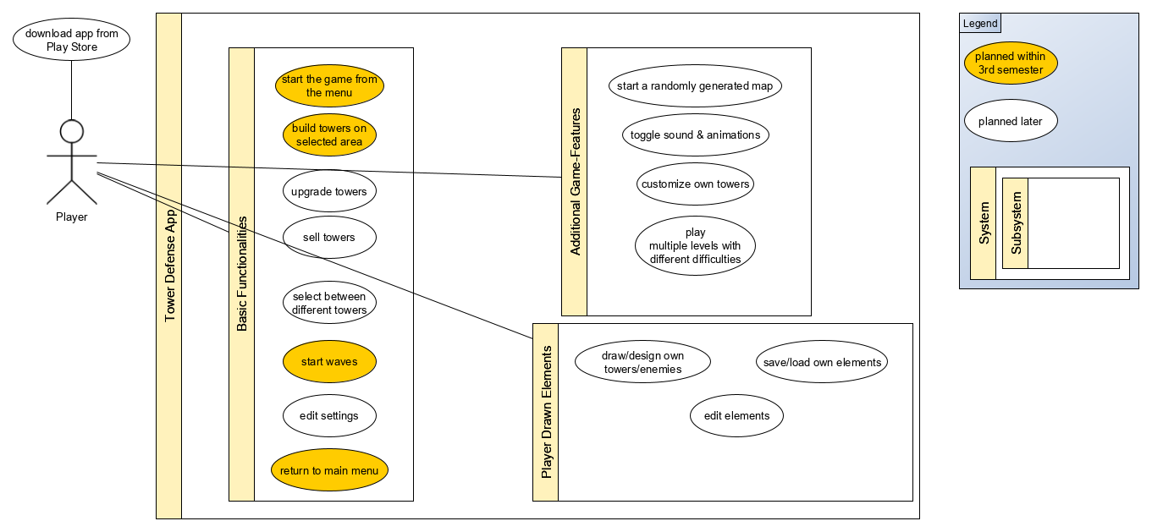
Tower Defense
Course: TINF18B4
Time-Data
Member | Overall Time (h) | Lecture Require-ments (h) | Analysis & Design (h) | Implemen-tation (h) | Testing (h)
Fabian | 0 | 0 | 0 | 0 | 0
Luca | 0 | 0 | 0 | 0 | 0
Nicolas | 0 | 0 | 0 | 0 | 0
Team-Members: - Fabian Braun (mail@mail.de) - Luca Rutschmann (mail@mail.de) - Nicolas Wagner (towerdefense@nicolas-wagner.com)
Task Type | Overall Time (h)
Lecture Requirements | 0
Analysis & Design | 0
Implementation | 0
Testing | 0
Use Case | Overall Time (h)
Start the game from the menu | 0
Start waves | 0
Build towers on selected area | 0
Return to main menu | 0

