Slide 1
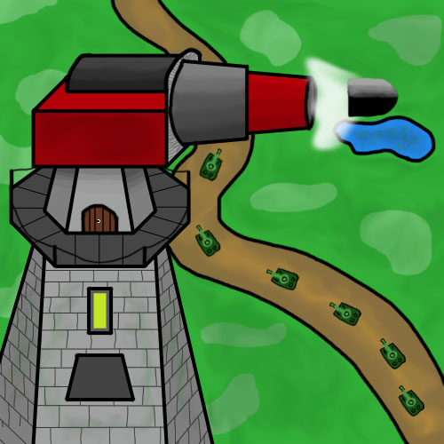
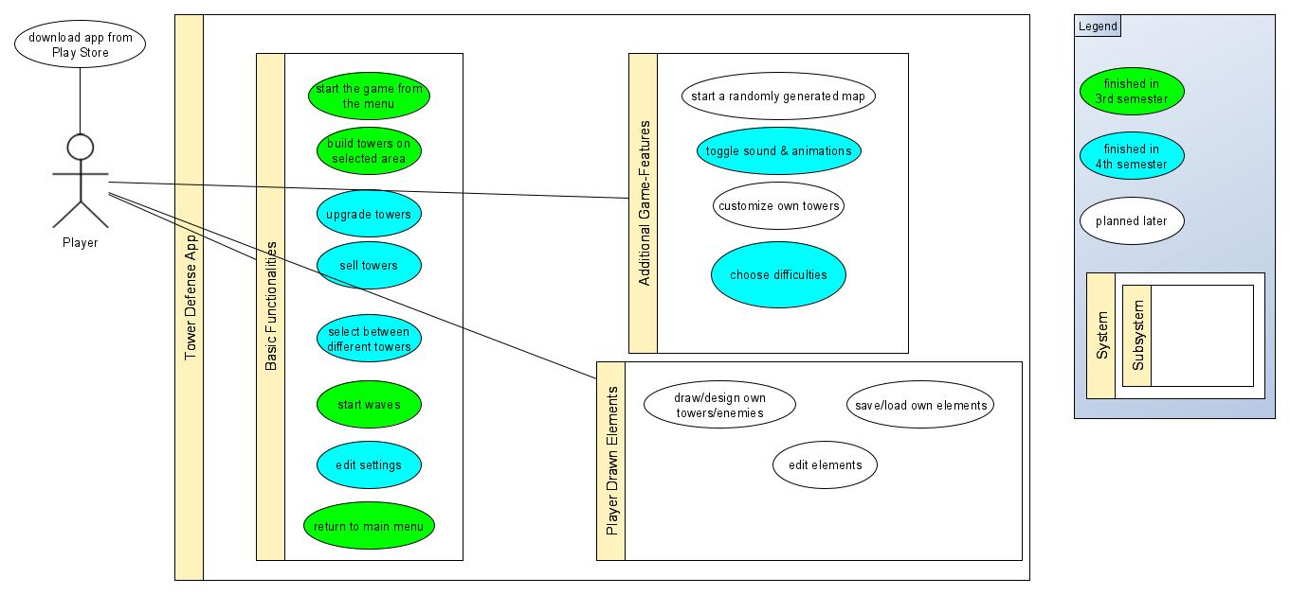
Tower Defense
Course: TINF18B4
Time-Data
Member | Overall Time (h) | Project Manage- ment (h) | Analysis & Design (h) | Implemen-tation (h) | Testing (h)
Fabian | 156,5 | 19,25 | 20,25 | 109 | 8
Luca | 106,25 | 26,25 | 27,25 | 47,25 | 5,5
Nicolas | 194,16 | 67,91 | 42,75 | 56,75 | 26,75
Team-Members: - Fabian Braun (fabian.braun@dh-towerdefense.de) - Luca Rutschmann (luca.rutschmann@dh-towerdefense.de) - Nicolas Wagner (nicolas.wagner@dh-towerdefense.de)
Task Type | Overall Time (h)
Project Management | 113,41
Analysis & Design | 90,25
Implementation | 213
Testing | 40,25
Use Case | Overall Time (h)
Start the game from the menu | 43
Start waves | 7
Build towers on selected area | 6,5
Return to main menu | 1,5
Upgrade towers | 12,375
Sell towers | 10,125
Select between different towers | 26
Edit settings | 12,5
Toggle sound & animations | 1,5
Choose difficulties | 15,5

