Slide 1
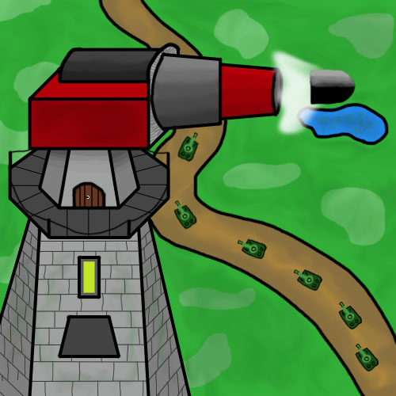
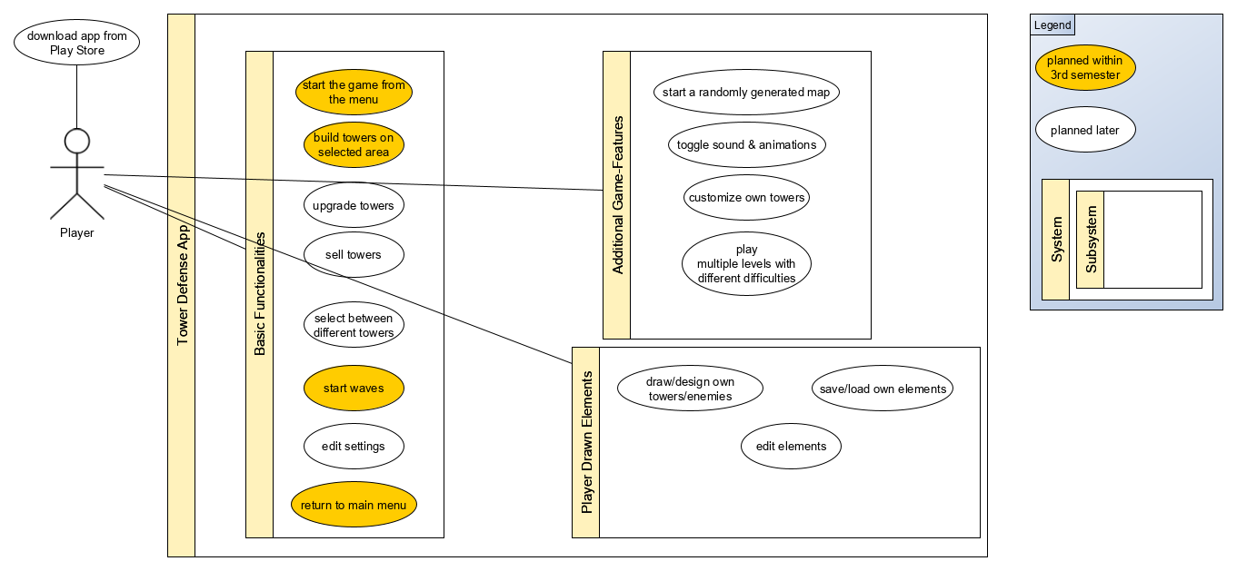
Tower Defense
Course: TINF18B4
Time-Data
Member | Overall Time (h) | Lecture Require-ments (h) | Analysis & Design (h) | Implemen-tation (h) | Testing (h)
Fabian | 45,75 | 7,25 | 5,75 | 26 | 6,75
Luca | 44,75 | 13,25 | 21,25 | 6,75 | 3,5
Nicolas | 70,91 | 30,66 | 15,75 | 15,75 | 8,75
Team-Members: - Fabian Braun (fabian.braun@dh-towerdefense.de) - Luca Rutschmann (luca.rutschmann@dh-towerdefense.de) - Nicolas Wagner (nicolas.wagner@dh-towerdefense.de)
Task Type | Overall Time (h)
Lecture Requirements | 51,16
Analysis & Design | 42,75
Implementation | 48,5
Testing | 19
Use Case | Overall Time (h)
Start the game from the menu | 39
Start waves | 7
Build towers on selected area | 6,5
Return to main menu | 1,5

