Slide 1
WEEK 2 SHOW-AND-TELL
ClearCare
NURSING HOMES IN IRELAND
545
What did inspectors find,
and was it fixed?
registered homes
Making Irish nursing-home
inspection evidence easier to follow
About 32,400 beds
End-2025 sector figures
ClearCare team
Source: supplied research, NHI / HRB
Notes:
ClearCare starts with a family's question when choosing a nursing home: Which one would be the best for our needs? After that: "Does this nursing home provide reliable care and amenities to its occupants?"
Ireland has 545 registered homes and about 32,400 beds. The Health Information and Quality Authority (HIQA) is an independent body that conducts regular inspections on Irish nursing homes and provides a publicly available platform for these inspection reports. When a family chooses a nursing home through locations and amenities, the recommended next step is to look at inspection reports. These reports would show if the provider is compliant in regulations and/or capable in making improvements/changes as advised by the HIQA. Going through these long reports and comparing them places a heavy burden on the user to come to a conclusion on deciding which provider to choose.

Slide 2
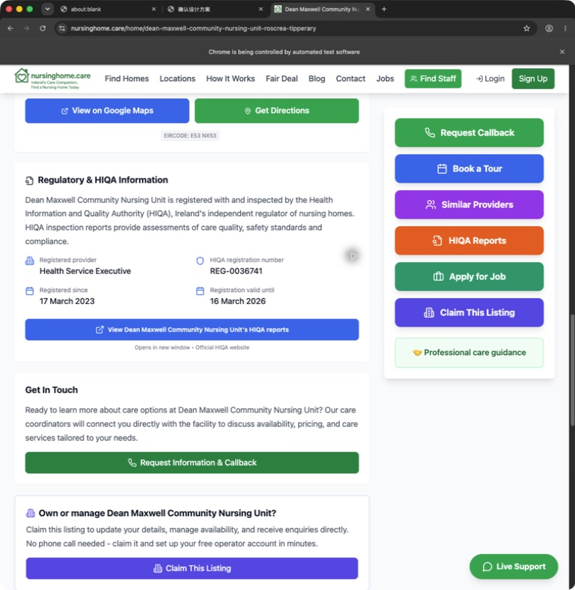
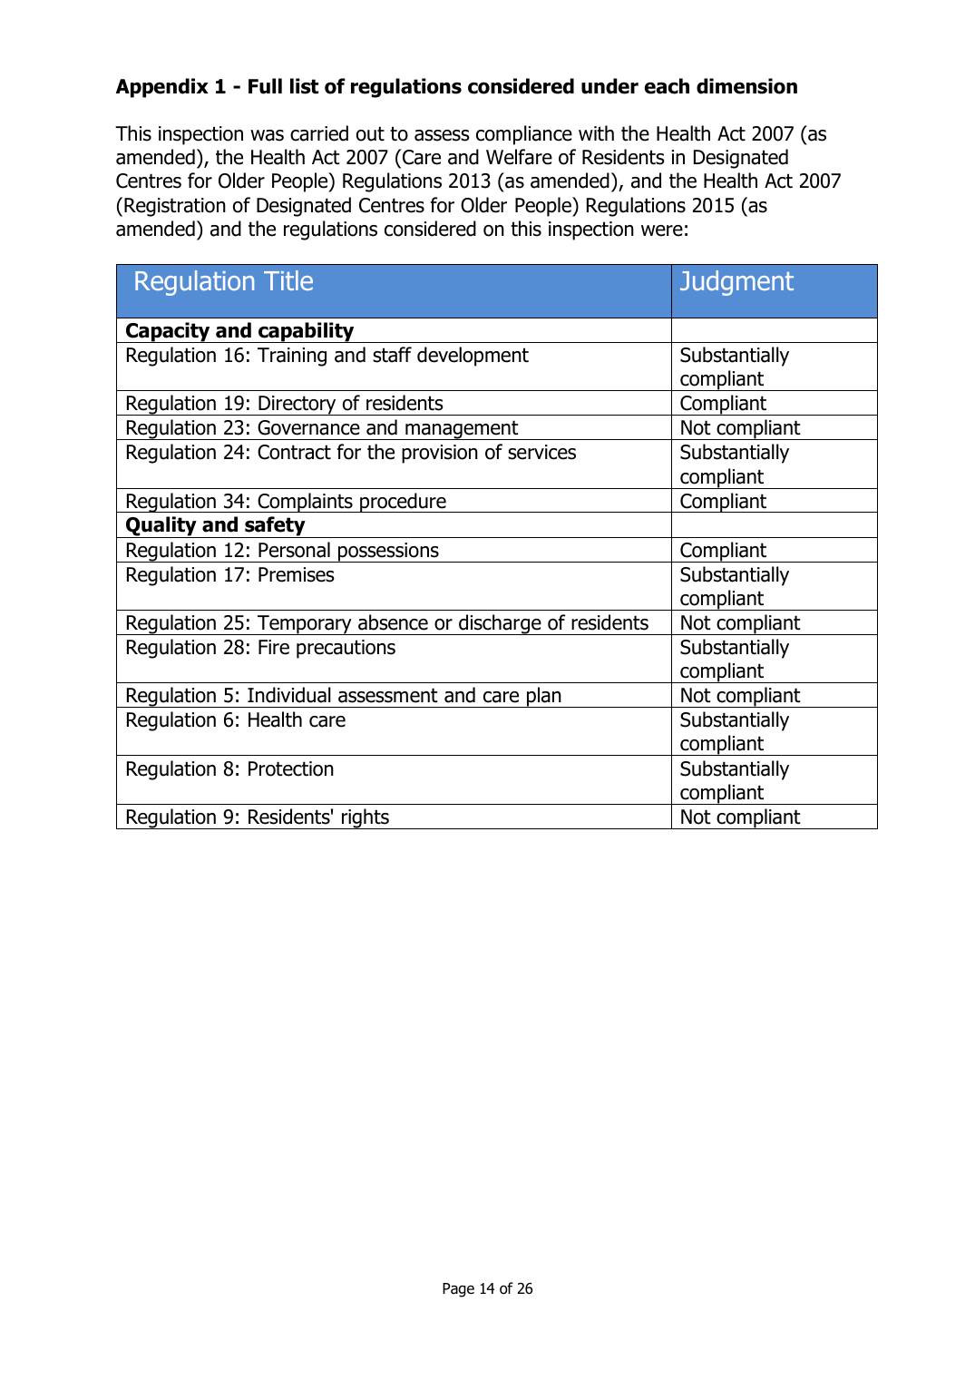
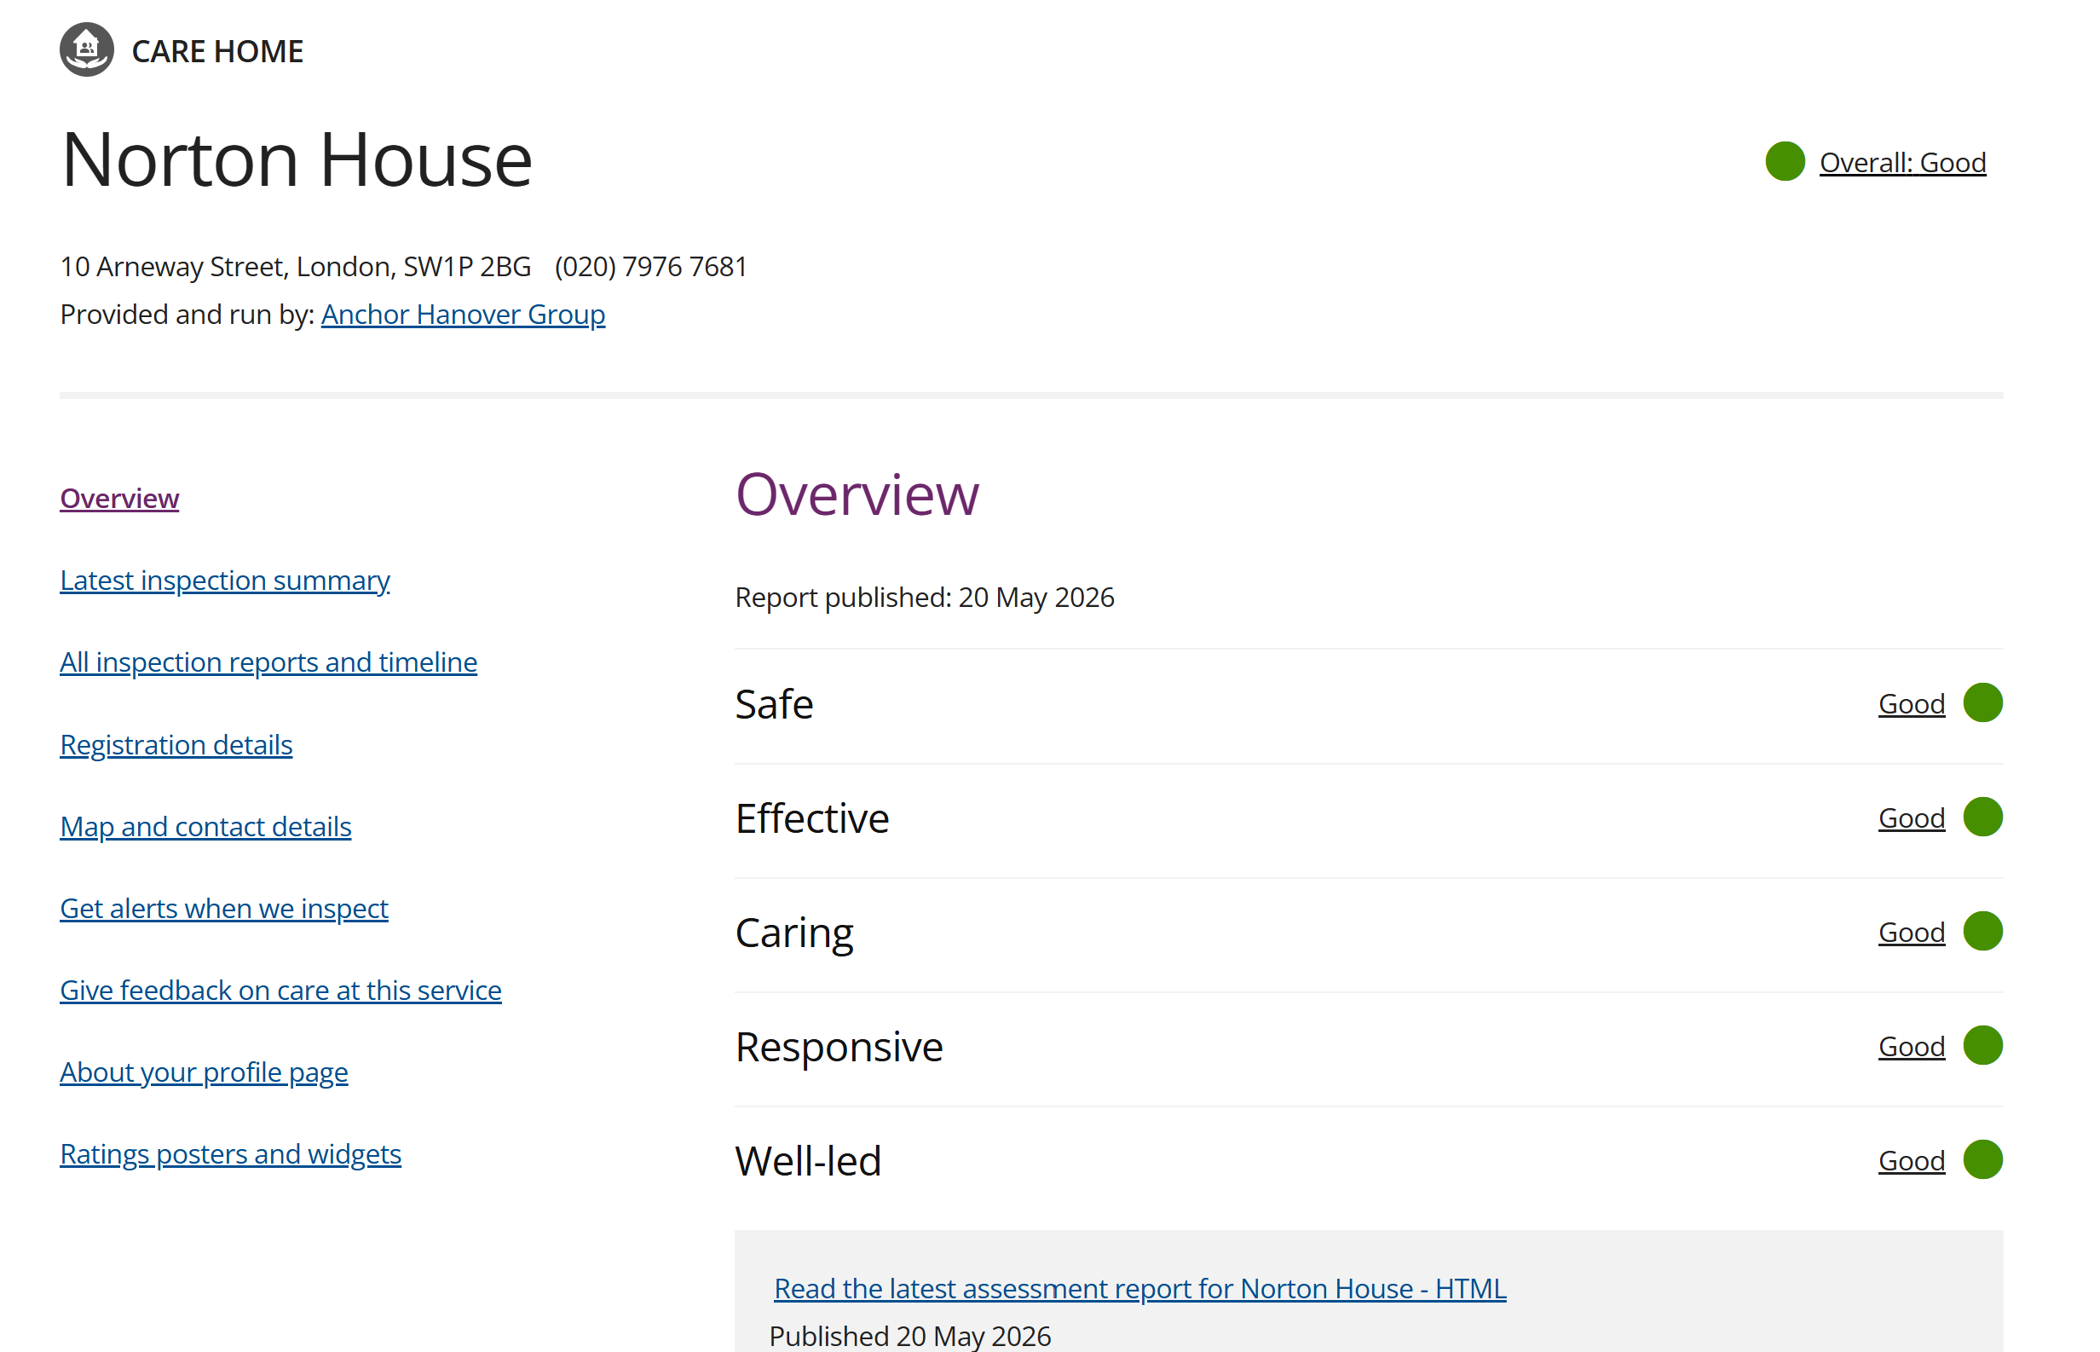
The evidence is in separate PDFs
Directory links lead to reports
HIQA report
2,266
inspection reports
Listed on 21 September 2026
England's CQC website
Inspector Judgments.
Provider responses.
Later inspections.
The reader makes the connections.
HIQA / CC BY 4.0 / Millbrook Manor, 10 Feb 2026, p.14
02
Directory: nursinghome.care, Dean Maxwell listing, 23 Sep 2026
Notes:
On September 2026, there are over 2,200 reports. Each inspection report typically contains 20-30 pages. Inspector judgements, nursing home provider responses, resident experiences, and follow-up inspections require separate/comprehensive reading, often across different regulation sets.
Existing websites such as nursinghomecare, FindCare and HIQA do provide a directory of reports but does not simplify the process for families choosing a nursing home based on regulation compliances. England's CQC website does this by not only providing the report, but as well provide a visual representation of the inspection ratings without having to read long pdfs. But for ClearCare, instead of displaying the ratings, we will aim to visually display the summarized reports and any rechecked regulations in a user friendly format.

Slide 3
A time-aware record for each home
Compare regulation-level judgments, with evidence behind every mark.
INSPECTOR
PROVIDER
NEXT INSPECTION
Finding
Compliance plan
Follow-up
Dates, regulation, PDF page and the inspector’s wording stay attached.
No home ranking, score or recommendation.
CLEARCARE / PROPOSED PRODUCT
03
Notes:
Through Clearcare, we propose a structured, time aware record of regulation checks for each home.
Each home inspection report summary will have a regulation level finding and the following year’s finding and the following year’s and so on.
On a detailed look at each finding, the provider’s compliance plan will be highlighted.
This is to inform the user whether there has been a follow through on the suggested measures.
Because a promised action is not proof of resolution.
In the report summary we provide, users can compare a shortlist on the regulations they care about.
Every finding retains the inspection and publication dates, regulation, PDF page and inspector’s wording.
The judgements: Compliant, substantially compliant, not compliant and not assessed remain distinct.
The primary users are adults choosing elderly care for their loved ones.
Advocates journalists, researchers and providers may also use the evidence.
A point to be highlighted is that we never turn those findings into a ranking, overall score or recommendation.

Slide 4
Goal and delivery milestones
Can a family answer the evidence question
faster and more accurately than with the PDFs?
Parser evaluation
User study
Hand-labelled gold set; abstain when uncertain
Evidence tasks against the original PDFs
Week 7 · 5 Nov
Week 10
Week 12 · 10 Dec
Dublin MVP, end to end
All counties planned
Final demo
Planned milestones. Week 4 precision results determine the product scope.
Source: Week 1 project material, 23 Sep 2026
04
Notes:
Our goal is to test whether families answer the evidence question faster and more accurately than with inspection report PDFs.
Our evaluation has two halves: a hand-labelled gold set tests the parser, and a user study compares evidence-finding tasks against the original documents.
Uncertain extraction should ideally abstain and enter review, not guess.
The planned Dublin MVP covers about one hundred and thirty homes and three years of reports, working end to end for the week-seven demo on the fifth of November.
All counties are planned for week ten, with the final demonstration on the tenth of December.

Slide 5
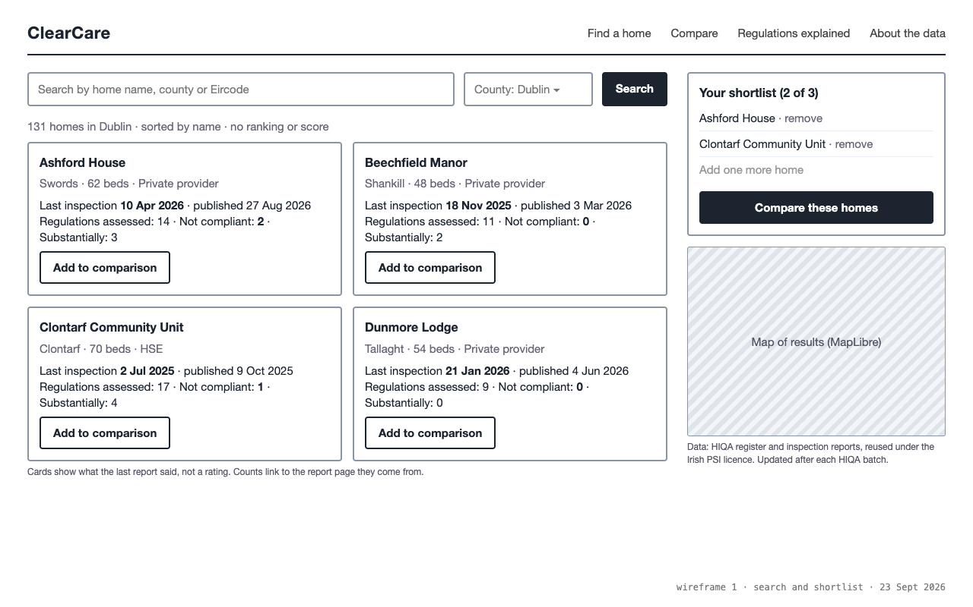
Search and build a shortlist
Name, county
or Eircode
Choose up to
three homes
The grid is the destination.
WIREFRAME
Layout and copy change
after the Week 6 pilot.
05
Notes:
The first wireframe shows how someone reaches the comparison. The user inputs a home name, county or Eircode. Then page would then show results through card components and contain the latest inspection date and the number of regulations found not compliant at that inspection, without converting them into an overall score (to avoid distinction bias). A person can add up to three homes to a shortlist. Search is an entry point; the comparison grid is the destination. This is an illustrative wireframe, not a working product or a factual assessment of the example homes used. The layout and copy is subject to change /
after the week-six pilot, based on what participants can actually understand and use.

Slide 6
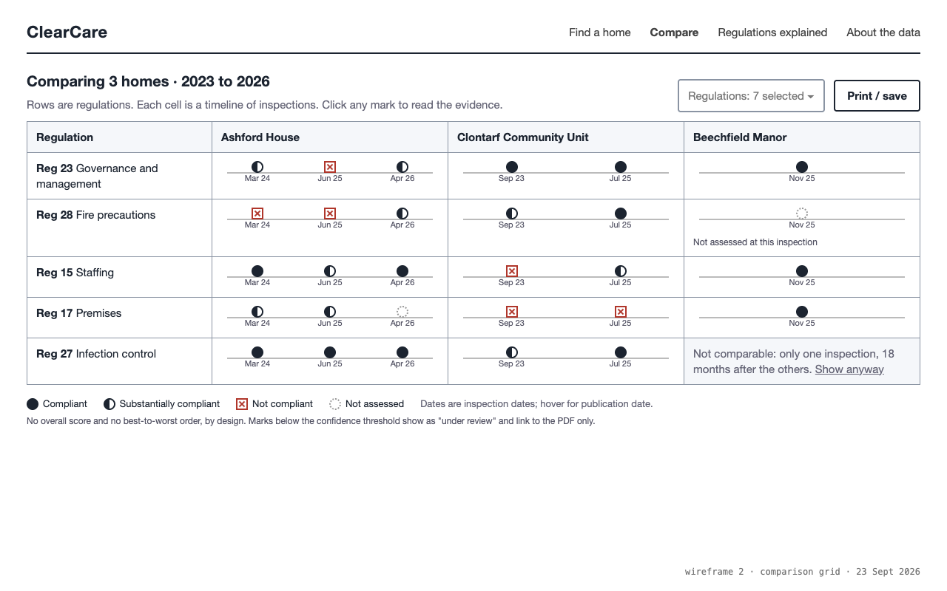
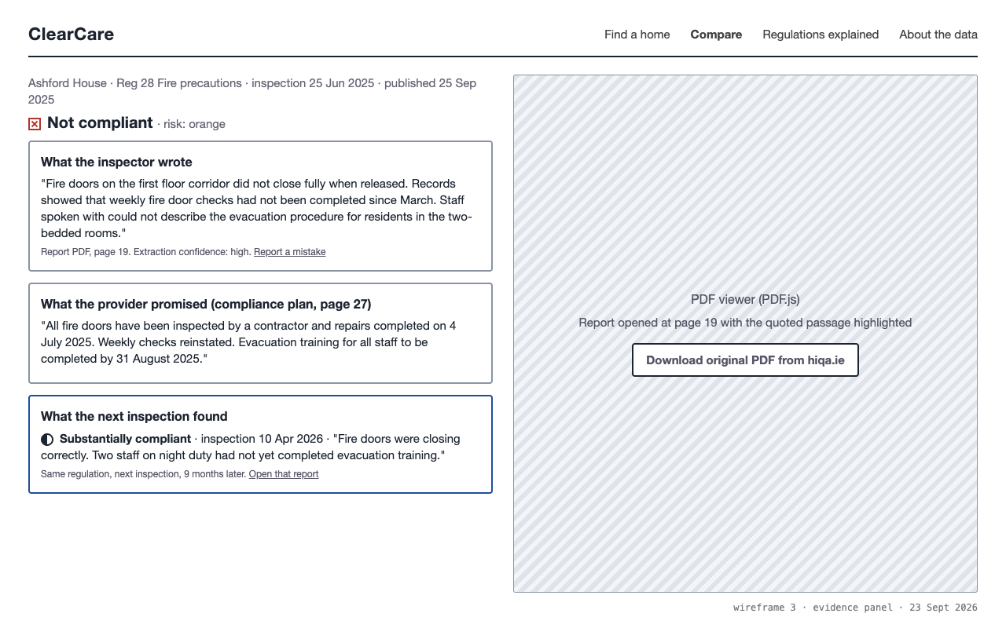
Compare, then open the evidence
ONE MARK, SOURCE EVIDENCE
Inspector text and PDF page.
Provider plan and later findings.
No source, no published mark.
States use words and shapes.
WIREFRAMES / Illustrative judgments. “Not assessed” and “not comparable” remain explicit.
06
Notes:
In the comparison grid, rows represent regulations and columns represent homes. Each cell contains inspection dates and judgment marks, so time and assessment coverage stay visible. Not assessed and not comparable are explicit states rather than unexplained blanks. Selecting a mark opens the inspector's paragraph beside its PDF page, together with the provider's plan and any later assessment of that regulation. The system will be using a legend format where words and shapes accompany colour to support color blind users and printed copies.
(No source no published mark means a reg is not inspected)
In the case scenario where if we cannot show the source, we do not publish the mark. Both screens are wireframes with illustrative judgments. The intended benefit is auditable comparison, not a simplified verdict on a home.

Slide 7
The technical work behind the grid
Archive, extract, parse
HIQA PDFs
FastAPI
Review uncertain fields
PostgreSQL
Link finding, plan and follow-up
Register + company records
Next.js
Daily identity snapshots
Entity resolution
Homes / grid / evidence
Extract
Link
Resolve
Compare
Abstain when
confidence is low
Finding, promise
and follow-up
Renamed and
sold homes
Dates and regulation
coverage matter
PROPOSED SYSTEM / Original report files stay archived. Doubtful judgments enter review.
07
Notes:
The technical work follows four problems. First, extraction must handle changing layouts, scans and wrapped tables, with doubtful fields sent to review. Second, we must link a finding, the provider's promise and later follow-up. Third, homes are renamed and sold, so daily register snapshots and company records support identity resolution. Fourth, dates and regulation coverage determine whether comparison is meaningful. Archived PDFs feed extraction, parsing, review and linking; resolved identities and evidence enter PostgreSQL, then FastAPI serves the Next.js home pages, grid and evidence panel. The planned stack also includes Tailwind, PyMuPDF, Docling, pgvector, PostGIS, object storage, a Docker Compose virtual machine, Vercel and GitHub Actions. Access uses register, centre, map and direct-PDF routes without bypassing browser checks. The reuse plan credits HIQA and excludes personal data; HIQA has not agreed to the project.

Slide 8
Project Management and Methodology
Process
SCRUM
Code
GitHub
Issue Tracking
JIRA
Sprint
1 week long sprint with sprint planning on every Friday
Stand ups
Around 15 minutes long standups every morning
Notes:
Next week has five owners. Likun builds fixture-driven Next.js home pages, a Vercel preview and the grid's data shape. Aswin starts daily register snapshots and a hashed Dublin PDF archive with a manifest, and requests older reports and a structured export. Waseel audits thirty Dublin reports, checking appendix and compliance-plan variation, then writes the labelling protocol and initial gold set. Twila contacts Sage Advocacy using approved invitations, drafts six interview questions and starts the ethics assessment. Niwash connects the JIRA CC Scrum board to GitHub, protects main and plans numbered Sprint Two tasks. Friday decides the default regulations and appendix-only versus narrative extraction. Proposed defaults cover governance, fire, staffing, training, premises, infection control and residents' rights. These are planned deliverables, not completed work.

Slide 9
Week 2: one owner, one deliverable
Likun
Frontend draft and Vercel preview
Aswin
Daily register snapshots and Dublin PDF archive
Waseel
Audit 30 reports; labelling protocol and gold set
Twila
Advocacy outreach, interview guide and ethics form
Niwash
JIRA CC board, GitHub link and Sprint 2 tasks
Notes:
Next week has five owners. Likun builds fixture-driven Next.js home pages, a Vercel preview and the grid's data shape. Aswin starts daily register snapshots and a hashed Dublin PDF archive with a manifest, and requests older reports and a structured export. Waseel audits thirty Dublin reports, checking appendix and compliance-plan variation, then writes the labelling protocol and initial gold set. Twila contacts Sage Advocacy using approved invitations, drafts six interview questions and starts the ethics assessment. Niwash connects the JIRA CC Scrum board to GitHub, protects main and plans numbered Sprint Two tasks. Friday decides the default regulations and appendix-only versus narrative extraction. Proposed defaults cover governance, fire, staffing, training, premises, infection control and residents' rights. These are planned deliverables, not completed work.

Slide 10
Week 4 decides the product scope
HAND-LABELLED DUBLIN REPORTS
Precision gate
SUFFICIENT PRECISION
INSUFFICIENT PRECISION
Full comparison
Source-linked search
Source evidence remains the foundation in either scope.
Variable PDFs
Review and abstention
Slow recruitment
Outreach in Week 2
Source access changes
Alternative routes
No achieved accuracy or numeric precision threshold is claimed.
09
Notes:
Week four makes the scope decision explicit. Measured precision on hand-labelled Dublin reports determines whether we continue full comparison or narrow to source-linked search. We have not established a numerical threshold or achieved accuracy, so neither is claimed here. Variable PDFs are addressed through review and abstention from day one. Slow recruitment means contacting organisations in week two, rather than waiting for the pilot; a smaller formative study can still produce useful findings. Source-access changes call for alternative documented routes and polite crawling. Whichever scope the evidence supports, the foundation stays the same: users can trace what we show back to the source, and we state the limits of what the system knows.

