Slide 1
MSc Group 2 Project
Team
ClearCare
Likun Fang
A00049290
Week 3 update
Twila Habab
C20361521
Aswin Remesh
A record of
A00047249
What inspectors found.
What the provider planned.
Whether the next inspection found it fixed.
Niwash Acharya
A00046271
Waseel Chopra
A00046669

Slide 2
Week 3 update
Reflections
1
Qualitative research
Slides 3–4
Talk to real people about real problems
Last week's feedback,
in four topics.
2
Technologies
Slide 5
The choice of backend and hosting
3
Data visualisation
Slide 6
Show a lot of inspection data effectively
4
Artificial intelligence
Slide 7
Why build this when anyone can ask a chatbot
ClearCare · Week 3 · 02

Slide 3
1
Feedback 1 of 4
Qualitative research
This week
Today
We need real people:
two interviews this week.
Availability over preference?
Ahead: demand will grow faster than supply
+162%
1,000
95%
population aged 85+ by 2045
extra nursing-home beds
a year, to 2040
occupancy already,
in nursing homes
Department of Health projections,
via Nursing Homes Ireland
ESRI
Nursing Homes Ireland
ClearCare · Week 3 · 03

Slide 4
1
Feedback 1 of 4
Interviews: how many families read the reports
Director of Nursing
Assistant Director of Nursing
Private nursing home, Dublin · 29 Sept
Private nursing home, Dublin · 30 Sept
“Not everyone checks the
reports, maybe one out of five
or ten.
“All families check
reports.”
Two interviews, 29 and 30 Sept, with signed consent.
ClearCare · Week 3 · 04

Slide 5
2
Feedback 2 of 4
Technologies
Decision 1 · Hosting
Decision 2 · Backend
Hosting on Oracle Cloud (OCI)
FastAPI
Spring Boot
One provider for the API, the pipeline,
the database and the PDF archive.
Mature ecosystem, supported for the
life of the project.
How we judge “enterprise ready”
Evaluation
Security
Monitoring
Testing
gold set, measured accuracy
Spring Security
health checks, job alerts
real PostgreSQL in CI
ClearCare · Week 3 · 05

Slide 6
3
Feedback 3 of 4
Data visualisation
Goal: show the most information with the least display.
Compliance per regulation over time
Legend, per regulation
Bar charts, with the legend shown at right
Compliant
A mind map of each report
Substantially compliant
Regulations, judgments, the provider's promises
Not compliant
Maximum agreed price per home
Not assessed
From the HSE
Not looked at is not the same as passed.
Activities and services
In the inspector's words
ClearCare · Week 3 · 06

Slide 7
4
Feedback 4 of 4
AI vs ClearCare
General AI chatbot | ClearCare
You find and upload each report | Every HIQA report collected automatically and kept current
Answers can vary between runs | Judgments extracted once, stored, the same for every user
Paraphrases loosely, may hallucinate | Every line linked to the inspector's words and the PDF page
Compares anything and may sound confident | Says “not comparable” when inspections covered different regulations
Conversation only | One page per home: findings, promises, what the next inspection said
No memory across reports | Compliance history over time
ClearCare · Week 3 · 07

Slide 8
Week 3 update
We will listen to
the advice given.
Next: the retrospective — what went well, what did not, what comes next
Notes:
So we decided one of the main goals for this week is to reflect last week's advice and notes. Then we held a retrospective meeting to prepare for next week.

Slide 9
Sprint review
Retrospective I
What went well
What went poorly
Conducted two interviews; emailed Sage Advocacy.
Sage Advocacy has not
replied yet.
Defined the coding standards and conventions.
Deployed the first Next.js app.
Less coding than we wanted.
Re-evaluated the technologies.
The Spring Boot backend is
not started yet.
Audited a few HIQA reports.
Had the first meeting with our mentor.
ClearCare · Week 3 · 09

Slide 10
Sprint review
Retrospective II
New ideas
Actions for next week
1
Show where homes are
1
Further outreach for interviews
On a map
2
Add the financial side
2
Start Spring Boot backend
Maximum contract price
3
Mobile-friendly UI
3
More coding!
ClearCare · Week 3 · 10

Slide 11
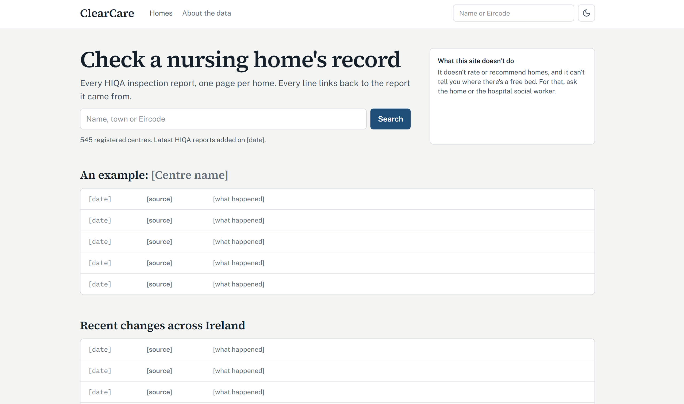
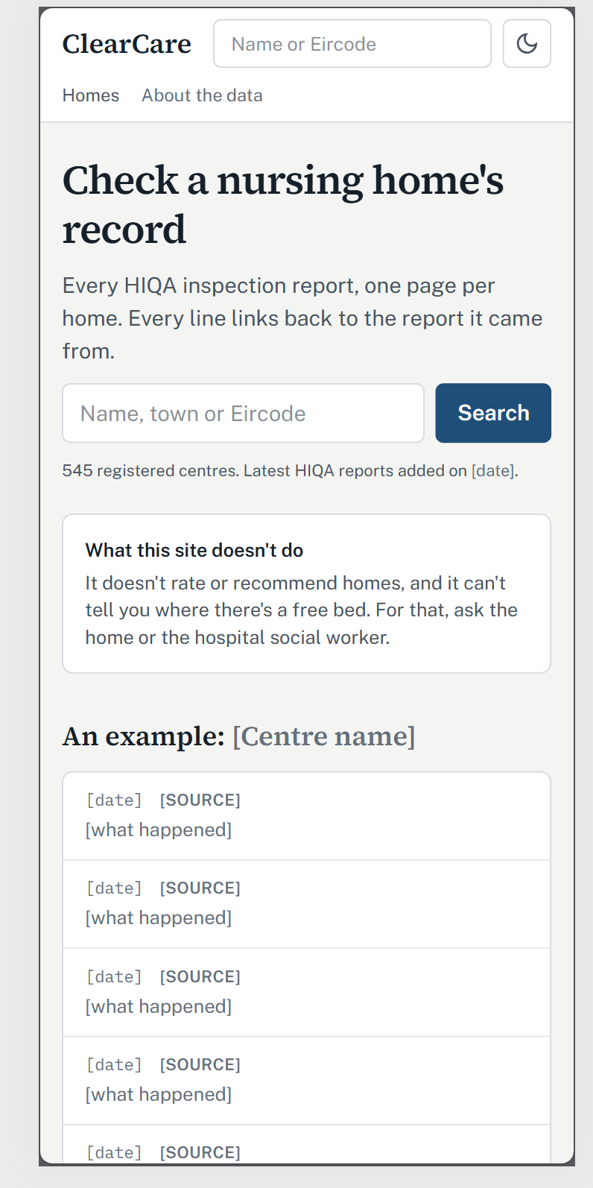
Vercel deployment
clear-care-nine.vercel.app
ClearCare · Week 3 · 11

Slide 12
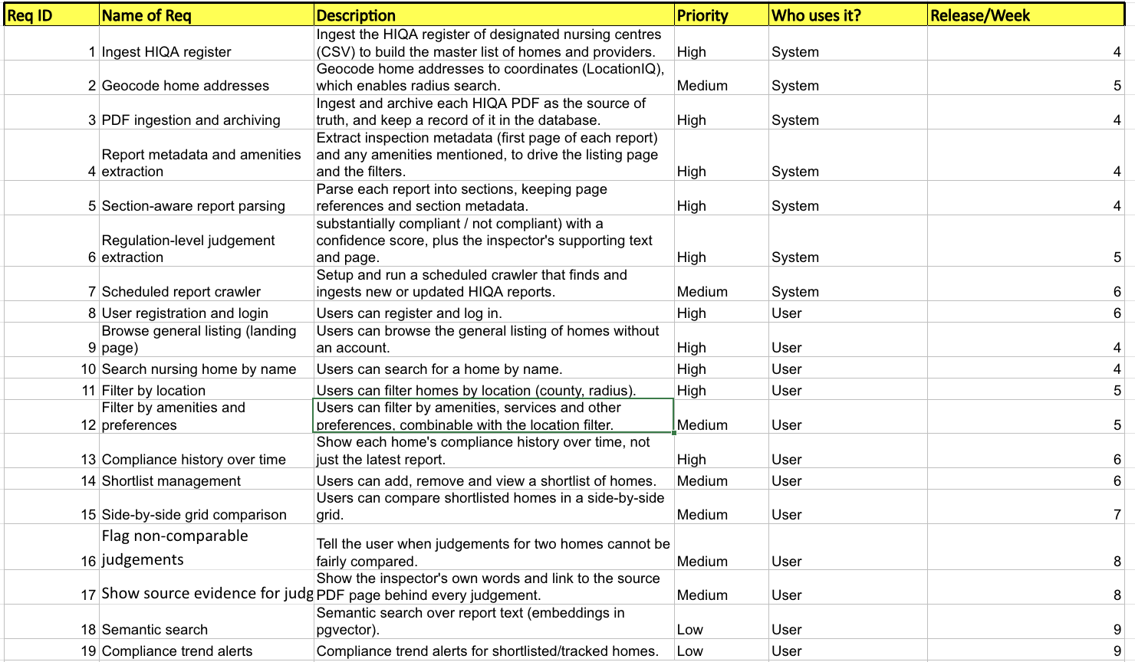
Requirements specification
ClearCare · Week 3 · 12

