Slide 1

Team ClearCare
Interim Presentation
A00049290 - Likun Fang
C20361521 - Twila Habab
A00047249- Aswin Remesh
A00046271 - Niwash Acharya
A00046669 - Waseel Chopra

Slide 2
Project Mission & Vision
Mission
  To help people make informed decisions, and give informed consent, about nursing home care.
Vision
  As Ireland's older population grows, more families will face this choice. We want every one of them to make it informed and prepared.

Slide 3
Project Goals
Who it is for?
  Families looking for a nursing home.
  Older people deciding for themselves.
  Advocates and researchers
Why the need?
  People should be able to choose even when the time is short.
Project Aim
  To help families and older adults understand the process and what to know before choosing a home.

Slide 4
Technology Stack
Pipeline
  Python 3.13 with PyMuPDF and psycopg. CSV mapping files drive the parser. Every extraction carries a version.
Data
  PostgreSQL 18 with Flyway migrations. Derived tables are append-only. The API reads views only. Raw files sit in Oracle Object Storage, write-once.
API and site
  Spring Boot 4 on Java 21: a read-only REST API with OpenAPI. Next.js 16, React 19, TypeScript and Tailwind CSS 4 on Vercel, rendered on the server.
Delivery
  One Oracle Cloud VM with Docker Compose. GitHub Actions checks every pull request and deploys on merge. LLM pilots (Claude, GPT-4o-mini) are research only until they score well against human labels.

Slide 5
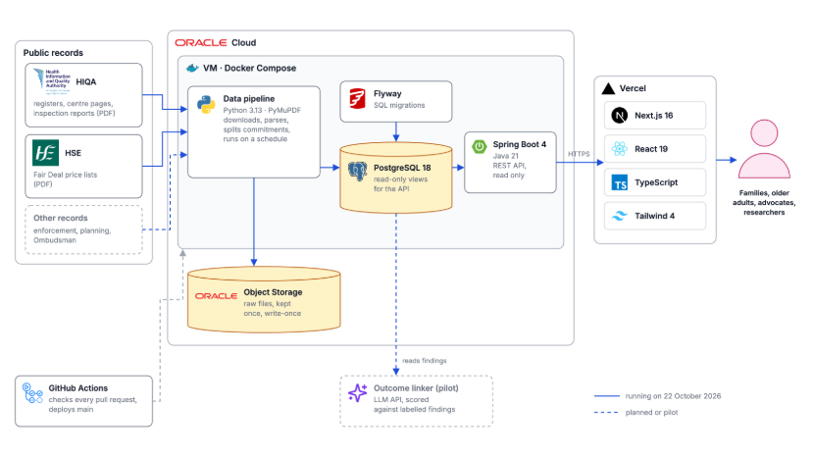

Slide 6
Data Stack
HIQA register
  A CSV export every day, 546 centres.
HIQA inspection reports
  A weekly check of every centre page. 2,204 PDFs stored, 1,969 standard reports parsed: judgments per regulation, compliance-plan rows, text per regulation, and about 38,000 commitments.
HSE price lists
  Two PDFs: 411 private and voluntary homes, 115 public homes. Found on the Fair Deal page and loaded weekly
Storage
  Every file is kept once under its content hash, with a write-once copy in object storage. A file already loaded is skipped, so every run is safe to repeat.
Access
  All three sources are public web pages. No logins or API keys are needed.

Slide 7
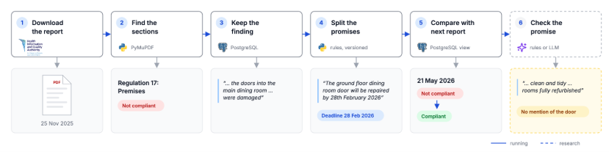

Slide 8
Evaluation
General User Evaluation
  Each lists three things they liked, three they disliked and three they wished.
Public Launch
  A visitor survey on a five-point scale, with questions based on Nielsen's usability heuristics. We report the median, the mode and the share who agree, grouped by heuristic.
End-User Interviews
  Thematic analysis (Braun and Clarke) answers four questions: is the site usable, does it stay useful as reports arrive, is it accessible, is it accurate.
Data: four numbers, each reproducible with one command
  Commitment splitter against labelled commitments: regulation, text span, date, page.
  Outcome linker, rules and LLM, against labelled outcomes: 5 report pairs, 43 findings. The pilot gave 0 invalid outputs for under $0.10.
  Amenities extraction against an 18-home gold set: nine fields, scored as match, missed or invented.
  National re-assessment figures, with their coverage and bias stated.

Slide 9
Research Question
What Drives Nursing Home Contract Prices?
Factors to test
  Location and Care Types
  Type of home: private, voluntary or public
  Registered capacity
  Facilities and services
What the HSE data shows
  Private and voluntary (411 homes): €1,192 to €1,508 a week, median €1,287
  Public (115 homes): €1,193 to €2,902 a week, median €1,966
  Dublin averages about €1,408 a week, compared with €1,276 outside Dublin
Next: link facilities to price
  HIQA reports describe each home's facilities and services
  Our amenities extraction pulls these out automatically
  These can then be tested against price

Slide 10
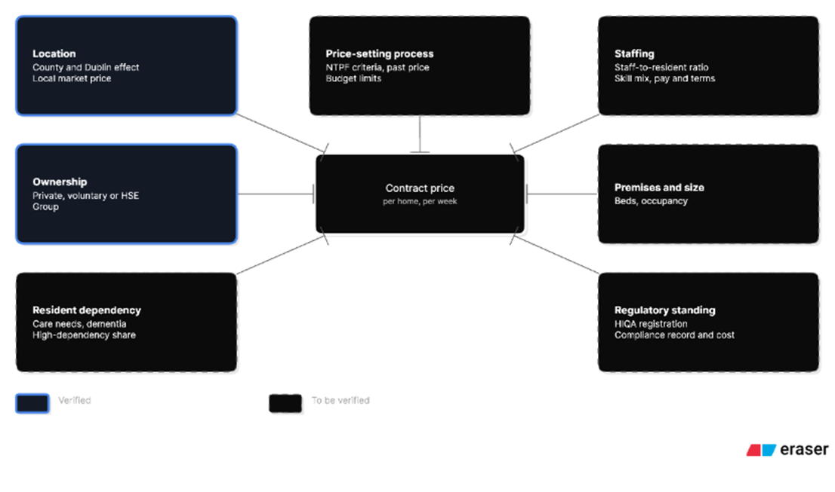
Research Question: Ontology

Slide 11
Predictive Modelling
Can We Predict Regulation Failures?
What we have
  HIQA judgments: Compliant, Substantially Compliant, Not Compliant
  Original wording and page references kept, so every finding traces back to its report
What we could analyse
  Which regulations are most often non-compliant
  Whether an earlier judgment is linked to a later outcome
What’s needed first
  Validate the extracted judgments
  Account for differences in what each inspection covered
  Test against suitable data before estimating any probability

Slide 12
Immediate Next Steps & Project Roadmap
Immediate
  Labelling reports, timed, and run the LLM pilot on them.
  Build the promise trail on the centre page.
  Grid Comparison
  Geocoding
  Alerts
Biggest Challenges
  Knowing whether a promise was kept.
  Gathering end-users for evaluation.

Slide 13
Current Prototype Demo
Search nursing homes by name, address, county or Eircode.
View a nursing home's page and see the home's details.
  Home details and Report Summaries
National Figures
Guides
  How a family chooses a nursing home
  Questions to ask
  How to read an inspection Report
  Fair Deal
  How to navigate ClearCare
Resources
  Contacts for advocacies and dementia report

Slide 14
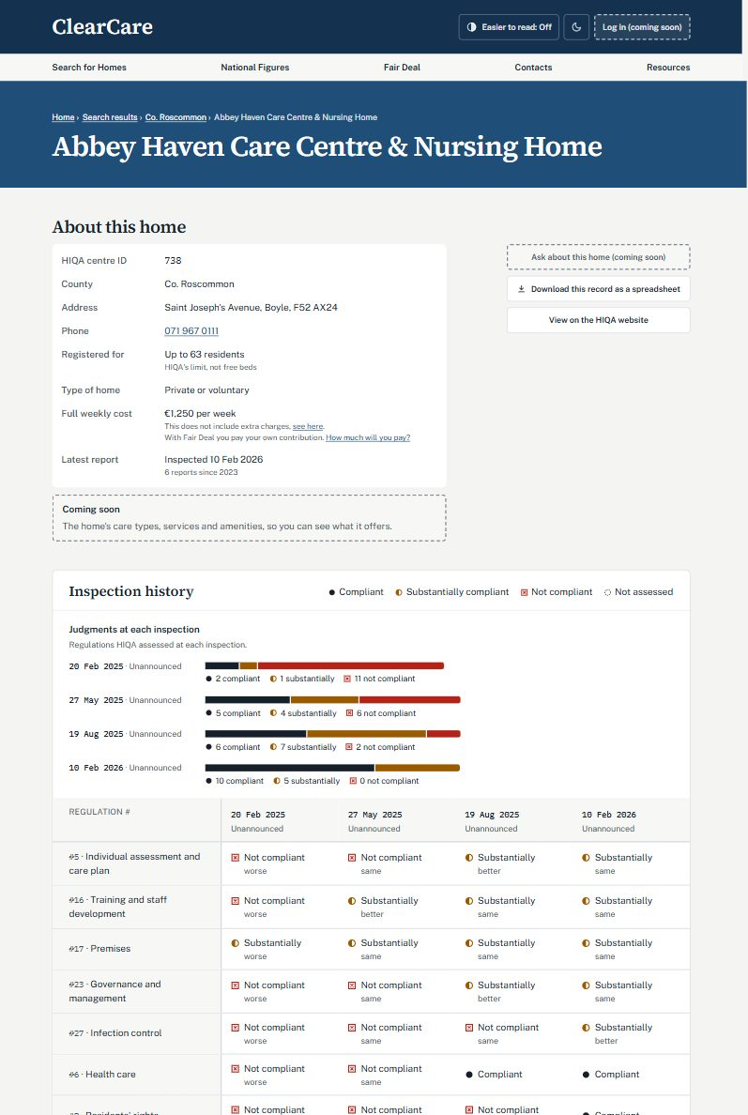
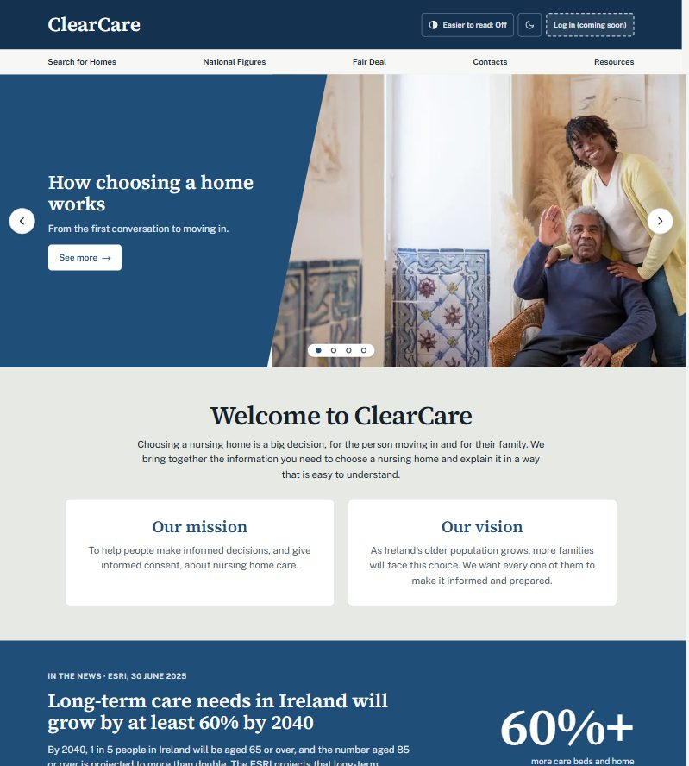

Slide 15
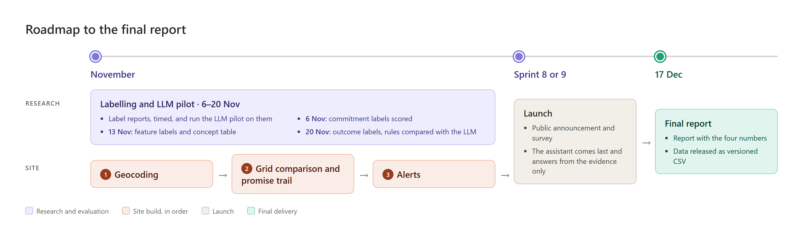
Roadmap

