Slide 1
MSc Group 2 Project
Team
ClearCare
Likun Fang
A00049290
Week 4 update
Twila Habab
C20361521
Aswin Remesh
A record of
A00047249
What inspectors found.
What the provider promised.
Whether the next inspection found it fixed.
Niwash Acharya
A00046271
Waseel Chopra
A00046669

Slide 2
Interview 3 · a family member
First end-user interview
A family member who arranged nursing-home care for a parent, twice.
Both times were stressful situations
They were not well informed of the process,
everything was quick.
In their view, there is less of a culture of looking
after the elderly in Dublin.
Their advice: plan ahead. Legal documents, finances,
power of attorney, and “have those conversations
when they still have the chance”.
ClearCare · Week 4 · 02

Slide 3
Problem and goals
The problem
Time and choice
Families and the elderly are not prepared when faced with the dilemma of
having to choose a nursing home, or they don't get to choose at all.
Everything happens quite quickly, families and elderlies are already
stressed and this is not fair for them, despite the information supposed
to be all available online.
Information
There is no central repository for information.
The information exists but in pieces: Fair Deal, nursing home websites,
inspection reports, all in different places.
What we heard
Families rarely choose because of the circumstances.
ClearCare · Week 4 · 03

Slide 4
Problem and goals
The goals
1
Inform
Where homes are, and the maximum the HSE has agreed they charge.
How to read a HIQA report.
How the process works: Fair Deal, the documents to have ready,
the legal side.
2
Make the elderly care sector be more transparent to families
3
Help families
ClearCare · Week 4 · 04

Slide 5
Who we build for
User Personas – A Family Member (1)
Mary, 54 years old, lives in Dublin with her elderly father.
Mary
Her father has recently been assessed and the family have started thinking
about long-term care options.
54 · Dublin
She has never gone through this process before and doesn't know where to
start especially on the financial side.
She comes across several nursing homes online but has no way of comparing
them meaningfully.
She finds HIQA reports but they are long, technical, and difficult to interpret.
She wants a quick, clear summary of each home so she can build a shortlist
and she wants guidance on the related financial process.
ClearCare · Week 4 · 05

Slide 6
Who we build for
User Personas – A Family Member (2)
Declan, 61 years old, lives in Limerick and is looking after his mother.
Declan
His mother has been assessed and needs to move into a nursing home
within the next few weeks.
61 · Limerick
He knows she needs high dependency care following a stroke and has a
preferred area in mind, but doesn't know which homes meet her needs.
He needs to compare several homes quickly and present a shortlist to his
siblings before a family decision is made.
He finds individual HIQA reports but has no way to filter or compare them
side by side.
He wants to filter homes by care type and compliance record and share his
shortlist with the rest of the family easily.
ClearCare · Week 4 · 06

Slide 7
Who we build for
User Personas – The Elderly
Michael, 68 years old, lives alone in Dublin.
Michael
Has always been independent and managed well at home, but has started to
realise he may eventually need more support with everyday activities.
68 · Dublin
He wants to be involved in the decision making with his family.
He comes across several nursing homes but finds it difficult to work out
how they compare.
He discovers HIQA reports but they're quite lengthy and contain
a lot of information.
He doesn't want to know which is “best”, but wants to see evidence that a
nursing home is capable of providing care.
ClearCare · Week 4 · 07

Slide 8
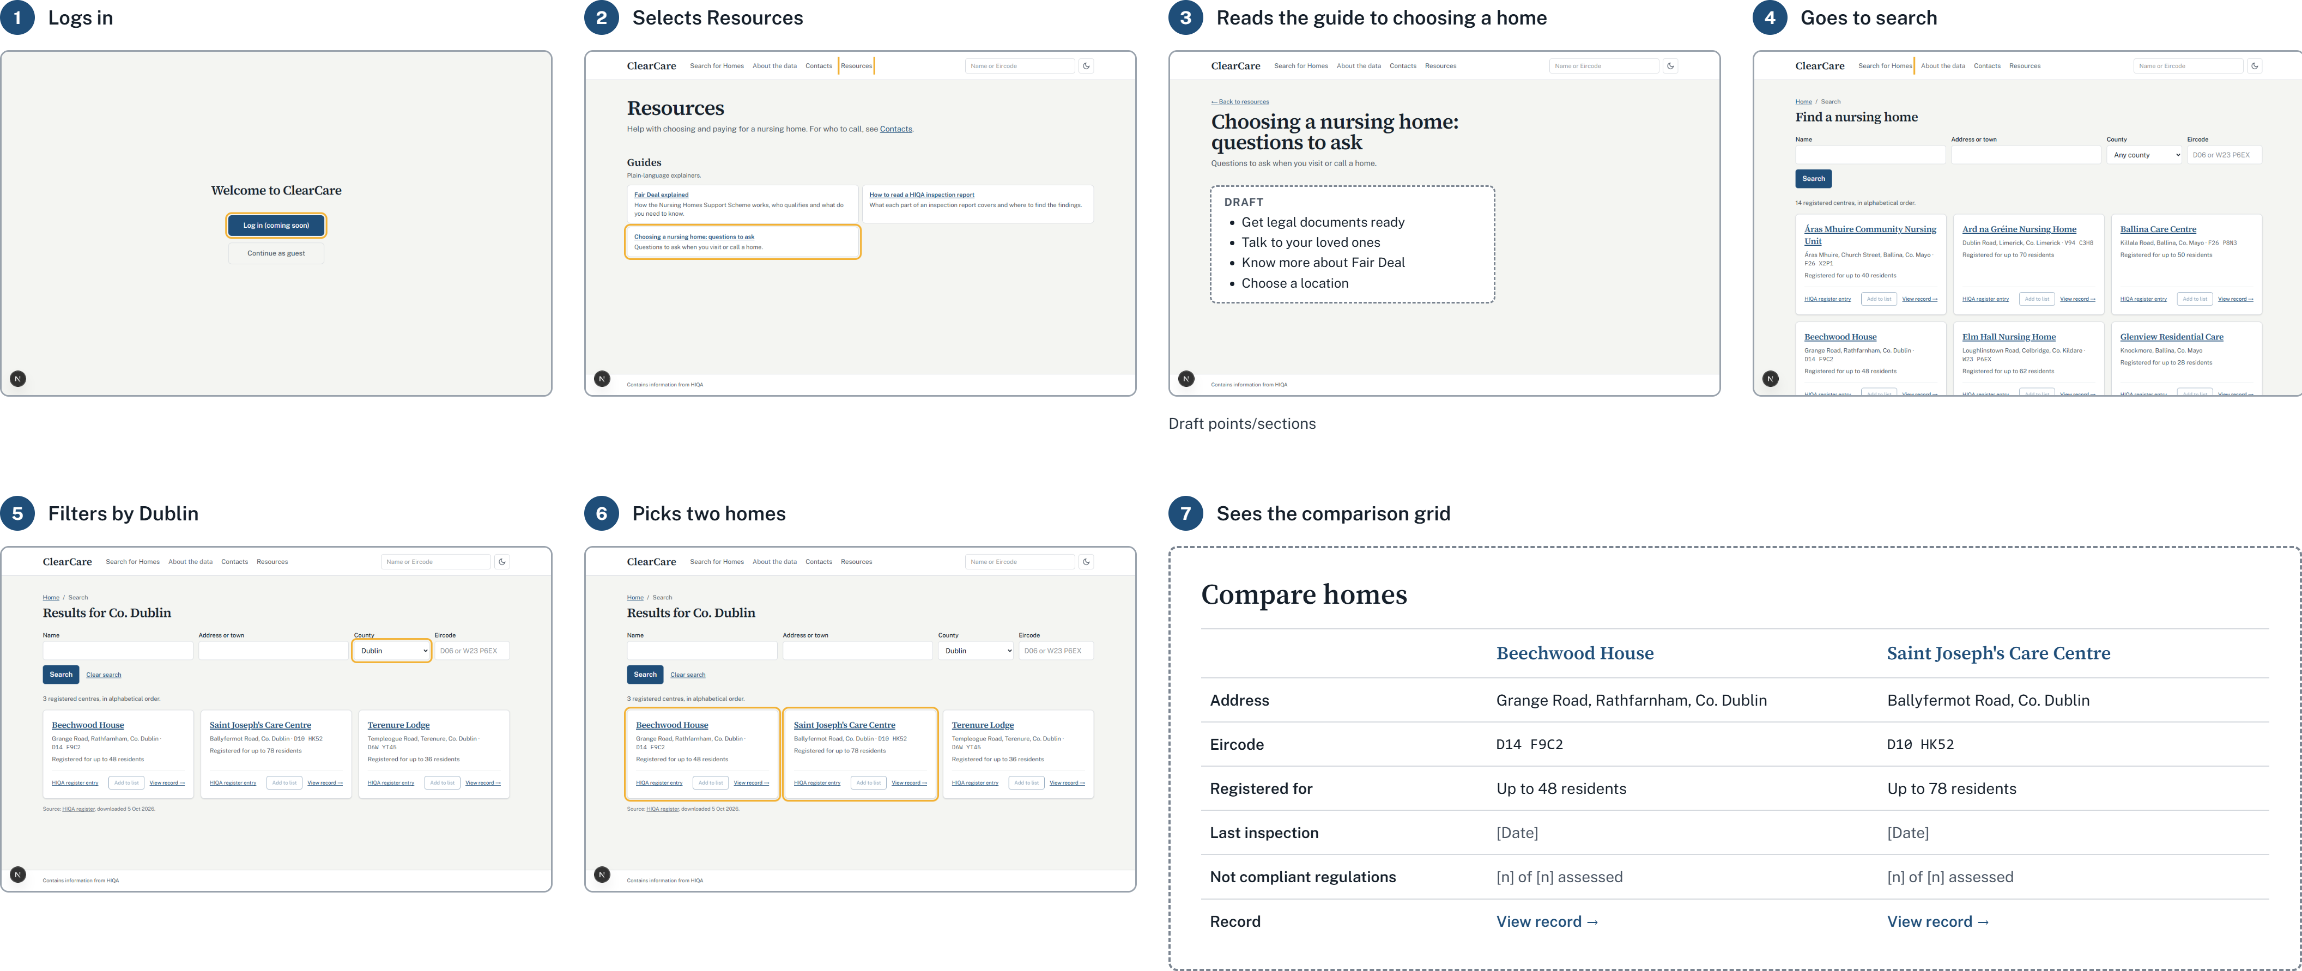
Storyboard – from the dev site
ClearCare · Week 4 · 08

Slide 9
Next week
Goals for next week
1
Reports into the database
Store the parsed hiqa reports into database; then preview these in UI
2
Guides
Fair Deal, documents, the legal side, how to read a report · medical topics such as dementia and Alzheimer's
3
Comparison Grid View
Two homes, the same regulations, “not assessed” visible
4
Data Visualization page
The older population now and projected, from CSO and Department of Health data
ClearCare · Week 4 · 09

Slide 10
System architecture
How ClearCare runs today
Data pipeline (Python)
PostgreSQL
HIQA website
Snapshots
Register loader
register tables
SQL migrations, insert-only
registers (CSV),
centre pages,
inspection reports
(PDF)
daily register download
Report downloader
Report parser
API
per county
written, not wired in yet
Spring Boot, read only:
search centres, one centre
HTTPS
Site
Object storage
Raw store
Next.js on Vercel
search, centre page
write-once copy
every download,
content-addressed
Families, advocates,
journalists, regulator
ClearCare · Week 4 · 10

