Slide 1
MSc Group 2 Project
Team
ClearCare
Likun Fang
A00049290
Week 5 update
Twila Habab
C20361521
Aswin Remesh
A record of
A00047249
What inspectors found.
What the provider promised.
Whether the next inspection found it fixed.
Niwash Acharya
A00046271
Waseel Chopra
A00046669
Notes:
We are ClearCare, MSc Group 2. ClearCare is a record of what inspectors found, what the provider promised, and whether the next inspection found it fixed. It does not rank, score or recommend. This is our week 5 update, and this week it goes person by person: each of us says what we did between 8 and 15 October, and we finish with next week.

Slide 2
8–15 Oct
This week in one line
Every HIQA nursing-home inspection report in the country is
downloaded, parsed and in the database.
545
centres
The site shows them: each home’s page has its inspection
history, one row per regulation, one column per inspection.
2,204
PDFs
The pipeline runs by itself on the server:
register daily, reports weekly.
1,969
The contacts & resources page are live, with draft guides and
a flowchart of how a family chooses a home.
reports loaded
ClearCare · Week 5 · 02
Notes:
The week in one line: every HIQA nursing-home inspection report in the country is now downloaded, parsed and in our database. That is 545 centres and 2,204 PDFs, and 1,969 reports are loaded. The site shows them: each home's page has its inspection history, one row per regulation and one column per inspection. The pipeline runs by itself on the server, taking the register daily and looking for new reports weekly. The contacts page is live, the guides are in draft, and there is a flowchart of how a family chooses a home.

Slide 3
Twila · frontend
Twila: the prod site
Centre page
Shows real inspection reports from the API: judgment per regulation
across inspections, newest inspection first, “not assessed” visible.
CCARE-89
New pages
Contacts (advocacies, Dementia Ireland, Fair Deal, HIQA, etc) and draft guides on
choosing a home and reading an inspection report.
The Fair Deal guide is not live yet.
CCARE-53, 54, 60, 61
Fixes
Double search bar, incomplete grid results when searching for a home.
CCARE-78, 79, 80
Adult-centred
user design
Currently reading WCAG 2.2, WAI and other public guides.
ClearCare · Week 5 · 03
Notes:
I worked on the site. The centre page now shows real inspection reports from the API: the judgment for each regulation across inspections, newest inspection first, with "not assessed" kept visible. I added new pages: Contacts, with the regulator, Fair Deal, dementia support and advocacy; Resources; and draft guides on choosing a home and reading an inspection report. The Fair Deal guide is not live yet. I also fixed the double search bar, made the search grid show 24 results so it has no gaps, and fixed some visual bugs. Alongside that I am researching adult-centred user design, and I am currently reading WCAG 2.2, WAI and other public guides.

Slide 4
Likun · data pipeline and deployment
Likun: the pipeline runs itself
Deploys
Every merge to main deploys to the server from CI.
CCARE-19
Download
Downloaded every inspection report in the country: 545 centres, 2,204 PDFs.
13 Oct
Docker Compose
One project with the database and the API: loads the register daily, looks
for new reports weekly, uploads every file to object storage and loads the
parsed reports into the database. The old systemd timers are gone.
CCARE-87, 88
Cut-over
The server ingested all 1,969 standard reports in 1 h 43 min:
26,876 regulation judgments, 15,049 compliance-plan items.
15 Oct
Reviews
Six pull requests merged; reviewed the parser with a national run
before it merged.
CCARE-34
ClearCare · Week 5 · 04
Notes:
My part was the data pipeline and deployment. Every merge to main now deploys to the server from CI. On 13 October I downloaded every inspection report in the country: 545 centres, 2,204 PDFs. The pipeline now runs as one Docker Compose project with the database and the API. It loads the register daily, looks for new reports weekly, uploads every file to object storage and loads the parsed reports into the database, so the old systemd timers are gone. We cut over today, 15 October: the server ingested all 1,969 standard reports in an hour and 43 minutes, which is 26,876 regulation judgments and 15,049 compliance-plan items. I merged six pull requests, and I reviewed the parser with a national run before it merged.

Slide 5
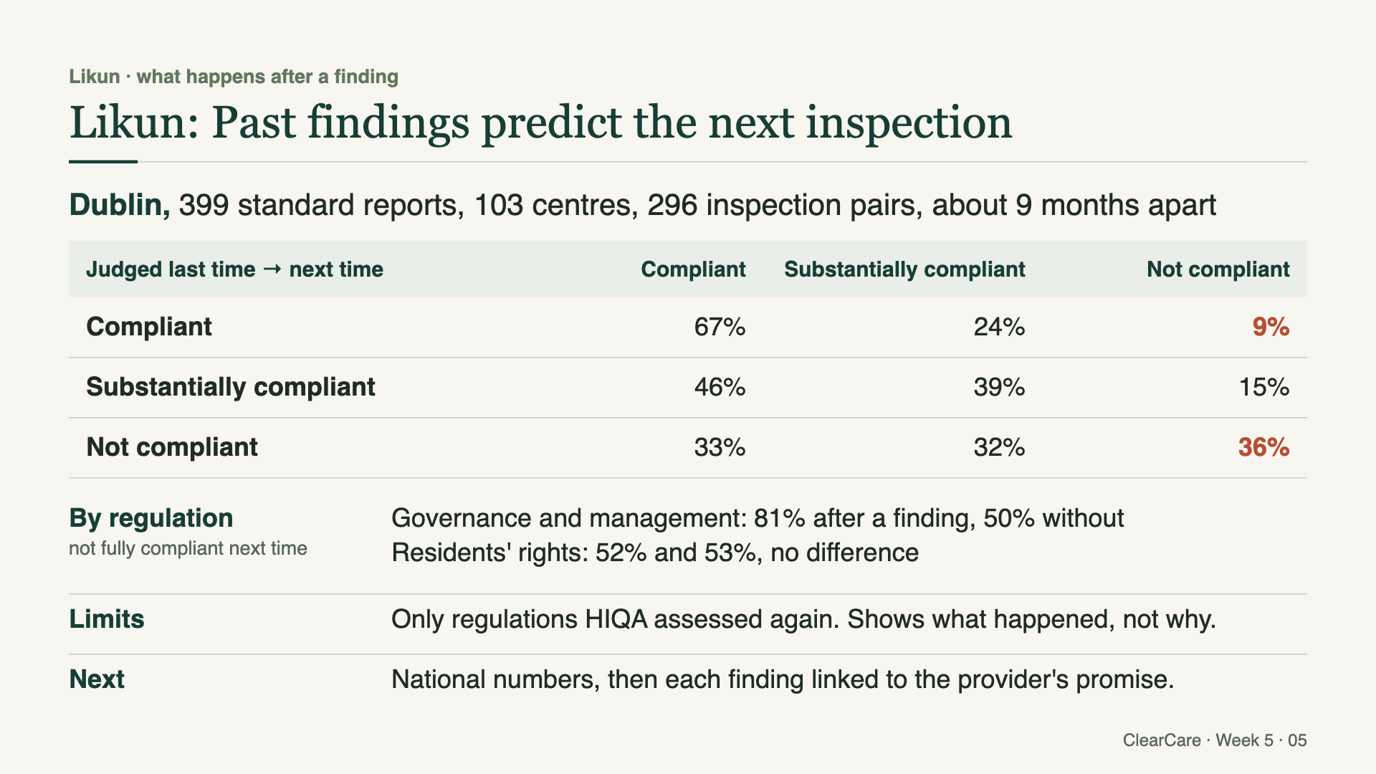
Likun · what happens after a finding
Likun: first numbers for the research question
Dublin, 399 standard reports, 103 centres, 296 consecutive inspection pairs
At the next inspection, a regulation judged…
Compliant
Same
Worse / better
Substantially compliant
46%
39%
15% worse
Not compliant
33%
36%
32% better
Highest repeat rates
Regulation 17 Premises 84%
Regulation 23 Governance and management 81%
Regulation 28 Fire precautions 77%
Median gap
268 days between inspections.
Next
National numbers, now that everything is in the database.
ClearCare · Week 5 · 05
Notes:
With the data in, we can start on the research question: what happens after a finding. These first numbers are Dublin only: 399 standard reports from 103 centres, which gives 296 pairs of consecutive inspections. A regulation judged substantially compliant is compliant at the next inspection 46% of the time, the same 39% of the time, and worse 15%. A regulation judged not compliant is compliant next time in 33% of cases, not compliant again in 36%, and better, meaning substantially compliant, in 32%. The highest repeat rates are Regulation 17, Premises, at 84%, Regulation 23, Governance and management, at 81%, and Regulation 28, Fire precautions, at 77%. The median gap between inspections is 268 days. Now that everything is in the database, the national numbers are next.

Slide 6
Niwash · parser, database, API
Niwash: Parsing the reports end to end
Parser
Section-aware: cover fields, inspectors, each regulation with its judgment
(Appendix 1), the compliance plan (Section 2). Handles page breaks and
tables that run over pages.
Batch ingestion
Parsed reports transformed and loaded into PostgreSQL.
Migrations
The report tables and the views the API reads.
Endpoints
A centre’s reports, and one report in full with inspectors, regulations
and compliance items.
Coverage
Reads 1,969 of 2,204 reports. The 235 it does not read are thematic
and National Standards reports, which have a different layout.
ClearCare · Week 5 · 06
Notes:
I built the parser, the database side and the API. The parser is section-aware: it reads the cover fields, the inspectors, each regulation with its judgment from Appendix 1, and the compliance plan from Section 2, and it handles page breaks and tables that run over pages. Batch ingestion transforms the parsed reports and loads them into PostgreSQL, and the migrations create the report tables and the views the API reads. There are two endpoints: a centre's reports, and one report in full with its inspectors, regulations and compliance items; that merged on 14 October. It reads 1,969 of the 2,204 reports. The 235 it does not read are thematic and National Standards reports, which have a different layout.

Slide 7
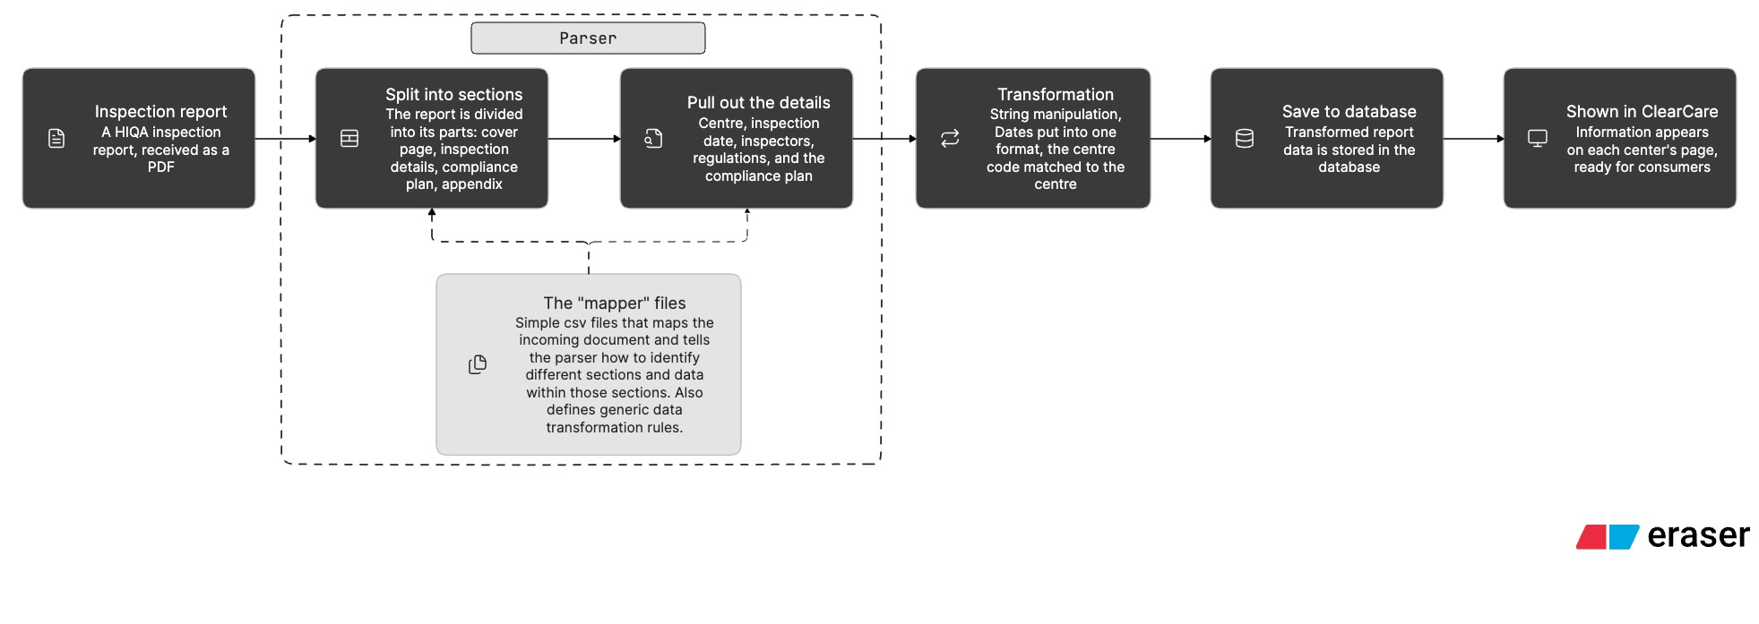
Niwash · parser, database, API
Niwash: Process flow diagram for parsing
ClearCare · Week 5 · 07

Slide 8
Waseel · research
Waseel: how to read a HIQA report
Reading guide
A guide on how to read a HIQA inspection report, from 16 hand-read reports.
Merged 15 Oct, now the text of the site’s guide.
CCARE-56
1
2
3
4
Start with the basics
Read the evidence
behind each judgment
Look for repeat
findings
Keep the provider’s plan
separate from the
inspector’s findings
Personas and retros
Second set of user personas; week 3 and week 4 retrospectives.
CCARE-52, 41, 42
Audit
Audit of the hand-read reports, in review.
CCARE-48
ClearCare · Week 5 · 08
Notes:
I wrote a guide on how to read a HIQA inspection report, from 16 reports we read by hand. It comes down to four steps: start with the basics, read the evidence behind each judgment, look for repeat findings, and keep the provider's plan separate from the inspector's findings. It was merged on 15 October and is now the text of the site's guide. I also did the second set of user personas and the week 3 and week 4 retrospectives, and the audit of the hand-read reports is in review.

Slide 9
Aswin · research and data
Aswin: amenities from the reports
User checklist
User “questions to ask yourself” checklist that became the choosing-a-home guide.
CCARE-55
Fair Deal guide
In review.
CCARE-86
Amenities extraction
Download
Extract
Load
A three-stage Python pipeline. Each report’s text goes once to GPT-4o-mini
with a fixed schema, so every home gets the same fields:
care types · room types · outdoor space · activities
Dublin first; a full run costs under €1; re-runnable and extendable
to other counties.
Validation
Spot-check extracted fields against the PDF.
ClearCare · Week 5 · 09
Notes:
I worked on the user personas and the "questions to ask yourself" checklist, which became the choosing-a-home guide, and the Fair Deal guide is in review. The main piece is amenities extraction: a three-stage Python pipeline that downloads, extracts and loads. Each report's text goes once to GPT-4o-mini with a fixed schema, so every home gets the same fields: care types, room types, outdoor space and activities. We started with Dublin; a full run costs under one euro, and it can be re-run and extended to other counties. To validate it, I spot-check the extracted fields against the PDF.

Slide 10
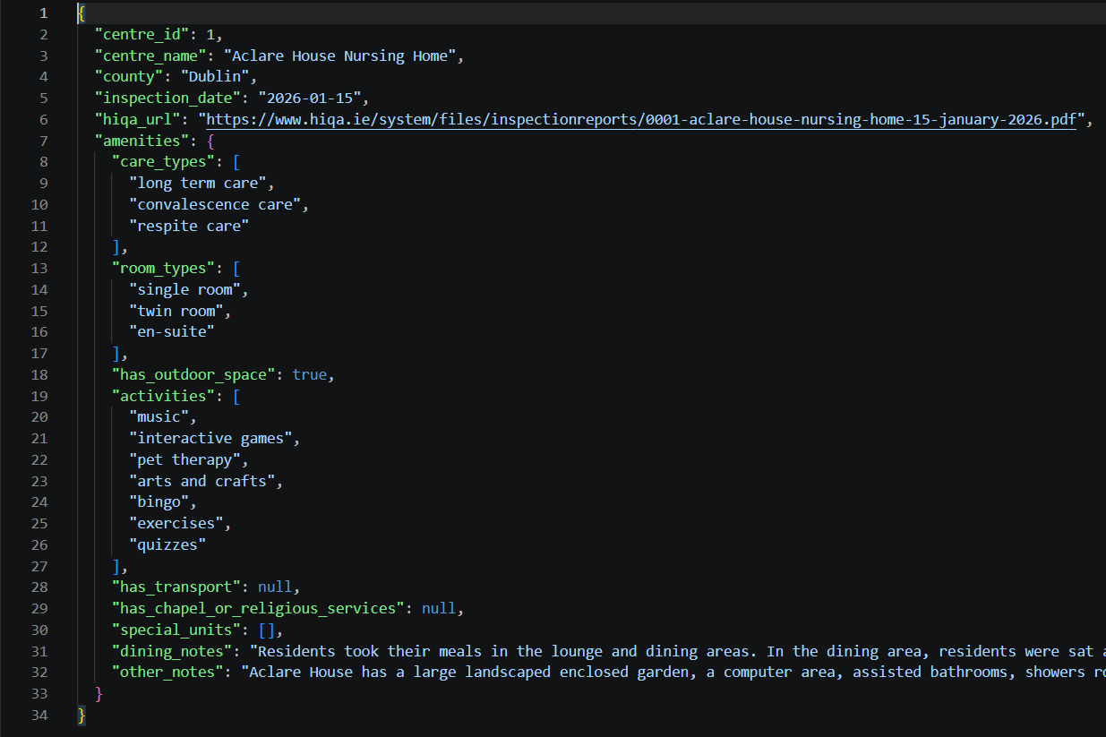
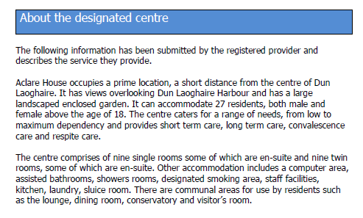
ClearCare · Week 5 · 10

Slide 11
Next week
Twila
Continued research on Adult-centred User Design · initial user evaluation ·
continuous front-end development
Likun
National numbers for the research question ·
store the “About the designated centre” paragraph the parser already finds,
as the source for amenities
Niwash
Parser hardening · thematic inspection reports ·
maximum contract prices per home
Waseel
Fixes to the audit report · a gold set to measure how accurately ClearCare
extracts information from reports
Aswin
Validate the amenities extraction against the source PDFs ·
connect the results to the site
ClearCare · Week 5 · 11
Notes:
Next week. Twila continues her research on adult-centred user design, starts an initial user evaluation, and keeps developing the front end. Likun computes the national numbers for the research question and stores the "About the designated centre" paragraph the parser already finds, as the source for amenities. Niwash hardens the parser, takes on the thematic inspection reports, and adds the maximum contract prices per home. Waseel fixes the audit report and builds a gold set to measure how accurately ClearCare extracts information from reports. Aswin validates the amenities extraction against the source PDFs and connects the results to the site.

