Slide 1



Development Guide
PyCharm

Slide 2
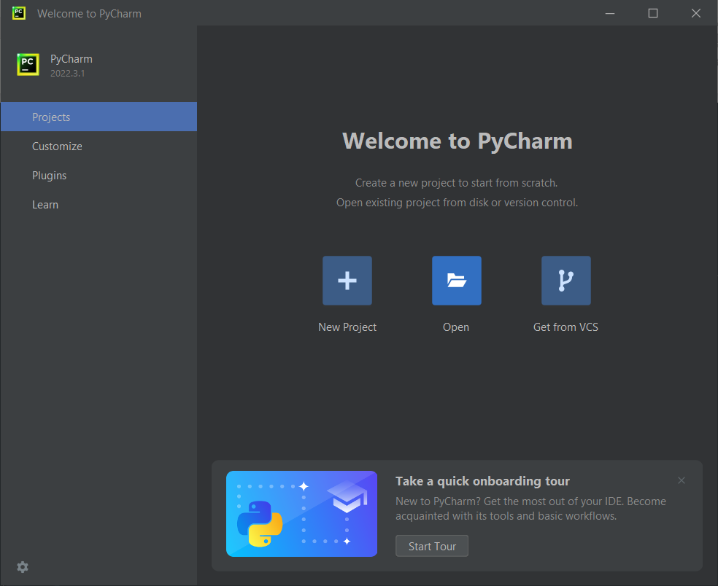
Prepare PyCharm project

Slide 3
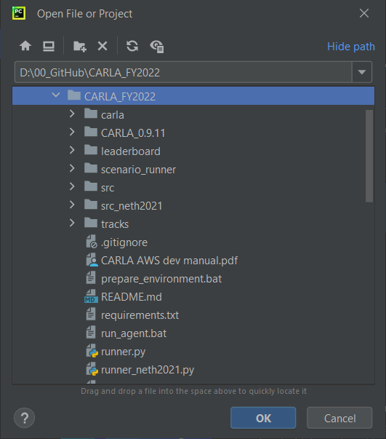
Prepare PyCharm project

Slide 4
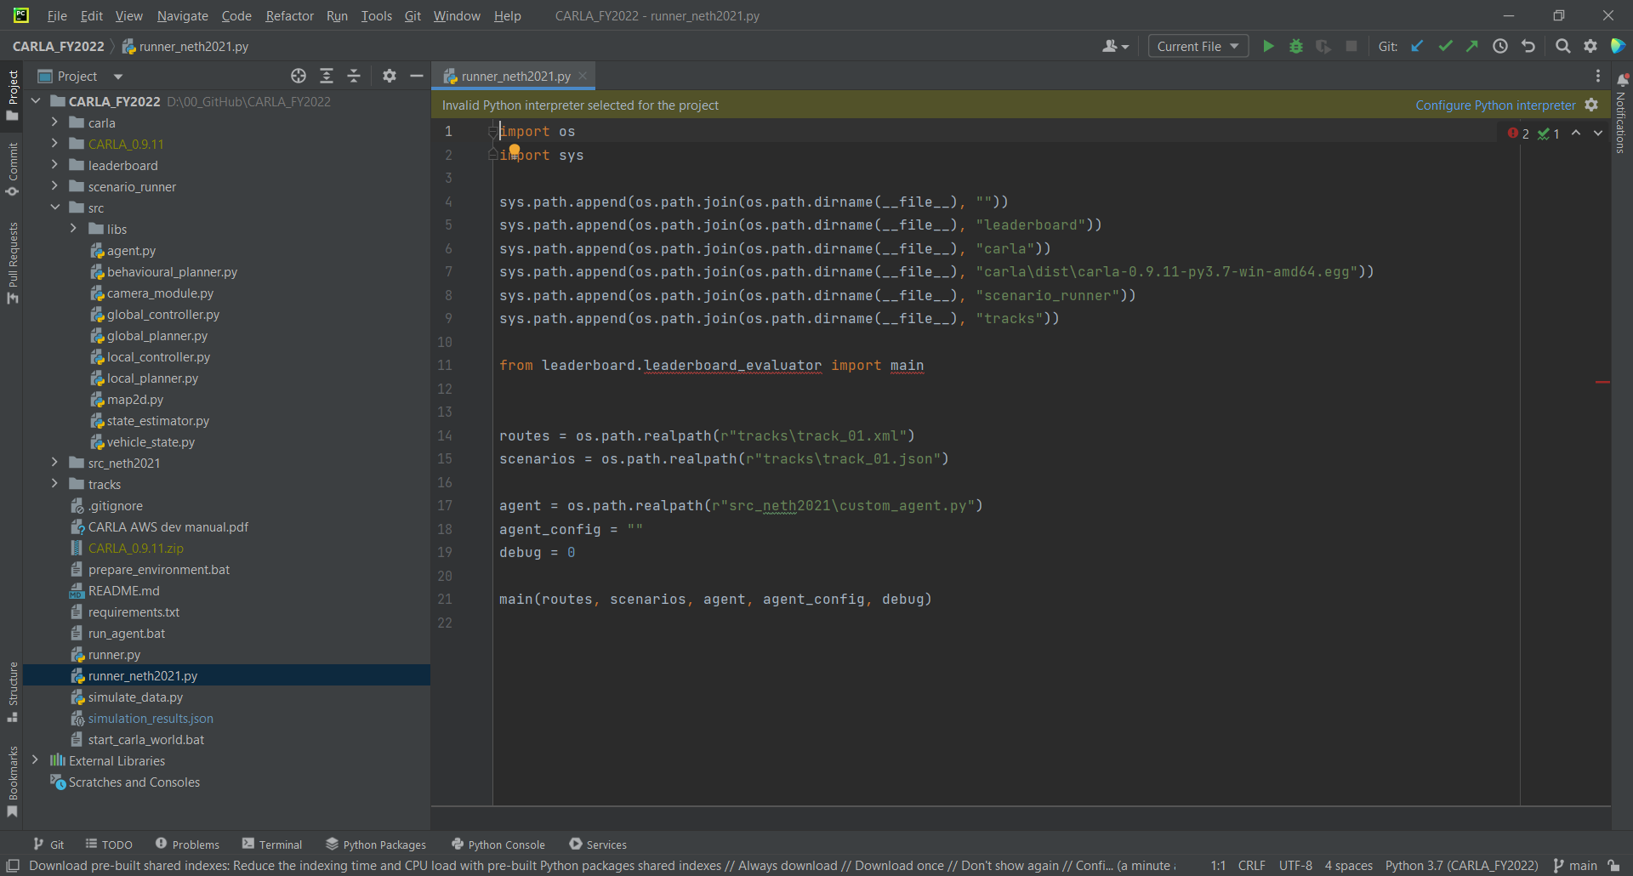
Prepare PyCharm project

Slide 5
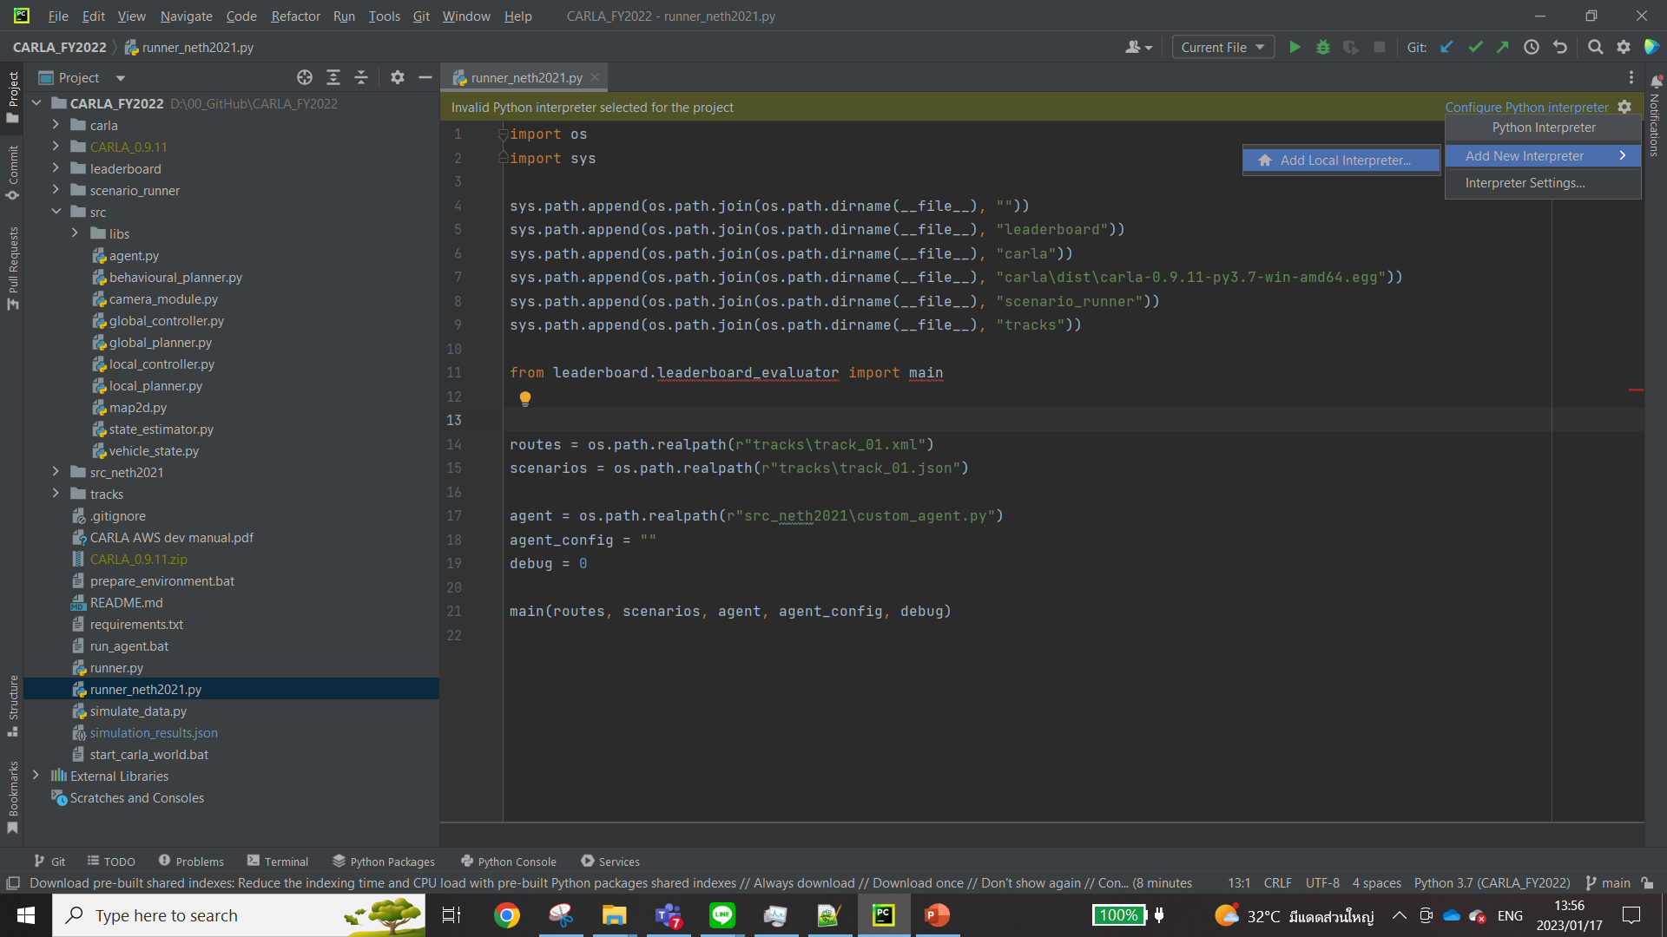
Prepare PyCharm project

Slide 6
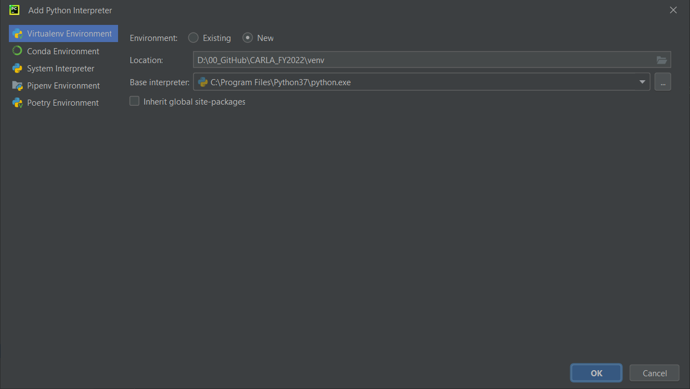
Prepare PyCharm project

Slide 7
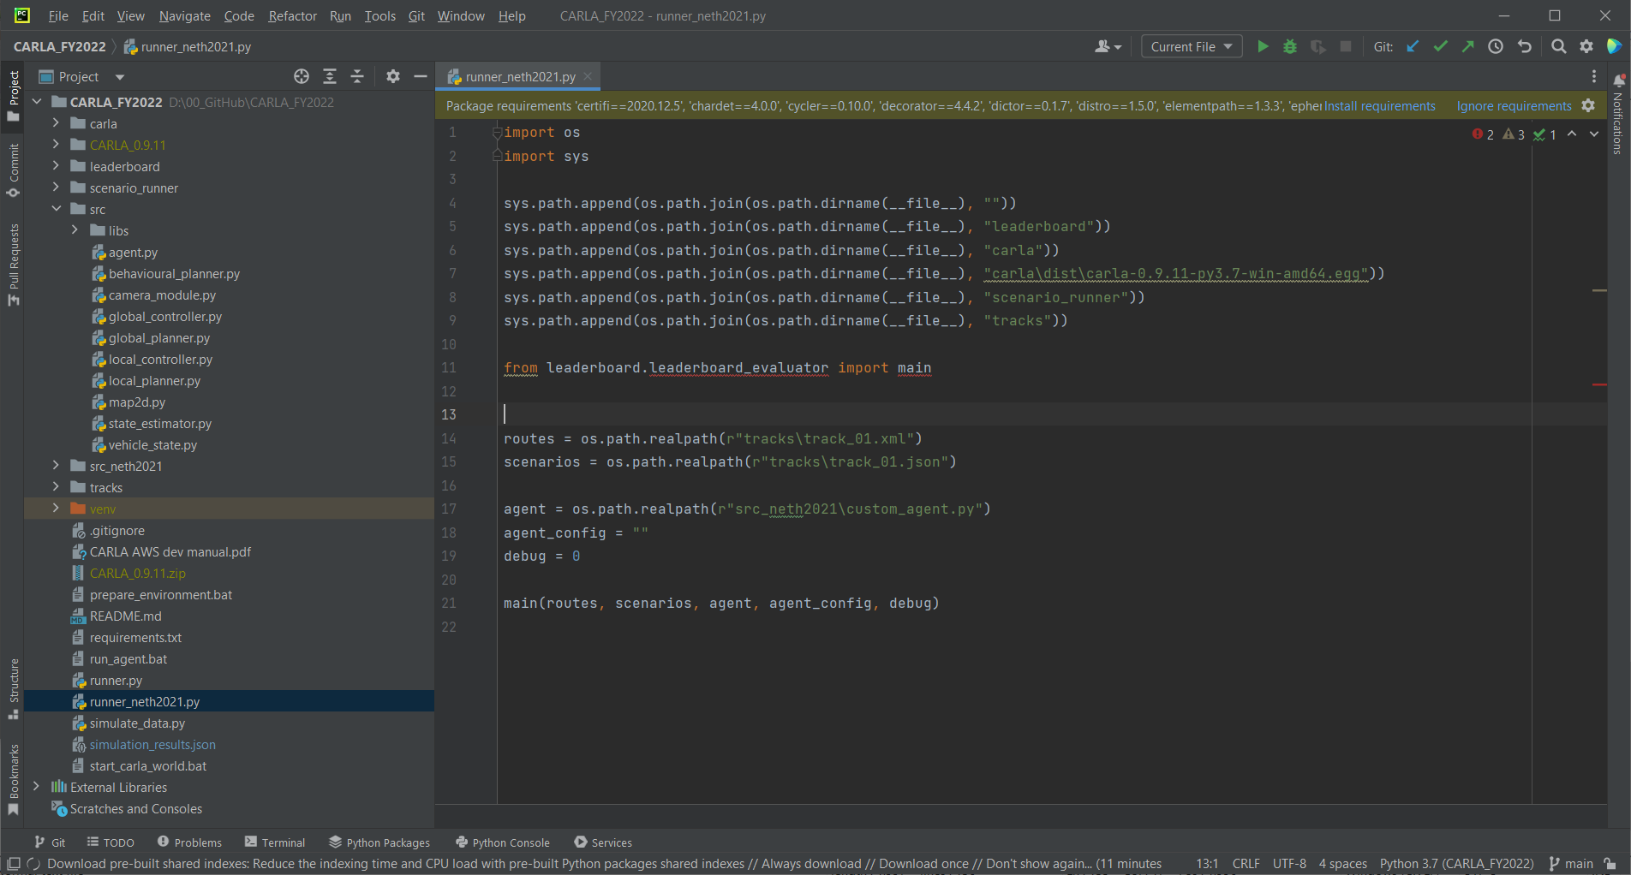
Prepare PyCharm project

Slide 8
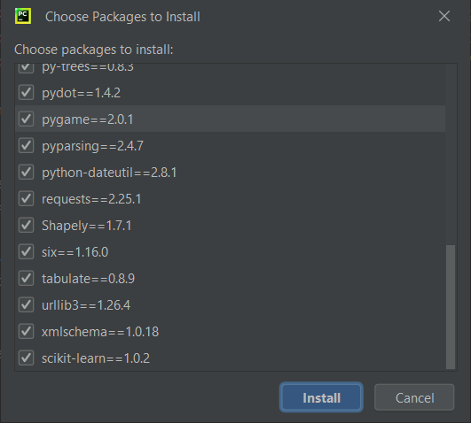
Prepare PyCharm project

Slide 9
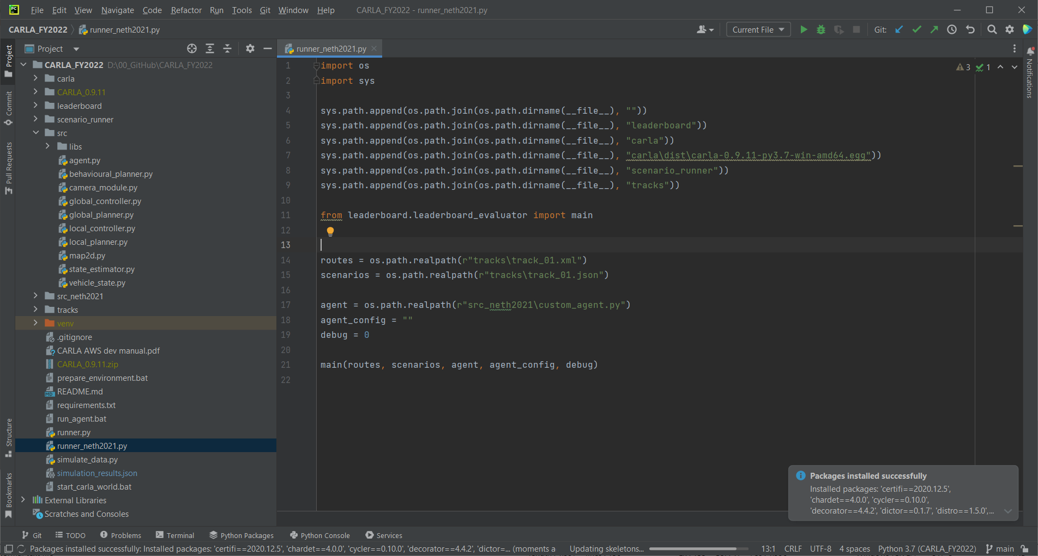
Prepare PyCharm project

Slide 10
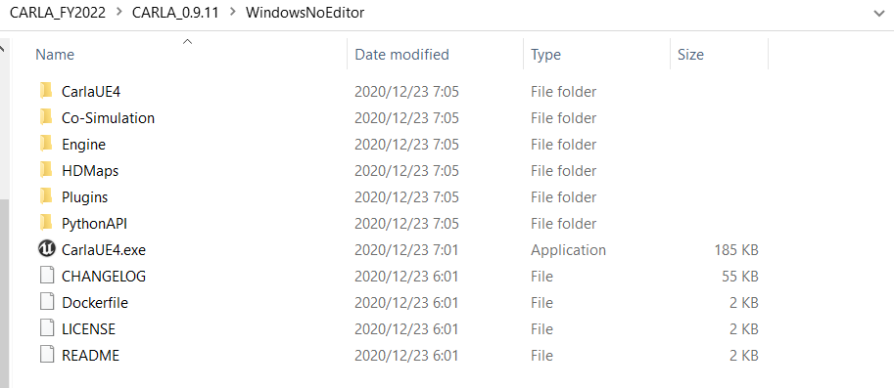
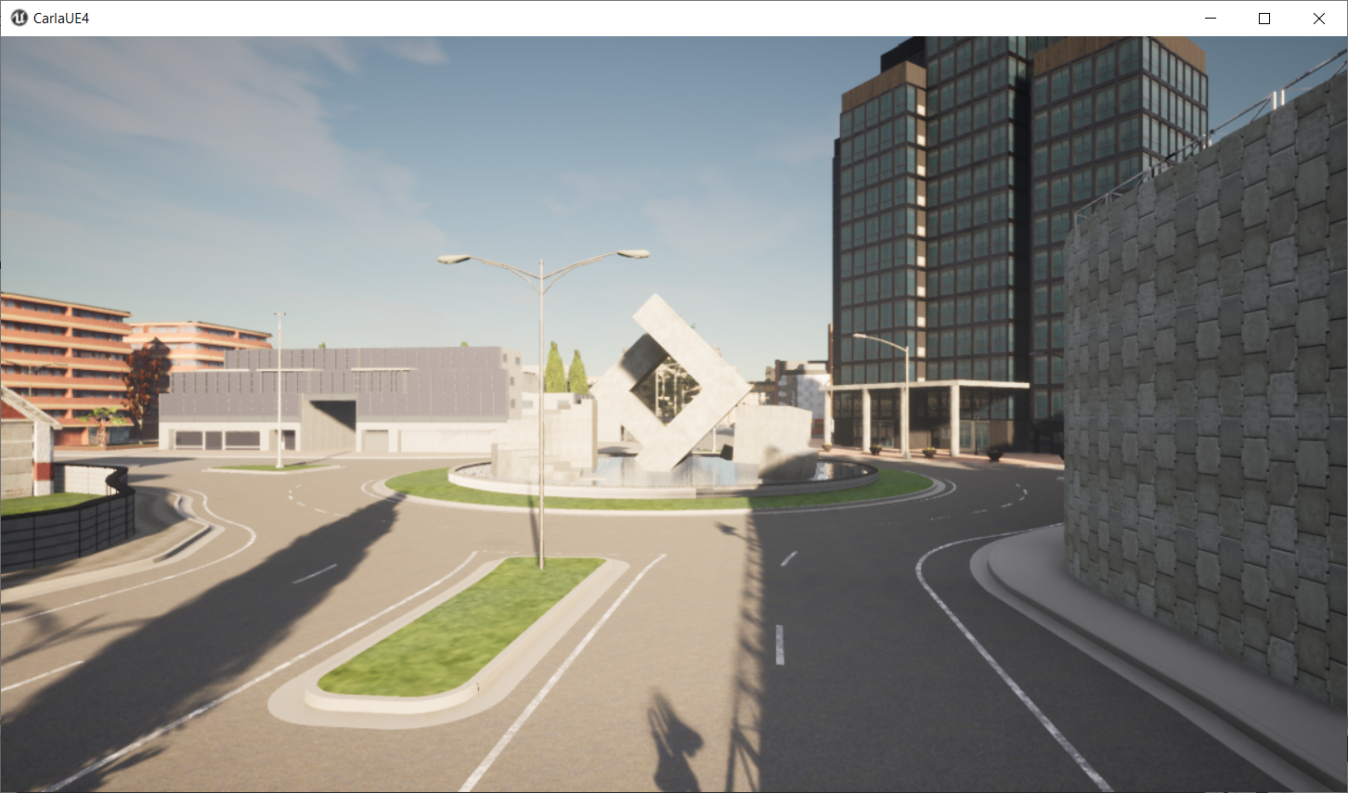
Execution
Start Carla simulator

Slide 11
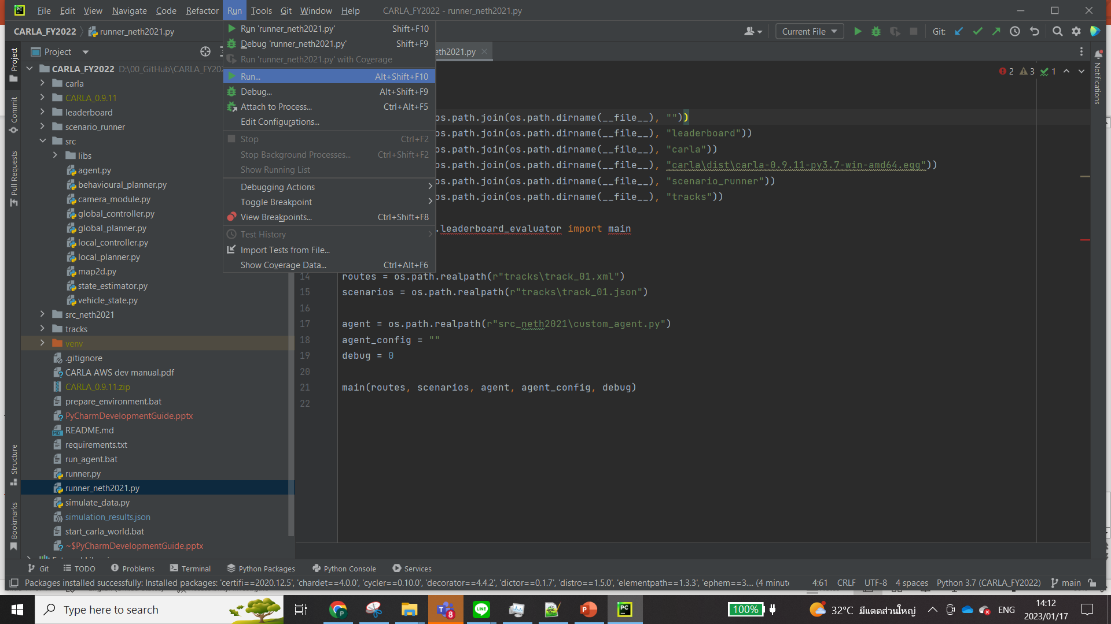
Execution
Run python runner on PyCharm

