Slide 1
A Real Time communication Project

Slide 2
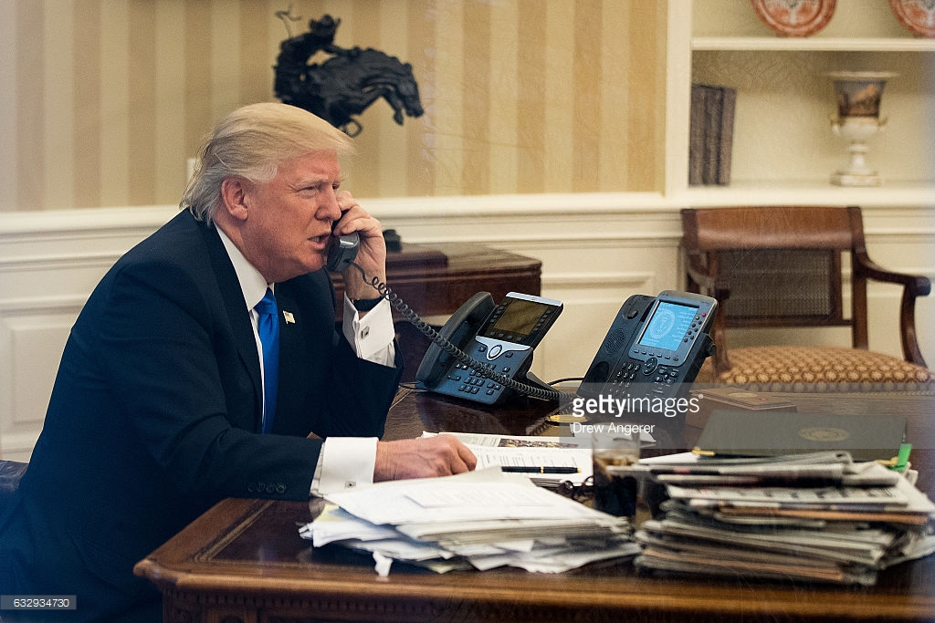

Slide 3
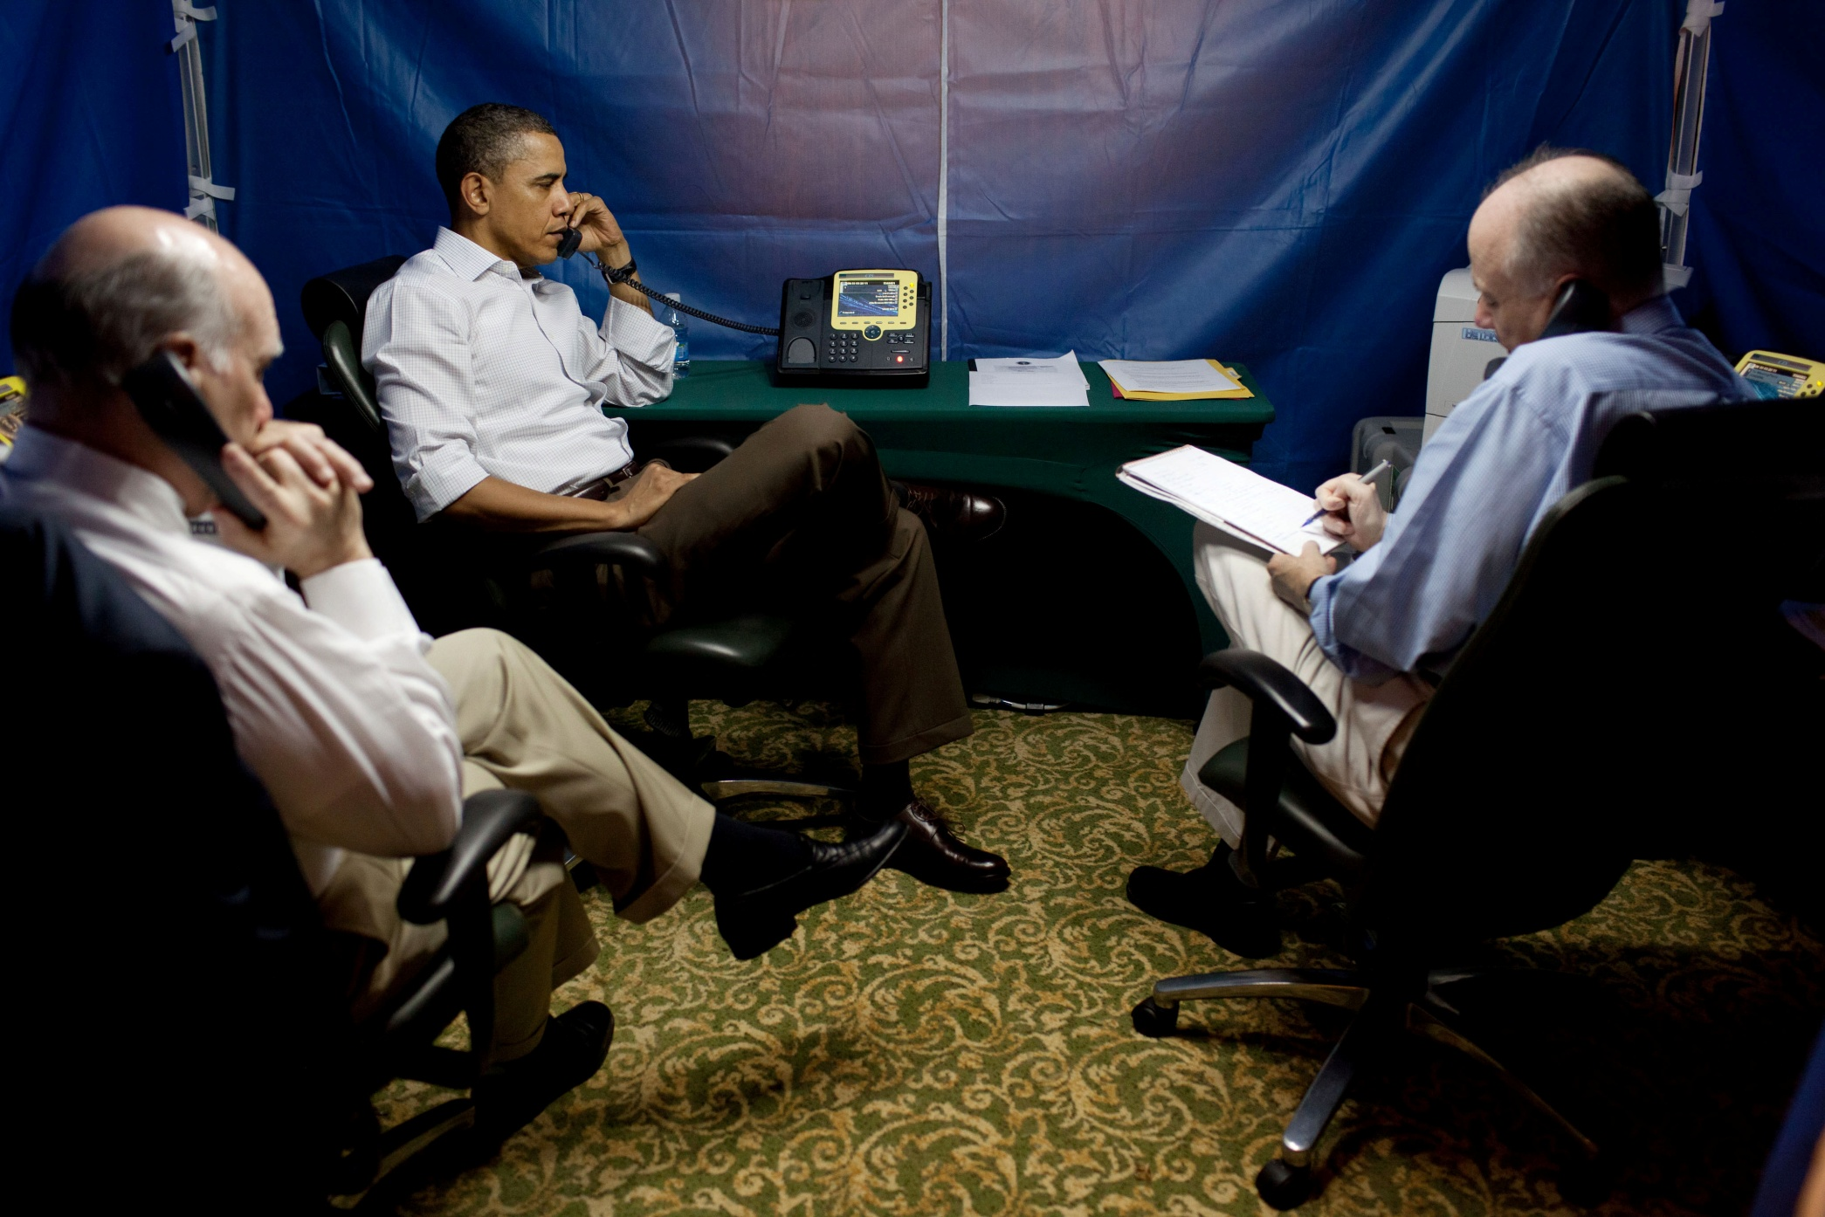

Slide 4
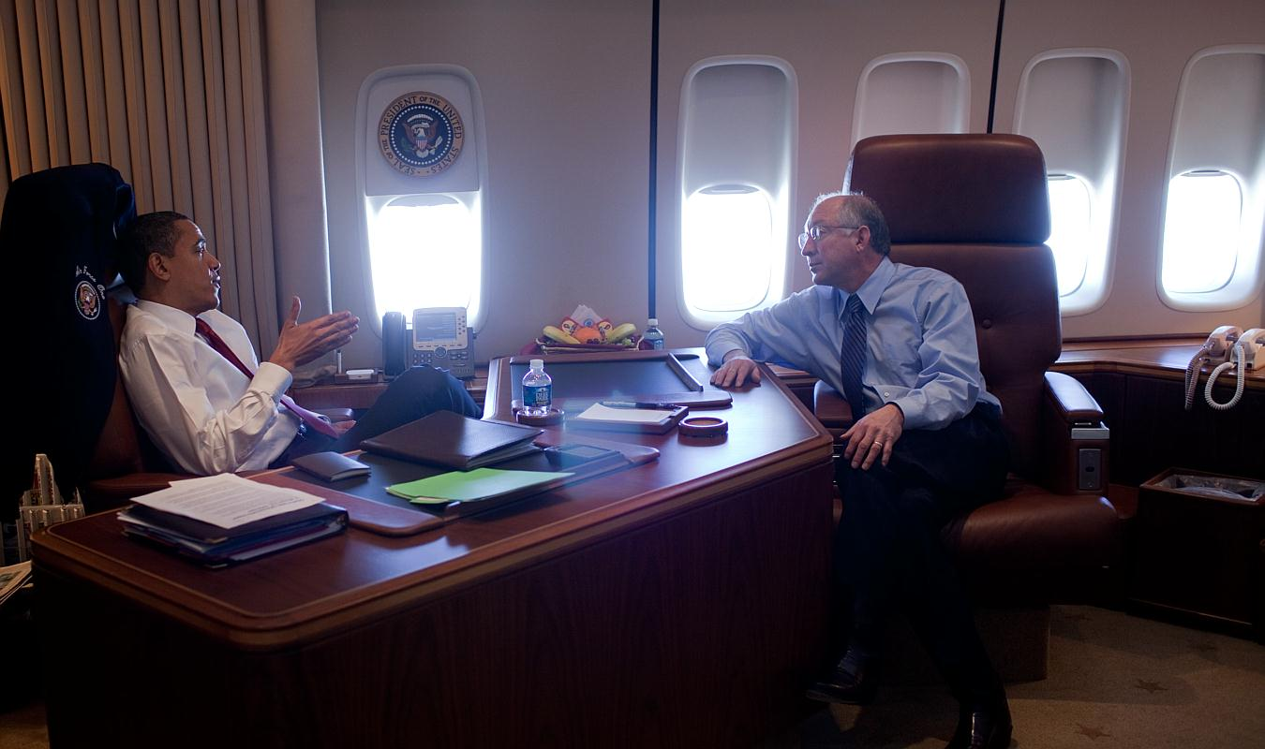

Slide 5
Implementation of a Internet phone which can do Real Time communication from any where

Slide 6
What you are expected to do
In the last assignment you learned how to exchange text message between two users using a TCP/IP socket
In this project instead of sending text messages you are going to exchange digitized audio data (un compressed) between two computers using TCP/IP Sockets
The Microphone and Speakers are hardware devices (they can be called as sensors and actuators), these are analog devices. However the audio card on your computer do have Analog to Digital and Digital to analog converter attached to these devices. Since the audio card is an hardware device we need device drivers to interact with it Since the device drivers are very much hardware dependent, all implementation of Linux has come out with various sets of Audio API which interact with device drivers. These API hides the microscopic low level and hard to learn details from a programmer and exposes a simple set of API to the programmer. This makes your learning and implementation much faster.
Audio Application, Player, recorder, Mixer, IP phone etc
Linux Audio API
HAL and device drivers
Hardware

Slide 7
PulseAudio is an audio library which exposes a set of high level API to interact with the sound card .
You can find the documentation about this at http://0pointer.de/lennart/projects/pulseaudio/doxygen/
You are expected to read and understand this Audio Library. As a learning exercise you can write a simple program (implement) a which will record audio into a file and another program which will play back the audio file.
From this web page you need to understand what are the API that need to used and how they need to used and use.
Linux comes with different types of Audio Libraries to meet the requirement of different application. So you can explore various other Audio Libraries in Linux.
Once you had understood the Audio APIs, you need to integrate this with socket APIs and implement a client and server. Then you can speak one side the other side should be able to hear clearly.

Slide 8
Deliverables for Phase-1
Implementation of IP Phone where you can hear both sides clearly along with code
A write up on your experiences about this implementation ( describe your struggle to get it working, )
The problems you found
Your approach to debug it
How you had solved it
What are problems which are still not solved
What are the improvement you can suggest to make this a better appliance
Your code and write up has to made available through github only
In LMS you just mention the path name to your github repository
A version control process, should be seen in github, through which I can see how you had evolved the code. You have to write short comments against each version describing what this version did, what are the issues etc.
Research very well on the API so that you really understand the concept of the terms “Release time” and “dead lines” w.r.t to audio - though you will not find these terms any where in the PulseAudio documentation ☺
Once you had found the code working, compile it on Raspberry Pi, attach a USB audio headset (with mic and headset) and see how it works, (Two Raspberry Pi with Internet connections are available in the Lab)

Slide 9
Pulse Audio down load and install
How to install Pulse audio
sudo apt-get install pulseaudio
sudo apt-get install libpulse-dev
sudo apt-get install libao-dev
sudo reboot
Note: Depending up on your machine, you may have to do an update before installing pulseaudio.
How to compile your source files with PulseAudio Library
cc -lpulse -lpulse-simple server.c -o server
cc -lpulse -lpulse-simple client.c -o client
While testing client and server in loop back more just give a bit delay in playing the sound at server side, this will help you to check hear the sound clearly.
Comment out using this delay #if 0 when testing over network.

