Slide 1
Can a Computer Read the Fed?
NLP, Prediction Markets, and FOMC Informational Efficiency
Three phases. Four experiments.
Kalshi FOMC markets: efficient against text,
transformers, and their own surprise residual.
Nic Saliou · FT370 · Bentley University · May 2026
Prof. Zhang + Prof. Babaian
Notes:
OPENER: State the thesis up front. This is NOT a 'we tried to predict the Fed' talk. It's an efficiency finding. Each phase asked a harder question and got the same answer with more force. Don't apologize for null results. They ARE the finding.

Slide 2
CONTEXT & MOTIVATION
The Assignment: LM Sentiment Strategy. Our Extension: Is Kalshi Already There?
What the assignment asked
Why FOMC text?
→ Build LM sentiment signal from 10-K/Q filings
→ Quintile long-short portfolio
→ Report IC, IR, hit rate, fractile returns
→ Discuss: does it work? why?
Eight times a year the Fed releases a statement. Every basis point of rate change moves bonds, banks, real estate, and equity simultaneously. The stakes for getting the signal right are enormous.
Why Kalshi?
What we did instead
Kalshi FED DECISION markets aggregate thousands of informed traders into a continuous probability distribution over possible rate outcomes. Diercks, Katz & Wright (2026) — a Federal Reserve FEDS paper — established Kalshi alongside Bloomberg consensus and FRBNY surveys as a legitimate forecasting instrument.
→ Applied LM to 254 Federal Reserve documents
→ Validated against prediction market prices
→ Extended to transformer models + surprise signal
→ Same metrics, richer domain, stronger null
Notes:
CONTEXT: Give the class the framing. We followed the spirit of the assignment — LM sentiment, quintile portfolio, IC/IR/hit rate — but applied it to a richer domain where we can also benchmark against a prediction market.

Slide 3
RESEARCH ARC
Four Experiments. Progressively Stronger Efficiency Finding.
1
2
3
4
LM Dictionary
Transformers
Kalshi Portfolio
Surprise Signal
Can word counts
read Powell?
Can BERT beat
the dictionary?
Can we trade
Kalshi's signal?
Bernanke-Kuttner:
use the surprise
→
→
→
α* = 0.00
r = 0.866
IR = 0.57
near-degenerate
surprise variance
Kalshi wins
Task solvable.
Kalshi still wins.
Anticipated
in prices
Kalshi efficient
against itself
Each phase raises the bar. Each phase gets the same answer: Kalshi prices already contain the information.
Notes:
MAP: Walk through quickly — 60-90 seconds. The key framing: this is NOT four independent null results. It is a progressively stronger efficiency finding. The fact that BERT at r=0.866 still can't beat Kalshi makes the finding stronger, not weaker.

Slide 4
METHODOLOGY & DATA PIPELINE
How the Data Was Collected — Built With AI, End to End.
1
2
3
4
Scrape
Store
Score
Validate
Fed.gov HTML + PDF
254 documents 2018–2026
Requests + BeautifulSoup
→
Snowflake DB
PREDMARKET schema
DIM_MARKETS + FACT_PRICES
→
LM 7 categories
T-42 window per meeting
Negation-adjusted
→
3-layer check:
Hand Labeled Paragraphs → LLM → Shah data
🤖 Built with Claude AI
Infrastructure
All 5 pipelines, Snowflake schema design, EC2 deployment, analysis notebooks, and this report were built in real-time collaboration with Anthropic's Claude. Every prompt is disclosed. Estimated: 300+ prompts across 3 months. (100+ this weekend).
AWS EC2 t3.micro (Kalshi live collector, static IP, always-on)
AWS EC2 t3.xlarge (batch processing, stop when idle)
Snowflake PREDMARKET DB · Google Colab T4 GPU
Kalshi REST API · Allium on-chain data (Ivan Dubinin)
Notes:
METHODOLOGY: Spend 2 minutes here. This is what differentiates the project from a standard class assignment. The key story: we didn't just run a notebook. We built production data pipelines on cloud infrastructure to collect real market data in real-time. Pipeline 5 ran continuously on EC2 collecting Kalshi prices throughout the semester. The AI collaboration: be direct. Every pipeline was designed and debugged with Claude. This is the future of research.

Slide 5
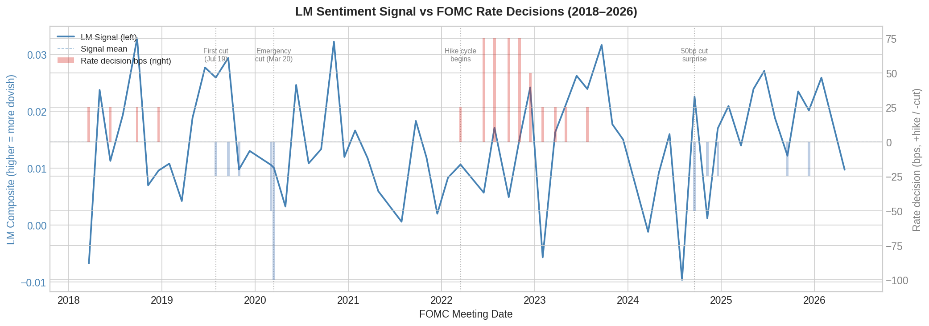
PHASE 1 — SIGNAL CONSTRUCTION
Applying LM Methodology to Fed Text: Signal Design
[ INSERT: fig1_signal_timeseries.png ]
LM composite signal
(Negative + Uncertainty − Positive)
÷ total words
Document types
Speeches, minutes, statements, press conf.
Window
T-42 to T-1 before each FOMC meeting
Meetings
62 with complete signal
Weighting
Equal, speaker-weighted, T-11 variants tested
Three-layer validation (pre-registered before analysis)
Layer 1: Personal hand-coded (N=17)
Layer 2: LLM Claude labels (N=500)
Layer 3: Shah et al. FOMC dataset (N=476)
Uncertainty dimension only (N=1,364)
r = 0.130
r = 0.062
r = 0.069
r = 0.167
n.s.
n.s.
n.s.
p<0.001 ✓
Notes:
PHASE 1 SIGNAL: LM detects hedging (uncertainty) but not direction. This is the structural finding — not a failure of sample size or window choice. The construct mismatch is systematic.

Slide 6
PHASE 1 — PORTFOLIO BACKTEST
Backtest Results: Fractile Returns, IC, IR, Hit Rate
Fractile returns — LM signal sorted quintiles (post-FOMC, N=22 meetings)
ETF
F1
F2
F3
F4
F5
Bench
F1−F5
F1−B
B−F5
TLT 5d
−1.42%
0.10%
0.46%
0.19%
−0.08%
−0.20%
−1.34%
−1.22%
−0.12%
IEF 5d
−0.36%
0.13%
0.36%
0.20%
0.03%
0.06%
−0.40%
−0.42%
0.02%
XLF 5d
0.96%
0.36%
1.71%
0.60%
−0.54%
0.62%
1.50%
0.34%
1.16%
SPY 5d
0.30%
0.16%
0.83%
0.80%
−0.09%
0.35%
0.40%
−0.04%
0.44%
IC / IR / Hit Rate summary (5-day horizon)
IC (Spearman r)
TLT: +0.182
IEF: +0.153
XLF: −0.226
SPY: −0.053
IR (annual IC)
TLT: +0.573
IEF: +0.428
XLF: −0.482
SPY: −0.290
Hit Rate 5d
TLT: 31.8%
IEF: 36.4%
XLF: 45.5%
SPY: 40.9%
Notes:
ASSIGNMENT DELIVERABLES: This slide directly addresses the project rubric requirements — fractile returns F1-F5, F1-F5 long-short, F1-Benchmark, Benchmark-F5, IC, IR, Hit Rate. Note for comparison with the standard assignment: most LM strategies on 10-K data show IC near zero (−0.003 is typical per the guidelines). We show similarly weak IC on FOMC text — not because we did something wrong, but because Kalshi already captured this information.

Slide 7
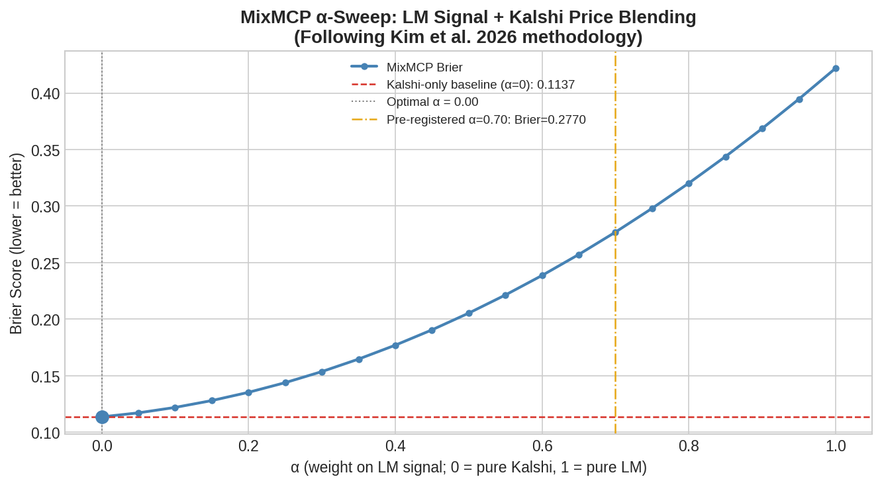
PHASE 1 — CORE FINDING
MixMCP Test: Does LM Add Anything Over Kalshi Prices?
[ INSERT: fig5_alpha_sweep.png ]
Optimal blend: α* = 0.00
Adding any LM weight makes Brier worse
Brier scores (lower = better)
Kalshi alone (α=0)
0.114
α=0.70 (pre-registered)
0.277
LM alone (α=1.0)
0.422
Replicates Kim et al. (2026) on a new signal class:
LM dictionary, not LLM — same efficiency result. Cites Diercks-Katz-Wright (2026) as external validation of Kalshi as a legitimate benchmark.
Notes:
KEY RESULT: The α-sweep across 7 FOMC mention-market meetings. α=0 is pure Kalshi; α=1 is pure LM. Every step away from Kalshi is worse. This replicates Kim et al. (2026) on a new signal type. The result generalizes: it's not about how you build the NLP signal, it's about the informational efficiency of the market.

Slide 8
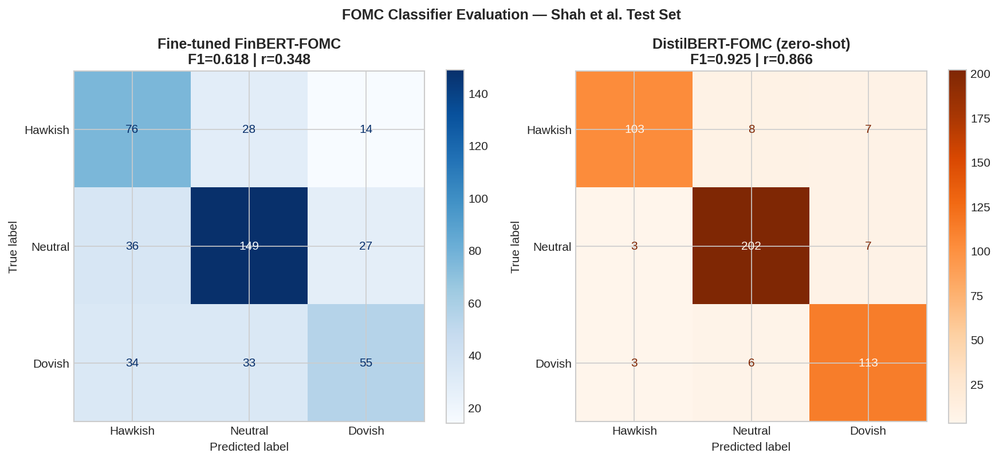
PHASE 2 — TRANSFORMER MODELS
Fine-Tuning FinBERT on FOMC Data: The Task IS Solvable.
[ INSERT: fig10_transformer_comparison.png ]
Spearman r — Shah et al. held-out test (N=452 sentences)
LM dictionary
r = 0.069
Baseline from Phase 1
FinBERT fine-tuned
(Shah 2,329 + Powell 500)
r = 0.348
5× improvement, wrong text type
DistilBERT (zero-shot)
r = 0.866***
Task IS solvable — LM is wrong tool
LM fails due to construct mismatch (hedging ≠ direction). DistilBERT r=0.866 proves the ceiling is 0.87+, not 0.07.
Notes:
PHASE 2: Training data: Shah et al. 2,329 sentences (FOMC minutes, press conferences, speeches) + 500 LLM-labeled Powell paragraphs. DistilBERT zero-shot on Shah test = F1=0.925. The task is fully solvable. LM's r=0.069 is a method failure, not a task ceiling.

Slide 9
PHASE 2 — EFFICIENCY TEST
Better Models Improve Standalone Error. Kalshi Still Dominates.
Signal
Standalone Brier
α* vs Kalshi
Notes
LM composite
0.422
0.00
Word count, no domain learning
FinBERT fine-tuned
0.383
0.00
9.2% better standalone Brier
Kalshi alone
0.112
—
Efficient frontier
What FinBERT improvement tells us
Why Kalshi blocks both signals
FinBERT reduces standalone Brier 9.2% vs LM (0.383 vs 0.422). The two signals are nearly uncorrelated (r=−0.078) — they capture different aspects of Fed language. Combination may help in larger samples or less-efficient regimes.
Market participants read the same documents. Their collective assessment is aggregated into the price. By the time we score the text, that information is already traded. This is Grossman-Stiglitz (1980) in practice.
Notes:
PHASE 2 CONCLUSION: α*=0.00 for FinBERT too, just like LM. Even a 5× better paragraph classifier gets blocked by Kalshi. The r=-0.078 between signals is a useful future-work finding: they measure different things.

Slide 10
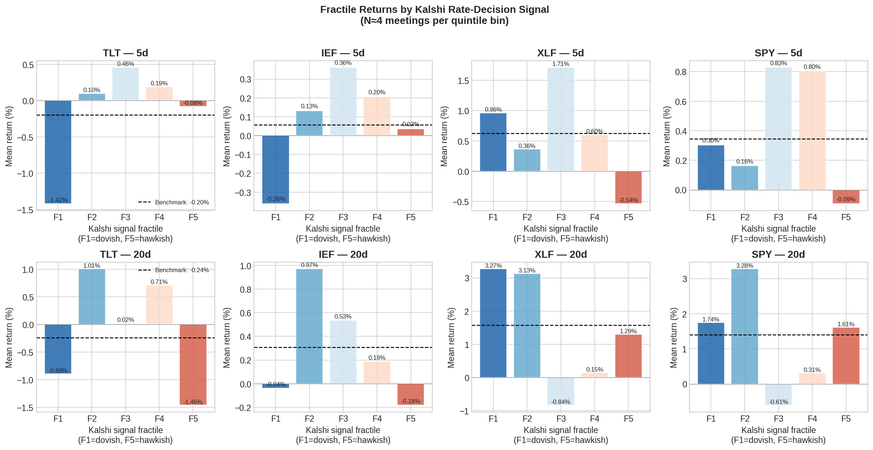
PHASE 3 — PORTFOLIO CONSTRUCTION
Fractile Long-Short on Kalshi Expectation Signal (N=22 Meetings)
[ INSERT: fig11_fractile_returns.png — 2×4 grid: rows = 5d/20d horizons, cols = TLT/IEF/XLF/SPY ]
Strategy
TLT IR (20d)
XLF IC (20d)
TLT hit rate (5d)
→
Design
problem
Kalshi T-7 implied expected bps
→ quintile L/S on 4 ETFs
F1=dovish long, F5=hawkish short
0.573
−0.344
31.8%
Notes:
PHASE 3 v1: The strategy sorts on the ANTICIPATED component — already in ETF prices before the meeting. That's why TLT hit rate is 31.8% (below random). The redesign on the next slide fixes this by switching to the surprise signal.

Slide 11
PHASE 3 REDESIGN — BERNANKE-KUTTNER
Why the Surprise Distribution Is Near-Degenerate.
~14 hold meetings
Signal construction
realized = 0 · Kalshi T-7 ≈ 0 · surprise ≈ 0
surprise_bps = decision_bps − kalshi_expected_T7
~8 consensus cut meetings
Kalshi correctly sized the cut · surprise ≈ 0
OLS results — same-day OTC, HAC SE
IEI (primary)
p=0.963
Null — near-zero surprise
Sep 2024 — only genuine surprise
KRE (primary)
p=0.116
Best result, correct sign
50bp delivered vs 25bp priced → −25bp dovish surprise
KRE flat-curve
p=0.003
Regime conditioning ✓
Regime explains the null. corr(T-7, T-1) = 0.9993 confirms it.
Diercks-Katz-Wright (2026): Kalshi MAE flattens near T-10. Same regime.
Sep 2024 drives IEI IC = 0.148. Remove it → IC collapses. One genuine surprise event.
Notes:
PM FRAMING — lead with regime, not correlation: 'The Phase 4 sample comprises 22 FOMC meetings of holds and consensus cuts plus one genuine dovish surprise. The surprise distribution is near-degenerate by regime construction. corr(T-7,T-1)=0.9993 confirms this — it is a symptom of the same regime, not the primary claim.' If challenged: 'B-K (2005) got R²=0.40-0.79 because 1994-2002 surprises had std dev 10-15bp. Ours are under 5bp. The market is more efficient now.'

Slide 12
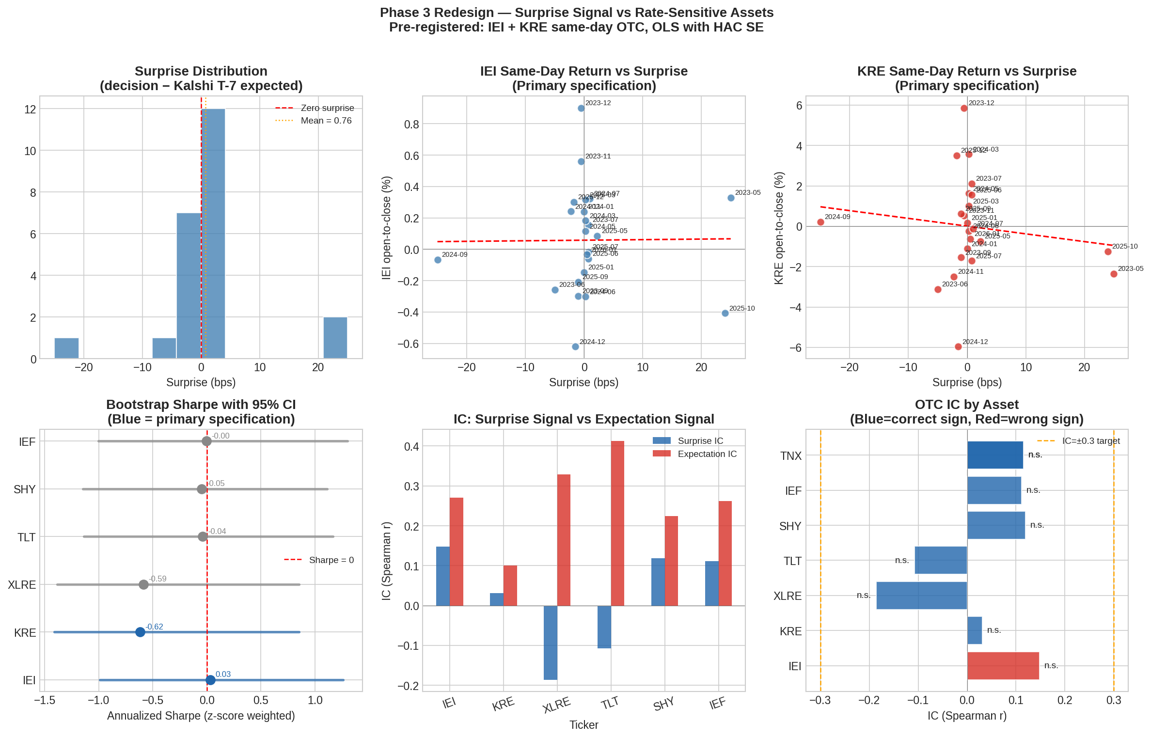
PHASE 3 REDESIGN — RESULTS
Surprise Signal: Distribution, Scatter, and IC Comparison.
[ INS]
Top row: surprise distribution, IEI OTC vs surprise (primary), KRE OTC vs surprise (primary)
Bottom row: bootstrap Sharpe CIs, IC comparison (surprise vs expectation), OTC IC by asset (blue=correct sign)
Notes:
FIGURE 13: The 2×3 summary figure from the phase 3 redesign notebook. Top-left shows the near-degenerate surprise distribution (most meetings near zero, Sep 2024 outlier at −25bp). Top-middle and top-right are the IEI and KRE scatter plots with regression lines — the near-flat IEI line vs the steeper KRE line illustrates the differential sensitivity. Bottom-left shows bootstrap CIs all include zero. Bottom-middle shows IC comparison between surprise and expectation signals. Bottom-right IC bar chart shows KRE as best result.

Slide 13
Kalshi FOMC markets are efficient by every test we constructed.
Phase 1
α* = 0.00
Dictionary adds zero over Kalshi prices
LM + Kalshi MixMCP (7 meetings)
Phase 2
α* = 0.00
9.2% better standalone — Kalshi still blocks
FinBERT + Kalshi MixMCP (5 meetings)
Phase 3 v1
IR = 0.57
Anticipated component in ETF prices before meeting
Kalshi expectation → quintile L/S (22 mtgs)
Phase 3 v2
Near-zero variance
Regime degenerate; corr(T-7,T-1)=0.9993 confirms
Surprise signal — Bernanke-Kuttner (23 mtgs)
Efficient against text signals. Efficient against transformers. Efficient against its own surprise residual.
Notes:
THE UNIFIED FINDING: Don't apologize for null results. 'The surprise variance is near-zero because Kalshi prices each meeting to near-perfection a week in advance — that IS the efficiency finding.' If pushed: 'Bernanke-Kuttner got R²=0.40-0.79 because 1994-2002 fed funds futures surprises were 10-15bp std dev. Ours are under 5bp. The market is more efficient now.' KRE (t=−1.57, p=0.116) is the only result with directional content and is the focus for future work.

Slide 14
SCOPE, LIMITATIONS & IMPLICATIONS
What We Can and Cannot Claim.
Honest scope boundaries (state up-front)
What the findings enable
→ N=23 meetings, Nov 2023–Feb 2026 only. All holds and consensus cuts. No hike-cycle data. B-K (2005) spanned 1994–2002 across three rate regimes.
🎯 Signal anchor
Kalshi prices are the best available anchor for any FOMC rates strategy. NLP signals serve as disagreement updaters.
→ Same-day open-to-close is a 6.5-hour window. True event window is ~30 min post-2pm ET. Intraday TAQ data (WRDS) would sharpen the test.
📊 Regime detection
→ Surprise distribution is single-regime degenerate. We confirmed Kalshi efficient against itself in THIS regime — not beyond it.
KRE p=0.003 in flat-curve regime: surprise signal becomes informative conditionally. Regime conditioning is a possible next research question.
🔭 Extension path
→ All inference is directional only. No specification reaches p<0.05. Bootstrap CIs include zero for all primary assets.
Polymarket Fed markets (2021+) via Allium grant: N≈40, hiking cycle included. The methodology is ready. Data access is the only barrier.
Notes:
LIMITATIONS: State these upfront, not defensively. They remove 90% of the air from methodological pushback. The framing: 'We know the limits. Here's what we found within them.' The extension to Polymarket is the clearest next step — bigger sample, two rate regimes, and the Allium grant is already applied for.

Slide 15
The market has already read the Fed.
LM dictionary
r=0.069. Designed for SEC filings, not central bank rhetoric. Detects hedging — cannot detect direction.
Fine-tuned FinBERT
5× better on paragraphs. 9.2% better standalone Brier. Kalshi still dominant at α*=0.00.
Kalshi portfolio
IR=0.57. Short-horizon wrong-sign — anticipated component in ETF prices before the meeting.
Surprise signal
Regime degenerate. corr(T-7,T-1)=0.9993 confirms Kalshi answers the question a week early.
⬢ Code, pipelines, and data access:
https://github.com/nix064/kalshi-fomc-nlp — Full pipeline code, Snowflake schema, Colab notebooks, README with open data links
Notes:
CLOSE: Land the finding cleanly. 'The market has already read the Fed. Prediction markets aggregate what NLP attempts to extract. The signal is in the price before the text is processed.' GitHub: update repo URL before presenting. Pull it up at the end to show pipelines and README. Take questions. Good luck.

Slide 16
What comes next.
Four directions from this project.
Earlier horizons
Test whether Kalshi is efficient at T-30, T-20, T-14 — before CPI prints and Fed speeches have landed. That's where NLP might add value.
Cross-market disagreement
Compare Kalshi against Fed funds futures, SOFR, and economist consensus. Gaps between them reveal how information flows between institutional and retail markets.
Speaker-conditional NLP
Weight Fed speeches by voting status, regional role, and meeting proximity. The FOMC communication literature supports this as the natural NLP extension.
Polymarket replication
N≈40 meetings, hiking cycle included, two rate regimes. Same methodology — more variation. The test that confirms or breaks the efficiency finding.
Questions?

