Slide 1
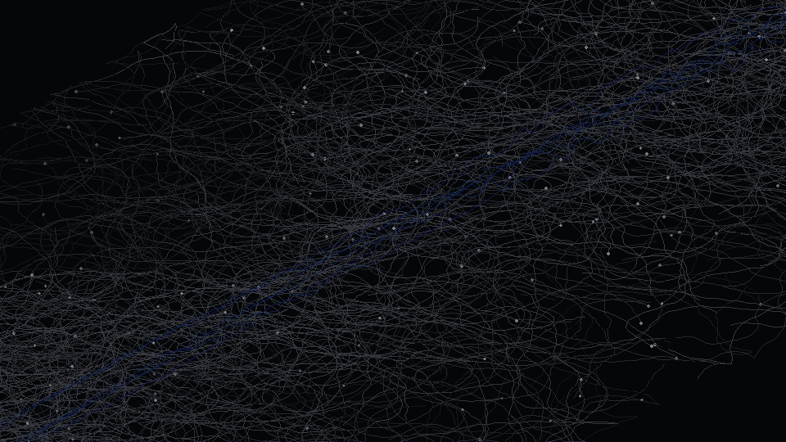
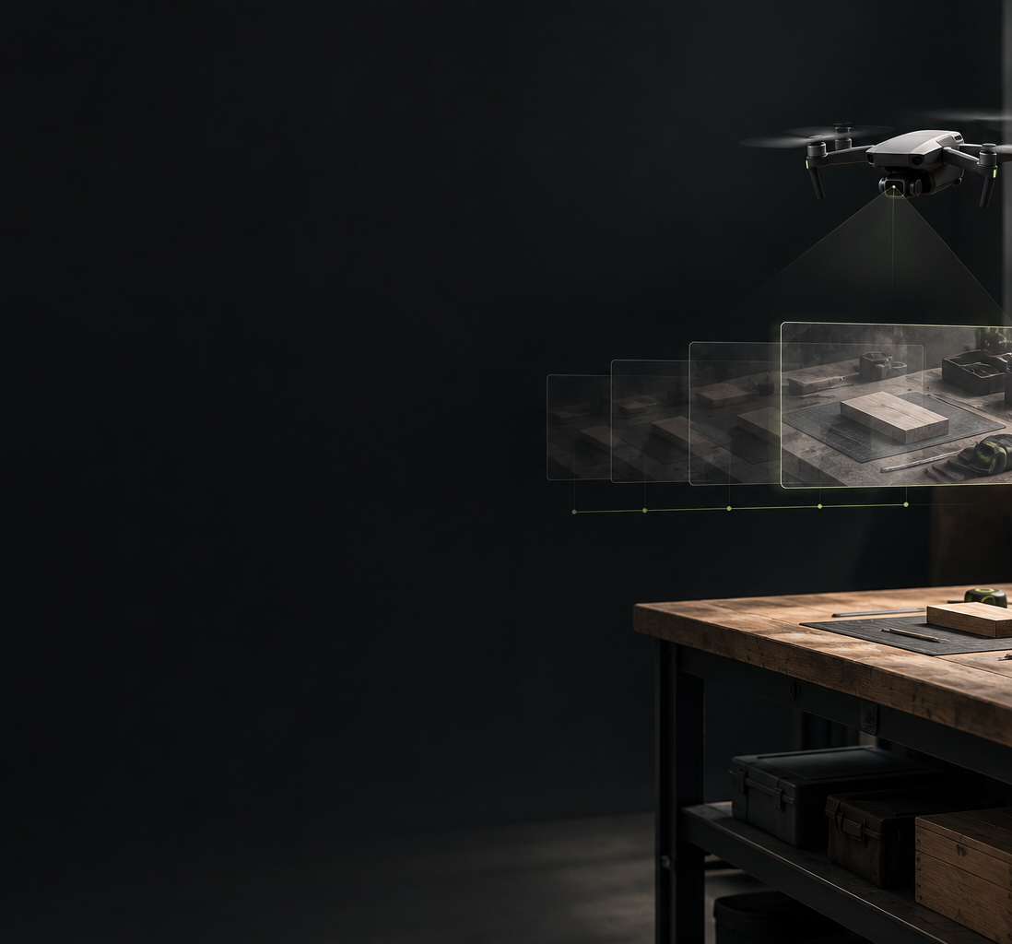
FIELDNOTES / 01 TITLE
01
FieldNotes
Physical memory for physical agency
Timestamped observations that AI agents can revisit
HACKATHON PROTOTYPE
CONCEPT ART · NOT RECORDED EVIDENCE
Drone → timestamped evidence → MCP → agent. Human controls flight.
t0
t1
t2
t3
observations across time (motif)
FIELDNOTES / HACKATHON PROTOTYPE / INNOVATION CUP 2026
Notes:
Physical agency means an AI can help pursue a goal in the real world. FieldNotes builds one necessary part: a memory of physical observations that the agent can revisit.
[12 s] Cover only: do not introduce the technology stack here. The drone is flown by a human operator; FieldNotes observes video and does not fly the aircraft.
Team/member names and roles go in the submission message, not on this slide.

Slide 2


FIELDNOTES / 02 PROBLEM & URGENCY
02
A physical decision depends on what is still true
Problem + Inspiration: 200 words maximum across slides 02–03
WHO · FOR PEOPLE OVERSEEING PHYSICAL WORK
“Is the workstation ready for the next job?”
WHAT
Earlier images may be stale.
WHY IT MATTERS NOW
Missing objects may simply be out of view.
CURRENT OPTION
Reviewing footage still takes human attention.
A capable agent needs recent evidence, not only a plausible answer.
ILLUSTRATIVE WORK SCENARIO · CONCEPT ART
Research: SayCan · DynaMem · Gemini Robotics (see notes)
Part of the surface is hidden: an unseen object is unknown, not absent.
FIELDNOTES / HACKATHON PROTOTYPE / INNOVATION CUP 2026
Notes:
Consider a worker asking whether a station is ready for the next job. A useful agent needs more than a plausible answer. It needs recent evidence. Earlier images can be stale, and an object outside the camera view may still be present. Someone usually has to reconstruct that context.
[22 s] The job question is an intended workflow, not a completed FieldNotes demonstration. Urgency is framed as a design need for capable agents, not as a market trend. No claim that all existing video products lack search.
Grounding research (notes only): SayCan https://arxiv.org/abs/2204.01691 ; DynaMem https://arxiv.org/abs/2411.04999 ; Gemini Robotics https://deepmind.google/blog/gemini-robotics-brings-ai-into-the-physical-world/

Slide 3
FIELDNOTES / 03 INSPIRATION / KEY INSIGHT
03
Physical agency needs shared context
User goal → reasoning → permitted robot capability → observation → memory update → reassessment
WHAT WE OBSERVED
Reasoning alone answers without evidence.
LLM
Robot tools
Space Info
reasons about the job
execute bounded capabilities
preserves observations across time
WHAT IT REVEALED
The missing part is memory of what was seen, and when.
FUTURE INTEGRATION
Observed · Last seen · Changed · Unknown
WHY IT UNLOCKS A SOLUTION
MCP lets an agent request evidence the way it requests any tool.
evidence and temporal records return to the reasoner
FieldNotes builds the temporal evidence layer
FIELDNOTES / HACKATHON PROTOTYPE / INNOVATION CUP 2026
Notes:
Research in robot planning separates high-level reasoning from executable skills. Dynamic-memory research shows why changing environments also matter. Our approach uses three responsibilities: the LLM reasons about the job, robot tools execute bounded capabilities, and Space Info carries observations through time. FieldNotes focuses on that third part.
[20 s] Observed / Last seen / Changed / Unknown are information categories, not a claim that all are automatically resolved. Robot tools are a future integration; FieldNotes implements no robot control, 3D localization, or DynaMem.
Related research (not dependencies): SayCan https://arxiv.org/abs/2204.01691 ; DynaMem https://arxiv.org/abs/2411.04999 ; MCP tools spec https://modelcontextprotocol.io/specification/2025-06-18/server/tools

Slide 4
FIELDNOTES / 04 SOLUTION OVERVIEW
04
The agent can return to the evidence
Evidence-based example from one recorded session · not a verbatim transcript
WHO IT IS FOR
AI agents and the people overseeing physical work
HOW IT WORKS · THREE MCP CALLS
“What changed around the workstation?”
1
Search earlier observations
search_visual_history
PLACEHOLDER — INSERT ORIGINAL
Original frame 300.jpg
data/evidence/80777bc1e2ac4fa8b2578015d93a332d/300.jpg
Not in this checkout. Copy from the recording Mac; do not substitute generated imagery.
PLACEHOLDER — INSERT ORIGINAL
Original frame 370.jpg
data/evidence/80777bc1e2ac4fa8b2578015d93a332d/370.jpg
Not in this checkout. Copy from the recording Mac; do not substitute generated imagery.
2
Inspect original frames
get_evidence
→
3
Explain the supported change
get_memory_state / record_memory
Seated earlier. Standing later.
Task completion was not observed.
300.jpg 02:50:45.991 PDT · 27 Sep 2026
370.jpg 02:50:59.918 PDT · 27 Sep 2026
Person seated beside an open laptop
Person standing
WHAT CHANGES: the agent cites originals instead of guessing.
Camera reframed between frames: not every image difference is object movement.
FIELDNOTES / HACKATHON PROTOTYPE / INNOVATION CUP 2026
Notes:
Here is evidence from our recorded session. An agent can search earlier images and inspect the originals. In the first frame, the person is seated beside a laptop. In the later frame, they are standing. That supports a posture change. It does not establish that a job finished, and the camera also reframed.
[32 s] Evidence: session 80777bc1e2ac4fa8b2578015d93a332d, frames 300.jpg (receipt 02:50:45.991 PDT, 27 Sep 2026) and 370.jpg (02:50:59.918 PDT). Timestamps are local receipt at decode, not exposure. The text is an evidence-based example, not a verbatim model transcript. The redesigned portal is not shown because it does not exist yet.
MCP tools exercised in the inspected session: get_memory_status, list_sessions, get_observation_window, search_visual_history, get_evidence (src/fieldnotes/mcp_server.py).

Slide 5
FIELDNOTES / 05 QUANTIFIED IMPACT
05
148 retained evidence images
One recorded prototype session · numbers classified below
148
712
140.7 s
received frames
of observed footage
VERIFIED
CALCULATED
VERIFIED · one recorded prototype session
sampled frames retained as evidence (motif, not to scale)
A record the agent can inspect after the moment has passed.
HOW THE NUMBERS WERE CALCULATED
session 80777bc1… · 27 Sep 2026 · memory.sqlite3 (read-only)
Counts: rows of received frames and retained evidence.
Duration: last receipt − first receipt = 140.707 s.
Productivity improvement has not yet been measured.
FIELDNOTES / HACKATHON PROTOTYPE / INNOVATION CUP 2026
Notes:
One recorded session received 712 frames over about 141 seconds and retained 148 evidence images. Those are verified prototype counts, not a productivity claim. They demonstrate that observations remain available for later inspection. Whether this reduces review time is the next evaluation question.
[20 s] Session 80777bc1e2ac4fa8b2578015d93a332d. Source: data/memory.sqlite3 and data/journal.sqlite3 read in SQLite read-only mode.
First receipt 2026-09-27T09:49:47.368214+00:00; last receipt 2026-09-27T09:52:08.075604+00:00; 140.707 s = last − first (CALCULATED). 712 received frames and 148 retained evidence images are VERIFIED counts from the frozen session database. 148 is evidence coverage, not accuracy, compression efficiency, or labor savings.
NOTE: this checkout does not contain data/; the counts are a previously recorded snapshot from the recording Mac, not independently re-verified here.

Slide 6
FIELDNOTES / 06 WHAT MAKES THIS DIFFERENT?
06
The agent retrieves context when it needs it
Maximum 100 words · workflows compared, not vendors
HOW IT IS DIFFERENT
WHY IT IS POSSIBLE — AND HARD TO COPY
Manual review
a person reconstructs the sequence
Originals, receipt timestamps, and temporal records are stored together and served through one MCP interface, so the agent can cite evidence rather than a summary.
Defensibility is not a moat yet; it is accumulated workflow evaluation.
Summary alone
an interpretation without the full visual context
FieldNotes
MCP access to earlier originals, timestamps, and temporal records
A decision can require another observation.
Requesting it through a robot tool is future work.
Built today an integrated evidence workflow
Still to prove reliability across varied physical jobs
FIELDNOTES / HACKATHON PROTOTYPE / INNOVATION CUP 2026
Notes:
The distinction is that evidence remains available to the agent when it needs context. A summary is useful, but it is still an interpretation. FieldNotes exposes earlier originals and temporal records through MCP. Our contribution is the integrated workflow. Reliability across different jobs remains to be demonstrated.
[22 s] Compare workflows, not named competitors. No established moat is claimed; the potential advantage is accumulated workflow evaluation and integration. Requesting a physical re-observation through a robot tool is future work.
MCP tools spec: https://modelcontextprotocol.io/specification/2025-06-18/server/tools

Slide 7
FIELDNOTES / 07 TECHNICAL DESIGN
07
Observation becomes agent-accessible memory
Maximum 150 words · solid = implemented · dotted = future boundary
LOCAL MAC
OUTSIDE THE LOCAL BOUNDARY
DJI + phone
RTMP publish
MediaMTX + FFmpeg
ingest · decode
Frame buffer
timestamped
Original JPEG evidence + SQLite records
images
OpenAI API
vision summaries
summaries
MobileCLIP2 retrieval
local visual search
Human controls flight. Evidence is sampled. Interpretations can be wrong.
originals · timestamps · temporal records
Future robot MCP
bounded observation / action tools
Portal
same backend
FieldNotes MCP
status · sessions · evidence · search · memory · tracking
Agent
LLM reasoning
MCP (interface)
NOT IMPLEMENTED
STACK
Python 3.12 · FastMCP (Streamable HTTP) · FFmpeg · MediaMTX · SQLite · OpenAI Responses API · MobileCLIP2-S0 · EdgeTAM (optional)
FIELDNOTES / HACKATHON PROTOTYPE / INNOVATION CUP 2026
Notes:
The drone publishes video through DJI Fly. MediaMTX and FFmpeg decode timestamped frames. FieldNotes retains selected originals, generates vision summaries, and indexes evidence for local visual search. MCP lets an agent retrieve that history. The portal reads the same backend. Flight remains with the operator. A separate robot-control interface belongs to the future architecture.
[32 s] Solid lines = implemented data flow; dotted = future boundary. Selected sampled images are sent to the OpenAI API while observation is enabled (not all processing is local). MCP is an interface, not a model. Optional EdgeTAM selected-region tracking (start_visual_track / get_visual_track) is implemented but was not exercised in the inspected session. Excluded by design: Gaussian splatting, calibrated 3D maps, Core ML, automatic flight control.
Sources: src/fieldnotes/{ingest,core,mcp_server,memory,perception}.py; docs/visual-memory.md; docs/sessions.md; MobileCLIP2 https://machinelearning.apple.com/research/mobileclip2 ; EdgeTAM https://github.com/facebookresearch/EdgeTAM

Slide 8
FIELDNOTES / 08 FUTURE ROADMAP
08
Toward evidence-grounded physical agency
Planned milestones · maximum 75 words
PLANNED MILESTONES · NOT ACHIEVED RESULTS
01
NEAR TERM
02
MEDIUM TERM
03
LONG TERM
Session review and cited process timelines
Evaluate change interpretation across 20 annotated sessions
Connect one bounded robot observation tool and verify its result
20 sessions = proposed target
observation first, not manipulation
The agent should know when it needs another look.
FIELDNOTES / HACKATHON PROTOTYPE / INNOVATION CUP 2026
Notes:
Next we will improve session review and evaluate interpretations across twenty annotated sessions. Then we will connect a bounded robot observation tool and check its returned evidence. The broader goal is physical agency where an agent can recognize that its knowledge is incomplete and obtain the next observation it needs.
[20 s] All three horizons are planned milestones, not achieved results. 20 sessions is a proposed evaluation target (ILLUSTRATIVE), not existing evidence. The long-term milestone is a constrained observation capability, not manipulation. No extra thank-you slide.

