Slide 1

The Fintech Nexus:
Revolutionizing personal Finance with AI

Slide 2


The FinTech Nexus: Revolutionizing Personal Finance with AI
Welcome! We are The FinTechNexus.
Our team: Nixat Rajpurohit, Nidhi Sharma, Niharika Sankhla, and Raj singh Rajpurohit. We are addressing the critical problem of financial awareness and delivering a brainstorming solution through AI.
Problem Statement: Artificial Intelligence / Machine Learning
Finance for Gen Z: A mobile-first UI for personal finance or investment app that makes budgeting fun and visual.

Slide 3

Introducing FinSightAI
FinSightAI is an AI-powered personal finance assistant designed to empower users with intelligent insights and proactive guidance.
Lack of Financial Awareness
Many individuals struggle with tracking expenses and understanding their cash flow.
Impulse Spending
Users often overspend due to a lack of real-time insights and alerts, leading to budget deviations.
GENERIC FINANCIAL TOOLS
Existing apps lack personalized advise and
Behavioral coaching based on individual
habits
Complexity
Many financial tools are overwhelming for non-finance- savvy users, hindering adoption and consistent use.
Limited Engagement
Most finance applications lack proactive, real-time interaction through voice or chat-based guidance.

Slide 4
FinSightAI: Opportunities & Uniqueness
All-in-One Platform
Unlike other platforms requiring users to switch between apps, FinSightAI consolidates stock investments, mutual funds, budget management, and loan tips into a single, intuitive interface.
Unique Selling Proposition (USP)
Personalizedvoice insights,proactivealerts,emotional spending analysis, and intelligent saving goals define FinSightAI as a 360° smart financial companion.
Comprehensive Problem Solving
FinSightAI tackles critical financial issues, including untracked expenses, forgotten subscriptions, impulse spending, and inadequate financial planning.
Real-Time Market Data
Theplatform providesdaily updates on investment opportunities and fluctuating interest rates across various banks.

Slide 5

Key Features of FinSightAI
1
Smart Expense Categorization
Utilizes Natural Language Processing (NLP) to automatically categorize transactions, simplifying expense tracking.
Financial Summaries
Provides weekly and monthly summaries in both text and voice formats for convenient financial oversight.
2
3
Subscription Tracking
Monitorsrecurringsubscriptionsandauto-debits, helping users avoid unexpected charges.
Emotional Spending Detection
4
Identifies spending patterns linked to emotional triggers, offering insights to promote disciplined habits.
5AI-Based Budgeting
Generatespersonalizedbudgeting suggestions based on spending behavior and financial goals.
6
Personalized Planning
Offers tailored savings and investment planning, aligning financial strategies with individual objectives.
7Smart Payment Reminders
Sends timely reminders for billpayments and upcoming financial obligations.
8Chatbot/Voice Assistant
Providesaninteractiveinterfaceforinstant financial queries, such as "How much did I spend last week?"
9
Goal Tracker
Visualizesprogress towards financial goals, like a "Laptop fund: 60% completed," to maintain motivation.

Slide 6
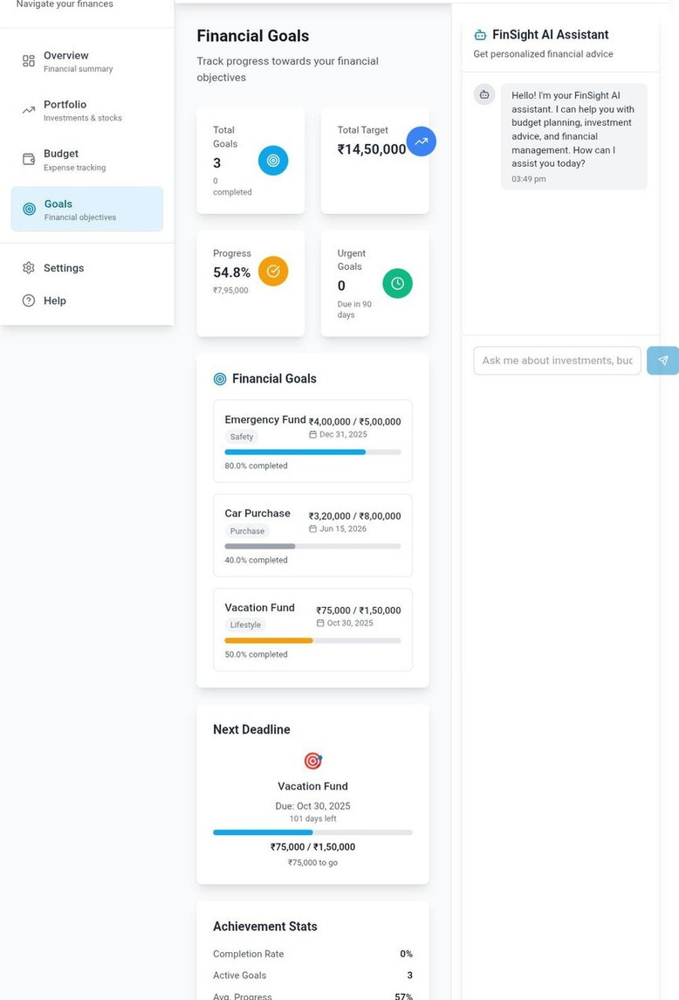

FinSightAI Process Flow
User Input
User provides financial data for analysis.
AI Analysis
AI analyzes the input to identify patterns and categorize expenses.
Insights Generated
Personalized insights are derived from the categorized data.
Alerts & Goals
Voice or text alerts and goal suggestions are sent to the user.
User Action & Learning
User acts on advice, and AI continually learns from interactions.

Slide 7
Technology Stack for FinSightAI
Financial Data Fetching: Fi's MCP for structuredJSON transactiondata.
Voice Interface: Google Dialog flow / Agent Builder for voice-first experiences.
AI/ML: TensorFlow, Scikit-learn for robust machine learning models.
NLP: Vertex AI PaLM models or Gemini for advanced financial insight generation.
Backend: Python with Flask for scalable server-side development. Frontend: React / Flutter for responsive and intuitive user interfaces. Database: Firebase for real-time data storage and synchronization.

Slide 8

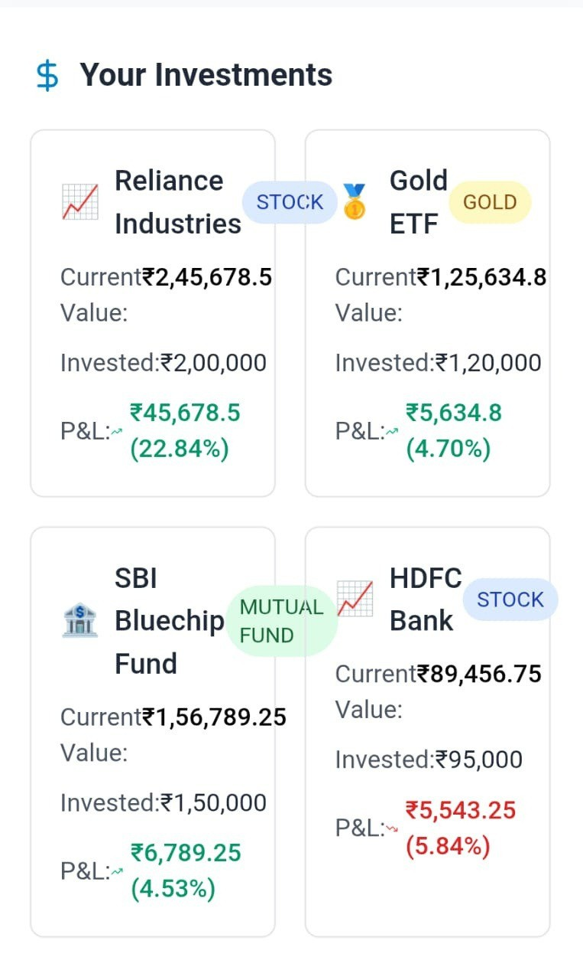
FinSightAI Architecture Diagram
Frontend (Web/App, Mobile- friendly)
User-facing interface, ensuring accessibility on various devices.
API Gateway (Flask)
Manages requests and responses, acting as a secure entry point.
Core AI Engine (Google Cloud)
Includes Gemini/Vertex AI for insight generation, Agent Builder for
orchestration, Voice/Chat Agents, and Spend Prediction Models.
Database Layer (User Data, Transactions, Models)
Stores and retrieves all critical user and application data.
External APIs (Fi MCP, UPI, Investment,
Voice Services)
Integrates with external services for data fetching and real-time
interactions.

Slide 9
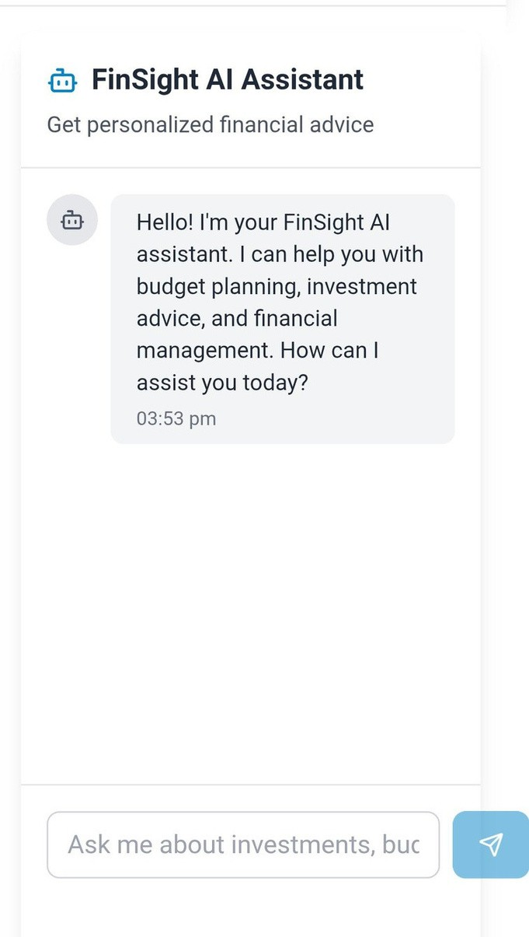
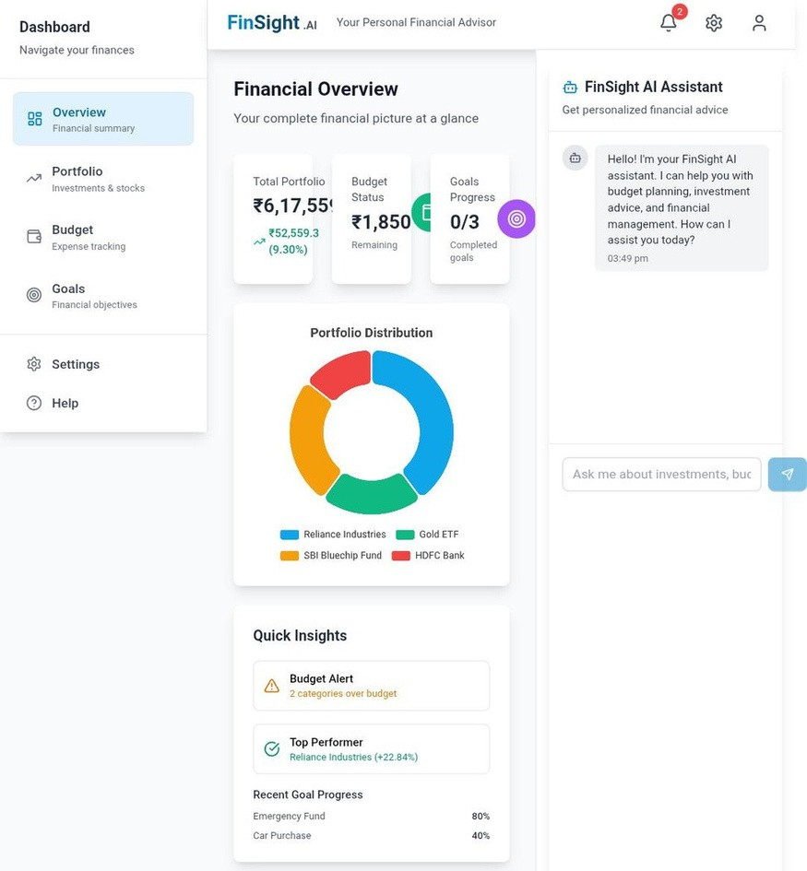
GLIMPSES OF FINSIGHT AI:

Slide 10



https://youtu.be/Am0tSRJzHAE?si=nUrZ_ItydUAJo6N2
https://ory-chatbot-ckbe-alphaproject.netlify.app/

Slide 11
THANK YOU

