Slide 1

SMART FOOD BOT
By : GROUP 10

Slide 2
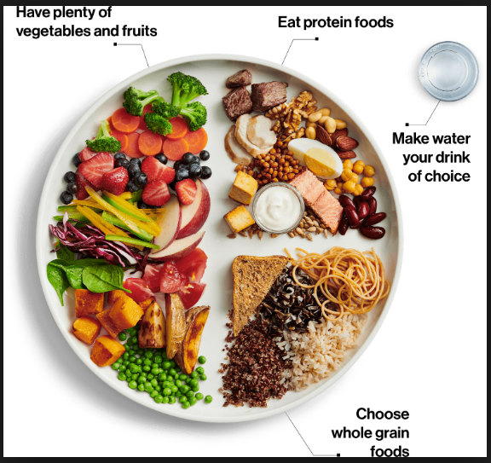


Background for the project
People who are on a strict diet or bodybuilding regime usually have trouble with eating because they don’t know how much calories are contained in the food they eat. For example, they might not know how much calories a chicken steak contained.
Notes:
Someone who is working out seriously will calculate the exact amount of calorie intake required for muscle-building and minimalize excess fat.
Hence, they can’t eat carelessly without knowing the amount of calorie contained in their food.
This is the inspiration for our project: to give them freedom on choosing what they want to eat, just by taking a picture and uploading it to get a result and reminder for the user’s calorie intake, so users can be at ease while enjoying their food.

Slide 3
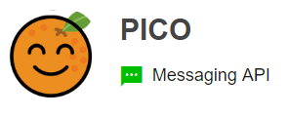




What DO WE MAKE?
SNAP
UPLOAD
CALCULATE

Slide 4
How to make it work
IOTTALK Server
NGROK
LineBot
Clarifai API
IMGUR API
Beautiful Soup (Web Crawler)
Python
Chromedriver (auto login)
Selenium
JSON (Result From Clarifai)

Slide 5

Clarifai ?
Clarifai Inc. is an artificial intelligence (AI) company that specializes in computer vision. It uses machine learning and deep neural networks to identify and analyze images and videos. The company offers its services via API.

Slide 6
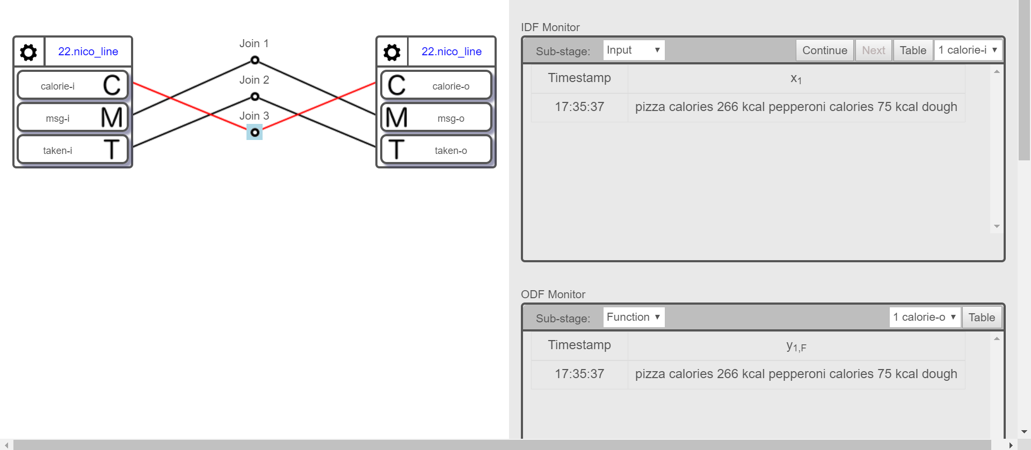
IOTTALK v1
msg-i&o : to transfer image-link
calorie-i&o : to transfer the calculation
taken-i&o : transfer ingridients (p>=0.7)

Slide 7
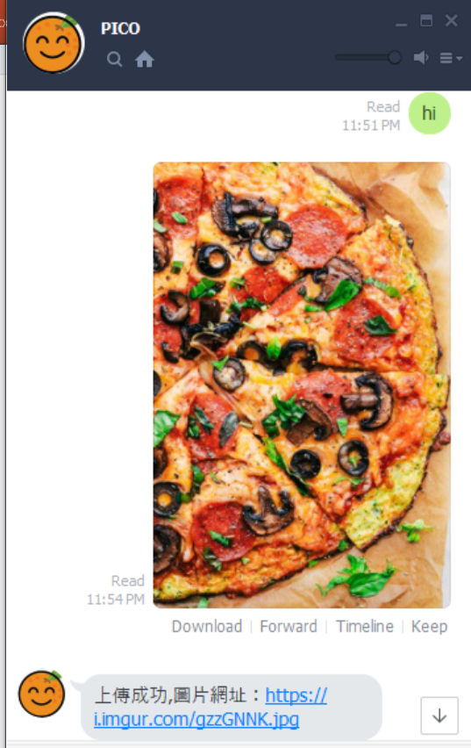
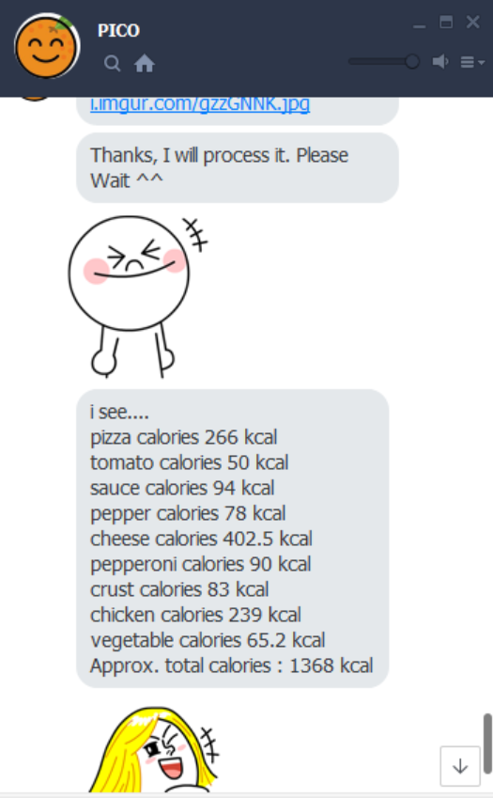
OUTPUT

Slide 8
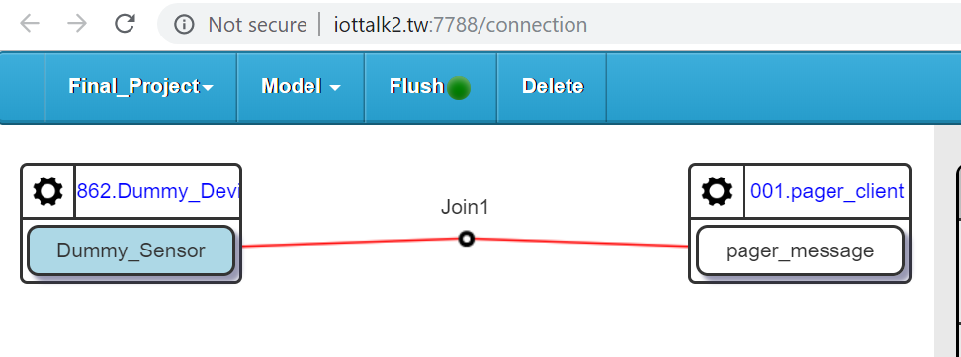
IOTTALK V2 (FOR PAGER, COOPERATION)
We send an output.txt file to them using iottalkv2
Dummy_Device (IDF) : Accept txt file and push it.
Pager_client(ODF) : ODF from other group.

Slide 9
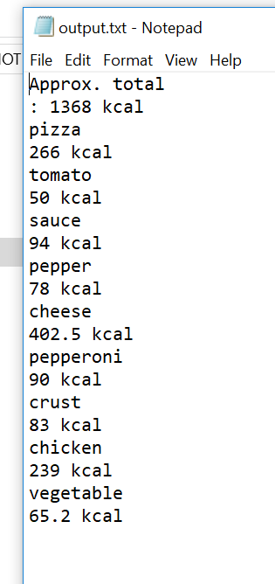
OUTPUT.txt FILE
This is what will display in their pager.
Useful for smartwatch development.

Slide 10
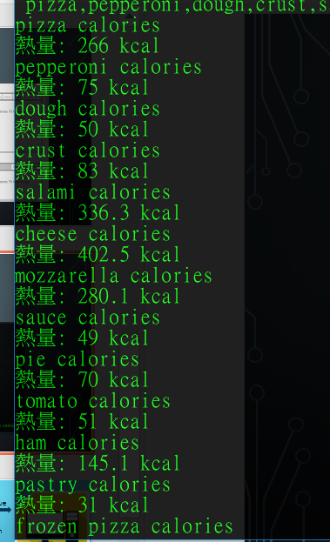
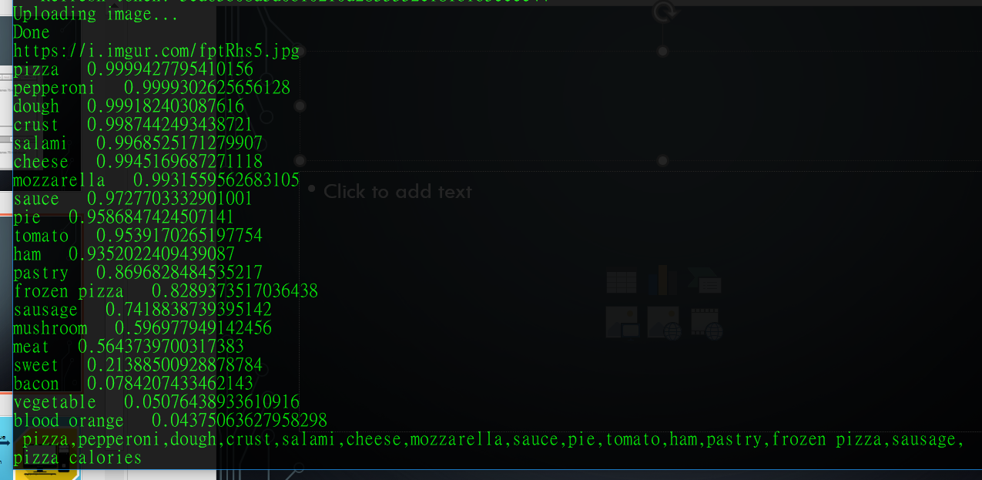
Behind the scenes

Slide 11



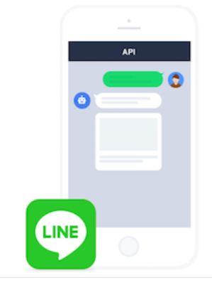

The Process
Pass the ingridients
Image Links
Notification of total calories
Result of Calorie and Notification
Image
Proceed to identify image
List of things in the food.
Web Crawler
Notes:
First, we take a picture of the food.
Convert image to link via IMGUR, and send it to IOTTALK.
Image data will be sent to Clarifai, which will determine the elements in the image.
Clarifai will return a list of ingredients and send it to a program to calculate the amount of calories.
Results will be sent to IOTTALK → LineBot. User will receive the total calorie in their food and a reminder for the total calories the user has taken for the day.

Slide 12
Explanation
First, we take a picture of the food.
Convert image to link via IMGUR, and send it to IOTTALK.
Image data will be sent to Clarifai, which will determine the elements in the image.
Clarifai will return a list of ingredients and send it to a program(WEB CRAWLER) to calculate the amount of calories.
Results will be sent to IOTTALK → LineBot. User will receive the total calorie in their food.

Slide 13
OUR CONTRIBUTION
We write our own Picture Uploader(to imgur) using python + chromedriver + selenium.
We pass the image link using IOTTALK to Clarifai and get the result in JSON.
From the JSON file, we take the ingredients detected with probability >= 0.7, and pass it to IOTTALK.
We write a WEB CRAWLER, to get calories of the food ingredients.

Slide 14
Hardships encountered
If the user’s picture contains other food that isn’t theirs, the bot might also take it into consideration, which might result in wrong calorie calculation.
Blurry pictures will affect element detection and calculation results.
Combining two version of IOTTALK is challenging.
The input and output between two projects must be synchronized properly.
IOTTALKv2 server can crash suddenly.

Slide 15
Work distribution
周家賢 – Linebot + clarifai(API)+ iottalkv1+ Combining code
陳年進 – Idea + iottalkv2
張豐繹 – Image upload + Web Crawler
劉南宏 – PPT and testing
張育茹 – PPT and testing

