Slide 1

AVL Trees
Dr. Aiman Hanna
Department of Computer Science & Software Engineering
Concordia University, Montreal, Canada
These slides has been extracted, modified and updated from original slides of :
Data Structures and Algorithms in Java, 5th edition. John Wiley& Sons, 2010. ISBN 978-0-470-38326-1.
Data Structures and the Java Collections Framework by William J. Collins, 3rdedition, ISBN 978-0-470-48267-4. Both books are published by Wiley.
Copyright © 2010-2011 Wiley
Copyright © 2010 Michael T. Goodrich, Roberto Tamassia
Copyright © 2011 William J. Collins
Copyright © 2011-2018 Aiman Hanna
All rights reserved

Slide 2
Coverage
Section 10.2: AVL Trees
6
v
3
8
z
4
AVL trees are named after its their Soviet inventors, G. M. Adelson-Velskii and E. M. Landis, in 1962. AVL Trees were the first invented self-balancing tress.
AVL Trees
Notes:
NOTES: For illustrative animation, please see: http://www.youtube.com/watch?v=vTc5eMBc92k, or click on the above self-balancing link above.

Slide 3
Performance of Binary Search Trees
A binary search tree should be an efficient data structure for map implementation.
However, as seen, binary search trees may have O(n) in the worst case, which is not any better than list-based or array-based map implementation.
That problem is caused by the possibility that the nodes may be arranged such that n = h + 1, where h is the height of the tree.
AVL Trees

Slide 4
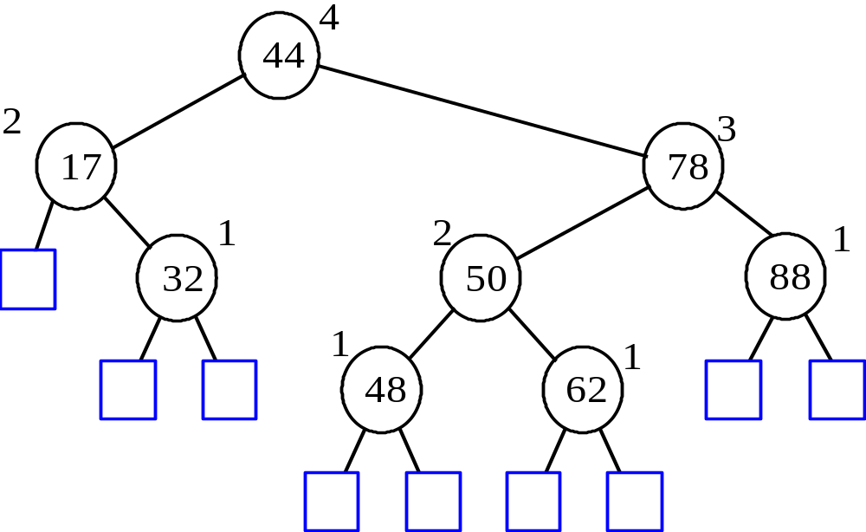
AVL Tree Definition
The performance problem of binary search trees can be corrected using AVL trees.
AVL Trees are balanced Trees.
An AVL Tree is a binary search tree such that for every internal node v of T, the heights of the children of v can differ by at most 1; this is referred to as the Height-Balance Property.
An example of an AVL tree where the heights are shown next to the nodes
AVL Trees

Slide 5
Height of an AVL Tree
n(2)
3
4
n(1)
Any binary search tree that satisfies the height-balance property is said to be an AVL tree.
AVL trees are named after their inventors (Adel’son Vel’skii and Landis).
Fact: The height of an AVL tree storing n keys is O(log n).
Proof: Let us bound n(h): the minimum number of internal nodes of an AVL tree of height h.
We can easily see that n(1) = 1 and n(2) = 2,
since an AVL tree of height 1 must have at least 1
internal node and an AVL of height 2 must have at
least 2 internal nodes.
n(2)
3
4
n(1)
AVL Trees

Slide 6
Height of an AVL Tree
n(2)
3
4
n(1)
Now, for n >= 3, an AVL tree of height h contains the root node, and at minimum, one AVL subtree of height h-1 and another of height h-2.
That is, for n >= 3:
n(h) = 1 + n(h-1) + n(h-2)
Knowing that n(h-1) > n(h-2), we get n(h) > 2n(h-2),
which indicates that: n(h) at least doubles each time h increases by 2.
So:
  n(h) > 2n(h-2), n(h) > 4n(h-4), n(h) > 8n(h-6), … (by induction),
  ➔ n(h) > 2^{i}n(h-2i)
AVL Trees

Slide 7
Height of an AVL Tree
n(2)
3
4
n(1)
➔ n(h) > 2^{i}n(h-2i), for any integer i such that h-2i >= 1.
Recall that we already know n(1) and n(2).
So, let us pick up i such that h – 2i is equal to either 1 or 2:
i = ceil(h/2) – 1
➔ n(h) > 2^{i}n(h-2i) ➔ n(h) > 2^{ceil(h/2) – 1} n(h- (2ceil(h/2)) +2)
➔ n(h) > 2^{ceil(h/2) – 1} n(h- (2ceil(h/2)) +2)
➔ n(h) > 2^{ceil(h/2) – 1} n(h- (ceil(h/2) + ceil(h/2)) +2)
➔ n(h) > 2^{ceil(h/2) – 1} n(h- (ceil(h/2) -1 + ceil(h/2) -1))
➔ n(h) > 2^{ceil(h/2) – 1} n(h- (2i)) ➔ n(h) >= 2^{ceil(h/2) – 1} n(1)
➔ n(h) >= 2^{ceil(h/2) – 1}
AVL Trees
Notes:
The idea is n(h) is bigger than many things. Let us then try to refer to it in relation to anyone that we know, which is n(1) and n(2).
Now:
Let us consider the > 2^{i}.n(h-2i)
we need to force n(h-2i) to become either n(1) or n(2)
h-2i = 1 or h-2i = 2
2i = h -1 or 2i = h-2
i = ½ h -1/2 or i= ½ h – 1
This can he generalized as: i = ceil( ½ h) - 1 (since if the ceil does not give anything then it is still -1, and if the ceil gives something, which at most ½ since we divide by 2, then are getting ½ more, or in other words, we have just taken off only ½ (that is – ½))
In the last step, we are already started by assuming that h-2i = 1 or h-2i = 2, so n(h) >= 2^ceil( ½ h) - 1 * n(1) or n(h) >= 2^ceil( ½ h) - 1 * n(2). While it does not really matter as both are constants, we can indicate that n(h) >= the smaller one of them, so we need to consider n(1), effectively have the last statement, where we can finally ignore that constant.
In the next slide, if it is more than it with the ceiling, then it is more than it without the ceiling.

Slide 8
Height of an AVL Tree
n(2)
3
4
n(1)
➔ n(h) >= 2^{ceil(h/2) – 1} ➔ n(h) >= 2^{h/2 – 1}
➔ log n(h) > (h/2) -1
➔ h < 2 log n(h) + 2
This implies that the height of an AVL tree storing n entries can, at most, be 2 log n + 2.
Thus the height of an AVL tree is O(log n).
Consequently, a map implemented with an AVL tree runs in
O(log n).
AVL Trees

Slide 9
Insertion
Insertion is as in a binary search tree (Always done by expanding an external node), but additional computations are needed afterwards.
Example: put(54)
44
44
17
78
17
78
c=z
a=y
32
50
88
32
50
88
48
62
48
62
b=x
54
before insertion
w
AVL Trees
after insertion

Slide 10
Insertion
Insertion adds the new node at a previously external node then creates two external nodes to this new added node.
This would hence increases the height of that part of the tree which may violates the height-balance property, resulting in the tree being unbalanced.
Consequently, the tree may have to be “restructured” to restore the height-balance.
A balanced tree would have the difference (absolute value) between the heights of its left and right children being at most 1.
NOTE: If a tree is balanced, then each of its internal nodes (subtrees at these nodes) must be balanced as well.
AVL Trees
after insertion

Slide 11
Trinode Restructuring
If the tree becomes unbalanced after the addition, then the nodes in the path from this new node to the root have to be the only involved nodes where the unbalance has occurred.
Let w be the new added node causing the unbalance to occur.
Let z be the first encountered node from w up towards the root when the unbalance started to occur.
Let y be the child of z with the higher height.
Finally, let x be the child of y with the higher height.
44
5
2
z
4
17
y
78
1
3
1
32
50
x
88
1
2
48
1
62
Unbalanced, after put(54)
w
T
54
3
T
0
T
2

Slide 12
Trinode Restructuring
We now need to rebalance the tree rooted at z. The rebalancing method is referred to as trinode restructuring.
Trinode restructuring starts by temporarily renaming x, y and z to a, b and c, where a precedes b and b precedes c in an inorder traversal (see illustrative example).
There are actually 4 possible ways for mapping x, y and z to a, b and c.
T₀
T₀
a = z
a = z
T₁
b = y
c = y
T₃
b = x
T₂
T₃
T₂
c = x
T₁
c = z
T₃
T₃
c = z
T₂
a = y
b = y
T₀
T₀
T₁
b = x
a = x
T₁
T₂

Slide 13
Trinode Restructuring
Trinode restructuring rebalances the tree as follows:
  1) Replace z with the node called b (that is, direct the edge heading to z from its parent to b instead of z).
  2) Take a and c and make them children of b.
  3) Take the 4 subtrees (T₀, T₁, T₂, and T₃, which were the previous children of x, y and z) and make them children of a and c.
    Maintain the inorder relationship between these 4 subtrees when placing them as the children of a and c.
  ➔ The trinode restructuring adjustments locally the balance of the originally unbalanced subtree at the older node z, which actually results in the entire tree, globally, becoming balanced again.
T₀
a = z
T₁
b = y
b = y
T₃
T₀
T₁
T₂
T₃
c = x
a = z
c = x
T₂

Slide 14
Trinode Restructuring
The restructuring of the first two cases are referred to as single rotation (since geometrically can be visualized as rotating y over z.
T₀
single rotation
a = z
T₁
b = y
b = y
T₃
T₀
T₁
T₂
T₃
c = x
a = z
c = x
T₂
c = z
T₃
T₂
single rotation
b = y
b = y
T₀
T₀
T₁
T₂
T₃
a = x
T₁
a = x
c = z

Slide 15
Trinode Restructuring
The restructuring of the other two cases are referred to as double rotation (since geometrically can be visualized as rotating x over y then rotating x over z.
T₀
a = z
double rotation
c = y
b = x
T₂
T₃
T₀
T₁
T₂
T₃
b = x
a = z
c = y
T₁
T₃
c = z
a = y
double rotation
T₀
T₁
b = x
b = x
T₀
T₁
T₂
T₃
T₂
a = y
c = z

Slide 16
Insertion Example
5
44
c=z
2
4
17
a=y
78
1
3
1
32
50
b=x
88
1
2
48
1
62
w
54
T
3
unbalanced...
T
T
2
0
4
T
1
44
2
3
b=x
17
a=y
62
c=z
1
2
2
32
50
78
1
1
1
...balanced
48
54
88
T
2
T
T
T
AVL Trees
0
1
3

Slide 17
Removal
Removal begins as in a binary search tree, which means that the removed node will become an empty external node. Consequently, however, its parent, w, may cause an imbalance.
Example:
44
44
17
62
17
62
32
50
78
50
78
48
54
88
48
54
88
before deletion of 32
after deletion
AVL Trees

Slide 18
Rebalancing after a Removal
Let z be the first unbalanced node encountered while travelling up the tree from w. Also, let y be the child of z with the larger height, and let x be the child of y with the larger height
We perform restructure(x) to restore balance at z
62
a=z
44
w
b=y
44
78
17
62
c=x
17
50
88
50
78
48
54
48
54
88
AVL Trees

Slide 19
Rebalancing after a Removal
Unfortunately, this restructuring may upset the balance of another node higher in the tree. That is, locally adjusting the tree does not guarantee the tree being adjusted globally.
For instance, assume a node has height 6 with its children having heights of 5 and 4, and the one with height 4 has children with heights of 3 and 2. If the removal is taken from the child with height 2, then that tree height becomes 1, which is unbalanced with its sibling (having 3). The restructuring will turn these two children to height 2, which is balanced, but this will consequently change the height of their parent from 4 to 3, causing further unbalance between this node (now having height 3) and its sibling, which has height 5.
Thus, we must continue checking for balance until the root of T is reached, and readjust along the way if needed (which may result in log n constructions in the worst case).
AVL Trees

Slide 20

AVL Tree Performance
a single restructure takes O(1) time
  using a linked-structure binary tree
get takes O(log n) time
  height of tree is O(log n), no restructures needed
put takes O(log n) time
  initial find is O(log n)
  Restructuring up the tree, maintaining heights is O(1)
  However, we still need O(log n) to find out if restructuring is needed
remove takes O(log n) time
  initial find is O(log n)
  Restructuring up the tree, maintaining heights is O(log n)
AVL Trees

