Slide 1

Sorting Lower Bound
Dr. Aiman Hanna
Department of Computer Science & Software Engineering
Concordia University, Montreal, Canada
These slides has been extracted, modified and updated from original slides of :
Data Structures and Algorithms in Java, 5th edition. John Wiley& Sons, 2010. ISBN 978-0-470-38326-1.
Data Structures and the Java Collections Framework by William J. Collins, 3rdedition, ISBN 978-0-470-48267-4. Both books are published by Wiley.
Copyright © 2010-2011 Wiley
Copyright © 2010 Michael T. Goodrich, Roberto Tamassia
Copyright © 2011 William J. Collins
Copyright © 2011-2018 Aiman Hanna
All rights reserved

Slide 2

Coverage
Sorting Lower Bound
Sorting Lower Bound

Slide 3

Comparison-Based Sorting
Many sorting algorithms are comparison based.
  They sort by making comparisons between pairs of objects
  Examples: bubble-sort, selection-sort, insertion-sort, heap-sort, merge-sort, quick-sort, ...
Some of these algorithms were able to provide a performance of O(n log n).
This question can then be asked: Can we sort any faster than O(n log n)?
In other words, what is the lower bound (best case) that we can achieve when sorting (that is actually Ω())?
Sorting Lower Bound

Slide 4
Comparison-Based Sorting
Let us start by deriving a lower bound on the running time of any algorithm that uses comparisons to sort n elements, x₁, x₂, …, x_{n}.
Let us then count only the number of comparisons for the sake of finding the lower bound.
Is x_{i} < x_{j}?
no
yes
Sorting Lower Bound

Slide 5
Counting Comparisons
Suppose, we are given a sequence S = {x₁, x₂, …, x_{n}} that we wish to sort.
Whether the sequence is implemented using an arrays or a list is irrelevant since we are counting comparisons.
Each time we compare two elements, x_{i} < x_{j}, the result is either yes or no.
Based on this answer, some internal computation may be performed (which we ignore here), then another comparison is conducted, which will again have one of two possible outcomes.
Sorting Lower Bound

Slide 6
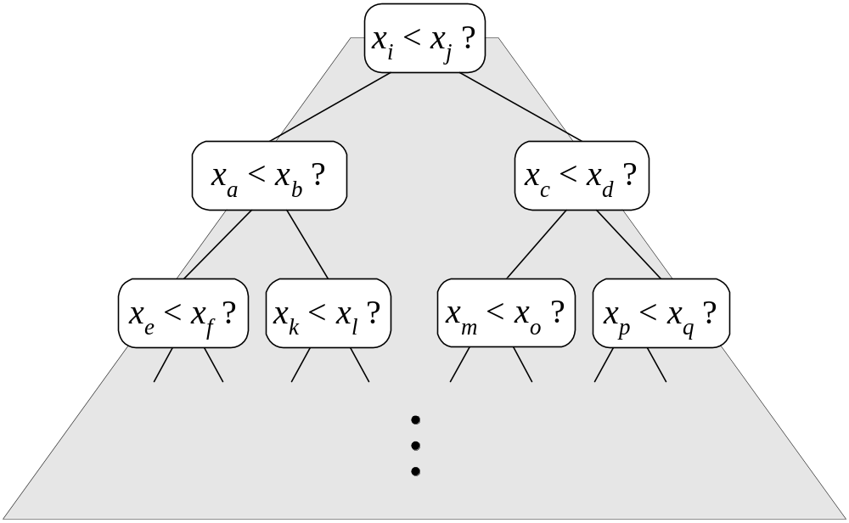
Counting Comparisons
Consequently, we can represent a comparison-based sorting with a decision tree.
Each possible run of the algorithm corresponds to a root-to-leaf path in that tree.
Sorting Lower Bound

Slide 7
Counting Comparisons
It is important to note that the algorithm may have no explicit knowledge of the tree; rather, it simply represent all the possible sequences of comparisons that the application might make.
Each leaf hence represents one possible permutation (sorted sequence) of the elements to be compared.
The number of leaves can then conclude the height of the tree.
Given n values to compare, That number of leaves (possible permutations) is actually n!
Sorting Lower Bound

Slide 8
Counting Comparisons
Example: Assume a sequence S with elements {x1, x2, x3} is to be sorted. There are 3! possible sorted sequences as follows:
(x1 x2 x3), (x1 x3 x2), (x2 x1 x3), (x2 x3 x1), (x3 x1 x2), and
(x3 x2 x1).
The following tree illustrates the possible comparisons:
x1 < x2
N
Y
x1 < x3
x2 < x3
Y
N
Y
N
x2 < x3
x3 x1 x2
x1 < x3
x3 x2 x1
Y
N
Y
N
x1 x2 x3
x1 x3 x2
x2 x1 x3
x2 x3 x1
Sorting Lower Bound

Slide 9
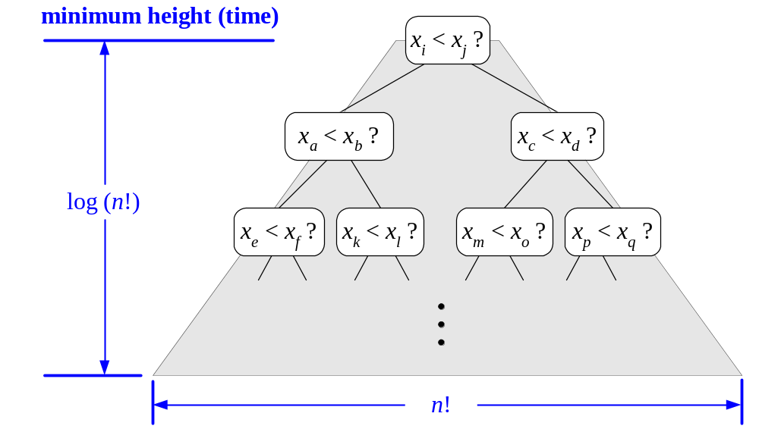
Decision Tree Height
The height of the decision tree is a lower bound on the running time.
Since there are n! leaves, the height of the tree is at least log (n!).
Sorting Lower Bound

Slide 10

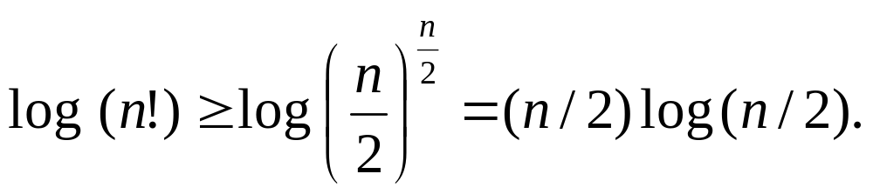
The Lower Bound
Any comparison-based sorting algorithms takes at least log (n!) time
Therefore, any such algorithm takes, at least, time
That is, any comparison-based sorting algorithm must run in at least Ω(n log n) time. In other words, we comparison-based algorithms, we cannot achieve any better performance than n log n.
However, can we do any better if the algorithm is not a comparison-based then? Are such algorithms possible?
Sorting Lower Bound
Notes:
Notes: You should notice that this time is not for every element. This time is already based on the number of elements to compare (which is n), which was the reason we have this tree with n! leaves. In short, this is the time needed to sort n elements using comparisons.
In other words, following any root-to-leaf path will result in the final sorting. Since this root-to-leaf path is limited to the height of the tree, which is log n!, sorting is o(log n!). This is already bigger than O(nlog n), which means we cannot sort in any less than nlogn → Ω(n log n)

