Slide 1

Graphs
Dr. Aiman Hanna
Department of Computer Science & Software Engineering
Concordia University, Montreal, Canada
These slides has been extracted, modified and updated from original slides of :
Data Structures and Algorithms in Java, 5th edition. John Wiley& Sons, 2010. ISBN 978-0-470-38326-1.
Data Structures and the Java Collections Framework by William J. Collins, 3rdedition, ISBN 978-0-470-48267-4. Both books are published by Wiley.
Copyright © 2010-2011 Wiley
Copyright © 2010 Michael T. Goodrich, Roberto Tamassia
Copyright © 2011 William J. Collins
Copyright © 2011-2018 Aiman Hanna
All rights reserved

Slide 2
Coverage
Graphs
Data Structures for Graphs
1843
ORD
SFO
802
1743
337
LAX
1233
DFW
Graphs

Slide 3
Graphs
A graph is a collection of objects (called vertices) and connections (edges) between these vertices.
A graph can hence be viewed as a pair (V, E), where
  V is a set of nodes, called vertices
  E is a collection of pairs of vertices, called edges
  Vertices and edges are positions and store elements/values
Example:
  A vertex represents an airport and stores the three-letter airport code
  An edge represents a flight route between two airports and stores the mileage of the route
849
PVD
1843
ORD
142
SFO
802
LGA
337
1743
1387
HNL
2555
1099
LAX
1233
DFW
1120
Graphs
MIA

Slide 4
Edge Types
Directed edge
  ordered pair of vertices (u,v)
  the first vertex, u, is the origin
  the second vertex, v, is the destination
  e.g., a flight
Undirected edge
  unordered pair of vertices (u,v)
  e.g., a flight route, distance between two cities
flight
AA 1206
ORD
PVD
849
miles
ORD
PVD
Graphs

Slide 5
Edge Types
Examples:
  A graph representing relations between authors. An edge exists if two authors have coauthored some publication. The edges are undirected since co-authorship is a symmetric relation; that is if A has co-authored a book with B then B must has co-authored something with A.
  A graph representing relationship between different inherited classes of an object-oriented language. Such edges (between a parent and child class) are directed edges since inheritance relationship is asymmetric; since inheritance goes only one way.
co-authored
publication
A
B
inherit
CL2
CL1
Graphs

Slide 6
Directed, Undirected & Mixed Graphs
A directed graph (also referred to as digraph) is a graph where:
  all the edges are directed
    e.g., route network
An undirected graph is a graph where:
  all the edges are undirected
    e.g., flight network
An mixed graph is a graph where:
  Some of the edges are directed and some are undirected
It is possible to convert a mixed or undirected graph to a directed graph by replacing every undirected edge (u, v) by two directed edges (u, v) and (v, u)
  However, it is often useful to keep such graphs as they are
Graphs

Slide 7
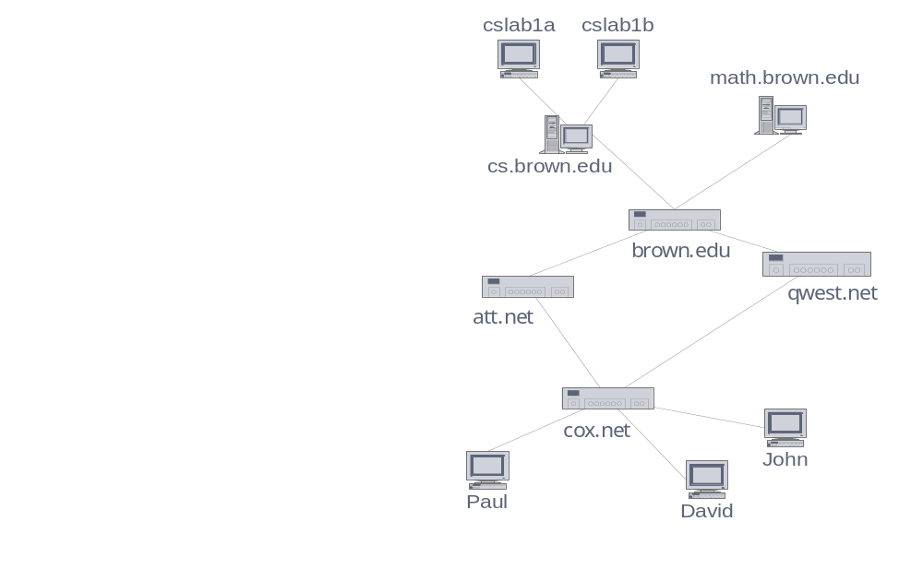
Applications
Electronic circuits
  Printed circuit board
  Integrated circuit
Transportation networks
  Highway network
  Flight network
Computer networks
  Local area network
  Internet
  Web
Databases
  Entity-relationship diagram
Graphs

Slide 8
Terminology
The two vertices joined by an edge are referred to as end vertices or endpoints.
  U and V are the endpoints of a
If an edge is directed, then its first endpoint is referred to as the origin, while its second endpoint is referred to as destination
Two vertices are called adjacent if there is an edge with these two vertices as endpoints .
  W, and Y are adjacent. V and Z are not
V
a
b
h
j
U
d
X
Z
c
e
i
W
g
f
Y
Graphs

Slide 9
Terminology
An edge is said to be incident on a vertex if the vertex is one of the edge’s endpoints
  e is incident on X; e is also incident on W
The outgoing edges of a vertex are those directed edges whose origin is that vertex
The incoming edges of a vertex are those directed edges whose destination is that vertex
V
a
b
h
j
U
d
X
Z
c
e
i
W
g
f
Y
Graphs

Slide 10
Terminology
The degree of a vertex v, deg(v), is the number of incident edges of that vertex v
  X has degree 5; that is
  deg(x) = 5
The in-degree of a vertex v, indeg(v), is the number of directed incoming edges of that vertex v
The out-degree of a vertex v, outdeg(v), is the number of directed outgoing edges of that vertex v
V
a
b
h
j
U
d
X
Z
c
e
i
W
g
f
Y
Graphs

Slide 11
Terminology
A Graph refers to the group of edges as a collection and NOT as a set
This classification allows two undirected edges to have the same endpoints and allows two directed edges to have the same origin and the same destination (i.e. two different flights from one city to another)
Such edges are referred to as Parallel edges or multiple edges
  h and i are parallel edges
Self-loop referred an edge that connects one vertex to itself
  j is a self-loop
V
a
b
h
j
U
d
X
Z
c
e
i
W
g
f
Y
Graphs

Slide 12
Terminology (cont.)
Path
  sequence of alternating vertices and edges
  begins with a vertex
  ends with a vertex
  each edge is preceded and followed by its endpoints
Directed path
  path such that all edges are directed and are traversed along their directions
Simple path
  path such that all its vertices and edges are distinct
Examples
  P₁=(V,b,X,h,Z) is a simple path
  P₂=(U,c,W,e,X,g,Y,f,W,d,V) is a path that is not simple
V
a
b
P₁
d
U
X
Z
P₂
h
c
e
W
g
f
Y
Graphs

Slide 13
Terminology (cont.)
Cycle
  circular sequence of alternating vertices and edges
  each edge is preceded and followed by its endpoints
Simple cycle
  cycle such that all its vertices and edges are distinct
Examples
  C₁=(V,b,X,g,Y,f,W,c,U,a,↵) is a simple cycle
  C₂=(U,c,W,e,X,g,Y,f,W,d,V,a,↵) is a cycle that is not simple
V
a
b
d
U
X
Z
C₂
h
e
C₁
c
W
g
f
Y
Graphs

Slide 14
Terminology (cont.)
Subgraph
  A graph H is a subgraph of graph G if all vertices and edges of H are subsets of the edges and vertices of G
  For example, vertices W, Y and X and edges e and f form a subgraph of the shown graph
Spanning Subgraph
  A graph H is a spanning subgraph of graph G if H contains all the vertices of G
Connected Graph
  A graph is connected if there is a possible path between any two of its vertices. In other words, it is all in one piece.
V
a
b
h
j
U
d
X
Z
c
e
i
W
g
f
Y
Graphs

Slide 15
Terminology (cont.)
Connected Components
  If a graph G is a disconnected graph, then its maximal connected subgraphs are called the connected components of G.
Forest
  A forest is a graph without cycles. Notice
  that a forest may have many components
Tree
  A tree is a connected graph without cycles (hence can be though of as a connected forest)
  NOTE: In the context of graphs, a tree is somewhat different than what we have previously introduced as trees
  In the context of graphs, a tree here has no root
  To eliminate ambiguity, trees as we defined before are referred to as rooted trees
  Trees as defined here are referred to as free trees
V
b
h
U
d
X
Z
c
W
g
Y
Graphs

Slide 16
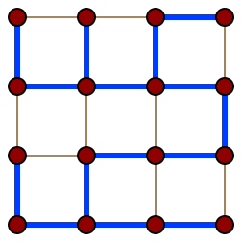
Terminology (cont.)
Spanning Trees
  A spanning tree T of a graph G is a spanning subgraph of G that is a free tree
  In other words, a spanning tree T of a graph G is:
    A subgraph that has all the vertices of G,
    All vertices are connected (that is one piece; a path exists between any two vertices)
    Has no cycles
  A spanning tree of a graph G can then be defined as:
    A maximal set of edges of G that contains no cycle, or as
    A minimal set of edges that connect all vertices
A spanning tree (blue heavy edges) of a grid graph*
*Source: http://en.wikipedia.org/wiki/Spanning_tree
Graphs

Slide 17
Graph Properties (Assume Simple Graphs Here)
Property 1:
  The sum of all degrees in a graph is equal to twice the number of edges in the graph
  Σ_{v} deg(v) = 2m
  Proof:
  each edge is counted twice when we calculate the degree (since each connection gives/adds 1 value to the degree at both ends)
  In other words, each edge adds 2 to the degree
Notation
  n number of vertices
  m number of edges
  deg(v) degree of vertex v
Example
  n = 4
  m = 6
  deg(v) = 3
  Σ_{v} deg(v) = 3 ∗ 4 = 12 = 2m
Graphs

Slide 18
Graph Properties (Assume Simple Graphs Here)
Property 2:
  If G is a directed graph then the sum of in-degree equals to the sum of the out-degree and equals to the number of edges
   Σ_{v} indeg(v) = Σ_{v} outdeg(v) = m
  Proof:
  each directed edge is counted once when we calculate the in-degree and counted once when we calculate the out-degree (since each connection gives/adds 1 value to the in-degree and 1 value to the out-degree)
Notation
  n number of vertices
  m number of edges
  deg(v) degree of vertex v
Example
  n = 4
  m = 6
  Σ_{v} indeg(v) = Σ_{v} outdeg(v) = 6 = m
Graphs

Slide 19
Graph Properties (Assume Simple Graphs Here)
Property 3
  The number of edges of an undirected simple graph is less than or equal to
  n(n − 1)/2, where n is the number of vertices
  m ≤ n(n − 1)/2
  Proof:
  each vertex has degree of at most (n − 1); this is the case when every other vertex has an edge with that vertex
  The maximum possible total (sum) degree is hence n(n-1)
  Using Property 1, 2m <= n(n-1)
  ➔ m ≤ n(n − 1)/2
Notation
  n number of vertices
  m number of edges
  deg(v) degree of vertex v
Example
  n = 4
  m = 6
  2m = 12 <= 4 * 3 = 12
Graphs

Slide 20
Main Methods of the Graph ADT
Vertices and edges
  are positions
  store elements
Accessor methods
  endVertices(e): return an array of the two end vertices of e
  opposite(v, e): return the vertex opposite of v on e; error if e is not incident of v
  areAdjacent(v, w): return true if v and w are adjacent; false otherwise
  replace(v, x): replace element at vertex v with x
  replace(e, x): replace element at edge e with x
Graphs

Slide 21
Main Methods of the Graph ADT
Update methods
  insertVertex(x): insert and return a new vertex storing element x
  insertEdge(v, w, x): insert and return a new edge (v,w) storing element x
  removeVertex(v): remove vertex v and all its incident edges, and return the element stored at v
  removeEdge(e): remove edge e and return the element stored at e
Iterable collection methods
  vertices(): return an iterable collection of all the vertices of the graph
  edges(): return an iterable collection of all the edges of the graph
  incidentEdges(v): return an iterable collection of all the edges incident upon vertex v
Graphs

Slide 22
Data Structures for Graphs
There are three popular ways of representing graphs, which are referred to as:
  Edge List Structure
  Adjacency List Structure
  Adjacency Matrix Structure
All three use a collection to store the vertices of the graph
However, for edges, there is a fundamental difference between the first two structures and the latter
The first two structures only store edges actually present in the graph, resulting in a O(n + m) space complexity (n vertices and m edges)
  The adjacency matrix structure stores an edge placeholder for each pair of vertices whether or not the edge exists, resulting in a O(n²) space complexity
Graphs

Slide 23
Edge List Structure
In this representation of a graph, both vertices and edges are represented as objects
The vertices objects are stored in a collection/sequence V, and the edges are stored in another collection E
V and E can be array lists, node lists or other types
Each entry in V points to a vertex object
Each entry in E points to an edge object
A vertex object stores the value of that vertex and a pointer to its location in V
An edge object stores the value of that edge, two pointers to its two vertices, and a pointer to its location in E
Graphs

Slide 24
Edge List Structure
u
Vertex object
  element
  reference to position in vertex sequence
Edge object
  element
  origin vertex object
  destination vertex object
  reference to position in edge sequence
Vertex sequence
  sequence of vertex objects
Edge sequence
  sequence of edge objects
Graph
a
c
b
d
v
w
z
Edge List
V
u
v
w
z
a
b
c
d
E
Graphs

Slide 25
Edge List Structure Analysis
Edge list is simple to implement, however it has significant performance limitations
Finding the end points of an edge: O(?)
Finding the opposite end point of an edge: O(?)
The insertion of a vertex: O(?)
The insertion of an edge: O(?)
The removal of an edge: O(?)
Finding the incident edges of a vertex v: O(?)
Finding if a vertex w is adjacent to a vertex v: O(?)
Removing a vertex: O(?)
Graphs

Slide 26
Edge List Structure Analysis
Edge list is simple to implement, however it has significant performance limitations
Finding the end points of an edge, or the opposite vertex of an edge is O(1)
The insertion of a vertex, the insertion of an edge, as well as the removal of an edge is also O(1)
However, to find the incident edges of a vertex v, a complete search of the edges list is required, resulting in O(m) instead of O(deg(v))
Finding if a vertex w is adjacent to a vertex v would also require searching all edges to find an edge with endpoints v and w, resulting in O(m)
Removing a vertex would also result in O(m), since an entire search of the list is required to remove all incident edges of that vertex.
Graphs

Slide 27
Edge List Structure Analysis
Operation | Complexity
endVertices(e), opposite(v, e) | O(1)
replace(v, x), replace(e, x) | O(1)
insertVertex(x), insertEdge(v, w, x), removeEdge(e) | O(1)
incidentEdges(v) | O(m)
areAdjacent(v, w) | O(m)
removeVertex(v) | O(m)
vertices() | O(n)
edges() | O(m)
Space Complexity | O(m + n)
Graphs

Slide 28
Adjacency List Structure
The adjacency list structure includes all the structural components of the edge list structure plus:
  A vertex object v holds a reference to a collection, referred to as the incidence collection of v or l(v). The incidence collection of v is traditionally a list whose elements store references to the edges incident on v.
  The edge object for an object e connecting vertices v and w has an additional two references, which reference the two elements associated with that edge e in l(v) and l(w). This allows for finding all incident edges of a vertex from an edge to that vertex.
  The space utilization is hence still proportional to the number of vertices and edges of the graph
Graphs

Slide 29
Adjacency List Structure
a
v
b
Graph
u
w
Adjacency List
V
Vertex objects
u
v
w
Incidence collections
Edge objects
a
b
E
Graphs

Slide 30
Adjacency List Structure Analysis
Finding the end points of an edge: O(?)
Finding the opposite end point of an edge: O(?)
The insertion of a vertex: O(?)
The insertion of an edge: O(?)
The removal of an edge: O(?)
Finding the incident edges of a vertex v: O(?)
Finding if a vertex w is adjacent to a vertex v: O(?)
Removing a vertex: O(?)
Graphs

Slide 31
Adjacency List Structure Analysis
Operation | Complexity
endVertices(e), opposite(v, e) | O(1)
replace(v, x), replace(e, x) | O(1)
insertVertex(x), insertEdge(v, w, x), removeEdge(e) | O(1)
incidentEdges(v) | O(deg(v))
areAdjacent(v, w) We can find that by inspecting the incidence collection of v or the incidence collection of w. We choose to inspect the smaller one. | O(min(deg(v), deg(w)))
removeVertex(v) Go to the incidence collection of v and remove all edges pointed by its elements | O(deg(v))
vertices() | O(n)
edges() | O(m)
Space Complexity | O(m + n)
Graphs

Slide 32
Adjacency Matrix Structure
The adjacency matrix structure includes all the structural components of the edge list structure plus:
  The vertex object is extended to include a distinct integer i in the range [0 – N-1], which is referred to as the index of v
  A matrix, which is a two-dimensional array A of size n x n, such that A[i, j] holds a reference to the edge (v, w), where v is the vertex with index i and w is the vertex with index j. If the edge (v, w) does not exist, then A[i, j] holds null.
Graphs

Slide 33
Adjacency Matrix Structure
a
v
b
Graph
u
w
Adjacency Matrix
V
Vertex objects
0
u
1
v
2
w
 | 0 | 1 | 2
0 | ∅ |  | ∅
1 |  | ∅
2 | ∅ |  | ∅
The Matrix
Edge objects
a
b
E
Graphs

Slide 34
Adjacency Matrix Structure Analysis
Finding the end points of an edge: O(?)
Finding the opposite end point of an edge: O(?)
The insertion of an edge: O(?)
The removal of an edge: O(?)
The insertion of a vertex: O(?)
Finding the incident edges of a vertex v: O(?)
Finding if a vertex w is adjacent to a vertex v: O(?)
Removing a vertex: O(?)
Graphs

Slide 35
Adjacency Matrix Structure Analysis
Operation | Complexity
endVertices(e), opposite(v, e) | O(1)
replace(v, x), replace(e, x) | O(1)
insertEdge(v, w, x), removeEdge(e) | O(1)
incidentEdges(v) We need to examine an entire row or column then follow the non-null links to find the exact edges | O(n + deg(v)) ➔ O(n)
areAdjacent(v, w) | O(1)
removeVertex(v), insertVertex(x) Any addition or removal require the creation/construction of a whole new matrix with larger or smaller size respectively | O(n²)
vertices() | O(n)
edges() | O(m)
Space Complexity | O(n²)
Graphs

Slide 36
Performance Comparison
n vertices, m edges no parallel edges no self-loops | Edge List | Adjacency List | Adjacency Matrix
Space | n + m | n + m | n²
incidentEdges(v) | m | deg(v) | n
areAdjacent (v, w) | m | min(deg(v), deg(w)) | 1
insertVertex(o) | 1 | 1 | n²
insertEdge(v, w, o) | 1 | 1 | 1
removeVertex(v) | m | deg(v) | n²
removeEdge(e) | 1 | 1 | 1
Historically, Adjacency Matrix was proposed first to represent graphs.
With the exception of areAdjacent(), Adjacency List performs best compared to the other two structures.
Graphs

