Slide 1

Linked Lists & Iterators
Dr. Aiman Hanna
Department of Computer Science & Software Engineering
Concordia University, Montreal, Canada
These slides has been extracted, modified and updated from original slides of :
Data Structures and Algorithms in Java, 5th edition. John Wiley& Sons, 2010. ISBN 978-0-470-38326-1.
Data Structures and the Java Collections Framework by William J. Collins, 3rdedition, ISBN 978-0-470-48267-4. Both books are published by Wiley.
Copyright © 2010-2011 Wiley
Copyright © 2010 Michael T. Goodrich, Roberto Tamassia
Copyright © 2011 William J. Collins
Copyright © 2011-2018 Aiman Hanna
All rights reserved

Slide 2




Coverage
Singly Linked Lists
Doubly Linked Lists
Circularly Linked Lists
Iterators
Linked Lists & Iterators

Slide 3
Singly Linked List
A singly linked list is a concrete data structure consisting of a sequence of nodes
Each node stores
  element
  link to the next node
next
elem
node
∅
A
B
C
D
Linked Lists & Iterators

Slide 4
The Node Class for List Nodes
public class Node {
// Instance variables:
private Object element;
private Node next;
/** Creates a node with null references to its element and next node. */
public Node() {
this(null, null);
}
/** Creates a node with the given element and next node. */
public Node(Object e, Node n) {
element = e;
next = n;
}
// Accessor methods:
public Object getElement() {
return element;
}
public Node getNext() {
return next;
}
// Modifier methods:
public void setElement(Object newElem) {
element = newElem;
}
public void setNext(Node newNext) {
next = newNext;
}
}
Linked Lists & Iterators

Slide 5
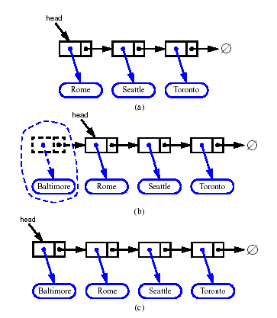
Inserting at the Head
Allocate a new node
Insert new element
Have new node point to old head
Update head to point to new node
Linked Lists & Iterators

Slide 6
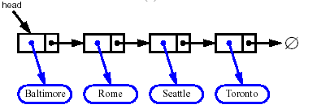


Removing at the Head
Update head to point to next node in the list
Allow garbage collector to reclaim the former first node
Linked Lists & Iterators

Slide 7
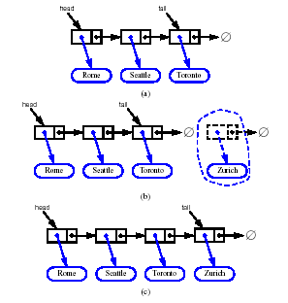
Inserting at the Tail
Allocate a new node
Insert new element
Have new node point to null
Have old last node point to new node
Update tail to point to new node
Linked Lists & Iterators

Slide 8
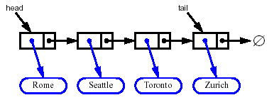
Removing at the Tail
Removing at the tail of a singly linked list is not efficient!
There is no constant-time way to update the tail to point to the previous node
Linked Lists & Iterators

Slide 9
Stack as a Linked List (Review Section 5.1.3)
We can implement a stack with a singly linked list
The top element is stored at the first node of the list
The space used is O(n) and each operation of the Stack ADT takes O(1) time
nodes
t
∅
elements
Linked Lists & Iterators

Slide 10
Queue as a Linked List (Review Section 5.2.3)
We can implement a queue with a singly linked list
  The front element is stored at the first node
  The rear element is stored at the last node
The space used is O(n) and each operation of the Queue ADT takes O(1) time
r
nodes
f
∅
elements
Linked Lists & Iterators

Slide 11
Doubly Linked List
A doubly linked list provides a natural implementation of the Node List ADT
Nodes implement Position and store:
  element
  link to the previous node
  link to the next node
Special sentinel/dummy trailer and header nodes (simplify implementation)
prev
next
elem
node
header
nodes/positions
trailer
elements
Linked Lists & Iterators

Slide 12
Insertion
We visualize operation insertAfter(p, X), which returns position q
p
A
B
C
p
A
B
q
C
X
p
q
A
B
X
C
Linked Lists & Iterators

Slide 13
Insertion Algorithm
Algorithm addAfter(p,e):
Create a new node v
v.setElement(e)
v.setPrev(p) {link v to its predecessor}
v.setNext(p.getNext()) {link v to its successor}
(p.getNext()).setPrev(v) {link p’s old successor to v}
p.setNext(v) {link p to its new successor, v}
return v {the position for the element e}
Linked Lists & Iterators

Slide 14
Deletion
We visualize remove(p), where p = last()
p
A
B
C
D
A
B
C
p
D
A
B
C
Linked Lists & Iterators

Slide 15
Deletion Algorithm
Algorithm remove(p):
t = p.element {a temporary variable to hold the return value}
(p.getPrev()).setNext(p.getNext()) {linking out p}
(p.getNext()).setPrev(p.getPrev())
p.setPrev(null) {invalidating the position p}
p.setNext(null)
return t
Linked Lists & Iterators

Slide 16
Performance
In the implementation of the List ADT by means of a doubly linked list
  The space used by a list with n elements is O(n)
  The space used by each position of the list is O(1)
  Operations of the List ADT run in O(1) time (as will be discussed later)
  Operation element() of the Position ADT also runs in O(1) time (as will be discussed later)
Linked Lists & Iterators

Slide 17
Iterators
An iterator abstracts the process of scanning through a collection of elements
It maintains a cursor that sits between elements in the list, or before the first or after the last element
Methods of the Iterator ADT:
  hasNext(): returns true so long as the list is not empty and the cursor is not after the last element
  next(): returns the next element
Extends the concept of position by adding a traversal capability
Linked Lists & Iterators

Slide 18
Iterable Classes
An iterator is typically associated with an another data structure, which can implement the Iterable ADT
We can augment the different ADTs (i.e. Stack, Queue, List, etc. ) with method:
  Iterator<E> iterator(): returns an iterator over the elements
  In Java, classes with this method extend Iterable<E>
Two notions of iterator:
  snapshot: freezes the contents of the data structure at a given time
  dynamic: follows changes to the data structure
  In Java: an iterator will fail (and throw an exception) if the underlying collection changes unexpectedly
Linked Lists & Iterators

Slide 19
The For-Each Loop
Java provides a simple way of looping through the elements of an Iterable class:
  for (type name: expression)
    loop_body
  For example:
    List<Car> ls1;
    for (Car c : ls1)
    System.out.println(c); // Car is assumed to have a toString method defined.
Linked Lists & Iterators

Slide 20
List Iterators in Java
Java uses a the ListIterator ADT for node-based lists.
This iterator includes the following methods:
  add(e): add e at the current cursor position
  hasNext(): true if there is an element after the cursor
  hasPrevious: true if there is an element before the cursor
  previous(): return the element e before the cursor and move cursor to before e
  next(): return the element e after the cursor and move cursor to after e
  set(e): replace the element returned by last, next or previous operation with e
  remove(): remove the element returned by the last, next or previous method
Linked Lists & Iterators

