Slide 1
Elimination of Ticket Stubs in Cineplex Theatres
Philip Dumaresq
ENCS 282

Slide 2
Purpose
The movie theatre industry in the US alone produces nearly 30,000 tones of waste in paper stubs alone, annually.
Cineplex is the 4th largest theatre company in North American and the largest in Canada with almost 10% market share.
10% means that they generate approximately 3,000 tonnes of paper stubs annually, and it all gets thrown in the garbage.
My proposal is a 4 year plan to completely phase out physical paper stubs in Cineplex theatres in North America.

Slide 3
Approach
We need to find a better solution than admitting people to theatres by ripping a paper stub.
Cineplex already has a lot of infrastructure in place to support phasing out physical tickets already. Primarily:
The Cineplex app
Scene cards
Using these two things, we can allow people to get into the theatres quickly an efficiently without generating waste, while promoting customer loyalty.
How?

Slide 4
Result
Connect cineplex app and Scene cards to allow using the two interchangeably for ticket purchasing
Buy a ticket on the Cineplex app, and use your scene card to gain entrance to the theatre.
Load a movie onto your Scene card at kiosks, then scan a QR code on your phone to get into the theatre.
Whenever people use their Scene cards, they gain points. Connecting your Scene card and the Cineplex app encourages customer loyalty by rewarding people for using Cineplex theatres.

Slide 5
Plan of Action
Expand the current system to allow QR codes scanned in every Cineplex theatre.
Add systems allowing customers to scan into the theatre using their Scene cards. Also allow customers to get a new Scene card on the spot if they don’t have one.
Link Scene cards and Cineplex app to work together seamlessly. Which method you use to purchase a ticket doesn’t matter, you can get in with your phone or your Scene card.
Finish phasing out existing system.

Slide 6
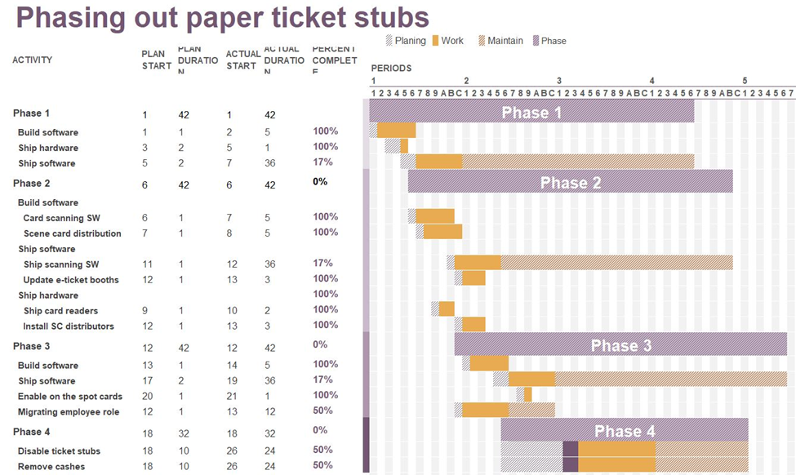
Schedule
Expansion of existing system: 6 months
Expansion of Scene card infrastructure:
Entry using Scene cards: 6 months
On the spot Scene card distribution: 3 months
Linking of Scene card and Cineplex app: 4 months
Finish phasing out existing system: 2 years

Slide 7
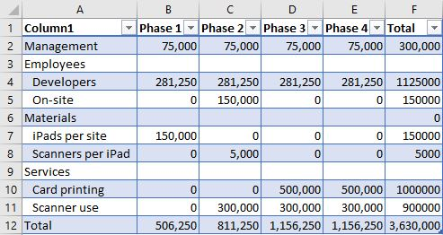
Budget
Management: …………………………………..... | $300,000
Labour: ……………………………………………… | $1,275,000
Materials: ………………………………………….. | $155,000
Services: ……………………………………………. | $1,900,000
Total: ………………………………………………… | $3,63o,000

Slide 8
Conclusion
Reduces up to 3,000 tonnes of waste annually after the full 4 year transition.
Makes a more convenient system for customers to use.
Reduces amount of on-site personnel for each theatre.
Makes profit from first-time distribution of Scene cards.

