Slide 1

Grand Falls Flowage
The Maine Blade Runners
http://www.themainebladerunners.net/

Slide 2
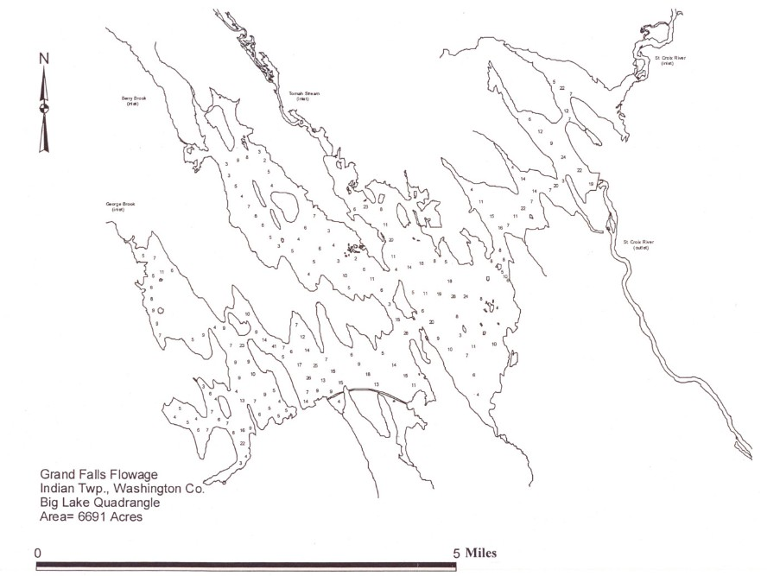

Slide 3
The issue: On February 9, 2012, the Maine Blade Runners received notice that ALL permits on Grand Falls Flowage were being denied after years of successful events on this body of water Why?

Slide 4
Maine Blade Runners President Matt Mitchell: “If I, or any of my members truly felt this was a needed decision, we definitely would back IFW on this. I and many others surely can see that this decision was based completely on the desires of special interests. I have no issue with anyone trying to make a living off the waters of the state of Maine. I always have been a strong promoter of catch and release, but that's my choice. On the other hand, I do not condemn people for eating what they catch, that's their choice. Bottom line of this issue is, why does catch and release mean NO BASS TOURNAMENTS? We may not release our fish immediately after they're caught, but they all are released alive at the end of the day. I cannot make the connection between the two issues. I was first told by MDIFW Fisheries Director Mike Brown that this was a small fish issue, then it went to fisherman's input, then a habitat concern because of the re-introduction of alewives. We fish a lot of lakes that contain alewives. Its a major food source for bass. Mr. Brown stated alewives ruined Spednik Lake. I stated that alewives did not ruin that lake but when IFW took out the dam to allow alewives back into that fishery, the water level dropped below the spawning beds of the bass and killed all the spawn. Mr. Brown admitted this was true, but only one factor on the bass decline in that lake. I also find it very interesting that I was told this on the deadline day of bass tournament permits being issued. It was no secret that we were drawing permits on GFF, our club has done it for years. Plus, we drew them at an open meeting held every winter just for bass tournament permits. This was on Jan. 12, 2012 in Augusta. Seems to me if this was a real issue, they would have known before Jan. 12, 2012. They knew Feb. 9, 2012, the day my applications were denied. “

Slide 5
Is there another reason?

Slide 6
IFW Advisory Committee Minutes 9/28/11:
“The flowage, it was the first time our biologists and the Indian biologist had worked together. “
“Mr. Wheaton presented a letter from Long Lake Camps. On the St. Croix watershed on the West Branch we had Big Lake, Long Lake, Louis Lake and the flowage. The bass fishery is world renowned on the flowage. He belonged to the Grand Lake Guide’s Association, the Maine State Guide Association, etc. Recently, the fishing on the flowage had gotten so bad (1/2 the water was Passamaquoddy water) leading into Louis Lake and Long Lake where the reservation was. They recently voted to go to no kill. Many years ago Spednik Lake had many articles written (that’s on the East Branch of the St. Croix river) about the fabulous fishery. Then came the introduction of alewives. They were stocked without any input from IF&W. They did not have to prove they were detrimental to the fishery. Finally through legislation the people there fought and got alewives stopped from running above Grand Falls. The fish had deteriorated in Spednik Lake while the alewives were there. Mr. Wheaton stated he had fished there for 50 years. The land trusts had bought all the land around the lake, so it was complete wilderness. The fishing was so bad he went from 80 to 100 fish per day, down to 1 and some days none. “

Slide 7
IFW Advisory Committee Minutes 9/28/11:
Mr. Wheaton stated most of them had read about alewives getting into the St. Croix and going to Spednik Lake and annihilating the fishery. With diving biologists there were so few fish that we had to bring in fish from other lakes to restock the lake. It was determined to go to a catch and release program so the population could rebuild. The fishery was now starting to come back. For some reason, the flowage had gone down hill. The catch rate was almost zero. The Indians wanted to close it to catch and release. Greg Burr, regional fishery biologist decided that might be a good idea and everyone in the region was in favor. It had been brought to Mr. Wheaton by many guides and camp owners on Long Lake and Big Lake that they would like to see the regulation brought to Big, Long and Louis Lakes. This was what Mr. Wheaton had wanted to address in the catch and release portion of his request.

Slide 8
IFW Advisory Committee Minutes 9/28/11:
Mr. Wheaton stated in talking with IF&W biologists of Enfield and Jonesboro they did health studies on Meddybemps Lake and Baskehegan Lake and the fish were put into tanks and transported to Spednik Lake to restock it. On Meddybemps approximately 1400 bass were taken and released and the following year they went to Baskahegan Lake and another 1200 were caught and released. Spednik Lake had been made catch and release only. The large class of fish was not there yet. The 4-5 lb. class of smallmouth was not there, but it took 25 years to get a fish that big. They were catching fish. The guides of Grand Lake Stream, Big Lake, Long Lake, Louis Lake and the flowage had decreased because they were keeping fish. Many sports were going to Spednik Lake. The lake would support catch and release. People did not want to travel. License revenues were coming in to fish Spednik Lake 50 miles away. The Indians voted to go to catch and release. Long Lake camps would like to see a few lakes in the area go catch and release. They believed we would see increased revenue and increased work for guides. Mr. Wheaton stated he had talked to fish biologist Greg Burr and he was supportive.

Slide 9
Information from MDIFW

Slide 10
Regional Fishing Information - Region C
Big Lake and Grand Falls Flowage
Two other waters, Big Lake and Grand Falls Flowage, in this part of the region provide outstanding smallmouth bass fisheries. Both waters attract numerous “sports” who fish these waters each June to do battle with feisty smallmouths. These waters have responded well to the slot limits adopted in 1992. Although Grand Falls Flowage has historically been a consistent producer of 16-18” bass, it seems it’s ready to yield even more fish of this highly desirable size. Anglers need to use caution when boating due to numerous slightly submerged deadheads.
Retrieved on 2-19-12 from: http://www.maine.gov/ifw/fishing/regional_information/region_c.htm

Slide 11
Retired MDIFW Biologist Rick Jordon
"Numbers of bass have declined since the days when we started going there but they seem to be coming back as of late. The bass on that water need a higher level of protection, it's a unique type of water to all the other types of waters in Maine. It doesn't have a lot of spawning areas with good depths so the harvest limits should be restricted. Having said that, I see no reason to eliminate bass tournaments. They have been ongoing for a number a years with good bags being weighed in. The new rule of continuous running of the live well will greatly, if not virtually, eliminate bass mortality during tournaments. In my opinion, a 'no harvest rule' should not point to an elimination of weigh-in- then release bass tournaments. The number of anglers participating in these events is just a tiny fraction of the total number of anglers that fish for bass throughout the open water season. Again, I don't understand the elimination bass tournaments there.“
Retrieved on February 12,2012 from:
http://www.mainesportsman.com/forum/viewtopic.php?f=7&t=606&sid=277c37d95adea2eeba27630dcf163e38&start=30

Slide 12
Note: The following tournament data is based on a total catch of only 5 fish because of the tournament rules. In actuality, many more fish are caught and released in a day’s fishing, but are not included in these results
What we have seen in our tournaments

Slide 13
GFF Bag Weight (lbs.) Trends SP=spring / SU=summer/ F=fall (five fish)

Slide 14
GFF Lunker trends (single fish wt. in lbs.)

Slide 15
GFF Spring Bag Weight (lbs.) Trends (five fish)

Slide 16
GFF Fall Bag Weight (lbs.) Trends (five fish)

Slide 17
Average Single Fish Weight Trend in lbs.

Slide 18
GFF 2004-2010 Bass/HR

Slide 19
GFF 2004-2010 Bass/Day

Slide 20
See what others are saying…
The Maine Sportsman Forum:
http://www.mainesportsman.com/forum/viewtopic.php?f=7&t=606
The Maine Blade Runners Forum:
http://www.themainebladerunners.net/blog.html
Advisory Board Minutes on DIFW:
http://www.maine.gov/ifw/commissioners_office/advisorycouncil/minutes/index.htm

Slide 21
We want answers, and we need your help.

Slide 22
Who we have contacted
•Governor Paul LePage Senator Kevin Raye
•MDIFW Commissioner Chandler Woodcock
•MDIFW Fisheries Director Michael Brown
•MDIFW Fisheries Biologist Gregg Burr
•ALL DIFW advisory Board members
•Bangor Daily news
•Calais Advertiser

Slide 23
Please contact these people and others and ask for answers.

Slide 24
The Maine Blade Runners
http://www.themainebladerunners.net/

