Slide 1
How does financial innovation affect bank behavior? Evidence from credit markets
Lars Norden
Consuelo Silva Buston
Wolf Wagner

Slide 2
Motivation
There is an ongoing debate about the effect of financial innovations on financial institutions: risk-sharing benefits versus costs of risk-taking incentives
“Credit derivatives [have] contributed to the stability of the banking system by allowing banks . . . to measure and manage their credit risks more effectively. …”
Alan Greenspan, 2005
"The boom in subprime mortgage lending was only a part of a much broader credit boom characterized by an underpricing of risk, excessive leverage, and the creation of complex and opaque financial instruments that proved fragile under stress,"
Ben Bernanke, 2008
Notes:
Risk-sharing benefits: It would allocate risk in a more efficient way, passing on the risk to the agents that are in a best position to bear them.
Risk-taking incentives: They allow financial institutions to extend a larger volume of loans, increasing banks exposures.
Citation Bernanke: http://www.wallstreetandtech.com/articles/227000512 University of California at Berkeley (2008)

Slide 3
Effects may depend on economic conditions:
There is the concern that financial innovation, although beneficial under normal market circumstances, are exacerbating problems in crisis times. Thus, innovations fail precisely when they are most needed.
Whether or not this is the case, is likely to depend on the channel through which financial innovations affect banks:
If banks use innovations to manage risks better, they should be less affected by crises. However, they may also become reliant on markets for innovations

Slide 4
This paper
Focus on credit derivatives
Study potential benefits and costs of use of credit derivatives at banks by looking at the (loan) spreads banks charge to their corporate customers
Try to identify the channel through which loan pricing may be affected
Compare operation of channel in normal and in crisis times

Slide 5
Channels: Financial innovations and loan pricing
Incentives Channel: Banks transferring the risk have less incentives to monitor and screen their borrowers. Therefore, end up with riskier borrowers (Morrison (2006), Wagner and Marsh (2007), Cebenoyan and Strahan (2004), Santos and Ashcraft (2007)). Should result in higher (loan) spreads.
Hedging Channel: By hedging exposures banks can reduce the marginal cost of risk-taking (Nadaud and Weisbach (2011)). Should result in lower spreads.
Capital Relief Channel: Banks are lending constrained due to low amount of capital. Risk transfer removes this constraint by reducing the risk of their portfolios, releasing capital to be lent (Loutskina and Strahan (2006)). Should result in lower spreads.
Risk Management Channel: Banks can use financial innovations to achieve a more balanced risk profile of their portfolio and more easily keep overall risk at target. This reduces risk of becoming constrained and being exposed to stress, allowing banks to price loans more aggressively (Cebenoyan and Strahan (2004)) and Hirtle (2009)). Should result in lower spreads.

Slide 6
Financial Innovation and Spreads Prior to the Crisis
Ashcraft and Santos (2009) show that firms are charged higher spreads after they start being traded in the CDS market. They argue that this effect is driven by lowered bank incentives to monitor.
Hirtle (2009) finds a negative relation between net position held of credit derivatives and loan spreads, arguing Risk Management Channel.
Nadaud and Weisbach (2011), show that loans that are later on part of a CLO obtained lower spreads when issued, consistent with Hedging Channel.
Notes:
So far, no clear mechanism through which financial innovations affect loan interest rates.

Slide 7
Our approach to identify the channel
Key idea: distinguish between the net position (protection bought minus sold) and the gross CDS position (protection bought plus sold)
All channels except the risk management channel require taking a net position in credit derivatives
Risk management can take place through gross positions without necessarily taking a net position:
A bank may buy protection on borrowers that are overrepresented and sell protection on names not contained in portfolio
Regular use of credit derivatives improves risk measurement at banks regardless of what position is taken

Slide 8
Predictions of the effect of CDS channels on spreads
Channel | Net CD Position | Gross CD Position
Incentives Channel | (+) | No effect
Hedging Channel | (-) | No effect
Capital Relief Channel | (-) | No effect
Risk Management Channel | No effect | (-)

Slide 9
Data
Individual loan data from Loan Pricing Dealscan Database (syndicated loans)
Term loans with single lead arranger
Match each loan with bank data (lead arranger) from U.S Call Reports
Sample: 1Q97-1Q10, 2638 observations, 77 different banks.
Dependent Variable: Spread (all-in) over Libor
Variables of interest: CD position of bank extending the loan, net and gross
Loan Controls: log(amount), secured/unsecured, maturity dummies, loan purpose dummies, tranche type dummies.
Borrower Controls: log(sales), ticker, rated, industry dummies
Bank Controls: log(assets), equity/TA, ROA, sub.debt/TA, liquidity/TA, charge-offs/TA.

Slide 10
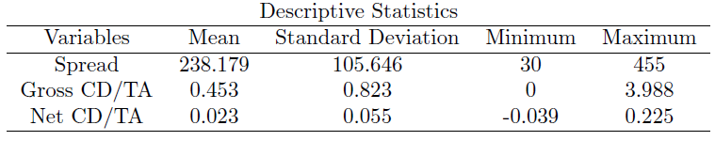
Data (II)

Slide 11
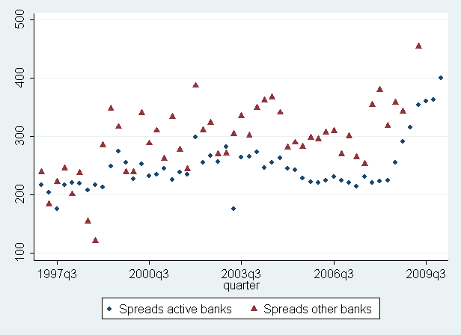
CDS and spreads: A look at the sample means…

Slide 12
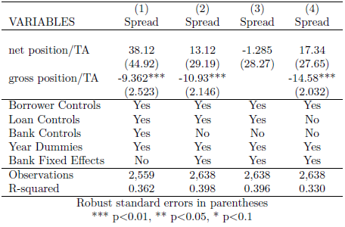
CDS and spreads: Baseline regressions
Evidence for risk management channel: Gross position significantly negative.
No evidence for other channels (no effect through net position).
Economic effect is also significant: One standard deviation increase in Gross position leads to a decrease in spread by 8.9 bps
Notes:
Dependent variable: spread over LIBOR.
Variables of interest: Gross and Net over total assets.
All controls , Net +Gross
****Gross negative and significant: Consistent with Risk Management Channel.
(2) Because of possible banks unob. Chars: Exclude Bank Controls , Include Bank FE.
(3) Because of possible collinearity among two variables, we exclude gross.
(4) Because loan determinants and spreads usually jointly determined we exclude these controls.

Slide 13
Identification of risk management effect
CD use may be correlated with other risk management tools
Control in regression for other derivatives used for hedging
Endogeneity:
Risk-loving bank may simultaneously underprice in lending market and write protection in CD market.
Or: bank that has good lending opportunities may have low lending rates and hedge additional risk using credit derivatives.
This endogeneity operates through the net amount!
Any remaining endogeneity:
IV approach with other derivatives used for trading as instruments:
Trading derivatives typically precedes derivatives hedging and it is unlikely that pure trading has an independent effect on loan pricing
Contemporaneous endogeneity: lag CDS positions by one year

Slide 14
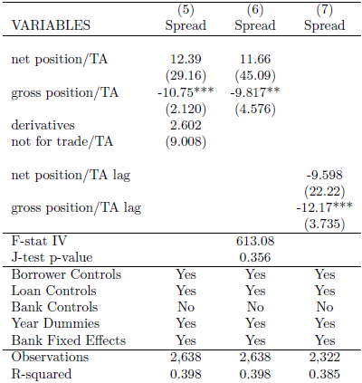
Identification
Results hold when controlling other forms of risk management
Results unchanged when instrumenting the gross position
Results robust when we control for contemporaneous endogeneity problems.
Notes:
(5) To control for the fact that the effect might be driven by the bank general sophistication in hedging. We include also the sum of the stock of other derivatives for hedging.
(6) Other possible source of bias in our model could arise if banks become more aggressive in a given period increasing the amount of derivatives held and also lowering spreads (negative bias). To control for this bias, we instrument the Gross position variable using derivatives held for trading: interest rate contracts, foreign exchange contracts, equity derivative contracts and commodity contracts.
Relevant instrument (Minton, 2009) F=613
Exogenous: trading activities are not related to pricing policy.
(7) We also test our hypothesis with the variables of interest lagged in order to account for other possible contemporaneous sources of biases.

Slide 15
Risk management benefits and borrower types
By comparing effects for different types of borrowers we can understand better the channels through which risk management affects loan pricing
We find that borrowers that are more likely to be actively traded in the CDS-market (large investment grade companies) benefit from banks risk management significantly larger (44 bps reduction for one stdev gross position)
Interestingly, we also find that risk management benefit extends to unrated borrowers, which are unlikely to be traded in CDS market (the impact is similar to the overall pool of firms)
This suggests that risk management using credit derivatives leads to general reduction in the cost of risk-taking at banks. It may also reflect pseudo-hedging.

Slide 16
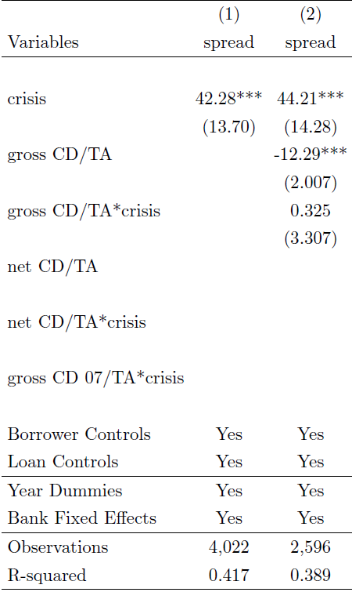
CDS and spreads during the crisis
Spreads have increased across the board, also for banks using CDS
The benefits from risk management persist after the onset of the crisis and do so with a similar magnitude
Notes:
We expect risk management benefits to persist during the crisis.
Just include the crisis dummy, equal to one after IV07 . We show that spreads increased across the board.
The benefit of risk management stays unchanged for this period. CRT banks do not have a different effect on spreads after the crisis.
It could be argued that the interaction term is insignificant because markets for financial innovations broke down during the crisis, to tackle this problem we use the gross position held by banks at the third quarter of 2007. So we check whether banks holding a larger amount of gross position before the crisis asked higher interest rate after the crisis.
We include net position. As expected, RR are unchanged. The effect of net is not significant.

Slide 17
How do risk-management banks compare to others?
We would expect banks which successfully manage their risks may experience lower loan charge-offs
Charge-offs should also not increase (relative to other banks) under adverse economic conditions.
We would also expect these banks to be less likely to be lending-constrained in a crisis (Froot, Scharfstein, Stein, 1993)

Slide 18
Bank-level analysis
Data
Same banks and sample period as in loan-level data set
Yearly data
Bank data from Call Reports
Dependent Variables:
(Net Charge-offs commercial loans– CDS gains)/TA
Commercial Loans/TA
Bank Controls: log(assets), total Loans/TA, commercial loans/TA, ROA, Sub. Debt/TA, liquidity/TA, equity/TA.
Notes:
Charge offs: debt that is deemed uncollectable and charged as expenses in the income statement.

Slide 19
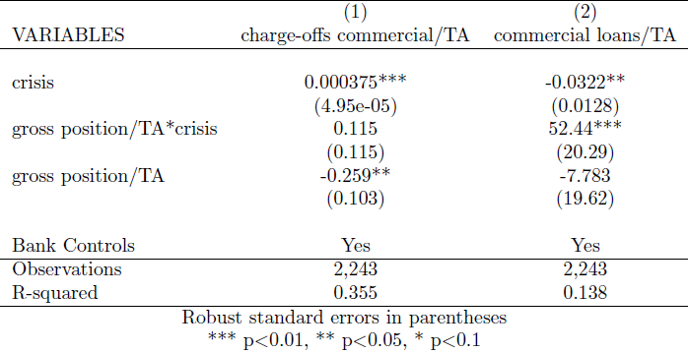
CDS and Banks performance
On average all banks experienced larger losses after the crisis.
Banks managing their risks using credit derivatives face lower losses and they do not suffer differently during the crisis period.
On average banks cut their lending after the crisis.
Bank managing risk were cutting lending by less, consistent with such banks being less likely to face constraints.
Notes:
We expect banks managing their risk to have less losses because of success of risk management. Also, we expect these banks to be able to isolate from liquidity variability in a more effective manner, therefore we expect them to have been less constrained during the crisis. Therefore, facing a lower contraction in loan volumes after the crisis.
(1) Dependent variable: Net charge-offs minus net gains of credit derivatives. If banks are being effective in managing their risks, charge-offs of loans should be offset by gains in CDS.
On average all banks experienced losses during the crisis. However, banks managing risk have less charge-offs than other banks, and they did not suffer more after the crisis.
(2) Dependent variable: Commercial Loans over total assets.
On average all banks cut their lending after the crisis. But, after the crisis banks managing risk cut their lending in a less amount.

Slide 20
Conclusion
We find that credit derivatives use at banks is associated with lower corporate loan spreads.
The relation exists for banks‘ gross credit derivatives position but not for their net position.
We argue that results are consistent with banks passing on risk management benefits from derivatives use to borrowers but not with other channels through which credit derivatives may influence loan pricing.
Risk management benefits are larger for firms more likely to be actively traded but are also present for firms unlikely to be traded.
Risk management benefits persist during the crisis.
Bank-level analysis is also consistent with risk management benefits that persist in crises times: Banks actively using credit derivatives generally have lower charge-offs and face smaller contractions in lending during the crisis.

