Slide 1
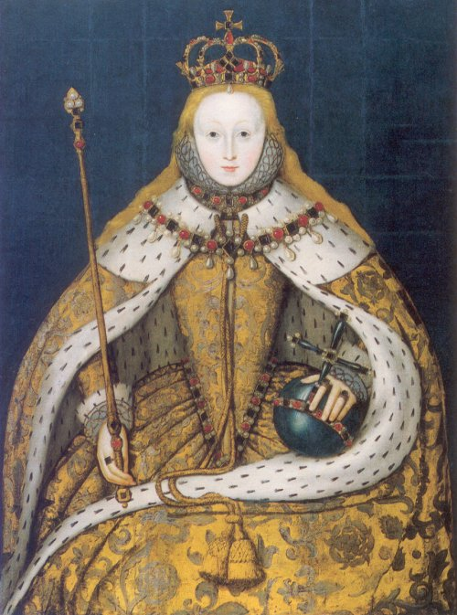
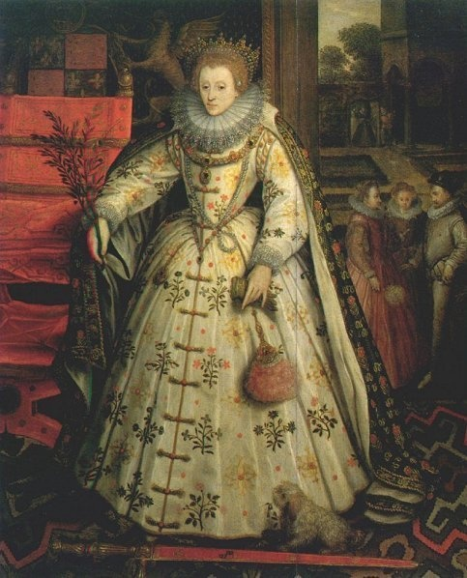
Elizabeth revision
“In mirrors more than one can see”

Slide 2
A good quote
“Elizabeth Tudor remains an enigma despite the intense historiographical tradition. In part this can be explained by the relative silence of Elizabeth’s own voice in a medieval, patriarchal society. Where there is scant evidence there is always endless debate. Each generation redefines Elizabeth according to the types of evidence they select , their own personal and historical context and the needs of the society in which they write.”
Some really smart person

Slide 3
FOUNDATIONAL MYTHS
Not just CAMDEN- A History of the most renowned and Glorious Princess Elizabeth
SPENCER- The Fairie Queen
AYLMER ? An harborowe for faithful and trewe subiectes

Slide 4
IMAGES OFELIZABETH
All of these images are static, implying that these were defining features throughout her reign. A more rational view would be that Elizabeth learned quickly and evolved as a Queen and leader despite Camden’s claim of “Semper Aedeum.” This is one of the reasons for constant debate in that they assume a static quality. It largely depends what period the Historian is looking at.

Slide 5
Why have the views of Elizabeth changed over time
PURPOSE
AUDIENCE
EVIDENCE
IDEOLOGICAL VIEW OF HISTORY
CONTEXT OF HISTORIANS

Slide 6
WHO ARE THE HISTORIANS
Constructions of Elizabeth’s identities and gender;
Neale, Elton, Haigh, Basnett Doran, Strong Walker
Political and Administrative Leadership; Camden, Neale, Elton, Haigh, Basnett, Mears
Religious beliefs and policies;
Camden, Lingard, Neale Elton Haigh Basnett

Slide 7
PURPOSE- MODERNIST/POST MODERNIST STRETCH
“Camden “Mine own judgement I have not delivered by affection; whilest writing with an undistempered minde, I have rather sifted out the judgement of others, and scarcely have interposed mine owne in any place
“History of the Most Glorious and Renowned Princess Elizabeth
a golden queen tending her people in a golden age.”
J E Neale “ honest and considered judgments based upon careful study of the original authorities.”
“This biography has been written for a particular occasion and a particular public.” ( 4th centenary of Queen Elizabeth’s birth) 1933
Julia Walker “What we seek to illuminate, however, is another, darker discourse, the less famous discourse of disrespect and dissent which also existed from Elizabeth's troubled days as a princess and into the decades after her death.

Slide 8
AUDIENCE
Narrow
Male
Elite
literate
HISTORIANS WORK | AUDIENCE
Camden The History of the Most renowned and Glorious Princess Elizabeth | Those literate English class living under Stuart rule
Neale Elizabeth | Admirers of Elizabeth 11
ELTON | Academics studying Tudor Politics
Basnett | Feminists
Haigh | Anti Feminists
NEW HISTORICISTS | Those who seek to hear a different voice
Wider
audience

Slide 9
evidence
HISTORIAN | EVIDENCE
CAMDEN | BURGHLEY PAPERS, ACTS OF PARLIAMENT, SPEECHES
NEALE | CAMDEN WITH FOOTNOTES/PAMPHLETTS FOR PURITAN CHOIR
ELTON | STRUCTURALIST HEAVY FOCUS ON PRIVY COUNCIL PAPERS
HAIGH | All of the above plus AMBASSADORIAL REPORTS
STRONG | PORTRAITURE
BASNETT | Elizabeths own prayers and letters
WALKER | NEW HISTORICIST Any negative image-Tomb sculpture,
MEARS | AZZIZE RECORDS, PLAYS, REGIONAL CHURCH RECORDS

Slide 10
Construction? CRITICISM
HISTORIAN | CONSTRUCTION
CAMDEN | ANNALES
NEALE | BIOGRAPHY
ELTON | STRUCTURAL ANALYSES
HAIGH/BASNETT/DORAN | BIOGRAPHY
STRONG | CHRONOLOGY BUT LIMITED SCOPE OF PORTRAITURE
MEARS | POST MODERN FOCUS ON DISCOURSE BETWEEN COURT AND REALM- NON LINEAR ,ANALYSES

Slide 11
Ideological and philosophical approach to history
Modernists
NEALE/ELTON
Truth achieved through empirical method- acknowledge documents as authoritorial evidence
Post Modernists
Everyone else
All perspectives valid
Sources evidence can be anything. New Historicists particularly rely on cultural meaning. They reason that cultural texts, eg plays and poems rise above the bias of document since they reflect collective attitudes.
Camden
Influenced by Tacitus- qualities of good leader
Black and white/ good or bad
Truth focussed

Slide 12
Elizabeth’S POLEMIC HISTORIANS
CAMDEN
NEALE
ELTON
ELTON
MEARS
HAIGH
BASNETT
STRONG
HACKETT

Slide 13
Elizabeth QUOTE
Elizabeth left no cipher with which to unlock the secret of her personality, no diary, no memoirs, and almost no private letters. What has survived is an occasional intimate postscript to public letters generally drafted by the principal secretaries of state, a number of magnificent official speeches, a handful of poems of somewhat doubtful authenticity, an occasional prayer and an avalanche of sayings, witticisms and episodes, treasured (but often fabricated) by those who watched and recorded her every action. Where there is scanty evidence, there is end­less debate.

Slide 14
Elizabeth QUESTIONS
Historians shed light on the past but that light can only reveal a partial, dimly-lit view.
Assess the relevance of this statement as it applies to at least ONE area of debate from your chosen case study. -2008
Although generic in nature, the question required a sustained, sophisticated and critical assessment
of why and how historians’ perspectives of the past are essentially limited. The quotation contained
in the question provided a clear discriminator because it required candidates to apply the statementto at least one area of debate in their chosen Case Study. Candidates must engage with the statement
and integrate their analysis into the substance of their response.
Better responses used a range of historians within their argument. These historians were drawn from
a significant time period and enabled candidates to make insightful observations about the ongoing
nature of the debates. These responses evaluated how and why history is only a partial
representation of the past, providing a consideration of the historian’s methodology as well as his
purpose and context.
Candidates are reminded that a limited range of historians limits the possibility of developing an
argument that would allow them to make critical judgements about historical interpretation.
Responses which developed around the context, methodologies and perspectives of a range of
historians were able to deal effectively with the focus of this question. Weaker responses tended to
describe the different viewpoints of the historians rather than critically evaluate how and why those
perspectives were limited. Using a single source or a textbook style summary of the debate limits
the response to a survey-style narrative.

Slide 15
Elizabeth revision
To what extent does Dening’s statement explain the changing interpretations in at least ONE area of debate from your chosen case study? 2009
Candidates needed to engage with the statement and integrate their analysis into the substance of their response.
Better responses drew on the work of a range of historians from a significant time period and made insightful observations about the ongoing nature of the debates. These responses evaluated how and why interpretations of history change over time, and provided a consideration of the historian’s methodology as well as his or her purpose and context.
Candidates are reminded that studying a limited range of historians restricts the possibility of their developing an argument that would allow them to critically judge changing historical interpretation. Responses that were developed around the context, methodologies and perspectives of a range of historians dealt effectively with the focus of this question

