Slide 1

Portfolio Analysis System: Baselined Requirements & Solution Outline
Structured approach for evaluating and planning portfolios
Notes:
AI-generated content may be incorrect. ---

Slide 2
System Overview and Objectives
Notes:
Purpose and Strategic Goals of the Portfolio Analysis System

Slide 3
Purpose and Strategic Goals of the Portfolio Analysis System
Actionable Stock Recommendations
The system delivers Buy, Hold, Reduce, or Exit recommendations to optimize portfolio capital allocation and address underperformers early.
Systematic Stock Discovery
It screens the market systematically to find high-quality stocks using fundamental, technical, and sentiment criteria, reducing emotional bias.
Portfolio Balance and Optimization
Focuses on diversification, sector control, correlation management, and risk-adjusted returns to optimize portfolio performance holistically.
Notes:
The Portfolio Analysis System is designed as a long-term, AI-powered investment decision support platform that continuously evaluates both individual stocks and the portfolio as a whole. Its primary purpose is to move beyond static, one-time analysis and instead provide an adaptive, rules-driven framework that evolves with market conditions. The system is anchored around three clearly defined strategic goals. The first goal focuses on generating actionable recommendations—Buy, Hold, Reduce, or Exit—for stocks that already exist in an investor’s portfolio, ensuring capital is allocated efficiently and underperformers are addressed early. The second goal is systematic new stock discovery, where the system screens the broader market universe to identify high-quality businesses that meet predefined fundamental, technical, and sentiment criteria, reducing reliance on ad hoc tips or emotional decisions. The third goal addresses portfolio-level balance and optimization, emphasizing diversification, sector exposure control, correlation management, and risk-adjusted returns rather than isolated stock performance. Together, these goals ensure that decision-making remains disciplined, repeatable, and aligned with long-term wealth creation. By integrating stock-level analysis with portfolio context, the system avoids common pitfalls such as overconcentration in popular sectors, chasing momentum without fundamentals, or holding onto broken investment theses. This overview sets the foundation for understanding why each subsequent layer, metric, and rule exists within the framework.

Slide 4
Decision Framework Architecture
Notes:
Three-Layer Investment Decision Framework

Slide 5

Three-Layer Investment Decision Framework
Business Filter Layer
Evaluates company fundamentals including revenue, profitability, capital efficiency, and sector positioning to determine investment worthiness.
Timing Filter Layer
Analyzes technical indicators like trend strength, momentum, and volatility to decide optimal investment timing and amount.
Conviction Filter Layer
Incorporates sentiment, analyst insights, insider activity, and news flow to adjust confidence and position sizing.
Notes:
The system’s decision framework is intentionally structured into three sequential analytical layers, each answering a distinct investment question and building logically on the previous one. Layer 1, the Business Filter, evaluates whether a company is fundamentally sound and worthy of ownership at all, focusing on revenue quality, profitability, capital efficiency, balance sheet strength, and sector positioning. This layer acts as a hard gate: if a stock fails here, no amount of technical strength or positive news can justify an investment. Layer 2, the Timing Filter, addresses the question of when and how much to invest by analyzing technical indicators such as trend strength, momentum, volatility, and risk metrics. This prevents investors from overpaying for great businesses during unfavorable market phases. Layer 3, the Conviction Filter, incorporates sentiment, analyst behavior, insider activity, and news flow to calibrate confidence and position sizing rather than changing the core buy or sell direction. For portfolio-level decisions, an additional overlay evaluates how each action impacts diversification, sector exposure, correlation, beta, and Sharpe ratio. This layered approach mirrors how experienced investors think, translating qualitative judgment into a structured, automatable system.

Slide 6
Fundamental Analysis Layer
Notes:
Layer 1 Metrics: Evaluating Business Quality

Slide 7

Layer 1 Metrics: Evaluating Business Quality
Earnings Sustainability Metrics
Revenue growth, free cash flow, and net profit margin trends evaluate the quality and sustainability of earnings over time.
Valuation Indicators
PEG ratio, P/E relative to sector median, and EV/EBITDA differentiate fairly priced stocks from overvalued ones.
Capital Efficiency & Risk
Return on Invested Capital and debt-to-equity ratios measure productive capital use and balance sheet risk respectively.
India-Specific Governance Metrics
Promoter holding trends and pledge percentages highlight governance and risk signals unique to the Indian market.
Notes:
The Fundamentals layer is the most critical component of the system, as it determines whether a company qualifies as a viable long-term investment. Metrics such as revenue growth, free cash flow generation, and net profit margin trends assess the sustainability and quality of earnings. Valuation indicators like PEG ratio, P/E relative to sector median, and EV/EBITDA help distinguish between fairly priced growth and overhyped stocks. Capital efficiency measures, particularly Return on Invested Capital, indicate whether management is deploying capital productively. Balance sheet risk is captured through debt-to-equity ratios, ensuring leverage remains within acceptable limits. India-specific metrics, including promoter holding trends and promoter pledge percentages, provide critical governance and risk signals unique to the local market. Sector classification further contextualizes expectations by distinguishing between cyclical and defensive businesses. Collectively, these metrics ensure that only companies with durable business models, reasonable valuations, and acceptable governance standards pass the first gate of the system.

Slide 8
Technical Analysis Layer
Notes:
Layer 2 Metrics: Timing, Momentum, and Risk

Slide 9

Layer 2 Metrics: Timing, Momentum, and Risk
Trend Direction Analysis
Price relative to the 200-day moving average helps identify the long-term market trend direction.
Momentum Indicators
RSI and MACD detect momentum shifts and signal overbought or oversold market conditions.
Risk and Volatility Metrics
Beta measures market sensitivity, while concentration and stop-loss metrics help manage portfolio risk.
Volume and Momentum Scores
Volume confirms price move strength and the 52-week momentum score reduces risk of entering downtrends.
Notes:
The Technicals layer focuses on optimizing entry, exit, and position sizing decisions by analyzing price behavior and market dynamics. Indicators such as price relative to the 200-day moving average establish long-term trend direction, while RSI and MACD identify momentum shifts and overbought or oversold conditions. Volume analysis confirms the strength or weakness behind price moves. Beta measures sensitivity to market movements, helping control overall portfolio volatility. The 52-week momentum score contextualizes current price levels within a broader range, reducing the risk of buying into extended downtrends. Portfolio-specific technical metrics, including concentration percentage and stop-loss proximity, ensure that individual positions do not introduce disproportionate risk. By integrating these signals, the system avoids emotionally driven timing errors and enforces disciplined risk management, even for fundamentally strong companies.

Slide 10
Sentiment and Conviction Layer
Notes:
Layer 3 Metrics: Market Confidence and Narrative

Slide 11

Layer 3 Metrics: Market Confidence and Narrative
Sentiment and News Analysis
Analyzes market perception through news sentiment and headlines capturing shifts not yet reflected in price.
Earnings Surprise Trends
Reveals management’s ability to consistently outperform market expectations with earnings results.
Insider and Analyst Activity
Insight from insider buying/selling and analyst upgrades or downgrades reflects confidence levels.
Institutional Ownership Changes
Signals long-term capital flows and validation from large investors in the stock.
Notes:
The Sentiment and News layer refines conviction by analyzing how the broader market perceives a stock and whether that perception is improving or deteriorating. Earnings surprise trends reveal management’s ability to consistently outperform expectations. Insider buying or selling provides insight into internal confidence levels, while analyst upgrades, downgrades, and price target changes reflect evolving external views. News sentiment scoring, derived from recent headlines and corporate announcements, captures shifts in narrative that may not yet be reflected in price. Changes in institutional ownership signal long-term capital flows and validation from large investors. Importantly, this layer does not override fundamental or technical decisions; instead, it influences position sizing, monitoring intensity, and confidence levels. This separation prevents short-term noise from derailing sound long-term strategies while still acknowledging the impact of market psychology.

Slide 12
Scorecard and Scoring Model
Notes:
Weighted Scorecards and Overall Stock Score

Slide 13
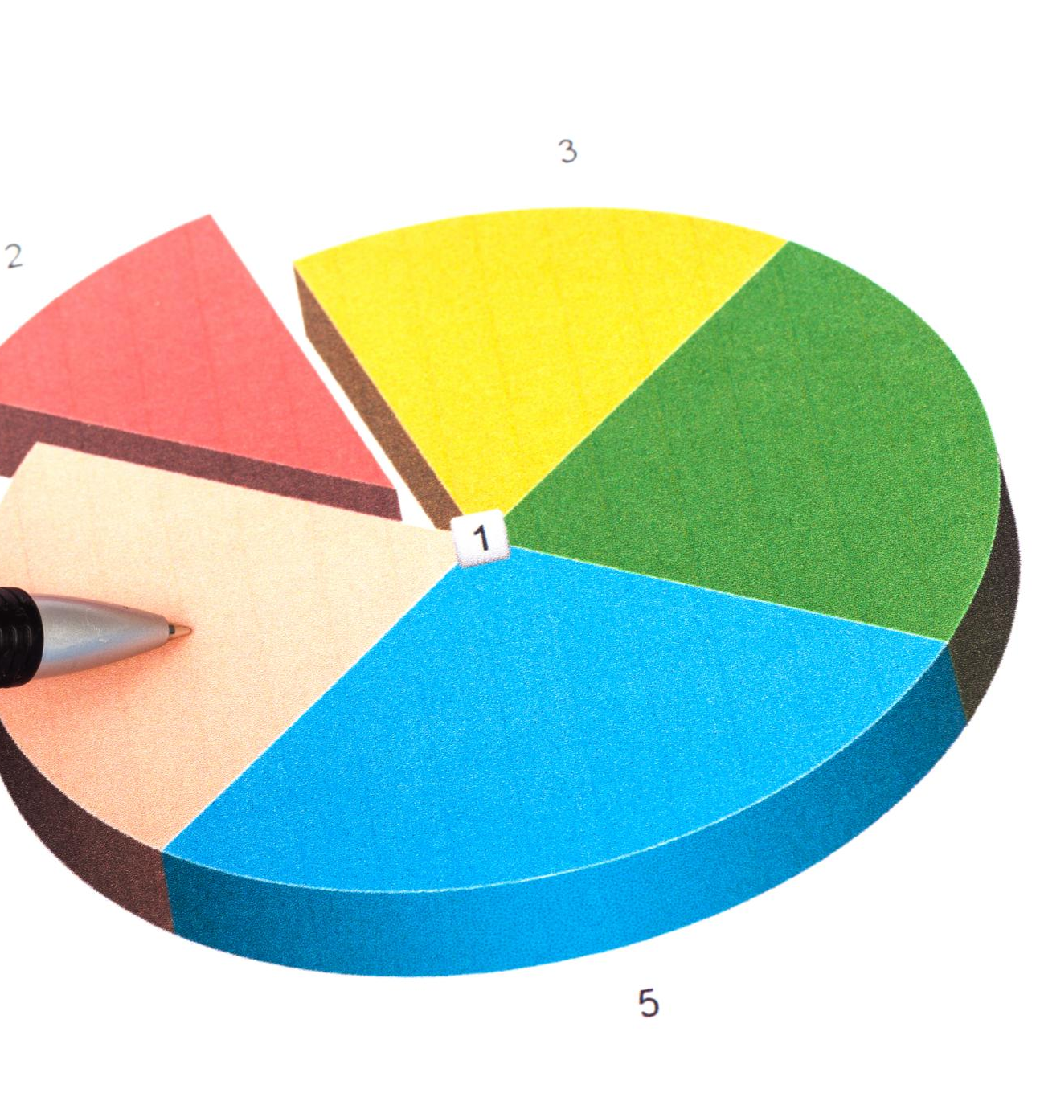
Weighted Scorecards and Overall Stock Score
Five Distinct Scorecards
The system uses five scorecards to evaluate stocks: Fundamental Health, Valuation, Technical Momentum, Sentiment and News, and Risk.
Weighted Contributions
Each scorecard has a predefined weight, with fundamentals and valuation making up over half the total score for a long-term focus.
Overall Stock Score & Recommendations
The combined score generates clear, predefined recommendations from Strong Buy to Exit, enhancing transparency and auditability.
Notes:
The system consolidates its 30 metrics into five distinct scorecards: Fundamental Health, Valuation, Technical Momentum, Sentiment and News, and Risk. Each scorecard contributes a predefined weight to the Overall Stock Score, ensuring balanced decision-making. Fundamentals and valuation together account for more than half of the total score, reinforcing the system’s long-term orientation. Technical momentum and sentiment provide tactical refinement, while the risk score penalizes excessive leverage, volatility, or concentration. The resulting Overall Stock Score maps directly to clear, predefined recommendations ranging from Strong Buy to Exit. This quantitative translation of complex, multi-dimensional analysis improves consistency, transparency, and auditability, allowing users to understand not just what the recommendation is, but why it was generated.

Slide 14
Decision Matrices
Notes:
Per-Stock and Portfolio-Level Decision Logic

Slide 15

Per-Stock and Portfolio-Level Decision Logic
Stock-Level Decision Matrix
Combines fundamentals, technicals, and sentiment to guide actions on individual stocks, including accumulation, hold, or exit.
Portfolio-Level Evaluation
Assesses sector drift, stock correlations, portfolio beta, and Sharpe ratio to inform rebalancing decisions.
Rebalancing Strategies
Guides trimming overweight sectors, replacing correlated holdings, and adding defensive assets during high risk.
Notes:
Decision matrices operationalize the framework by translating combinations of fundamental, technical, and sentiment signals into concrete actions. For individual stocks, the matrix distinguishes between existing holdings and new candidates, ensuring that portfolio inertia does not bias decisions. Strong fundamentals combined with favorable technicals and sentiment lead to aggressive accumulation, while mixed signals trigger holds, reduced position sizing, or watchlist status. Weak fundamentals result in exits regardless of short-term technical strength. At the portfolio level, separate matrices evaluate sector drift, inter-stock correlation, portfolio beta, and Sharpe ratio impact. These rules guide rebalancing actions such as trimming overweight sectors, replacing highly correlated holdings, or adding defensive assets during periods of elevated risk. Together, these matrices enforce discipline and alignment with portfolio-level objectives.

Slide 16
Risk Management and Exit Discipline
Notes:
Exit Rules and Capital Protection Mechanisms

Slide 17

Exit Rules and Capital Protection Mechanisms
Stop-Loss Exit Rules
Stop-loss rules enforce exits when prices drop a set percentage below purchase price to limit losses.
Thesis-Based Exits
Positions are closed when original investment rationale fails, even if still profitable.
Overvaluation and Trimming
Partial trims occur when valuation and momentum indicate overvaluation to protect gains.
Concentration & Sector Limits
Limits on concentration and sector drift avoid unintended risk from disproportionate winners.
Notes:
Risk management is embedded through explicit, non-negotiable exit rules designed to protect capital and prevent small losses from becoming catastrophic. Stop-loss rules mandate exits when prices fall a defined percentage below the buy price, regardless of conviction. Thesis-based exits ensure that positions are closed when the original investment rationale no longer holds, even if the stock remains profitable. Overvaluation rules trigger partial trims when valuation and momentum simultaneously signal excess. Concentration and sector drift limits prevent unintended risk buildup as winners grow disproportionately large. By codifying these rules in advance, the system removes emotional bias from exit decisions and reinforces the principle that risk control is as important as return generation.

Slide 18
Data and Automation Architecture
Notes:
Computability, Data Sources, and Automation Coverage

Slide 19

Computability, Data Sources, and Automation Coverage
Diverse Data Sources
The system utilizes free, publicly available financial data from multiple Indian equity market platforms for comprehensive analysis.
AI-driven Sentiment Analysis
News and sentiment inputs are processed using AI-based natural language analysis to derive actionable insights.
High Automation Coverage
Approximately 85 percent of the framework is fully automatable, ensuring scalability and efficient data processing.
Balanced Human Oversight
Some components require human judgment to maintain qualitative context, such as thesis integrity assessments.
Notes:
The system is designed with automation in mind, leveraging free and publicly available data sources across the Indian equity market. Price and technical data are sourced from platforms such as Yahoo Finance and NSE India, while fundamentals and shareholding patterns rely heavily on Screener.in and BSE filings. News and sentiment inputs are derived from RSS feeds and processed using AI-based natural language analysis. Approximately 85 percent of the framework is fully automatable, with the remaining components requiring either external API integration or limited user judgment, such as thesis integrity assessments. This balance ensures scalability while preserving human oversight where qualitative context is essential.

Slide 20
Operational Cadence and Design Principles
Notes:
Ongoing Sustainment and Core System Principles

Slide 21

Ongoing Sustainment and Core System Principles
Defined Analytical Cadence
System operates on daily, weekly, monthly, and quarterly cycles aligned with evolving market dynamics.
Core Design Principles
Fundamentals guide ownership, technicals guide timing, and sentiment guides conviction in decisions.
Sector and Trend Focus
Sector context and trend prioritization ensure a robust and adaptive portfolio approach.
Portfolio Health Priority
Maintaining overall portfolio health is favored over focusing on individual stock appeal.
Notes:
To remain effective, the Portfolio Analysis System operates on a defined cadence that aligns analytical depth with market dynamics. Daily processes focus on price monitoring, stop-loss alerts, and news sentiment updates. Weekly routines refresh technical indicators, while monthly and quarterly cycles address fundamentals, insider activity, and full portfolio rebalancing. Underpinning these operations are core design principles: fundamentals determine what to own, technicals determine when to act, and sentiment determines conviction. Sector context is always applied, trends are prioritized over snapshots, and portfolio health takes precedence over individual stock appeal. These principles ensure that the system remains robust, adaptive, and aligned with long-term investment success.

