Slide 1

Kubernetes
Introduction

Slide 2
Introduction
Kubernetes is an open source orchestrator for deploying containerized applications. It provides the software necessary to successfully build and deploy reliable, scalable distributed systems.
Services are delivered over the network via APIs. These APIs are often delivered by a distributed system, connected via the network and coordinating their actions via network communication. Because we rely on these APIs increasingly for all aspects of our daily lives, these systems must be highly reliable. They cannot fail, even if a part of the system crashes or otherwise fails. Likewise, they must maintain availability even during software rollouts or other maintenance events. Finally, because more and more of the world is coming online and using such services, they must be highly scalable so that they can grow their capacity to keep up with ever-increasing usage without radical redesign of the distributed system that implements the services.

Slide 3
Reasons to use container API
There are four primary benefits of using container based solutions,
Velocity
Scaling (of both software and teams)
Abstracting your infrastructure
Efficiency

Slide 4
Velocity
Velocity is measured in terms of the number of things you can ship while maintaining a highly available service. Containers and Kubernetes can provide the tools that you need to move quickly, while staying available
The core concepts that enable this are immutability, declarative configuration, and online self-healing systems.

Slide 5
Scaling Your Service and Your Teams
As your product grows, its inevitable that you will need to scale both your software and the teams that develop it. Fortunately, Kubernetes can help with both of these goals. Kubernetes achieves scalability by favoring decoupled architectures.
In a decoupled architecture each component is separated from other components by defined APIs and service load balancers. APIs and load balancers isolate each piece of the system from the others. APIs provide a buffer between implementer and consumer, and load balancers provide a buffer between running instances of each service.

Slide 6
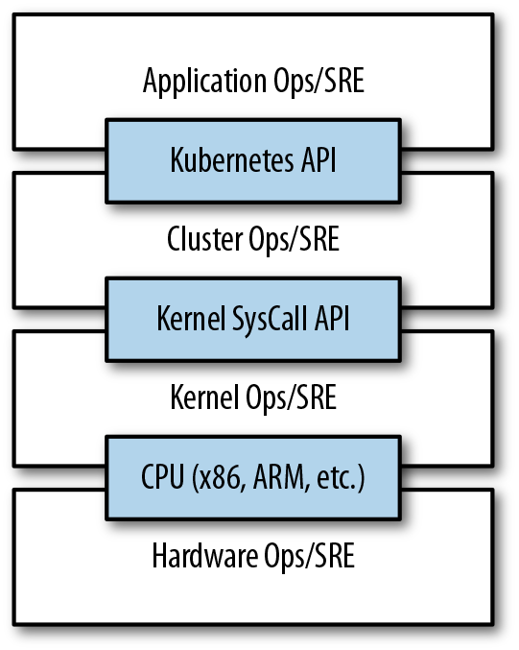
different operations are decoupled using APIs

Slide 7
Abstracting Your Infrastructure
When the developers build their applications in terms of container images and deploy them in terms of portable Kubernetes APIs, transferring the application between environments, or even running in hybrid environments, is simply a matter of sending the declarative config to a new cluster. Kubernetes has a number of plug-ins that can abstract us from a particular cloud implementation.
Building on top of Kubernetes’s application-oriented abstractions ensures that the effort that we put into building, deploying, and managing our application is truly portable across a wide variety of environments.

Slide 8
Efficiency
Efficiency can be measured by the ratio of the useful work performed by a machine or process to the total amount of energy spent doing so. When it comes to deploying and managing applications, many of the available tools and processes are somewhat inefficient. When discussing efficiency it’s often helpful to think of both the cost of running a server and the human cost required to manage it.
Kubernetes provides tools that automate the distribution of applications across a cluster of machines, ensuring higher levels of utilization than are possible with traditional tooling.

Slide 9
Containers
Containers fall into two main categories:
System containers
Application containers
System containers seek to mimic virtual machines and often run a full boot process. They often include a set of system services typically found in a VM, such as ssh, cron, and syslog.
Application containers differ from system containers in that they commonly run a single application. While running a single application per container might seem like an unnecessary constraint, it provides the perfect level of granularity for composing scalable applications, and is a design philosophy that is leveraged heavily by pods.

