Slide 1
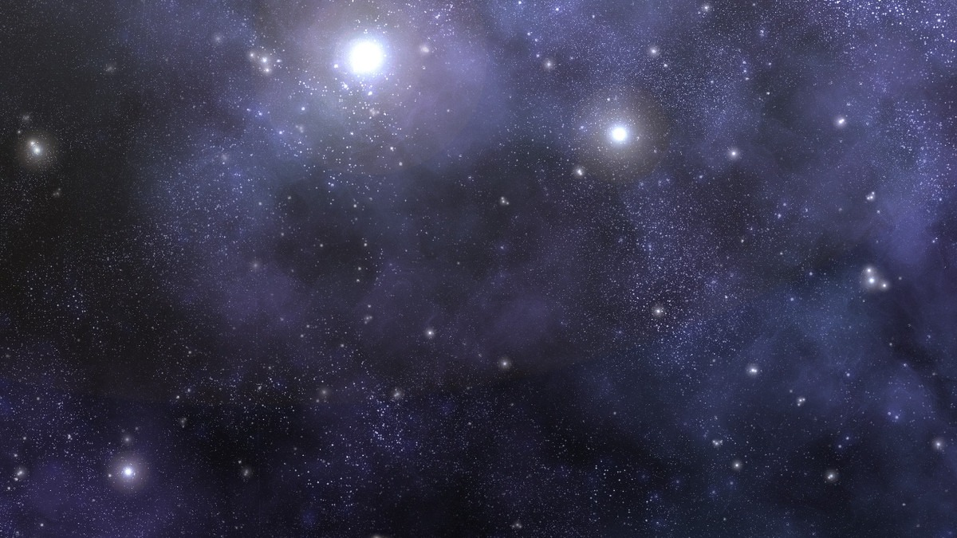
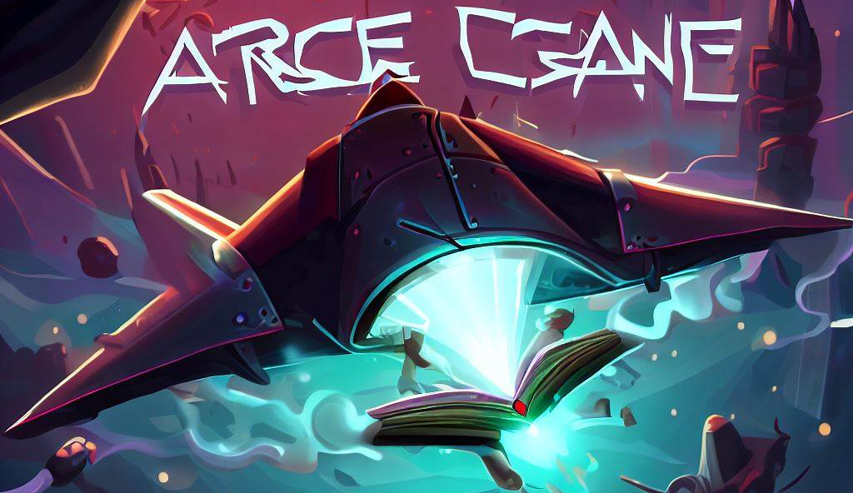

Slide 2

skip
>>
Main menu
PRESS ANY KEY TO START

Slide 3
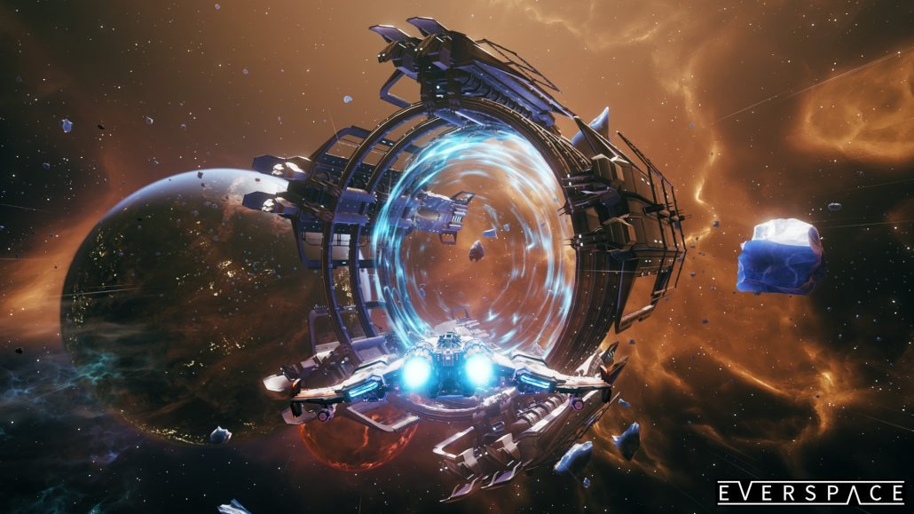
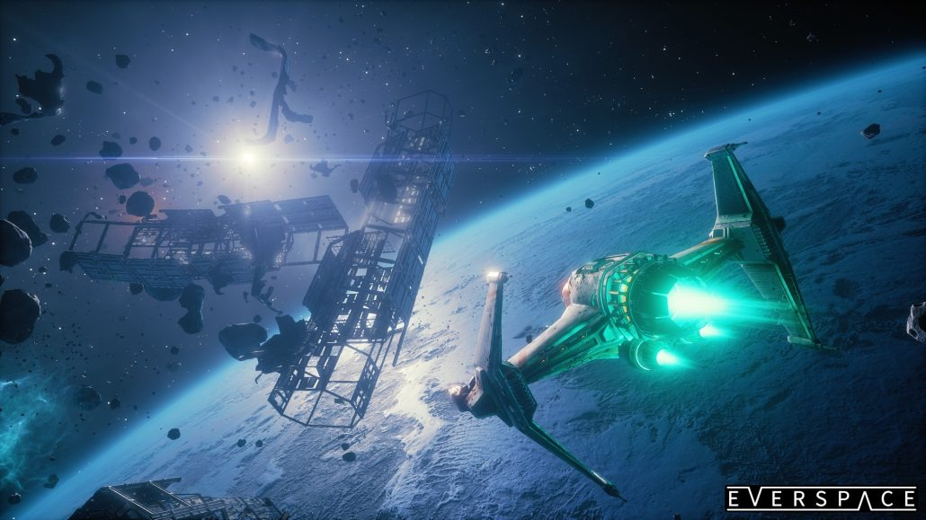
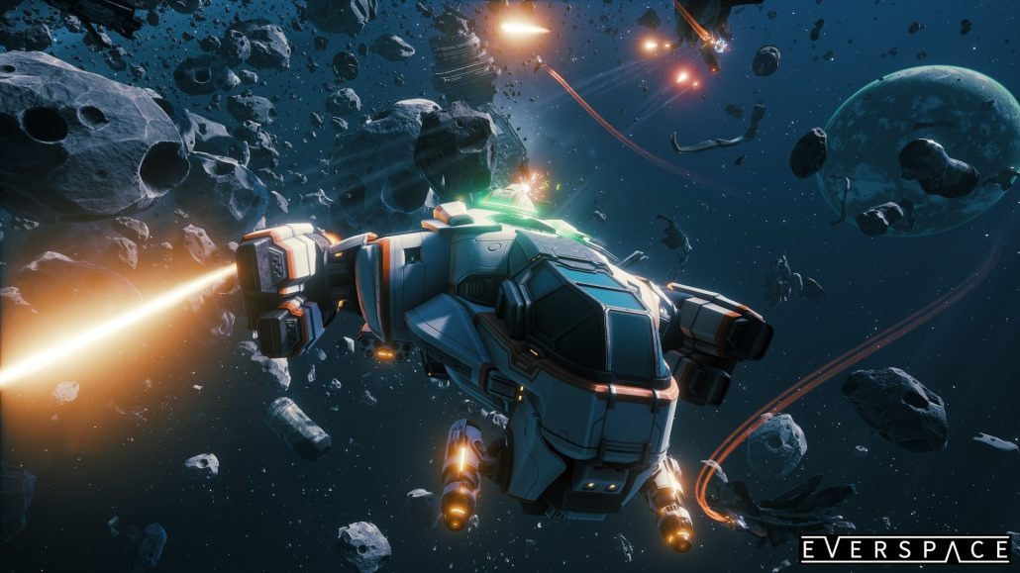
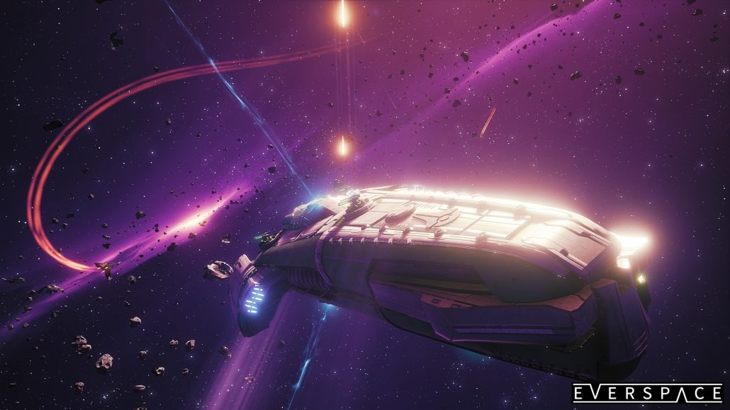
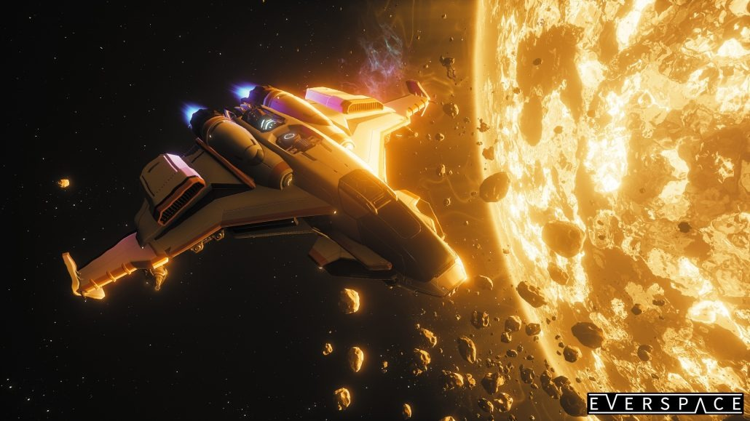
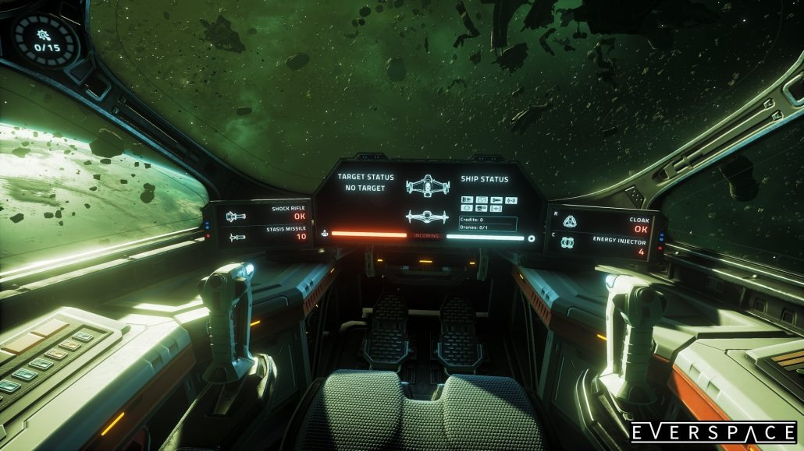

Slide 7
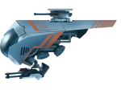
Main menu

Slide 8
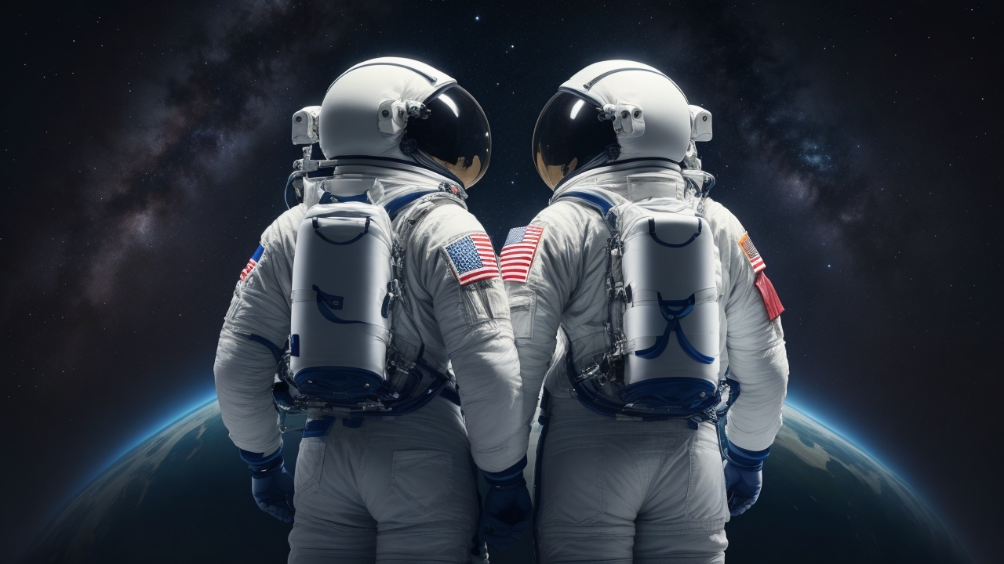

Main menu
SHAEAKH
AHMED CHOWDHURY
2020831022
SWE IICT SUST
NIXON
DEB ANTU
2020831023
SWE IICT SUST

Slide 9
Arcane Adventure: : The Cosmic Crusade
Main menu
In a distant future where humanity has colonized the galaxy, Captain Alex Mercer and his crew discover the powerful Arcane Crystal during an exploration mission. Unbeknownst to them, this artifact hides a dormant evil coveted by the malevolent Shadow Syndicate.
After surviving an ambush, Mercer and his crew embark on a perilous quest to seek allies and answers. Along their journey, they forge alliances with alien species, mastering the Arcane Crystal's energy to enhance their ships with cosmic abilities.
They unravel a prophecy that designates Mercer as the cosmic champion destined to defeat the Shadow Syndicate. Accepting his fate, Mercer undergoes intense training to unlock the true potential of the Arcane Crystal.
The final battle unfolds at the heart of the galaxy, where Mercer's ship, the Stardust Voyager, unleashes its full potential, channeling the essence of celestial phenomena. They face the Shadow Syndicate in an epic space showdown, banishing the malevolence back into the cosmic void.
With the galaxy at peace, Captain Mercer and his crew become legendary heroes, establishing a coalition of planets to preserve harmony and knowledge of the Arcane Crystal's powers.

Slide 11
PLAY
INSTRUCTION
STORY
ABOUT
EXIT

Slide 12
PLAY
INSTRUCTION
STORY
ABOUT
EXIT

