Slide 1
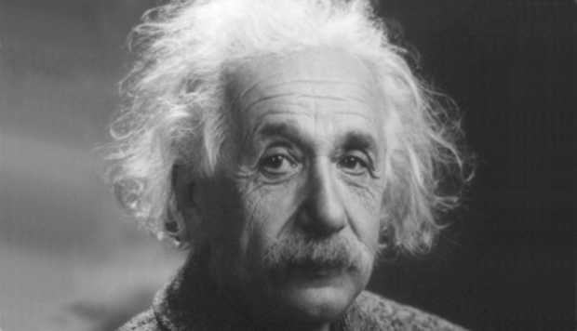
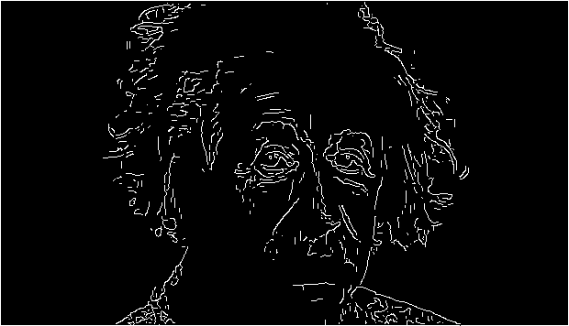

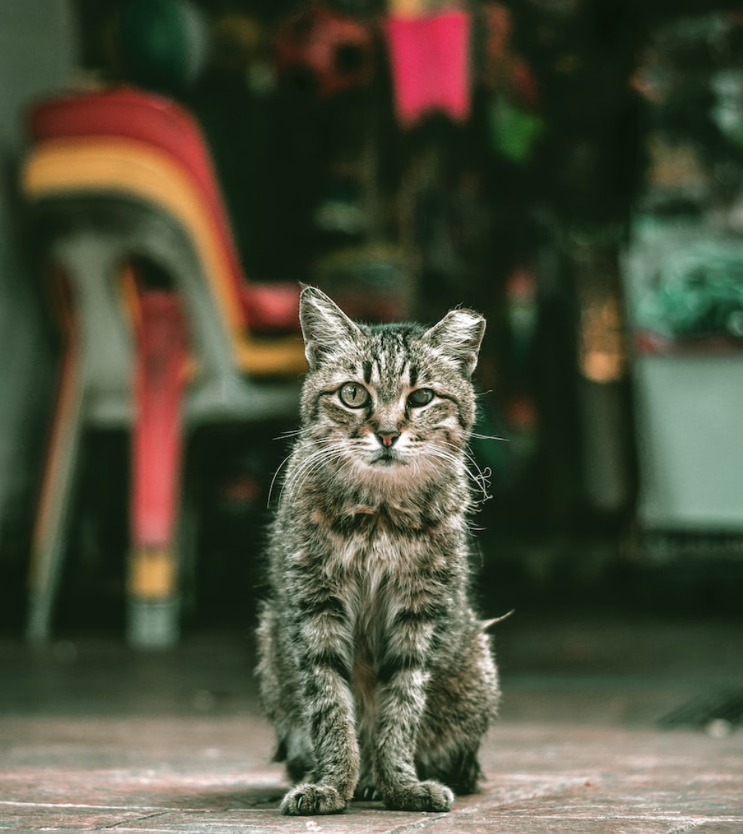
Lab2: Detecting edges, lines and circles
Implementing Canny edge detector for images
Edges can compactly represent the content.
Resilient to lighting and color!
We will learn image gradients, non-max suppression, and hysteresis thresholding!
Final Canny Edge Image
Relevant cool stuff: Edge detection for separating subject and background!

Slide 2
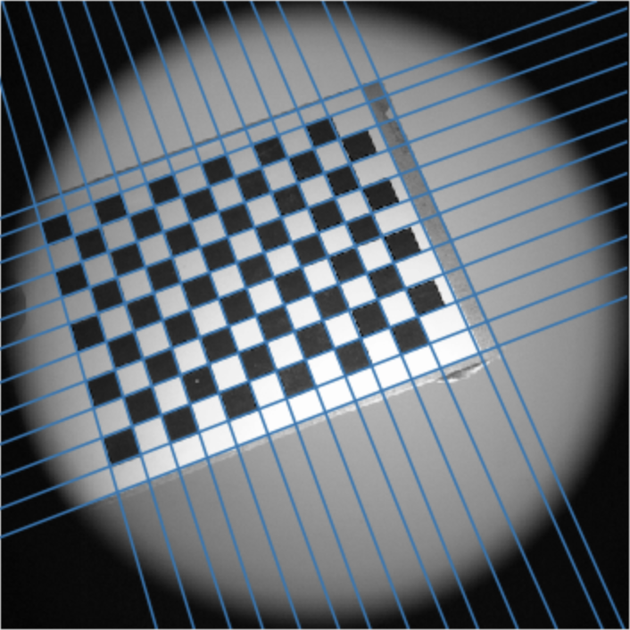
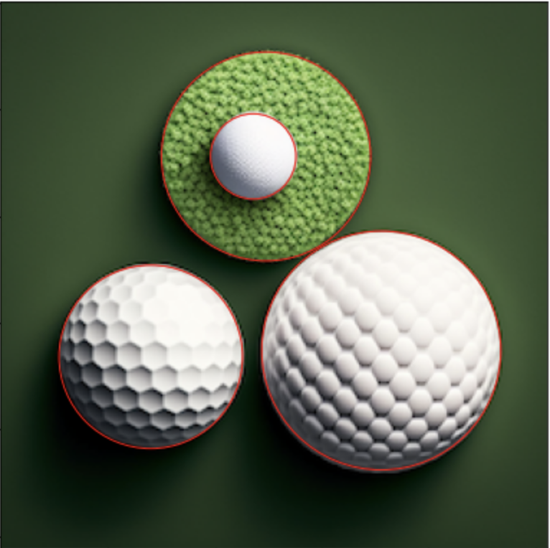
Lab2: Detecting edges, lines and circles
Implementing Hough transform for detecting lines and circles
Lines and circles are some special type of edges.
Use Canny edge image for Hough voting!

