Slide 1
>>>HELLO MUST

Slide 2
About Me
Ridge Kimani
Python Developer
Machine Learner
LOOVE THE CLOUDS

Slide 3
What is cloud computing
Practice of using a network of remote servers hosted on the internet to store, manage and process data rather than a remote server.
Funny fact: cloud computing cannot be measured in dollars

Slide 4
Example of cloud services
Microsoft Azure Services
Amazon Web Services
IBM
SAP cloud Computing
Google Cloud Computing …….. And many more

Slide 5
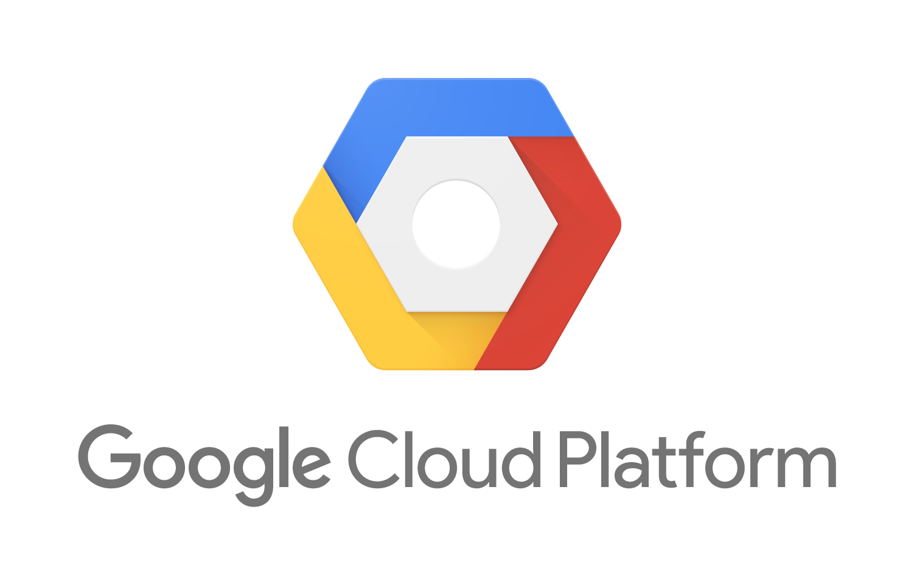

Slide 6
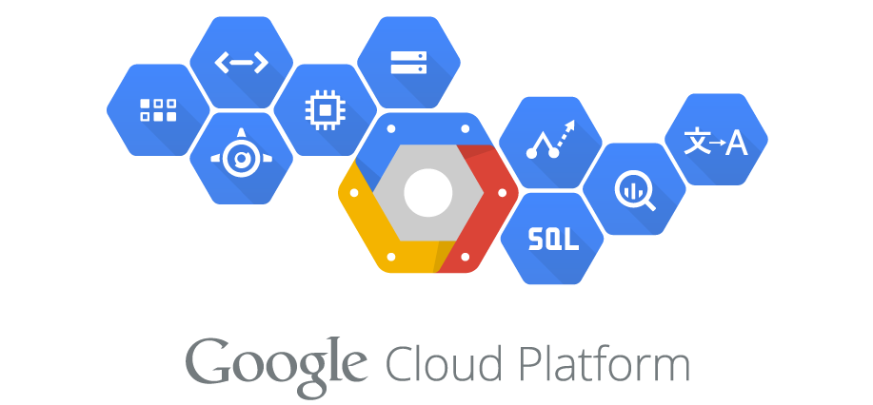

Slide 7
Services offered by GCP
Machine learning… using existing apis such as cloud vision, NLP, voice api etc
Business Intelligence
Big data
Data analytics
Hosting services

Slide 8
Languages that support
Python
Javascript(Node.js)
Go Lang
Java

