Slide 1

Chapter-01 : Part 1
C# Programming

Slide 2
Learning Objectives
At the end of this topic, you should be able to:
Explain the basic building blocks of C# programming.
Explain C# programming syntaxes.
Use control structures to solve basic problems.
Appreciate the use of divide and conquer approaches to solve complex problem.
Use methods to develop a modular program.
Develop a solution for a problem using arrays.
Use C# to develop a solution to a problem.

Slide 3
Introducing C# with an example
This is equivalent to ‘package’ in Java
namespace chap02 {
class Sample1 {
/* main method */
static void Main(string[] args) {
//declaring variables
double radius;
double area;
//assign a radius value
radius = 20;
//compute area
area = radius * radius * 3.14159;
//display result
Console.WriteLine("The area of the circle of radius " +
radius + " is " + area + ".");
Console.ReadKey();
} //end main
} //end class
} //end namespace
A class is enclosed within namespace { }
Main with capital ‘M’
Semi-colon is used to end a statement (just like Java)
This is how you print output
Notes:
This slide is to show students how similar C# is to Java. The differences are pointed out.

Slide 4
Facts about C#
C# is a language developed by Microsoft .
C# is intended to be a simple, modern, general-purpose, object-oriented programming language.
C# exists as part of the Visual Studio .NET package.
C# is intended to be suitable for writing applications for both hosted and embedded systems, ranging from the very large that use sophisticated operating systems, down to the very small having dedicated functions.
In other words, just like Java, you can use C# language to build from enterprise applications down to mobile applications.

Slide 5
Identifiers
An identifier is the word you use to name any variable, method, data definition, class etc.
A C# identifier must meet the basic following requirements:
An identifier can only begin with a letter, an underscore, or an @ sign.
An identifier can contain only letters or digits or underscore, not special characters such as #,$, or &
An identifier cannot be a C# reserved keyword
Examples:
Main 
firstNumber 
@hello 
_firstName 
HALO 
whatis@this 
main 
whatis_this 

Slide 6
Comments
In large programs it becomes difficult to remember why certain steps were included and the role of certain variables and methods.
Program comments are non-executing statements that you add to document a program.
You can also comment out various statements in a program to debug and observe the effects of the program with the statement or statements commented out.
There are three types of comments in C#:
Line comments //
Block comments or multiline comments /* comments */
XML-documentation format /// xml comments

Slide 7
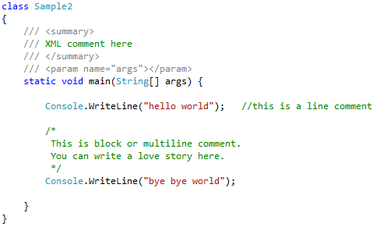
Comments

Slide 8
Variables and Data Types
A data item is classified as either constant or variable
Constant data items cannot vary.
Variable data items can hold different values at different points of time.
All data items in a C# program have a data type.
Data type defines the format and size of a piece of data.
A variable declaration includes:
The data type that the variable will store
An identifier that is the variable’s name
An optional assignment operator and assigned value when you want a variable to contain an initial value
An ending semicolon
Examples of variable declaration:
int myAge = 18;
The equal sign (=) is an assignment operator
The assignment operator works from right to left
An assignment made when a variable is declared is an initialization
It is not necessary to initialize a variable during a declaration.
For example, int myAge; is a valid declaration

Slide 9
Variables and Data Types
Examples of multiple variable declarations:
int myAge = 25;
int yourAge = 19;
int herAge;
the above 3 statements can be combined into 1 statement as follows:
int myAge = 25, yourAge = 19, herAge;
Declarations of variables of the same type can be separated by commas. However, separate statements are used when declaring variables of different types
int myAge, yourAge;
double mySalary, yourSalary;

Slide 10


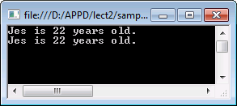
Variables and Data Types
Displaying Variable Values
Given the following variable declarations:
The following statements will display exactly the same output:
Traditional way
Use format string
Output:

Slide 11
Variables and Data Types
Displaying Variable Values
A format string is a string of characters that contains one or more placeholders. For example:
int age = 20;
Console.WriteLine("I am {0}.", age); //I am 20.
The number within the curly braces in the format string must be less than the number of values you list after the format string
You do not have to use the positions in order:
double someMoney = 1000;
int myAge = 20;
Console.WriteLine(
"The money is {0}. ${0} is a lot for my age which is {1}.",
someMoney, myAge);
//The money is 1000. $1000 is a lot for my age which is 20.

Slide 12
Variables and Data Types
Numeric Data Types
Twelve types belong to the numeric value type.
Nine of them are Integral (whole number types).
Two are floating-point (numbers that can have a fractional value).
One is a decimal type.
Decimal type was added to C# to eliminate the problems of loss of precision in mathematical operations that might occur.

Slide 13
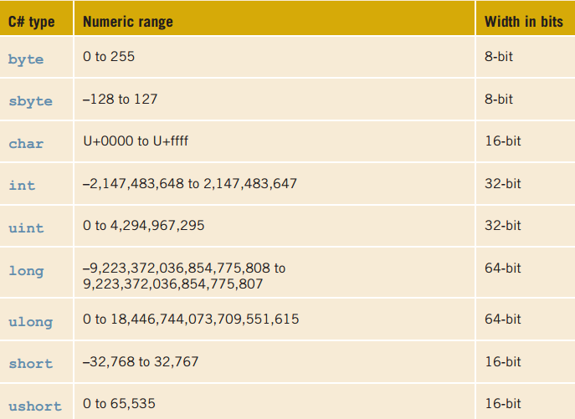
Variables and Data Types
Integral Types
Most Commonly Used

Slide 14
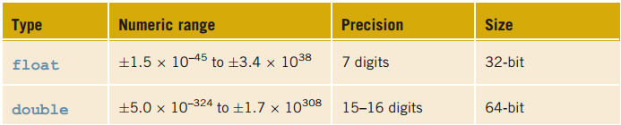

Variables and Data Types
Floating-Point Types
Most Commonly Used
it is necessary to attach the suffix f or F onto the end of a number to indicate float.
Without the suffix, a syntax error will occur as the number is treated as a double.

Slide 15

Variables and Data Types
Decimal Type
The decimal value type is new to modern programming languages.
It is the most suitable type for storing monetary data items because it allows both integral (whole) numbers and a fractional portion.
It provides for greater precision than what is found with floating-point types because 128 bits are used to represent the value.
Numbers ranging from negative -79,228,162,514,264,337,593,543,950,335 to positive 79,228,162,514,264,337,593,543,950,335 can be stored in a decimal value type (28 to 29 digits are possible with the decimal).
it is necessary to attach the suffix m or M onto the end of a number to indicate decimal.
Without the suffix, a syntax error will occur as the number is treated as a double.

Slide 16
Variables and Data Types
Boolean Type (bool)
Boolean logic is based on true or false comparisons
Boolean variables can hold only one of two values: true or false
You can assign values based on the result of comparisons to Boolean variables
bool isSmaller = true;
bool isBigger = 5 > 4; //true
bool isOkay = 4 != 4; //false

Slide 17

Variables and Data Types
Char Type
The char data type is used to hold a single character (‘A’,’b’,’9’).
A number can be a character only if it is enclosed in a single quotation mark (char aChar = 9; is illegal).
You can store any character in a char variable, including escape sequences and space.
Characters in C# are represented in Unicode.

Slide 18
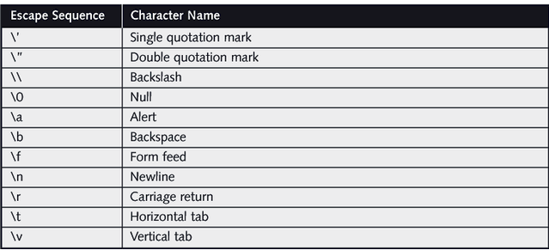
Variables and Data Types
Char Type
Common Escape Sequences
Console.WriteLine("\"he\\llo\"");
will print :
"he\llo"

Slide 19
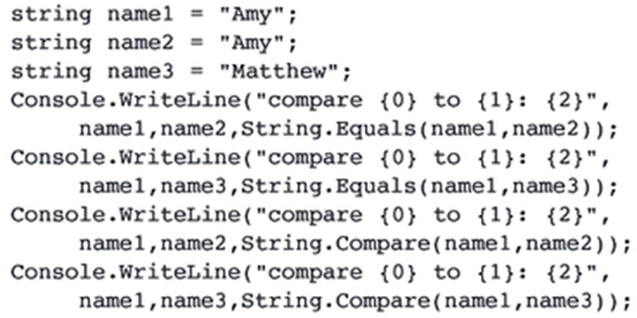
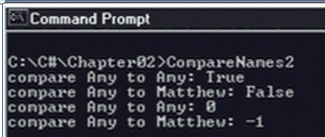
Variables and Data Types
string Type
In C# the string data type holds a series of characters.
C# recommends that you use the Equals() and Compare() methods to compare strings.
A string is considered greater than another string when it is greater lexically.
output:

Slide 20
Variables and Data Types
Counting Characters in a string
Length property: String class property that returns the number of characters in a string
IsNullOrEmpty() method: returns true if a string variable contains an empty string, false if the string has 1 or more characters

Slide 21
Variables and Data Types
Uppercase & Lowercase
ToLower() method: converts a text string to lowercase
ToUpper() method: converts a text string to uppercase
Syntax: simply append the method to the string variable
Example:
string myName = "sHuAi gE";
Console.WriteLine(myName.ToUpper());
// SHUAI GE is printed
Original value of the variable is not changed

Slide 22
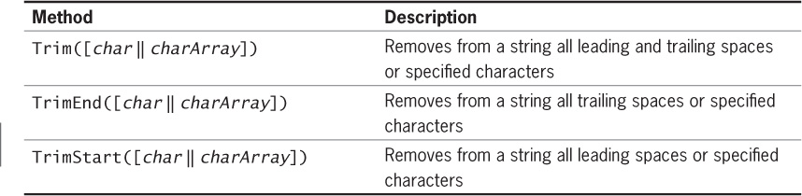
Variables and Data Types
Trimming strings
Use trimming methods of the String class to remove spaces or characters from a text string
If no argument is included, the trimming methods will remove spaces
Can specify which characters to remove
Can pass a character array argument to the trimming methods to remove any character in the array from the text string

Slide 23
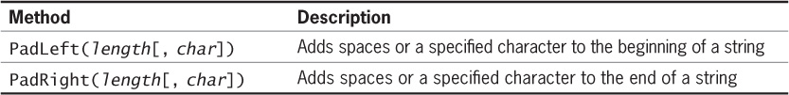
Variables and Data Types
Padding strings
Use padding methods of the String class to add characters to the beginning or end of a string
Length argument: represents total length of string after padding, not the number of characters to add

Slide 24
Variables and Data Types
Finding and Extracting Characters and Substrings
It is common to extract characters and substrings from strings
Example: extract the name portion of an e-mail address
C# has several methods for finding and extracting characters
Contains() method: returns true if the specified text was found in the string
StartsWith() method: determines whether the specified text appears at the beginning of the string

Slide 25
Variables and Data Types
Finding and Extracting Characters and Substrings
EndsWith() method: determines whether the specified text appears at the end of the string
Some string methods return a numeric position
Character positions in a string start at position 0
IndexOf() method: returns the position of the first instance of the specified character(s) in the string
Returns -1 if the character is not found
Can specify a starting position for finding a match
LastIndexOf() method returns the position of the last occurrence of the specified character(s) in the string

Slide 26
Variables and Data Types
Finding and Extracting Characters and Substrings
Substring() method: extracts text from a string starting at the specified position
Can specify the number of characters to be extracted
Chars property: retrieves a character by its specified index in a text string
Do not actually refer to it in your code
Use brackets enclosing the index position
Example: myString[6]

Slide 27
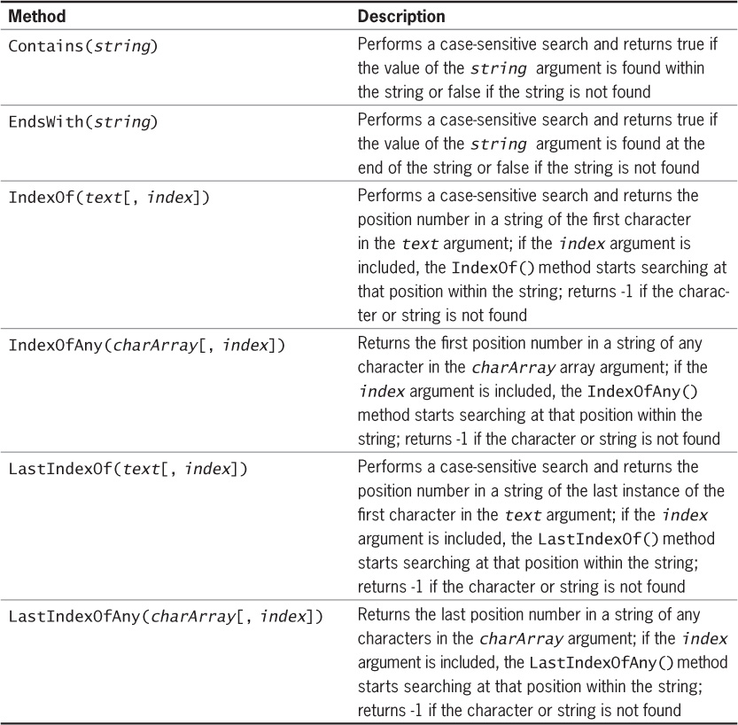
Variables and Data Types

Slide 28
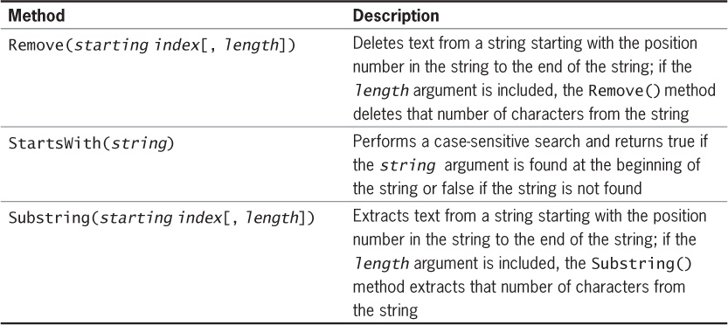
Variables and Data Types
Finding and Extracting Characters and Substrings

Slide 29
Variables and Data Types
Replacing characters and strings
Replace() method: replaces all instances of a specified character or text within a string
Syntax: string.Replace(oldText, newText)
Replace() method is case sensitive

Slide 30
Variables and Data Types
Comparing Strings
Comparison operators can be used with strings as well as numbers
string class also provides comparison methods
Equals() method: compares two strings to determine if they contain the same value
Syntax: string.Equals(string);
Compare() method: compares two strings
Syntax: string.Compare(string1,string2)
Returns 0 if string1 and string2 are equivalent
Returns >0 if string2 sorts before string1
Returns -1 if string1 sorts before string2

Slide 31
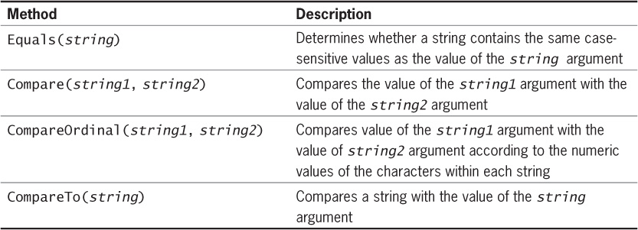
Variables and Data Types
Comparing Strings

Slide 32
Variables and Data Types
Combining Characters and Substrings
To combine text strings, you can use:
Concatenation operator (+)
Compound assignment operator (+=)
Concat() method of the String class
Concat() method: creates a new string by combining strings passed as arguments
Syntax:
string.Concat(string1, string2, …)
Insert() method: inserts text at the specified index position within the string
Syntax: string.Insert(index,text)

Slide 33
Variables and Data Types
Formatting Numbers with ToString()
The ToString method can optionally format a number to appear in a specific way
The following table lists the “format strings” and how they work with sample outputs
Format String | Description | Number | ToString() | Result
“N” or “n” | Number format | 12.3 | ToString(“n3”) | 12.300
“F” or “f” | Fixed-point scientific format | 123456.0 | ToString("f2") | 123456.00
“E” or “e” | Exponential scientific format | 123456.0 | ToString("e3") | 1.235e+005
“C” or “c” | Currency format | -1234567.8 | ToString("C") | ($1,234,567.80)
“P” or “p” | Percentage format | .234 | ToString("P") | 23.40%

Slide 34

Constant
Add the keyword const to a declaration
Value cannot be changed
Standard naming convention
Syntax:
const type identifier = expression;
const double TAX_RATE = 0.0675;
const int SPEED = 70;
const char HIGHEST_GRADE = 'A';

Slide 35
Operators
Assignment Operator
Equal Sign (=) is used as the assignment operator.
After a variable is declared, you can assign a value to it using the assignment operator (=).
Value is always assigned from right-to-left.
x = 1; // Assign 1 to x;
radius = 1.0; // Assign 1.0 to radius;
a = 'A'; // Assign 'A' to a;

Slide 36
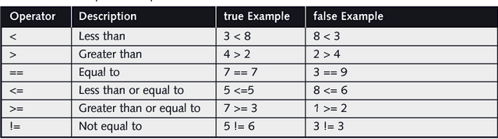
Operators
Relational Operators

Slide 37
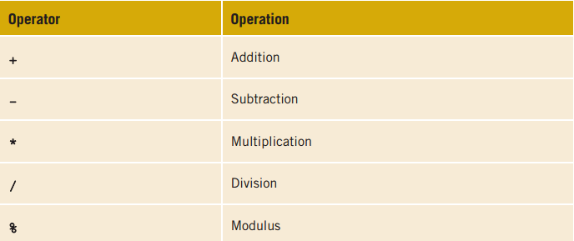
Operators
Arithmetic Operator
Note
+ once used with a string, it becomes a concatenation operator (joining 2 operands together).
modulus only works on integral types of data.

Slide 38
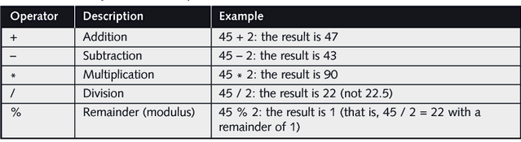
Operators
Arithmetic Operator
Note
C# (just like Java) treats a whole number as an int type.
When you divide two integers (using the division operator or the modulus operator), the result is ALWAYS an integer

Slide 39
Operators
Increment & Decrement Operators
Operator Name Description
++var preincrement The expression (++var) increments var by 1 and evaluates to the new value in var after the increment.
var++ postincrement The expression (var++) evaluates to the original value
in var and increments var by 1.
--var predecrement The expression (--var) decrements var by 1 and evaluates to the new value in var after the decrement.
var-- postdecrement The expression (var--) evaluates to the original value
in var and decrements var by 1.
If ++k or --k occurs in an expression, k is incremented or decremented by 1 before its new value is used in the expression.
If k++ or k-- occurs in an expression, k is incremented or decremented after its original value is used in the expression.

Slide 40
Operators
Increment & Decrement Operators
int a = 1; int b = 2; int c = 3;
a = ++b + c++;
a = 3 + 3;
Console.WriteLine(a);
Console.WriteLine(b);
Console.WriteLine(c);
b is incremented first (b = 3)
Original value of c is used
Then new value of b is used
Then c is incremented. (c = 4)

Slide 41
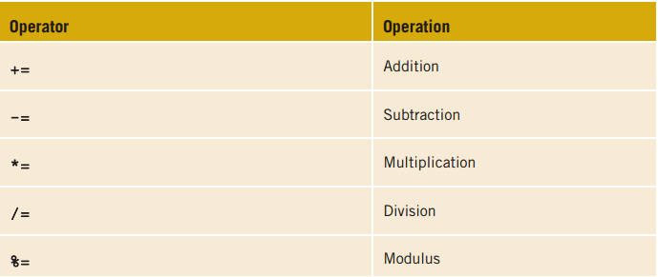
Operators
Compound Operators
C# provides you with several shortcut ways to count and accumulate

Slide 42
Operators
Compound Operators
Operator Example Equivalent
+= i+=8 i = i+8
-= f-=8.0 f = f-8.0
*= i*=8 i = i*8
/= i/=8 i = i/8
%= i%=8 i = i%8

Slide 43
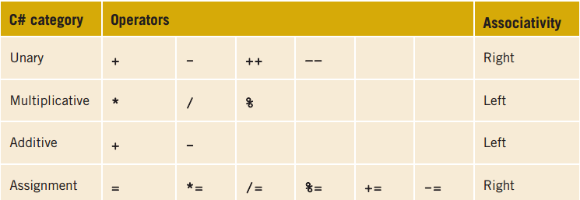

Operators
Operator Precedence
Operator precedence refers to the order in which parts of a mathematical expression are evaluated
e.g.

Slide 44
Operators
Type Conversion
In arithmetic operations with variables or constants of the same type, the result of the operation usually retains the same type. For example, an integer type added to another integer type will result in an integer type
When an arithmetic operation is performed with dissimilar types, C# chooses a unifying type for the result and implicitly converts the nonconforming operands to the unifying type.
E.g. when the binary operation involves a double and an int, implicit type conversion is performed. Integral types convert to floating-point types. Automatic conversion, by changing the int data type into a double, occurs for each of the preceding expressions.
2 * 3 + 5.5 = 10.5
2 + 5.5 + 4.5 = 12.0
double

Slide 45
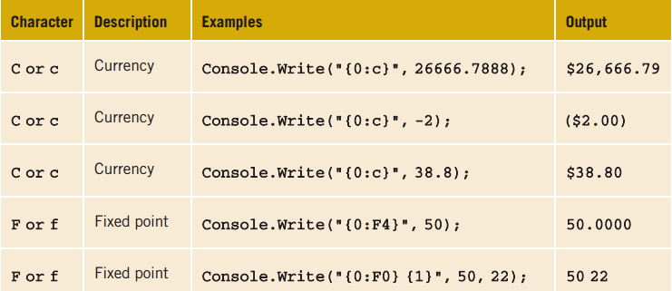
Formatting Output
Standard numeric format strings are strings of characters expressed within double quotation marks that indicate a format for output. For example, “F3” , where F is the format specifier and 3 is the precision specifier, indicates a fixed point with three significant digits.
The format specifier can be one of nine built-in format characters. The most commonly used identifiers are “C” (for currency) and “F” (for fixed point).
The precision specifier controls the number of significant digits or zeros to the right of the decimal point

Slide 46
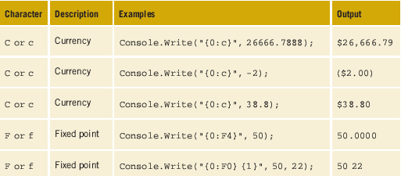
Formatting Output
Examples using format specifiers

Slide 47
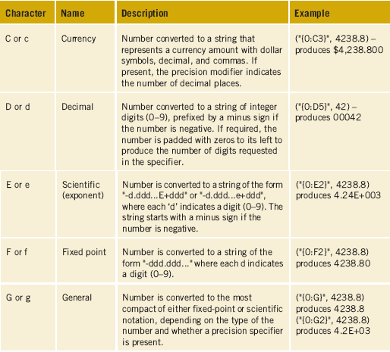
Formatting Output
Standard numeric format specifiers

Slide 48
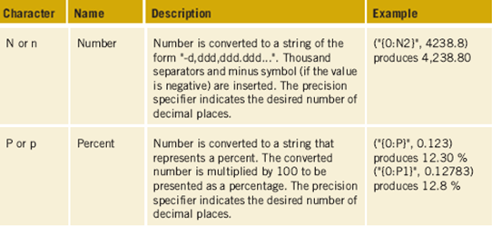
Formatting Output
Standard numeric format specifiers

Slide 49
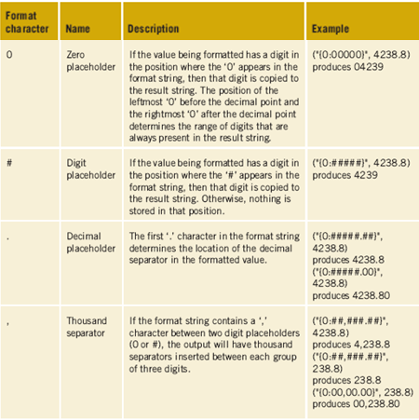
Formatting Output
Custom numeric format specifiers

Slide 50
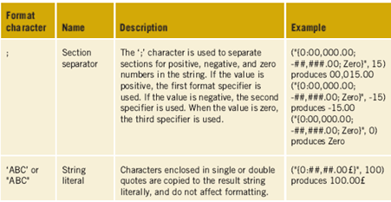
Formatting Output
Custom numeric format specifiers

Slide 51
Formatting Output
Width Specifier
Useful when you want to control the alignment of items on multiple lines
Alignment component goes after the index ordinal followed by a comma (before the colon)
If alignment number is less than actual size, it is ignored
If alignment number is greater, pads with white space
Negative alignment component places spaces on right
Console.WriteLine("{0,10:F0}{1,8:C}", 9, 14);
9 $14.00 //Right justifies values

Slide 52

Variables and Data Types
Data Type Conversion
Data obtained from keyboard input (via command line or UI components such as textbox/textfield) is always in a form of string.
String can’t be used in mathematical calculations.
Data type conversion is required whenever we need to use user’s input in any calculations.
Error because assigning string value to int variable isn't allowed.
integer
string

Slide 53
Variables and Data Types
Data Type Conversion
C# offers 2 mechanisms to convert string to numeric type i.e. Convert & parse
Convert
string (or any possible data) to int → Convert.ToInt32()
string (or any possible data) to double → Convert.ToDouble()
*** Convert is a class that provides various methods for converting data from one type to another. To see what methods are available, refer to the following MSDN page :
http://msdn.microsoft.com/en-us/library/system.convert.aspx
parse
string to int → int.Parse()
string to double → double.Parse()
Both mechanisms give identical results, except when the string is a null.
parse will throw an ArgumentNullException.
Convert will simply return a zero.

Slide 54


Variables and Data Types
Data Type Conversion
Convert
parse

Slide 55
Input Validation
TryParse(…) Method
The TryParse() method is similar to the Parse() method, except that if the conversion fails, false is returned instead, not an exception.
If the string value is converted correctly, the method returns true and the converted value will be assigned to the variable located after the ‘out’ keyword).
Syntax : datatype.TryParse(string, out target_variable)
double number;
string input;
Console.Write("Enter a number: ");
input = Console.ReadLine();
if (double.TryParse(input, out number))
{
// Converted correctly, the value entered is assigned to number variable
} else
{
//error. Non-numeric value is entered.
}

Slide 56
Input Validation
TryParse(…) Method
The TryParse() method supports most of the basic data types in C# such as:
int.TryParse()
double.TryParse()
byte.TryParse()
bool.TryParse()
DateTime.TryParse()
and many more…

Slide 57
Basic Programming Constructs
Simple sequence
Selection statement
if statement
switch
Iteration
Looping

Slide 58
Variables and Data Types
Making Decisions
Central to both selection and iteration constructs
Enables deviation from sequential path in program
Involves conditional expression
“The test”
Produces Boolean result

Slide 59
Variables and Data Types
Boolean Results and bool Data Types
Boolean flags
Declare Boolean variable
bool identifier;
Initialize to true or false
Use to determine which statement(s) to perform
Example
bool moreData = true;
: // Other statement(s) that might change the
: // value of moreData to false.
if (moreData) // Execute statement(s) following the if
// when moreData is true

Slide 60
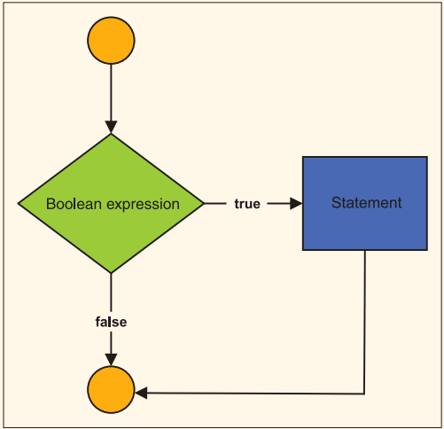
Selection Structure
One-way if Statement
Syntax:
if (booleanExpression) {
statement(s);
}
Statement(s) in the if block will only be executed when the booleanExpression is True.
Example:
int x = 10;
if(x >= 10) {
Console.WriteLine(“Bigger”);
}
Output:
Bigger

Slide 61
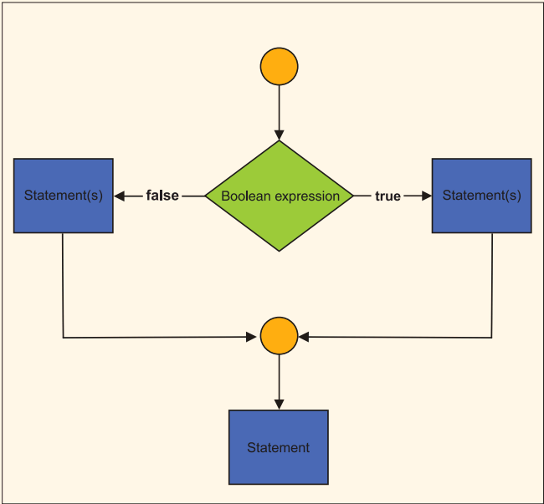
Selection Structure
Two-way if Statement
Syntax:
if (booleanExpression) {
statement(s) #1;
}else {
statement(s) #2;
}
Statement(s) #1 will be executed when the booleanExpression is True. When the booleanExpression is False, Statement(s) #2 will be executed instead.
Example:
int x = 9;
if(x >= 10) {
Console.WriteLine(“Bigger”);
}else {
Console.WriteLine(“Smaller”);
}
Output:
Smaller

Slide 62
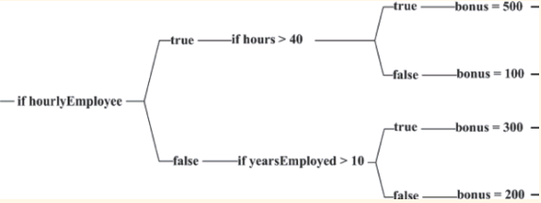
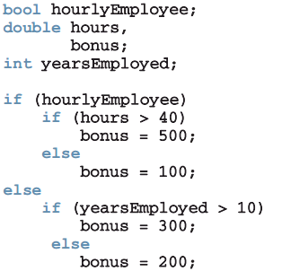
Selection Structure
Nested if..else Statements

Slide 63
Selection Structure
Nested if..else Statements

Slide 64
Selection Structure
Switch Statements
The switch statement is considered a multiple selection structure. It also goes by the name case statement.
It works for tests of equality only.
Only a single variable or expression can be tested
It cannot be used to test a range of values.
Unlike Java, Switch in C# always requires the break for any case (No fall-through available)
The switch or case statement allows you to perform a large number of alternatives based on the value of a single variable.
This variable or expression must evaluate to an integral or string value.
It cannot be used with a double, decimal, or float.

Slide 65
Selection Structure
Switch Statements
switch (expression)
{
case value1: statement(s);
break;
. . .
case valueN: statement(s);
break;
[default: statement(s);
break;]
}
Selector
Value must be of the same type as selector
Optional

Slide 66
Selection Structure
Switch Statements
Console.WriteLine("Enter a US state abbreviation. ");
String stateAbbrev = Console.ReadLine( );
switch(stateAbbrev)
{
case "AL": Console.WriteLine("Alabama");
break;
case "FL": Console.WriteLine("Florida");
break;
: // More states included
case "TX": Console.WriteLine("Texas");
break;
default: Console.WriteLine("No match");
break;
} // End switch

Slide 67
Repetition Structure
Why using a loop?
Repeat instructions with many data sets
Repetition or iteration structures
Rich set of looping structures
while
do…while
for
foreach statements

Slide 68
Repetition Structure
while statement
Simplest and most frequently used loop
while (conditional expression)
statement(s);
Expression – sometimes called loop condition
Returns a Boolean result of true or false
No semicolon after the conditional expression
Null body→ empty bodied loop→ infinite loop
Enclose multiple statements for body in { }

Slide 69
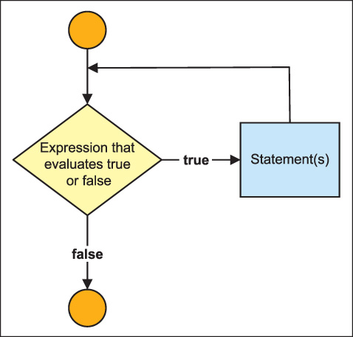
Repetition Structure
while statement
Pretest
If the conditional expression evaluates to true, statement(s) performed
If the conditional expression evaluates to false, statement(s) skipped

Slide 70
Repetition Structure
while statement example
int sum = 0;
int number = 1;
while (number < 11)
{
sum = sum + number;
number++;
}
Console.WriteLine("Sum of values "
+ "1 through 10"
+ " is " + sum);

Slide 71
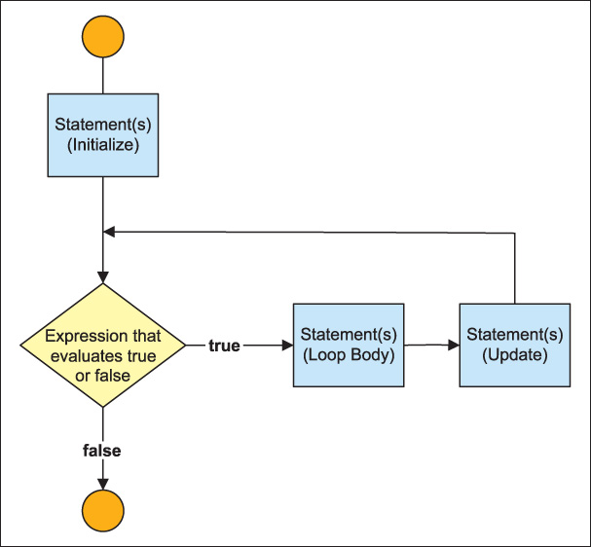
Repetition Structure
Repetition Structure
for loop
Pretest form of loop (like the while)
Considered specialized form of while statement
Usually associated with counter-controlled types
Packages initialization, test, and update all on one line
General form is:
for (statement; conditional expression; statement)
statement;
Interpreted as:
for (initialize; test; update)
statement;

Slide 72
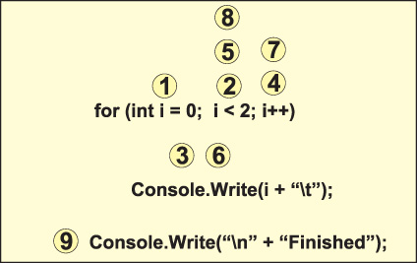
Repetition Structure
for loop
For loop statements are executed in the order shown by the numbered steps

Slide 73
Repetition Structure
for loop
int counter = 0;
while (counter < 11)
{
Console.WriteLine("{0}\t{1}\t{2}", counter,
Math.Pow(counter,2), Math.Pow(counter,3));
counter++;
}
for (int counter = 0; counter < 11; counter++)
{
Console.WriteLine("{0}\t{1}\t{2}", counter,
Math.Pow(counter,2), Math.Pow(counter,3));
}
Replace above while loop with for loop below –does same

Slide 74
Repetition Structure
for loop
0 0 0
1 1 1
2 4 8
3 9 27
4 16 64
5 25 125
6 36 216
7 49 343
8 64 512
9 81 729
10 100 1000
Output from both the while and for loop examples compared on the previous slide

Slide 75
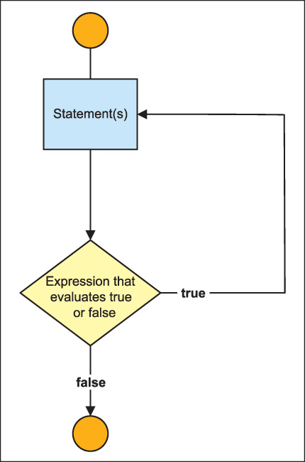
Repetition Structure
do…while statement
Posttest
General form
do
{
statement(s);
}
while ( conditional expression);

Slide 76
Repetition Structure
do…while statement
int counter = 10;
do // No semicolon on this line
{
Console.WriteLine(counter + "\t" + Math.Pow(counter, 2));
counter--;
}
while (counter > 6);
The output of this code is:
10 100
9 81
8 64
7 49

Slide 77
Repetition Structure
Nested Loop
Loop can be nested inside an outer loop
Inner nested loop is totally completed before the outside loop is tested a second time
int inner;
for (int outer = 0; outer < 3; outer++)
{
for(inner = 10; inner > 5; inner--)
{
Console.WriteLine("Outer: {0}\tInner: {1}",
outer, inner);
}
}
15 lines printed

Slide 78
Methods
Anatomy of a Method
Methods defined inside classes
Group program statements
Based on functionality
Called one or more times
All programs consist of at least one method
Main( )
User-defined method

Slide 79
Methods
Anatomy of a Method
using System;
namespace Square {
public class SquareExample
{
public static void Main( )
{
int aValue = 768;
int result;
result = aValue * aValue;
Console.WriteLine("{0} squared is {1}", aValue,
result);
Console.Read( );
}
}
}
Required method

Slide 80
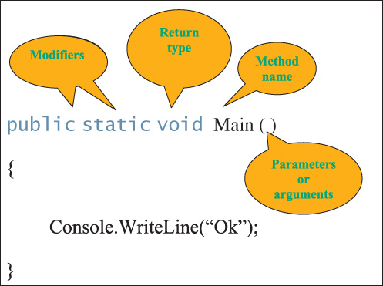
Methods
Method Components
Figure 3-1 Method components

Slide 81
Methods
Access Modifiers
Appear in method headings
Appear in the declaration heading for classes and other class members
Indicate how it can be accessed
Types of modifiers
static
Access

Slide 82
Methods
Static Modifier
Indicates member belongs to the type itself rather than to a specific object of a class
Main( ) must include static in heading
Methods that use static modifier - class methods
Instance methods require an object
Members of the Math class are static
public static double Pow(double, double)
double answer = Math.Sqrt(25);
Will be discussed more in details in the later topics.

Slide 83
Methods
Access Modifiers
public
protected
internal
protected internal
private

Slide 84
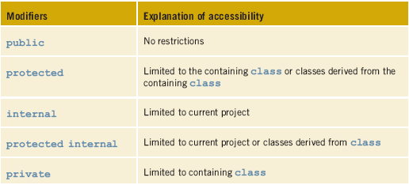
Methods
Access Modifiers - Level of Accessibility

Slide 85
Methods
Return Type
Indicates what type of value is returned when the method is completed
Always listed immediately before method name
void
No value being returned
return statement
Required for all non-void methods
Compatible value

Slide 86
Methods
Return Type
Return type
public static double CalculateMilesPerGallon
(int milesTraveled, double gallonsUsed)
{
return milesTraveled / gallonsUsed;
}
Compatible value (double) returned

Slide 87
Methods
Method Name
Follow the rules for creating an identifier
Pascal case style
Action verb or prepositional phrase
Examples
CalculateSalesTax( )
AssignSectionNumber( )
DisplayResults( )
InputAge( )
ConvertInputValue( )

Slide 88
Methods
Parameters
Supply unique data to method
Appear inside parentheses
Include data type and an identifier
In method body, reference values using identifier name
Parameter refers to items appearing in the heading
Argument for items appearing in the call
Formal parameters
Actual arguments

Slide 89
Methods
Parameters
public static double CalculateMilesPerGallon
(int milesTraveled, double gallonsUsed)
{
return milesTraveled / gallonsUsed;
}
Call to method inside Main( ) method
Console.WriteLine("Miles per gallon = {0:N2}",
CalculateMilesPerGallon(289, 12.2));
Two formal parameters
Actual arguments

Slide 90
Methods
Parameters
Like return types, parameters are optional
Keyword void not required (inside parentheses) – when there are no parameters
public void DisplayMessage( )
{
Console.Write("This is ");
Console.Write("an example of a method");
Console.WriteLine("body.");
return; // no value is returned
}

Slide 91
Methods
Method Body
Enclosed in curly braces
Include statements ending in semicolons
Declare variables
Do arithmetic
Call other methods
Value-returning methods must include return statement

Slide 92
Methods
Calling Class Methods
A.K.A. invoking a method
Call to method that returns no value [qualifier].MethodName(argumentList);
Qualifier
Square brackets indicate optional
Class or object name
Call to method does not include data type

Slide 93
Methods
Writing your own method
[modifier(s)] returnType MethodName ( parameterList )
{
// body of method - consisting of executable statements
}
void Methods
Simplest to write
No return statement

Slide 94
Methods
Example
Nothing is returned
Call to this method looks like:
DisplayInstructions( );
public static void DisplayInstructions( )
{
Console.WriteLine("This program will determine how "
+ "much carpet to purchase.");
Console.WriteLine( );
Console.WriteLine("You will be asked to enter the "
+ " size of the room and ");
Console.WriteLine("the price of the carpet, "
+ "in price per square yards.");
Console.WriteLine( );
}

Slide 95
Methods
Method Call
public static void DisplayResults(double squareYards,
double pricePerSquareYard)
{
Console.Write("Total Square Yards needed: ");
Console.WriteLine("{0:N2}", squareYards);
Console.Write("Total Cost at {0:C} ", pricePerSquareYard);
Console.WriteLine(" per Square Yard: {0:C}",
(squareYards * pricePerSquareYard));
}
static method called from within the class where it resides
To invoke method → DisplayResults(16.5, 18.95);

Slide 96
Methods
Value Returning Method
Has a return type other than void
Must have a return statement
Compatible value must be returned
Zero, one, or more data items may be passed as arguments
Calls can be placed:
In assignment statements
In output statements
In arithmetic expressions
Or anywhere a value can be used

Slide 97
Methods
Value Returning Method
public static double GetLength( )
{
string inputValue;
int feet, inches;
Console.Write("Enter the Length in feet: ");
inputValue = Console.ReadLine( );
feet = int.Parse(inputValue);
Console.Write("Enter the Length in inches: ");
inputValue = Console.ReadLine( );
inches = int.Parse(inputValue);
return (feet + (double) inches / 12);
}
Return type → double
double returned

Slide 98
Methods
Example

Slide 99
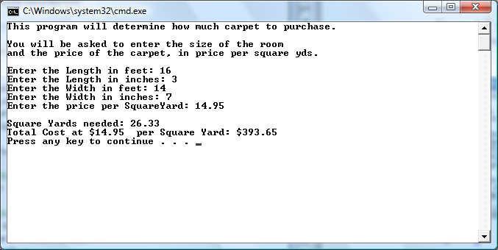
Methods
Output

Slide 100
Array
Array Basics
Data structure that may contain any number of variables
Variables must be of same type
Single identifier given to entire structure
Individual variables are called elements
Elements accessed through an index
Index also called subscript
Elements are sometimes referred to as indexed or subscripted variables

Slide 101
Array
Array Basics
Arrays are objects of System.Array class
Array class includes methods and properties
Methods for creating, manipulating, searching, and sorting arrays
Create an array in the same way you instantiate an object of a user-defined class
Use the new operator
Specify number of individual elements

Slide 102
Array
Array Declaration
Syntax for creating an array
type [ ] identifier = new type [integral value];
Type can be any predefined types like int or string, or a class that you create in C#
Integral value is the number of elements
Length or size of the array
Can be a constant literal, a variable, or an expression that produces an integral value

Slide 103
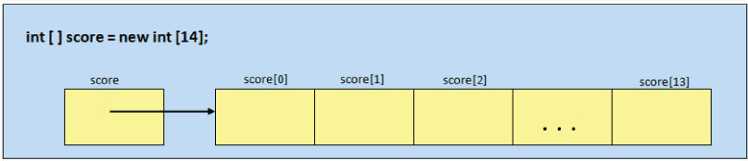
Array
Array Declaration
*** C# uses zero-based arrays—meaning the first element is indexed by 0

Slide 104
Array
Array Declaration
Array identifier, name, references first element
Contains address where score[0] is located
First index for all arrays is 0
Last element of all arrays is always referenced by an index with a value of the length of the array minus one
Can declare an array without instantiating it
The general form of the declaration is:
type [ ] identifier;

Slide 105
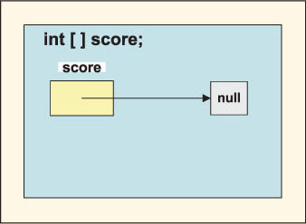
Array
Array Declaration

Slide 106
Array
Array Declaration
If you declare array with no values to reference, second step required – must dimension the array
General form of the second step is:
identifier = new type [integral value];
Examples
const int size = 15;
string [ ] lastName = new string [25];
double [ ] cost = new double [1000];
double [ ] temperature = new double [size];
int [ ] score;
score = new int [size + 15];
Two steps
Two steps

Slide 107
Array
Array Initializers
Compile-time initialization
General form of initialization follows:
type[ ] identifier = new type[ ] {value1, value2, …valueN};
Values are separated by commas
Values must be assignment compatible to the element type
Implicit conversion from int to double
Declare and initialize elements in one step

Slide 108
Array
Array Initializers
Array length determined by number of initialization values placed inside curly braces
Examples
int [ ] anArray = {100, 200, 400, 600};
char [ ] grade = new char[ ] {'A', 'B', 'C', 'D', 'F'};
double [ ] depth = new double [2] {2.5, 3};
No length specifier is required

Slide 109
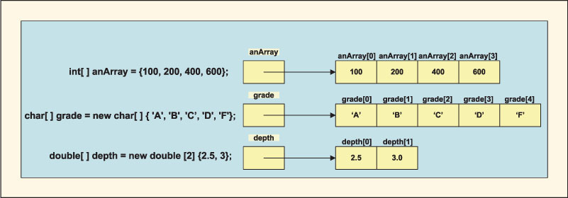
Array
Array Initializers

Slide 110
Array
Array Access
Specify which element to access by suffixing the identifier with an index enclosed in square brackets
score[0] = 100;
Length – special properties of Array class
Last valid index is always the length of the array minus one

Slide 111
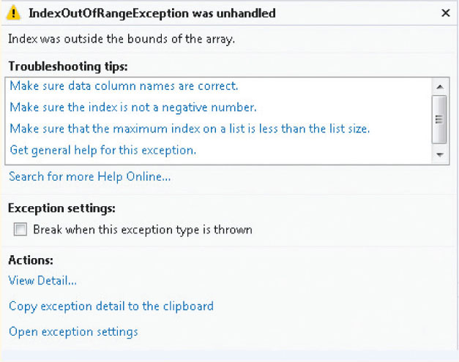
Array
Array Access
Try to access the array using an index value larger than the array length minus one, a nonintegral index value, or a negative index value – run-time error

Slide 112
Array
Array Example

Slide 113
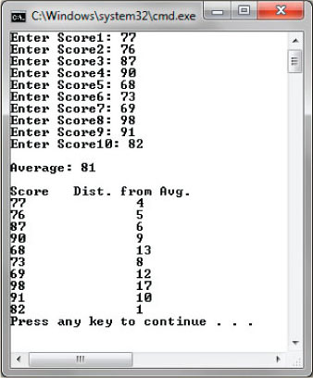
Array
Output

Slide 114
Array
Sentinel-Controlled Access
What if you do not know the number of elements you need to store?
Could ask user to count the number of entries and use that for the size when you allocate the array
Another approach: create the array large enough to hold any number of entries
Tell users to enter a predetermined sentinel value after they enter the last value
Sentinel value
Extreme or dummy value

Slide 115
Array
Using foreach with Arrays
Used to iterate through an array
Read-only access
General format
foreach (type identifier in expression)
statement;
Identifier is the iteration variable
Expression is the array
Type should match the array type

Slide 116
Array
Using foreach with Arrays
Displays red, blue, and green on separate lines
string [ ] color = {"red", "green", "blue"};
foreach (string val in color)
Console.WriteLine (val);
Iteration variable, val represents a different array element with each loop iteration
No need to increment a counter (for an index)

Slide 117
Array
Using foreach with Arrays
val is the iteration variable. It represents a different array element with
each loop iteration.
int total = 0;
double avg;
foreach (int val in score)
{
total += val;
}
Console.WriteLine("Total: " + total);
avg = (double)total / scoreCnt;
Console.WriteLine("Average: " + avg.ToString("F0"));

Slide 118
Array
Array Class
Base array class
All languages that target Common Language Runtime
More power is available with minimal programming

Slide 119
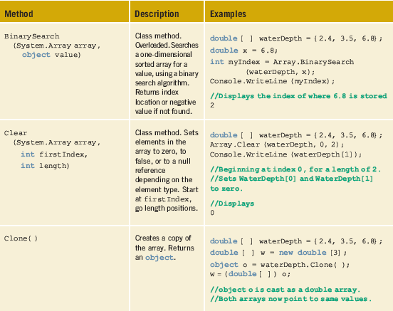
Array

Slide 120
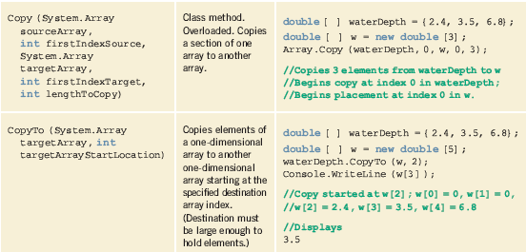
Array

Slide 121
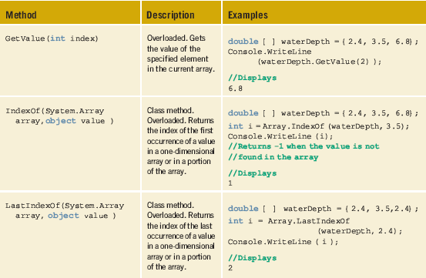
Array

Slide 122
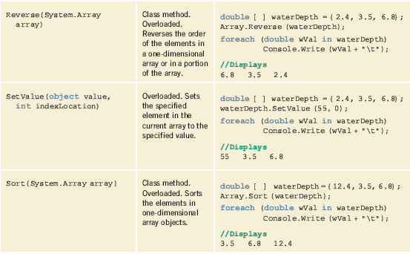
Array

Slide 123
Array
Array Class
// Copies 5 values from waterDepth, beginning at index location 2. Place
// values in Array W, starting at index location 0.
Array.Copy (waterDepth, 2, w, 0, 5);
Array.Sort (w); // Sorts Array w in ascending order
outputMsg = "Array w Sorted\n\n"; // Displays Array w sorted
foreach(double wVal in w)
{
if (wVal > 0)
outputMsg += wVal + "\n";
}
Review UsePredefinedMethods Example

Slide 124
Array
Array As Method Parameters
Can send arrays as arguments to methods
Heading for method that includes array as a parameter
modifiers returnType identifier (type [ ] arrayIdentifier...)
Open and closed square brackets are required
Length or size of the array is not included
Example
void DisplayArrayContents (double [ ] anArray)

Slide 125
Array
Pass by Reference
Arrays are reference variables
No copy is made of the contents
Array identifier memory location does not contain a value, but rather an address for the first element
Actual call to the method sends the address
Call does not include the array size
Call does not include the square brackets
Example
DisplayArrayContents (waterDepth);

Slide 126
Array
Example: Using Arrays as Method Arguments

Slide 127
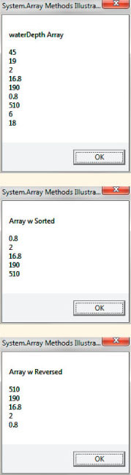
Array
Output

Slide 128
Array
Input Values into an Array
// Instead of doing compile time initialization, input values
public static void InputValues(int [ ] temp)
{
string inValue;
for(int i = 0; i < temp.Length; i++)
{
Console.Write("Enter Temperature {0}: ", i + 1);
inValue = Console.ReadLine( );
temp[i] = int.Parse(inValue);
}
}

Slide 129
Array
Input Values into an Array
To call InputValues(int [ ] temp) method
int [ ] temperature = new int[5];
InputValues(temperature);
Next slide, shows the result of inputting 78, 82, 90, 87, and 85

Slide 130
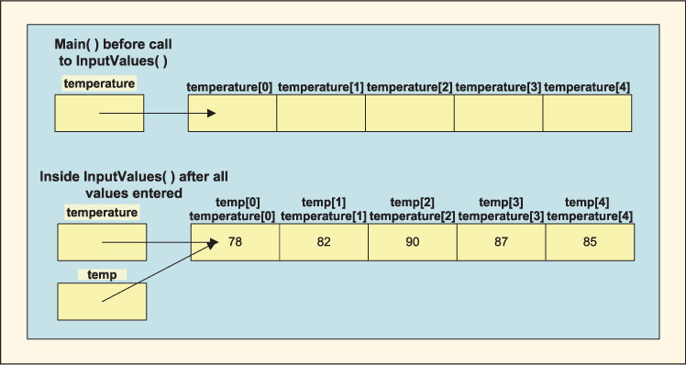
Array
Input Values into an Array

Slide 131
Array
Array Assignment
Assignment operator (=) does not work as you would think
Assigned operand contains the same address as the operand on the right of the equal symbol

Slide 132
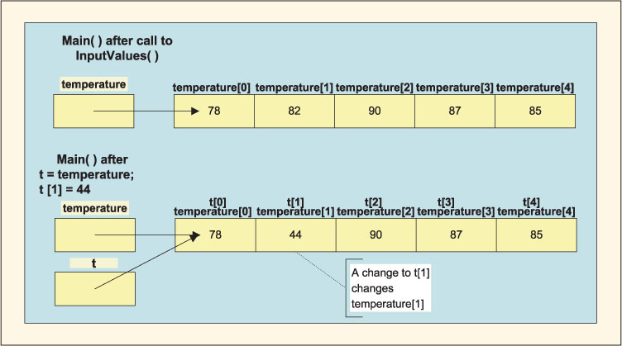
Array
Array Assignment

Slide 133
Array
Passing Arrays to Methods
int [ ] temperature = new int[5];
int [ ] t = new int[5];
InputValues(temperature);
public static void InputValues (int [ ] temp)

Slide 134
Array
Params Parameter
Keyword params used
Appears in formal parameter list (heading to the method)
Must be last parameter listed in the method heading
Indicates number of arguments to the method that may vary (the number of arguments is unknown)
Parallel array
Two or more arrays that have a relationship

Slide 135
Array
Params Parameter
public static void Main( )
{
DisplayItems(1, 2, 3, 5);
int[ ] anArray = new int[5] {100, 200, 300, 400, 500};
DisplayItems(anArray);
DisplayItems(1500, anArray[1] * anArray[2]);
Console.ReadKey( );
}
public static void DisplayItems (params int[] item)

Slide 136
Two-dimensional arrays
C# support two-dimensional (2D) arrays:
columns
A two-dimensional array may be stored in computer memory in either of two ways:
a
b
c
d
rows
e
f
g
h
i
j
k
l
row 0
row 1
row 2
logical view
row major order:
a
b
c
d
e
f
g
h
i
j
k
l
col 0
col 1
col 2
col 3
column major order:
a
e
i
b
f
j
c
g
k
d
h
l

Slide 137
Two-dimensional arrays
In a 2D array, we generally consider the first index to be the row, and the second to be the column: a[row, col]
columns 0 1 2 3 4
0 1 2 3
0,0
0,1
0,2
0,3
0,4
rows
1,0
1,1
1,2
1,3
1,4
2,0
2,1
2,2
2,3
2,4
3,0
3,1
3,2
3,3
3,4

Slide 138
Two-dimensional arrays
C# supports rectangular, non-rectangular and jagged arrays
Arrays can be of 1 or more dimensions
To declare a rectangular array
int[,] int2d = new int[2,3];
for (int i = 0; I < 2; i++) {
for(int j = 0; j < 3; j++) {
int2d[i,j] = i+j;
}
}

Slide 139
Two-dimensional arrays
Nonrectangular arrays
int [][] ragged = new int[4][];
for (int i = 0; i < 4; i++) { ragged[i] = new int[i + 1]; }
0 1 2 3
0 1 2 3
0
10
11
20
21
22
30
31
32
33
for (int i = 0; i < 4; i++) { for (int j = 0; j < ragged[i].length; j++) { ragged[i][j] = 10 * i + j; } }

Slide 140
Two-dimensional arrays
Jagged Arrays
These are really arrays of arrays
Each member must be created as a separate array
Note the difference in subscripting
int jag[][] = new int[2][];
jag[0] = new int[5];
jag[1] = new int[10];
jag[0][1] = 15;

