Slide 1

Chapter 02 – Part II
Design and Develop an Object-Oriented application

Slide 2
Learning Objectives
At the end of this topic, you should be able to :
Demonstrate understanding of encapsulation in Object-Oriented Programming.
Determine the classes, properties and methods for an Object-Oriented application.
Demonstrate the use of inheritance in Object-Oriented programming.
Demonstrate the use of dynamic types using polymorphism, method overloading and overriding.
Demonstrate software reusability, extensibility and maintainability through inheritance and polymorphism.
Develop an application with good object-oriented design.

Slide 3
OOP
As mentioned in the earlier topic, OOP must:
allow encapsulation,
have inheritance properties, and
have polymorphism properties

Slide 4

Watch this video

Slide 5
Inheritance
Inheritance is the principle that states you can apply your knowledge of a general category to more specific objects
When you create a class by making it inherit from another class, you are provided with data fields and methods automatically
There are many advantages to using inheritance

Slide 6
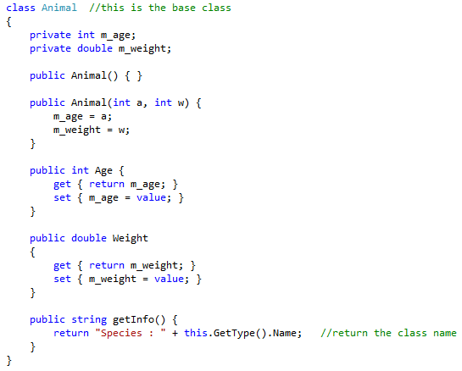
Inheritance
Animal Class

Slide 7
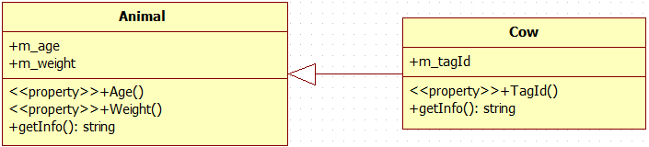
Inheritance
The ability to use inheritance makes programs easier to write, less error-prone, and easier to understand
In this example, cow is a derived class of animal. In other words, the 2 classes have IS-A relationship, meaning the child is a more specific version of the parent. E.g. cow is an animal.
This IS-A relationship allows the object of the derived class to have the attributes and operations defined in the base class. Whatever an animal has, a cow also has, and whatever an animal can do, a cow also can do.

Slide 8
Inheritance
A class that is used as a basis for inheritance is called a base class
When you create a class that inherits from a base class, it is a derived class or extended class
You can use the terms superclass and subclass as synonyms for base class and derived class
You usually can distinguish base classes from their subclasses by size
A derived class can be further extended
Inheritance is transitive; that means a child inherits all the members of all its ancestors
When you create your own transitive inheritance chains, you want to place fields and methods at their most general level

Slide 9
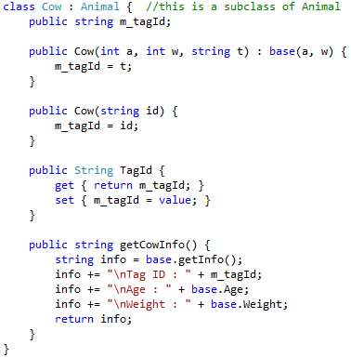
Inheritance : Extending Class
When you create a class that is an extension or child of another class, you use a single colon between the derived class name and its base class name
Inheritance works in one direction

Slide 10



Inheritance : Constructor
When a derived class object is instantiated using the parameterized constructor to initialize all object attributes, the attributes defined in the base class must be initialized using the base keyword as shown below:
In the above example, a and w values will be passed over to the base class constructor to initialize the age and weight of the animal.

Slide 11
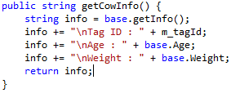
Inheritance : Attributes and Methods
Occasionally, you want to allow a subclass to access parent class data, while still abiding by the principle of information hiding
In other words, from derived class, you can only have access to non-private members of the base class
Calling base class method
Accessing base class properties

Slide 12
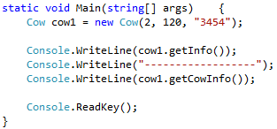
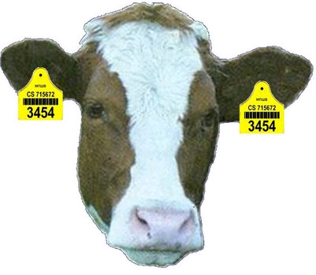

Inheritance : Extending Class
Example :
Creating a Cow object instance
Calling base class method
Calling method defined in Cow class
Output :
getInfo()
getCowInfo()

Slide 13
Overriding base class Methods
When we inherit a class into the derived class and provide a definition for one of the base class's method again inside the derived class, that method (in the base class) is said to be overridden, and the mechanism is called Method Overriding.
When you create a subclass by extending an existing class, the new subclass contains data and methods that were defined in the original base class.
Sometimes the base-class data fields and methods are not appropriate for the subclass objects
Using the same method name to indicate different implementations is called polymorphism

Slide 14
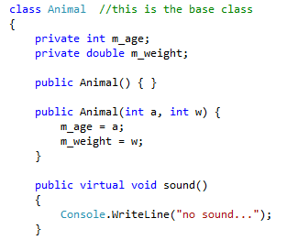
Overridden Method
Overridden method is a method in the base class that will be overridden by another method that has the same name and parameters.
The virtual keyword is used in the method header so that it can be overridden in a derived class.

Slide 15
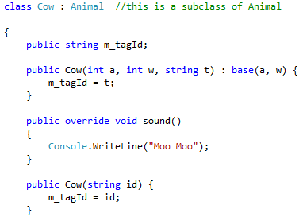
Overriding Method
Overriding method is a method in the derived class that overrides the method that has the same name and parameters in the base class.
The overrides keyword must be used in the method header.
The access modifier of the overriding method must be less restrictive than the one used for overridden method on the based class.

Slide 16
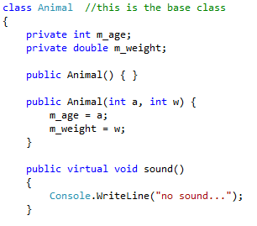
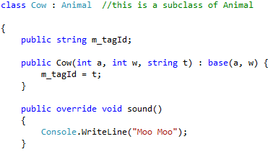
Overriding base class Methods
Will override

Slide 17
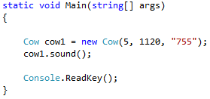
Overriding base class Methods
Output :

Slide 18
Polymorphism
Polymorphism means 'Many Forms'.
It allows you to invoke derived class methods through a base class reference during run-time.
This is handy when you need to assign a group of objects to an array and then invoke each of their methods.
A polymorphic reference is one which can refer to different types of objects at different times. It morphs!
The type of the actual instance, not the declared type, determines which method is invoked.
Animal myAnimal = new Cow();
declared type
actual instance

Slide 19
Polymorphism
To use polymorphism, there are a few rules that you must follow.
The method that we are invoking must be through a reference belonging to the base class. Any level of the parent class will do.
The method that you are calling must also be found in the parent class reference that you are using. In other words, the method must exist in both base class and derived class (the derived class’s method overrides the base class’s method)
The method modifier in the subclass must not be more restrictive than the one in the parent class.

Slide 20
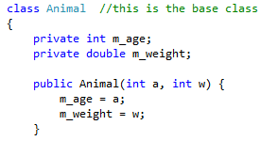


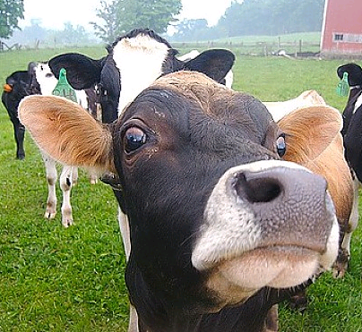
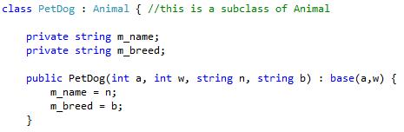
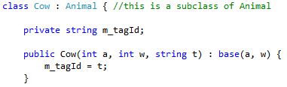
Polymorphism

Slide 21


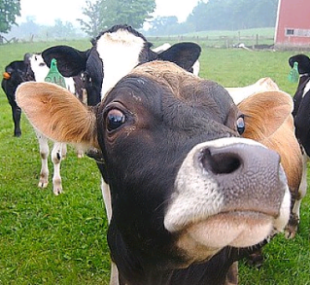


Polymorphism

Slide 22
Polymorphism
When we instantiate objects as follows:
Animal a1 = new PetDog(5, 45, "Doggy", "Rottweiler");
Animal c1 = new Cow(7, 120, "T220");
In order for us to invoke sound() methods in the derived classes as follows:
a1.sound();
c1.sound();
sound() methods must exist in Animal class, Cow class, and Dog class and the ones defined in Cow and PetDog class must override the one in the Animal class.

Slide 23
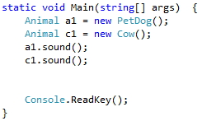
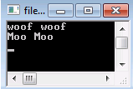
Polymorphism
Example :

Slide 24

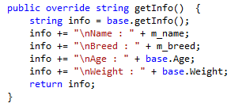
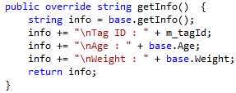
Polymorphism – Another Example

Slide 25
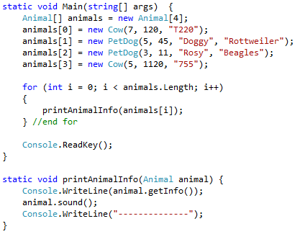
Polymorphism – Another Example
Study and try to understand the following program:

Slide 26
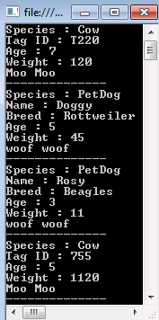
Polymorphism
Output :

Slide 27
Abstract Classes
Abstract classes used to prohibit other classes from instantiating objects of the class
  Can create subclasses (derived classes) of the abstract class
  Derived classes inherit characteristics from base abstract class
  Objects can only be created using classes derived from the abstract class

Slide 28
Abstract Methods
Only permitted in abstract classes
Method has no body
  Implementation details of the method are left up to classes derived from the base abstract class
Every class that derives from the abstract class must provide implementation details for all abstract methods
  Sign a contract that details how to implement its abstract methods

Slide 29
Abstract Methods (continued)
No additional special keywords are used when a new class is defined to inherit from the abstract base class
  [access modifier] abstract returnType MethodIdentifier
  ([parameter list]) ; // No { } included
Declaration for abstract method ends with semicolon; NO method body or curly braces
  Syntax error if you use the keyword static or virtual when defining an abstract method
Design

Slide 30
Abstract Methods (continued)
  // Classes that derive from Person
  // must provide implementation details
  // (the body for the method)
  public abstract string GetExerciseHabits( );
In the derived class, all abstract methods’ headings include the special keyword override
  public override string GetExerciseHabits()
  {
  return "Exercises daily";
  }
Defined in Person
Defined in Student

Slide 31
Interfaces
C# supports single inheritance
  Classes can implement any number of interfaces
  Only inherit from a single class, abstract or nonabstract
Think of an interface as a class that is totally abstract; all methods are abstract
  Abstract classes can have abstract and regular methods
  Classes implementing interface agree to define details for all of the interface’s methods

Slide 32
Interfaces (continued)
General form
  [modifier] interface InterfaceIdentifier
  {
  // members - no access modifiers are used
  }
Members can be methods, properties, or events
  No implementations details are provided for any of its members

Slide 33
Defining an Interface
Can be defined as member of existing namespace or class OR by compiling it to separate DLL
Easy approach is to put the interface in a separate project (like was done with Person and Student)
  Use the Class Library template from Start page
Unlike abstract classes, it is not necessary to use the abstract keyword with methods of interfaces
  Because all methods are abstract
Review LibraryFiles Example

Slide 34
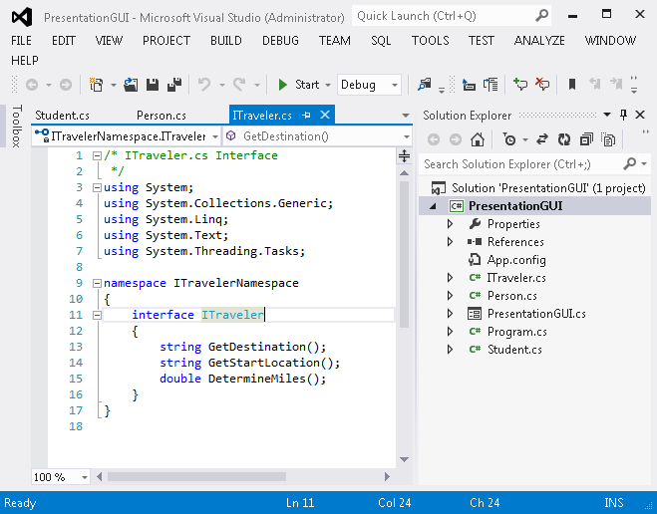
Defining an Interface (continued)
To store in Class Library, Build the interface DLL using Build option from BUILD menu
Figure 11-15 ITraveler interface

Slide 35
Implement the Interface
Follow same steps as with the Person and Student DLLs …if you want to store in Class Library
  Create Class Library File from Start page
  Compile and Build assembly from BUILD menu option, creating a .DLL file
  In the class implementing the interface, Add Reference to the .DLL file
  Type a using statement (for the namespace identifier) in the class implementing the interface

Slide 36
Implement the Interface (continued)
Heading for the class implementing the interface identifies base class and one or more interfaces following the colon (:) [Base class comes first]
  [modifier] class ClassIdentifier : identifier [, identifier]
    public class Student : Person, Itraveler
For testing purposes, PresentationGUI class in the PresentationGUIAbtractClassAndInterface folder modified to include calls to interface methods

Slide 37
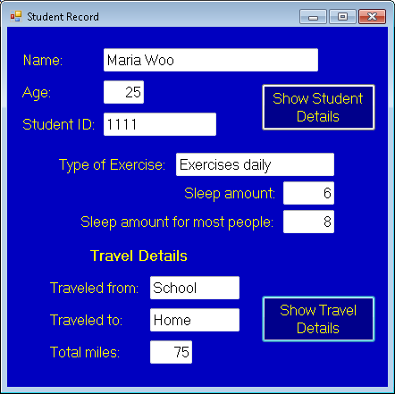
Implement the Interface: PresentationGUI Application
Populated by Interface methods
Figure 11-16 PresentationGUI output using interface methods

Slide 38
Implement the Interface: PresentationGUI Application
GetStartLocation( ), GetDestination( ), and DetermineMiles( ) members of ITraveler interface
  private void btnTravel_Click(object sender, EventArgs e)
  {
  // GetStartLocation( ), GetDestination( ) and DetermineMiles( )
  // methods all defined as abstract methods in ITraveler interface
  txtBxFrom.Text = aStudent.GetStartLocation();
  txtBxTo.Text = aStudent.GetDestination();
  txtBxMiles.Text = aStudent.DetermineMiles().ToString();
  txtBxFrom.Visible = true;
  … //More statements

