Slide 1

Chapter 03
Introduction to Windows Forms Programming

Slide 2
Learning Objectives
At the end of this topic, you should be able to :
Build a GUI using IDE tool in WYSIWYG mode.
Create and manipulate basic UI components such as buttons, labels, listbox, textfields, radiobuttons and groupbox.
Explain the events associated with different types of UI components.
Create a Graphical User Interface with various GUI components.

Slide 3
Windows App VS and Console App
Console applications
  Each line in Main( ) executed sequentially – then the program halts
Windows applications
  Once launched, sits and waits for an event
  Sits in a process loop
Event: notification from operating system that an action, such as the user clicking the mouse or pressing a key, has occurred
  Write event-handler methods for Windows apps

Slide 4
Graphical User Interfaces
Windows applications also look different from console applications
Interface: front end of a program
  Visual image you see when you run a program
Graphical user interface (GUI) includes:
  Menus
  Text in many different colors and sizes
  Other controls (pictures, buttons, etc.)

Slide 5
Windows Applications
Reference and import System.Windows.Forms namespace
Class heading definition
  Includes not only the class name, but a colon followed by another class name
    Derived class (first class)
    Base class (second class)
    public class Form1 : Form
Derived classes inherit from base class

Slide 6
Windows Applications
Text
  A property for setting/getting title bar caption
  Can be used in constructor
Windows forms/controls offer many properties including Text, Color, Font, and Location
Execution begins in Main( ) method
  Main( ) is located in Program.cs file for the application
  Call to Run( ) method places application in process loop

Slide 7
Windows Applications
// Windows0.cs Author: Doyle
using System.Windows.Forms;
namespace Windows0
{
public class Form1 : Form
{
public Form1( )
{
Text = "Simple Windows Application";
}
static void Main( )
{
Form1 winForm = new Form1( );
Application.Run(winForm);
}
}
}
New namespace referenced
Base class
Constructor
Sets title bar caption
Starts process loop
Notes:
This is how to create a windows form the hard way.. Code everything from scratch.. We try not to do it this way.

Slide 8
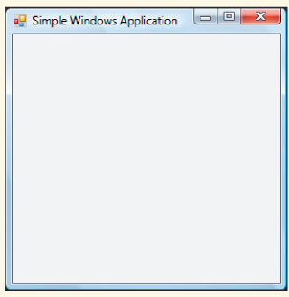
Windows Applications
Output generated from Windows0 application

Slide 9
Elements of Good Design
Appearance matters
  Human-computer interaction (HCI) research
Design considerations
  Consistency
  Alignment
  Avoid clutter
  Color
  Target audience

Slide 10
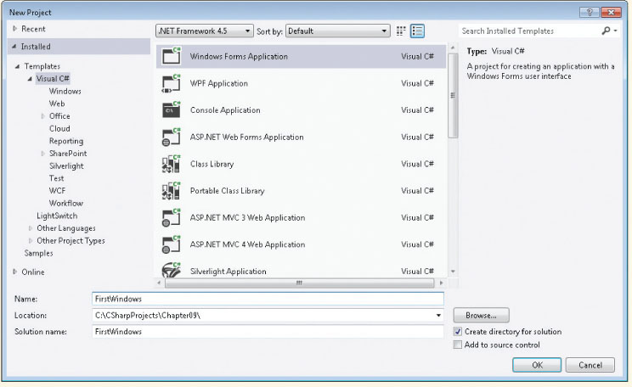
Use Visual Studio to Create Windows-Based Applications
Select File New Project
Windows Forms Application template
Browse to location to store your work
Name

Slide 11
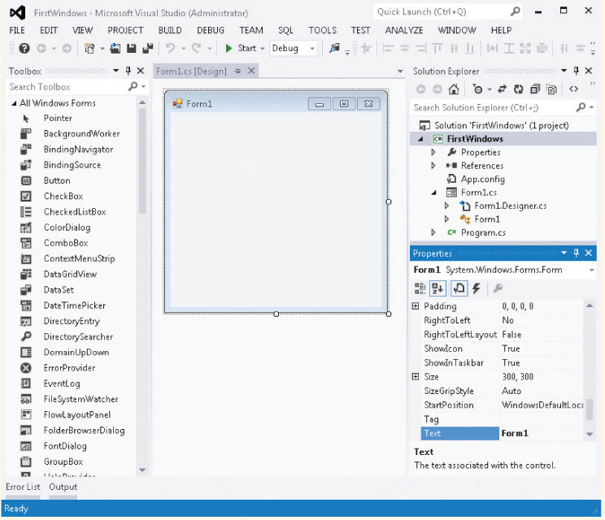
Use Visual Studio to Create Windows-Based Applications
Solution Explorer
Properties Window
Toolbox
Form’s Design View

Slide 12
Windows Forms
Extensive collection of Control classes
Top-level window for an application is called a Form
Each control has large collection of properties and methods
  Select property from an alphabetized list (in Properties window)
  Change property by clicking in the box and selecting or typing the new entry

Slide 13
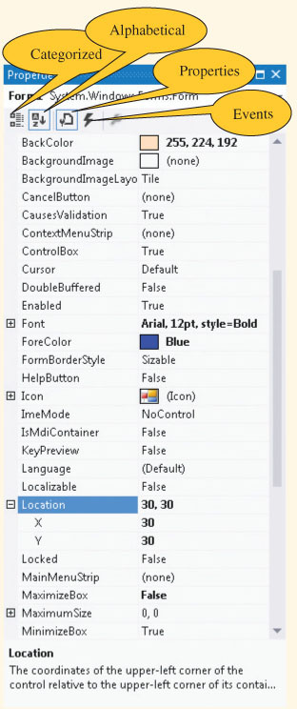
Windows Forms Properties
Property value
Properties

Slide 14
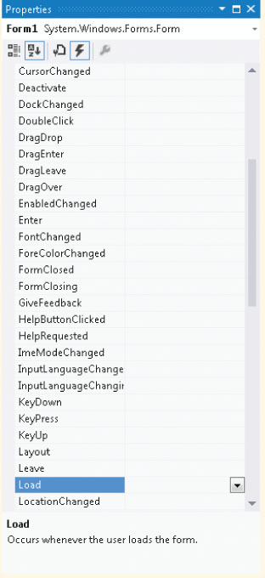
Windows Forms Events
When is clicked.

Slide 15
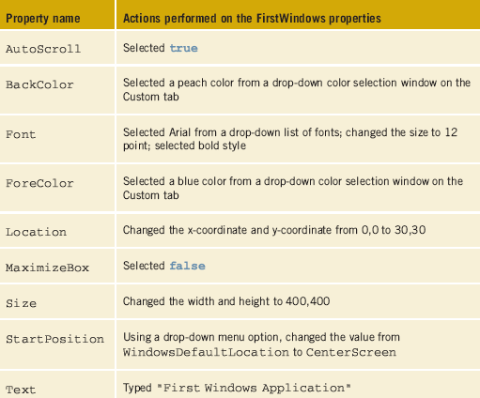
Windows Form Properties
Can set properties using program statements
  The table on the right shows properties set using Properties window
Selecting Code on View menu shows associated code

Slide 16
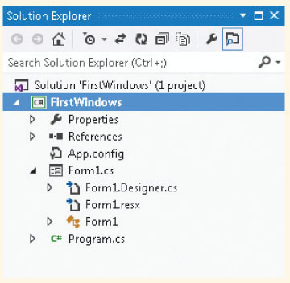
Code Generated by VS
Three source code files ending with a .cs extension are part of the application
Expand Form1.cs node to reveal the Form1.Designer.cs file

Slide 17
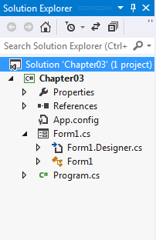
Simple Windows Application
IDE separates the source code into three separate files
  Form1.cs: normally this is the only one you edit
  Form1.Designer.cs: holds the auto generated code
  Program.cs: contains the Main( ) method, where execution always begins
Form1.cs and Form1.Designer.cs both include partial class definitions for the Form1 class
Click on any of these files to open code editor

Slide 18
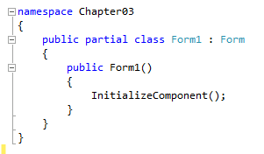
Inspecting the Code - Form1.cs
Number of namespaces automatically added, including System.Windows.Forms
Constructor calls InitializeComponent() method
This is the file where event handler methods will be placed

Slide 19
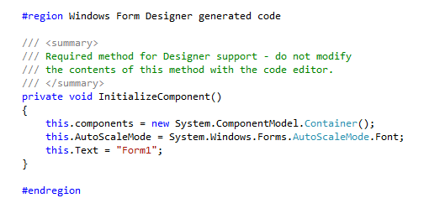
Inspecting the Code - Form1.Designer.cs
InitializeComponent( ) method included in the #region Windows Form Designer generated code preprocessor directive
  // do not modify the contents of this method with the Code Editor
  Keyword “this.” precedes property name
    Refers to current instance of the class
  #endregion // Ends the preprocessor directive

Slide 20
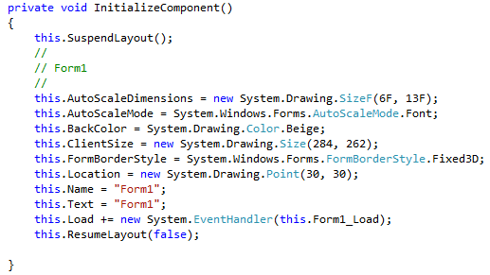
InitializeComponent( ) Method
Some of the auto generated code in the method
  Added as default values for properties or from changing property values

Slide 21
Windows Form Events
Add code to respond to events, like button clicks
  Code goes into Form1.cs file
From the Properties window, select the lightning bolt (Events)
  Double-click on the event name to generate code
    Registers the event as being of interest
    Adds a heading for event-handler method
Events button selected
Events (Form)

Slide 22
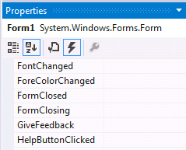

Windows Form – Closing Event
Double click here
Code automatically added to register event in the InitializeComponent() method.
Code automatically added for method heading (this is called an event handler)
You add statement to event-handler method body
  MessageBox.Show("Hope you are having fun!");

Slide 23
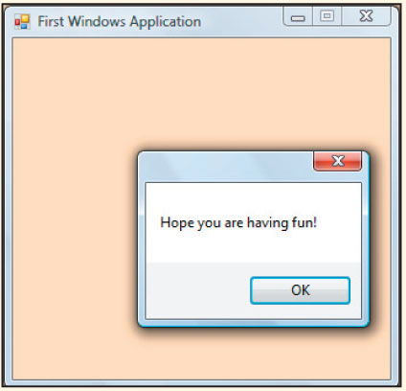
Running the Windows Application
No changes needed in the file that has Main( )
Run like you do console applications (F5 or Ctrl+F5)
Output produced
when you attempt to close the form.

Slide 24
Controls
Controls are all classes
  Button, Label, TextBox, ComboBox, MainMenu, ListBox, CheckBox, RadioButton, and MonthCalendar
Each comes with its own predefined properties and methods
Each fires events
Each is derived from the System.Windows.Forms.Control class

Slide 25
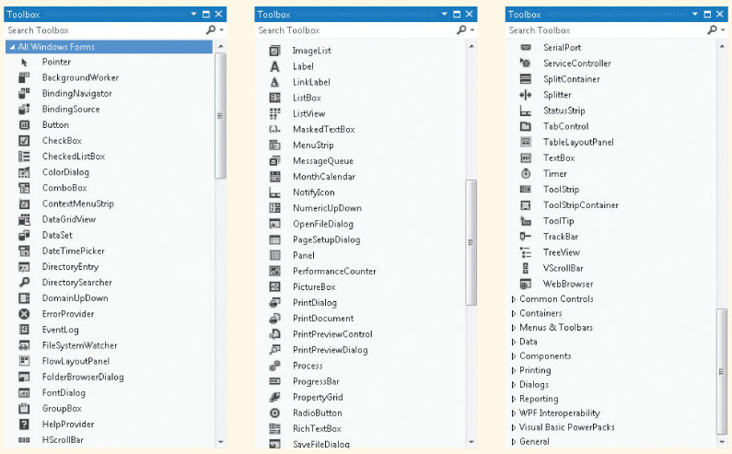
Standard Controls

Slide 26
Controls
Two procedures to place controls
  From Toolbox, double-click on control or drag and drop
Move, resize, and delete controls
Format controls
  Align controls
  Make same size
  Horizontal and vertical spacing

Slide 27
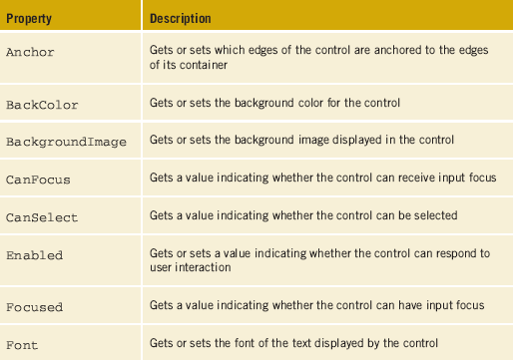
Common Properties of Controls

Slide 28
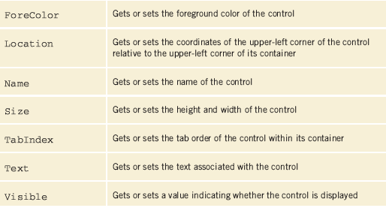
Common Properties of Controls

Slide 29
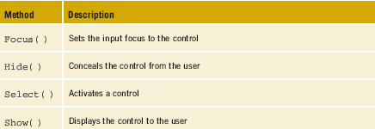
Methods of the Control Class
Control class has over 75 properties and over 100 methods
  Not all are useful for every class that derives from it
The table below includes a short list of some of the many methods. Explore MSDN documentation for more

Slide 30
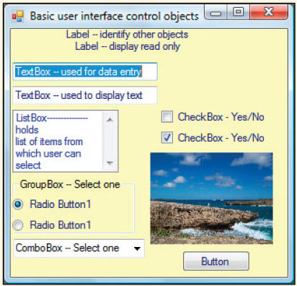
Controls

Slide 31
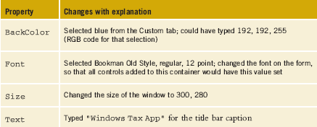
Label Objects
Provide descriptive text or labels for other controls
Some useful properties
  Text; TextAlign; Font; Location

Slide 32
Creating a TaxApp Form
Properties set for the Form container

Slide 33
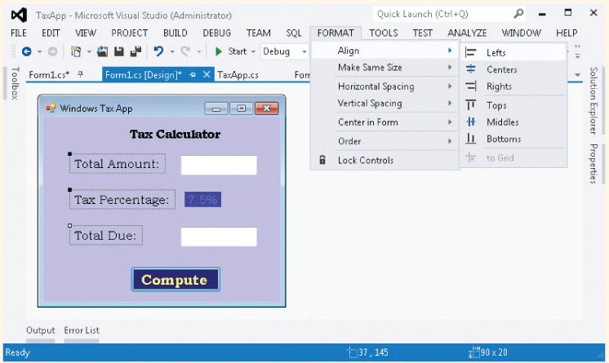
Creating a TaxApp Form
Add Label objects to Form object…

Slide 34
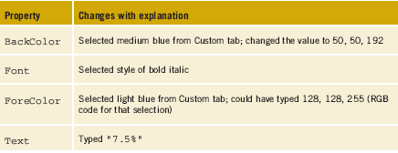
Adding Labels to TaxApp Form
This is for Label5 label object. We set these properties so that it will display “7.5%” nicely

Slide 35
TextBox Objects
Used to enter data or display text during run time
  Used for both input and output
Interesting properties
  MultiLine, ScollBars, MaxLength, PasswordChar, CharacterCasing

Slide 36
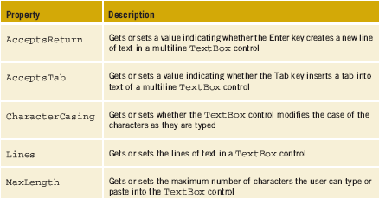
TextBox Objects

Slide 37
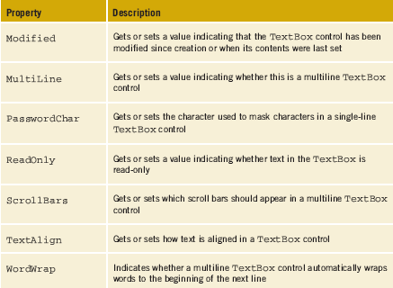
TextBox Objects

Slide 38
TextBox Objects
To retrieve string data from TextBox, use Text property
  string custName = txtName.Text;
  Place in method body
  When the statement is executed, the text stored in txtName will be assigned to custName string variable.
To display data on TextBox,
string str1 = “hello”;
  txtName.Text = str1;
  Place in method body
  When the statement is executed, txtName will display “hello” (value stored in str1 string variable).

Slide 39
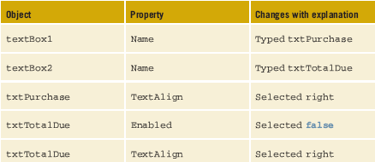
Adding TextBox Objects to TaxApp Form
Add TextBox objects, then set their property values

Slide 40
Button
Enables user to click button to perform task
  If button has event-handler method and is registered as an event to which your program is planning to respond, event-handler method is called automatically when button clicked
Button object’s properties
    Text, Enabled, Focused, TabIndex

Slide 41
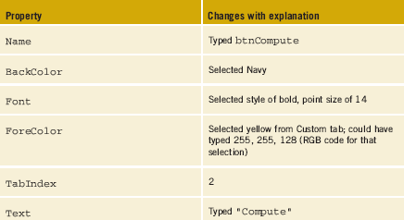
Adding Button Objects to TaxApp Form
Add Button objects, then set their property values

Slide 42
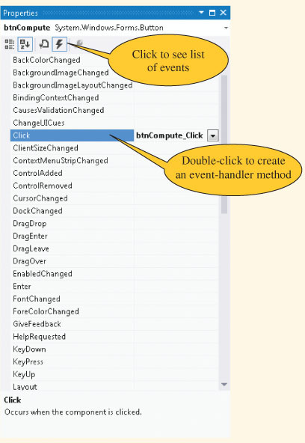
Register Click Event for the Button

Slide 43
Register Click Event for the Button
When you double-click on event, an event-handler method is created:
private void btnCompute_Click(object sender, System.EventArgs e)
{
}
AND registers click event (in the InitializeComponents() method in Form1.Designer.cs :
this.btnCompute.Click +=
new System.EventHandler
(this.btnCompute_Click);

Slide 44
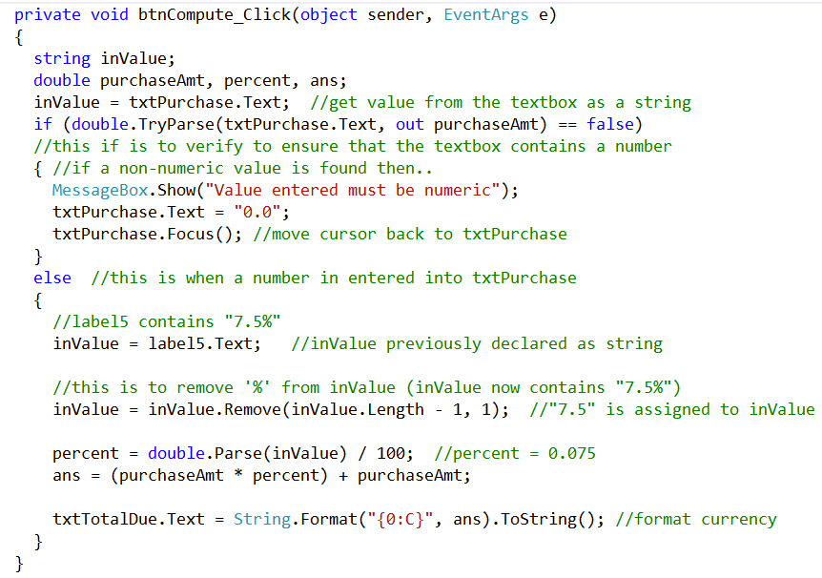
Click Event Handler

Slide 45
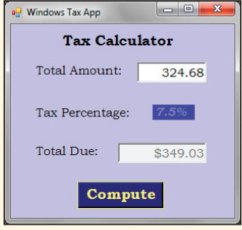
TaxApp Form
txtPurchase
label5
When compute button is clicked, the total due is displayed
txtTotalDue
btnCompute

Slide 46
ListBox Control
Displays list of items for single or multiple selections
  Scroll bar is automatically added when total number of items exceeds the number that can be displayed
Can add or remove items at design time or dynamically at run time

Slide 47
ListBox Control
Includes number of properties and events
  Items property
    Used to set initial values
    Click on (Collections) to add items
  Name property
    Useful to set if you are going to write program statements to manipulate the control
  Sorted property
    Set to true to avoid having to type values in sorted order

Slide 48
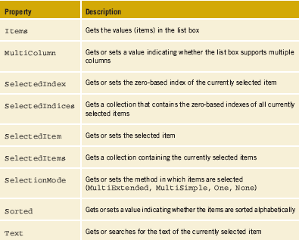
ListBox Control Properties

Slide 49
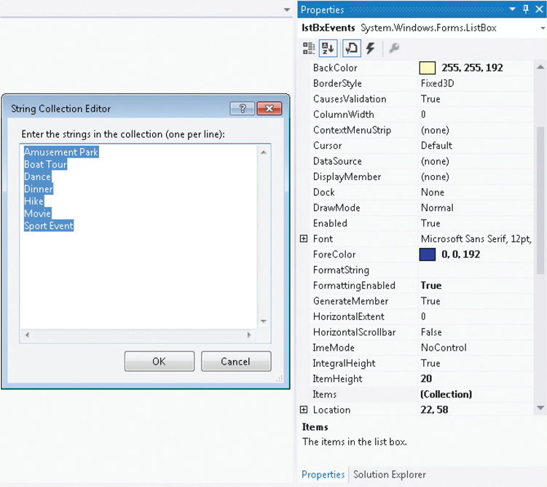
Adding Data to a ListBox
Add ListBox control, then click on Items property (Collection) to type entries

Slide 50
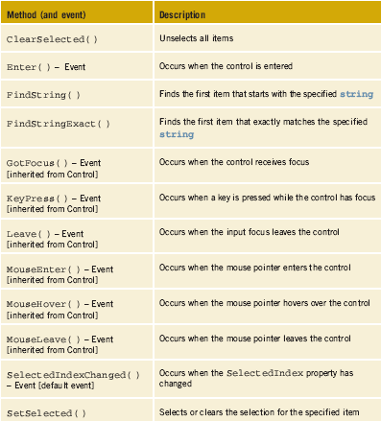
ListBox Events
Default event for ListBox

Slide 51
Registering A ListBox Event
Might want to know when the item selection changes
Double-clicking on any control registers its default event for the control
SelectedIndexChanged( ) → default event for ListBox
Visual Studio adds event-handler method
  private void listBox1_SelectedIndexChanged
  (object sender, System.EventArgs e)
  {
  }

Slide 52
ListBox Control Objects
To retrieve string data from ListBox, use Text property
  txtBoxResult.Text = lstBoxEvents.Text;
  Place in method body
  When event fires, selection retrieved and stored in TextBox object

Slide 53
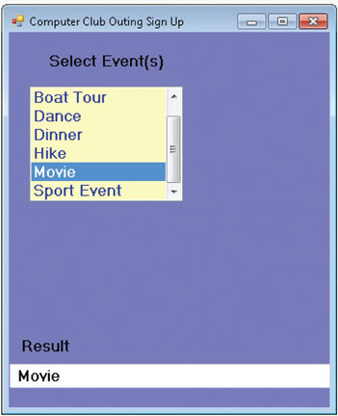
ListBox Control
When a selection is made to an item in the listbox, SelectedIndexChanged event fired

Slide 54
Multiple Selections with a ListBox
SelectionMode Property has values of MultiSimple, MultiExtended, None, and One
  MultiSimple: use the spacebar and click the mouse
  MultiExtended can also use Ctrl key, Shift key, and arrow keys
  foreach(string activity in lstBoxEvents.SelectedItems)
  {
  result += activity + " ";
  }
  txtBoxResult.Text = result;

Slide 55
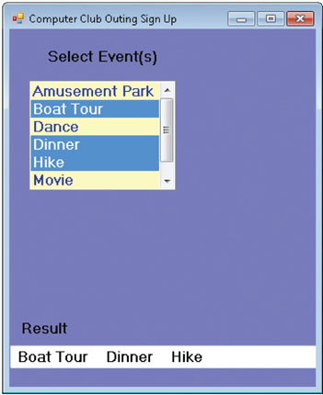
ListBox Control
Multiple selections within a ListBox object

Slide 56
ListBox Control
SelectedItem property returns objects
  Store numbers in the ListBox, once retrieved as objects, must be casted the object into an int or double for processing
For ListBox, use SelectedItems, SelectedIndices, or Items to retrieve a collection of items selected
  Zero-based structures
  Access them as you would access an element from an array
  SelectedIndices is a collection of indexes
  Text ONLY gets the first one selected

Slide 57
Adding Items to a ListBox
Add items at run time using Add( ) method with the Items property
lstBoxEvents.Items.Add("string value to add");
  private void btnNew_Click(object sender, System.EventArgs e)
  {
  lstBoxEvents.Items.Add(txtBoxNewAct.Text);
  }

Slide 58
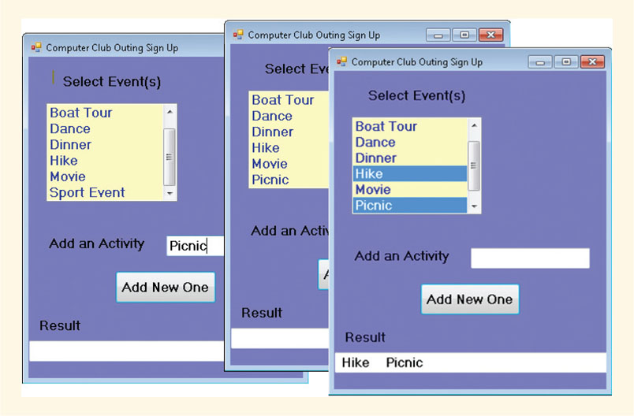
ListBoxExample
Add( ) method executed inside the buttonClick event

Slide 59
ComboBox Objects
In many cases, ListBox and ComboBox controls can be used interchangeably
ListBox control is usually used when you have all the choices available at design time
ComboBox only allows a single selection to be made, whereas ListBox allows multiple selection of items.
ComboBox facilitates displaying a list of suggested choices with an added feature
  ComboBox objects contain their own text box field as part of the object

Slide 60
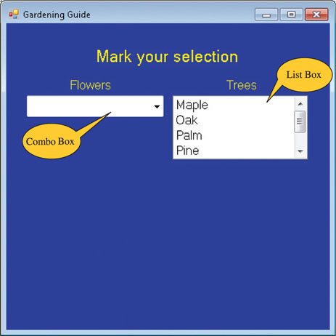
ComboBox

Slide 61
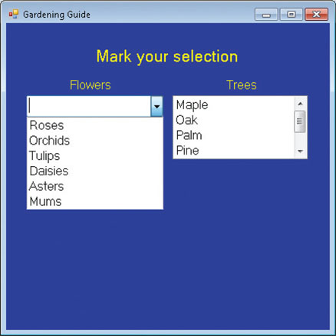
ComboBox
Top line left blank in ComboBox when DropDownStyle property is set to DropDown (default setting)

Slide 62
ComboBox
Double clicking on ComboBox object registers it’s default event, SelectedIndexChanged( ) - same as ListBox’s default event
  this.txtBxResultFlowers.Text = this.cmboFlowers.Text;
  Use .Text property to retrieve the value

Slide 63
CheckBox Object
Appear as small boxes
  Allow users to make a yes/no or true/false selection
Checked property set to either true or false depending on whether a check mark appears or not
  Default false value
CheckChanged( ) – default event-handler method
  Fired when CheckBox object states change
Can wire one event handler to multiple objects (Multiple Event Handler)

Slide 64
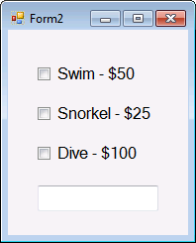
Wiring One Event Handler to Multiple Objects
Using Properties window, click on the Events Icon
Click the down arrow associated with that event
Select method to handle the event
Follow the same steps for other objects (must indicate the same method for each and every CheckedChanged event.
You can use 1 event handler to handle the CheckedChanged events of these 3 CheckBox objects.

Slide 65
CheckBox Control
Originally default event handler method for the Swim CheckBox object was:
private void ckBxSwim_CheckedChanged (object sender,
System.EventArgs e) { }
The heading for ckBxSwim_CheckedChanged( ) changed to ComputeCost_CheckedChanged ( )
private void ComputeCost_CheckedChanged (object sender, System.EventArgs e) { }
Method name more generic so it can be used with multiple controls

Slide 66
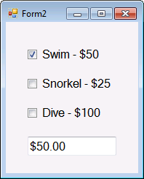

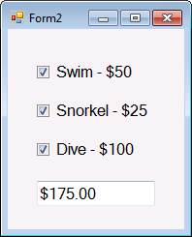

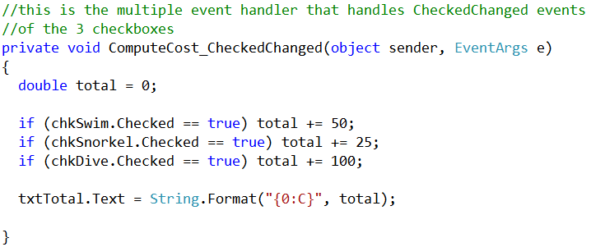
CheckBox Control

Slide 67
GroupBox Objects
GroupBox provides an identifiable group for controls – gives you a heading
  Objects may be grouped together for visual appearance
  Can move or set properties that impact the entire group
GroupBox control should be placed on the form before you add objects
GroupBox control adds functionality to RadioButton objects
  Allow only one selection

Slide 68
RadioButton Objects
Appear as small circles
Give users a choice between two or more options
  Not appropriate to select more than one RadioButton object (from a group)
Group RadioButton objects by placing them on a Panel or GroupBox control
  Setting the Text property for the GroupBox adds a labeled heading over the group

Slide 69
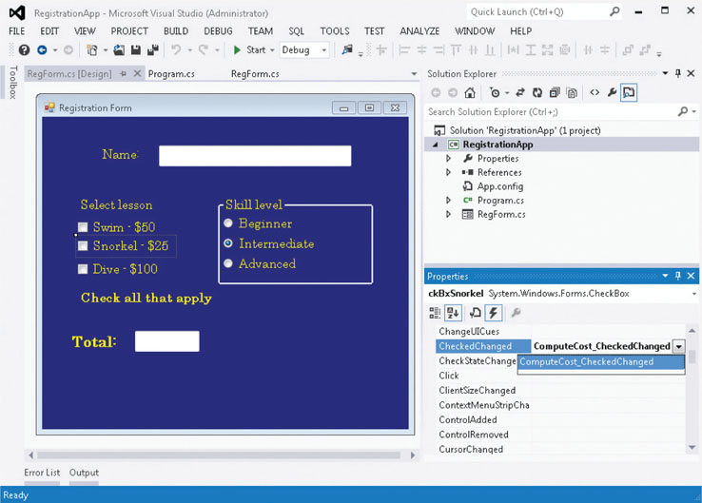
Adding RadioButton Objects
Box drawn around RadioButton objects is from GroupBox
GroupBox and RadioButton objects added

Slide 70
RadioButton Commands
To turn selection on @ runtime
  radInterm.Checked = true;
Raise a number of events, including Click( ) and CheckedChanged( ) events – Click event happens when you click on the RadioButton itself, whereas CheckedChanged whenever there is a change inside the RadioButton - either it is being selected or deselected (from selecting another option).
You are able to wire the event-handler method (multiple event handler) for RadioButton objects, just like CheckBox

Slide 71
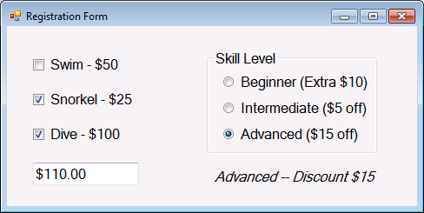
Example
The following program makes use of ComputeCost_CheckedChanged method (multiple event handler) to handle the CheckedChanged events of all the controls on the form (both CheckBox and RadioButton objects).

Slide 72
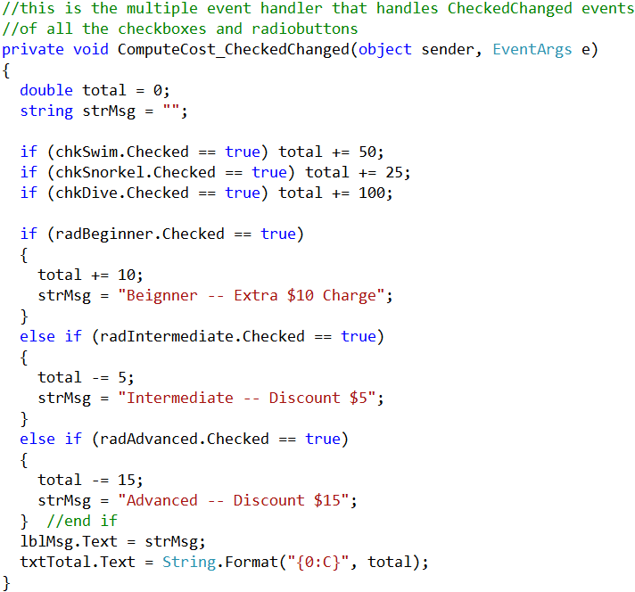
Example

