Slide 1

Web Application Development
Database Interaction
If people are not making mistakes, they are not trying new things.
- Walter C Wright Jr
Notes:
Image from: https://openclipart.org/detail/94723/database-symbol

Slide 2

Overview
Objective
  Learn how to store and manipulate data in MySQL using PHP Data Objects (PDO)
Content
  Use of PDO to perform CRUD operations
  Best practices:
    Data Access Object (DAO)
    ConnectionManager
    PHP initialization file (Out of scope)
After this module, you should be able to
  Use PDO to perform CRUD operations

Slide 3
Part I
Basic Syntax

Slide 4

Use of PDO
It allows a PHP code to send SQL queries to the database and receive the results
select * from book
PDO
application
database
title | isbn13 | price
Modern PHP | 1234567890123 | 88
PHP Cookbook | 3214567890456 | 99

Slide 5
Step 1: Connect to database
Data source name (DSN)
  Database type
  Host
  Database name
  Port
Create a PDO object
  Specify DSN, username, and password
$dsn = "mysql:host=localhost;dbname=week11;port=3306";
$pdo = new PDO($dsn, "root", "");

Slide 6
Step 2: Prepare the statement object
A PDOStatement object allows you to communicate with a database
$isbn13 = '1234567890123'; // simulates a user input
$sql = 'select * from book where isbn13 = :isbn13';
$stmt = $pdo->prepare($sql); //PDOStatement
$stmt->setFetchMode(PDO::FETCH_ASSOC);
$stmt->bindParam(':isbn13', $isbn13, PDO::PARAM_STR);
$stmt->execute();
while($row = $stmt->fetch()) {
echo $row['title'] . '|' . $row['isbn13']
. '|' . $row['price'];
}

Slide 7
Step 3: Specify the return data format
PDO::FETCH_ASSOC:
  Each matching DB record is retrieved as an associative array with column names as keys
$isbn13 = '1234567890123'; // simulates a user input
$sql = 'select * from book where isbn13=:isbn13';
$stmt = $pdo->prepare($sql); // PDOStatement
$stmt->setFetchMode(PDO::FETCH_ASSOC);
$stmt->bindParam(':isbn13', $isbn13, PDO::PARAM_STR);
$stmt->execute();
while($row = $stmt->fetch()) {
echo $row['title'] . '|' . $row['isbn13']
. '|' . $row['price'];
}

Slide 8
Step 4: Prepare a SQL statement
Each :XX specified in the SQL string is a value that you have to fill in using the bindParam method
$isbn13 = '1234567890123'; // simulates a user input
$sql = 'select * from book where isbn13 = :isbn13';
$stmt = $pdo->prepare($sql);
stmt->setFetchMode(PDO::FETCH_ASSOC);
$stmt->bindParam(':isbn13', $isbn13, PDO::PARAM_STR);
$stmt->execute();
$while($row = $stmt->fetch()) {
echo $row['title'] . '|' . $row['isbn13']
. '|' . $row['price'];
}

Slide 9
Some PDO class constants
Constants | Description
PDO::PARAM_BOOL | Represents the SQL BOOLEAN data type
PDO::PARAM_INT | Represents the SQL INT data type
PDO::PARAM_STR | Represents the SQL CHAR, VARCHAR, or other string data type. Use this for SQL FLOAT, DOUBLE, DECIMAL, and other data types that do not fit any other PDO constants too.
PDO::PARAM_NULL | Represents the SQL NULL data type
PDO::PARAM_LOB | Represents the SQL large object data type

Slide 10
Step 5: Run the SQL statement
$isbn13 = '1234567890123'; // simulates a user input
$sql = 'select * from book where isbn13 = :isbn13';
$stmt = $pdo->prepare($sql);
$stmt->setFetchMode(PDO::FETCH_ASSOC);
$stmt->bindParam(':isbn13', $isbn13, PDO::PARAM_STR);
$stmt->execute();
while($row = $stmt->fetch()) {
echo $row['title'] . '|' . $row['isbn13']
. '|' . $row['price'];
}

Slide 11
Step 6: Retrieve results row-by-row
Fetch each matching row as an associative array
Retrieve the value using the column name
$stmt->setFetchMode(PDO::FETCH_ASSOC);
while($row = $stmt->fetch()) {
echo $row['title'] . '|' . $row['isbn13'] .
'|' . $row['price'];
}
Key | Value
title | Modern PHP
isbn13 | 1234567890123
price | 88
$stmt->fetch()

Slide 12
Step 7: Free up resources
Close the connection to the database and SQL statement.
$stmt->closeCursor;
$pdo = null;

Slide 13
Issuing Insert/Delete/Update queries
$dsn = "mysql:host=localhost;dbname=week11;port=3306";
$pdo = new PDO($dsn,"root","");
$sql = 'insert into book (title, isbn13, price)
values (:title, :isbn13, :price)';
$title = "Java"; // simulates a user input
$isbn13 = "9999999999999"; // simulates a user input
$price = 105; // simulates a user input
$stmt = $pdo->prepare($sql);
$stmt->bindParam(':title', $title, PDO::PARAM_STR);
$stmt->bindParam(':isbn13', $isbn13, PDO::PARAM_STR);
$stmt->bindParam(':price', $price, PDO::PARAM_INT);
// $isAddOK stores true or false
$isAddOK = $stmt->execute();
$stmt->closeCursor();$pdo = null;

Slide 14
Exercise 1: Simple try
Given (in ex1 folder):
  week11.sql
  display.php
  search.php
To do:
  (1) Import week11.sql using phpMyAdmin.
    It will import all tables needed for this exercise and the following ones.
  (2) Put code given in previous slides corresponding to steps 1-7 into display.php.

Slide 15
Exercise 1: Simple try
drop database if exists week11;
create database week10;
use week11;
CREATE TABLE IF NOT EXISTS book (
title VARCHAR(128) NOT NULL,
isbn13 CHAR(13) NOT NULL,
price INT NOT NULL,
PRIMARY KEY(isbn13)
);
INSERT INTO book (title, isbn13, price) VALUES ('Modern PHP', '1234567890123', 88);
INSERT INTO book (title, isbn13, price) VALUES ('PHP Cookbook', '3214567890456', 99);
  week11.sql

Slide 16
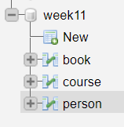


Exercise 1: Simple try

Slide 17
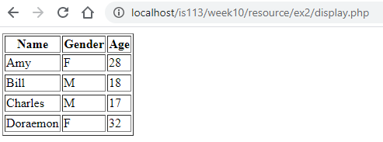
Exercise 2: Display table contents
Given (in ex2 folder):
  display.php (incomplete)
To do:
  Modify display.php such that it displays the data stored in the person table of the week11 database

Slide 18
Exercise 3: Insert new content
Given (in ex3 folder):
  add.html
  add.php (incomplete)
Implement add.php such that
  If insert operation is successful, print 'Person added'
  if insert operation is unsuccessful, print 'Person is not added'

Slide 19
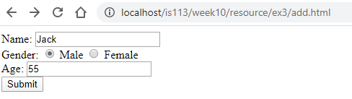
Exercise 3: Insert new content (Success)

Slide 20
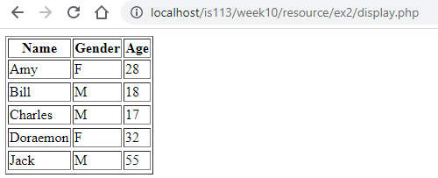
Exercise 3: Insert new content (Success)
Jack added

Slide 21
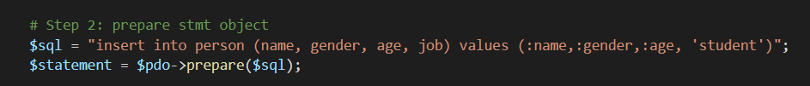
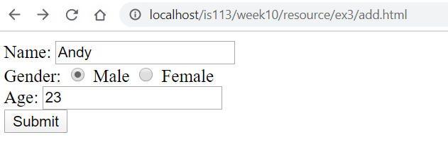
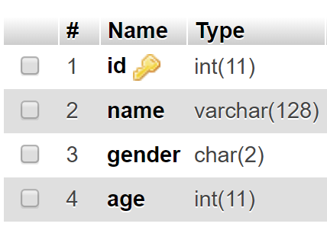
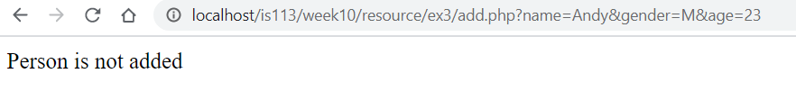
Exercise 3: Insert new content (Failure)

Slide 22
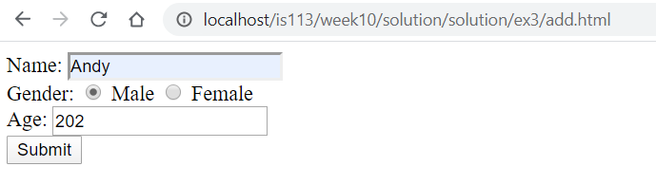
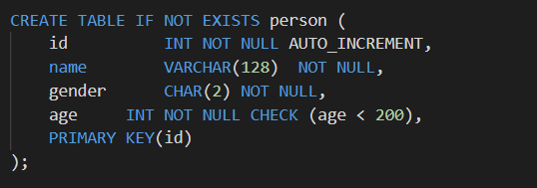
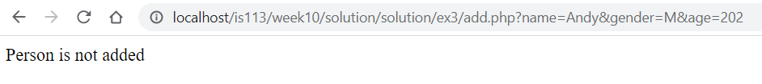
Exercise 3: Insert new content (Failure)

Slide 23
Part II
Best Practices

Slide 24
A. Create Data Access Object (DAO) classes
Avoid writing PDO code in multiple PHP pages
A DAO class captures reusable PDO code
  Grouped into logical unit
  E.g., BookDAO, PersonDAO, EmployeeDAO, etc.
PDO Code
PDO Code
display.php
add.php
display.php
add.php
PDO Code
BookDAO.php
PDO Code
book
week11
book
week11

Slide 25
Exercise 1: Simple try
How to do this with a DAO?

Slide 26
-- Book.php --
<?php
class Book{
private $title;
private $isbn13;
private $price;
public function __construct($title,$isbn13,$price){
$this->title = $title;
$this->isbn13 = $isbn13;
$this->price = $price;
}
public function getTitle(){
return $this->title;
}
public function getISBN13(){
return $this->isbn13;
}
public function getPrice(){
return $this->price;
}
}
?>
1

Slide 27
-- BookDAO.php --
<?php
class BookDAO {
public function findBook($isbn13) {
$dsn = "mysql:host=localhost;dbname=week10";
$pdo = new PDO($dsn, "root", "");
$sql = 'select * from book where isbn13=:isbn13';
$stmt = $pdo->prepare($sql);
$stmt->bindParam(':isbn13', $isbn13, PDO::PARAM_STR);
$stmt->execute();
$result = null;
$stmt->setFetchMode(PDO::FETCH_ASSOC);
if($row = $stmt->fetch()) {
$result = new Book($row['title'], $row['isbn13'], $row['price']);
}
$stmt = null;
$pdo = null;
return $result;
}
// Continue in the next page …
2

Slide 28
-- BookDAO.php –
public function addBook($book) {
$dsn = "mysql:host=localhost;dbname=week10";
$pdo = new PDO($dsn, "root", "");
$sql = 'insert into book (title, isbn13, price)
values (:title, :isbn13, :price)';
  $stmt = $pdo->prepare($sql);
  $title = $book->getTitle();
  $isbn13 = $book->getISBN13();
  $price = $book->getPrice();
  $stmt->bindParam(':title', $title, PDO::PARAM_STR);
  $stmt->bindParam(':isbn13', $isbn13, PDO::PARAM_STR);
  $stmt->bindParam(':price', $price, PDO::PARAM_INT);
  $isAddOK = $stmt->execute();
  $stmt = null;
  $pdo = null;
return $isAddOK;
}
// Continue in the next page …
Notes:
$stmt->bindParam(“:tite” $book->getTitle( ), PDO::PARAM_STR)
Will not work cost $book->getTitle( ) php interpreted as variable or …

Slide 29
-- BookDAO.php --
public function retrieveAll() {
$dsn = "mysql:host=localhost;dbname=week10";
$pdo = new PDO($dsn, "root", "");
$sql = ‘select * FROM book';
$stmt = $pdo->prepare($sql);
$stmt->execute();
$result = [];
$stmt->setFetchMode(PDO::FETCH_ASSOC);
while($row = $stmt->fetch()) {
$result[] = new Book($row['title'], $row['isbn13'], $row['price']);
}
$stmt = null;
$pdo = null;
return $result;
}
}
?>

Slide 30
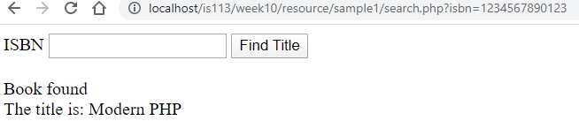
-- search.php –
<?php
spl_autoload_register(
function($class){
require_once "$class.php";
}
);
$dao = new BookDAO();
$book = $dao->findBook('1234567890123');
echo $book->getTitle() . "|" . $book->getISBN13() .
"|" . $book->getPrice();
?>
3

Slide 31

Code Sample 1: BookDAO
Given (sample1 folder):
  Book.php
  BookDAO.php
  display.php
To do:
  Open and check the above files
  Open display.php on your web browser
  It should produce:

Slide 32
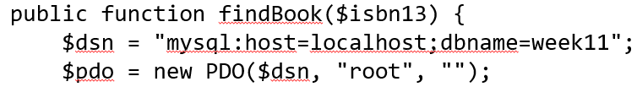
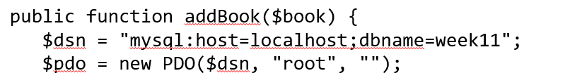
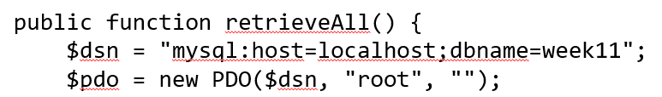
B. Create ConnectionManager class
Common step between many DAO methods
  Connect to a data source (e.g., database)

Slide 33
B. Create ConnectionManager class
Good idea to put this step in one common place
  ConnectionManager class
Benefits:
  Minimize code change when data source changes
  E.g.,
    database being moved to another location
    password gets changed
    Etc.

Slide 34
-- ConnectionManager.php --
<?php
class ConnectionManager {
public function getConnection() {
$dsn = "mysql:host=localhost;dbname=week11";
$pdo = new PDO($dsn, "root", "");
return $pdo;
}
}
?>
1

Slide 35
-- BookDAO.php --
<?php
class BookDAO {
public function findBook($isbn13) {
$connMgr = new ConnectionManager();
$pdo = $connMgr->getConnection();
$sql = 'select * from book where isbn13=:isbn13';
$stmt = $pdo->prepare($sql);
$stmt->bindParam(':isbn13', $isbn13, PDO::PARAM_STR);
$stmt->execute();
$result = null;
$stmt->setFetchMode(PDO::FETCH_ASSOC);
if($row = $stmt->fetch()) {
$result = new Book($row['title'], $row['isbn13'], $row['price']);
}
$stmt = null;
$pdo = null;
return $result;
}
// Continue in the next page …
2

Slide 36
-- BookDAO.php –
public function addBook($book) {
$connMgr = new ConnectionManager();
$pdo = $connMgr->getConnection();
$sql = 'insert into book (title, isbn13, price)
values (:title, :isbn13, :price)';
  $stmt = $pdo->prepare($sql);
  $title = $book->getTitle();
  $isbn13 = $book->getISBN13();
  $price = $book->getPrice();
  $stmt->bindParam(':title', $title, PDO::PARAM_STR);
  $stmt->bindParam(':isbn13', $isbn13, PDO::PARAM_STR);
  $stmt->bindParam(':price', $price, PDO::PARAM_INT);
  $isAddOK = $stmt->execute();
  $stmt = null;
  $pdo = null;
return $isAddOK;
}
// Continue in the next page …

Slide 37
-- BookDAO.php --
public function retrieveAll() {
$connMgr = new ConnectionManager();
$pdo = $connMgr->getConnection();
$sql = 'SELECT * FROM book';
$stmt = $pdo->prepare($sql);
$stmt->execute();
$result = [];
$stmt->setFetchMode(PDO::FETCH_ASSOC);
while($row = $stmt->fetch()) {
$result[] = new Book($row['title'], $row['isbn13'], $row['price']);
}
$stmt = null;
$pdo = null;
return $result;
}
}
?>

Slide 38
-- display.php –
<?php
spl_autoload_register(
function($class){
require_once "$class.php";
}
);
$dao = new BookDAO();
$book = $dao->findBook('1234567890123');
echo $book->getTitle() . "|" . $book->getISBN13() .
"|" . $book->getPrice();
?>
3

Slide 39
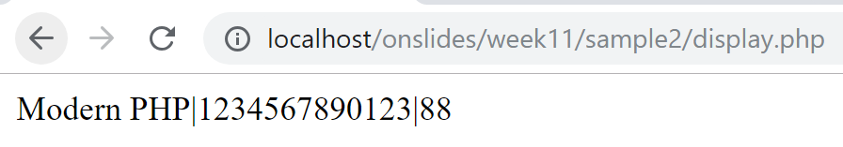
Code Sample 2: BookDAO+ConnectionManager
Given (sample2 folder):
  Book.php
  BookDAO.php
  ConnectionManager.php
  display.php
To do:
  Open and check the above files
  Open display.php on your web browser
  It should produce:

Slide 40
Exercise 4: Best Practice – I
Given (ex4 folder):
  model/ConnectionManager.php
  model/Person.php
  model/PersonDAO.php (incomplete)
  display.php
  add.php (incomplete)
  Add-view.html
  autoload.php

Slide 41
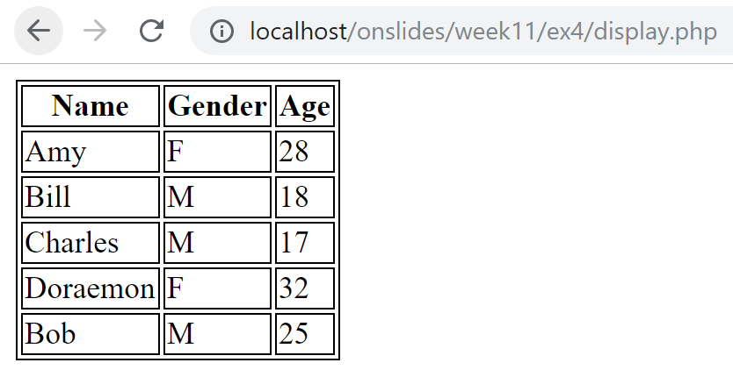
Exercise 4: Best Practice – I (display.php)
Implement retrieveAll() in PersonDAO.php
  Copy-paste-and-modify PDO code that you have written for Exercise 2
Use retrieveAll() of PersonDAO to simplify the original display.php

Slide 42
Exercise 4: Best Practice – I (add.html/php)
Implement add($person) in PersonDAO.php
  Copy-paste-and-modify PDO code that you have written for Exercise 3
Use add($person) of PersonDAO to simplify the original add.php

Slide 43
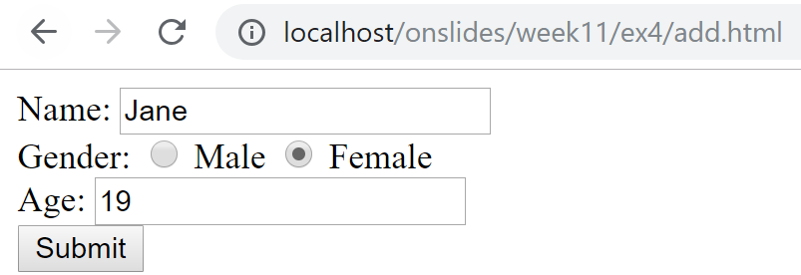
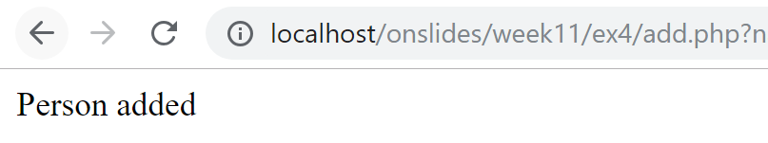
Exercise 4: Best Practice – I (add.html/php)

Slide 44
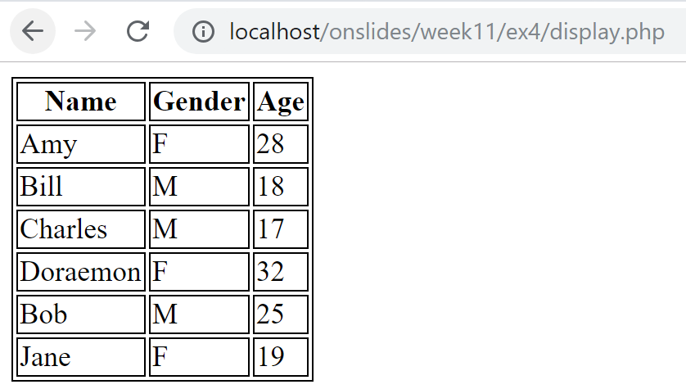
Exercise 4: Best Practice – I (add.html/php)
Jane added

Slide 45
Exercise 5: Best Practice - II
Us the following files in ex5 folder:
Complete the ones marked as incomplete
model/ConnectionManager.php
model/Course.php
model/CourseDAO.php
display.php (incomplete)
add.php (incomplete)
add-view.php
autoload.php

Slide 46
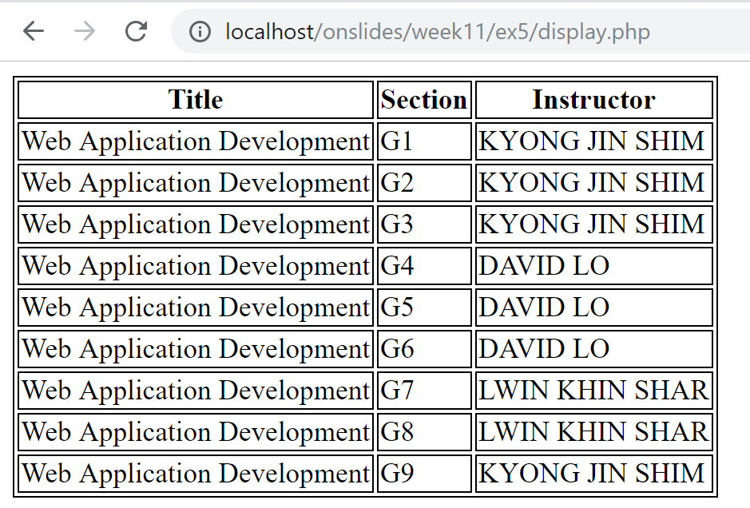
Exercise 5: Best Practice – II (display.php)

Slide 47
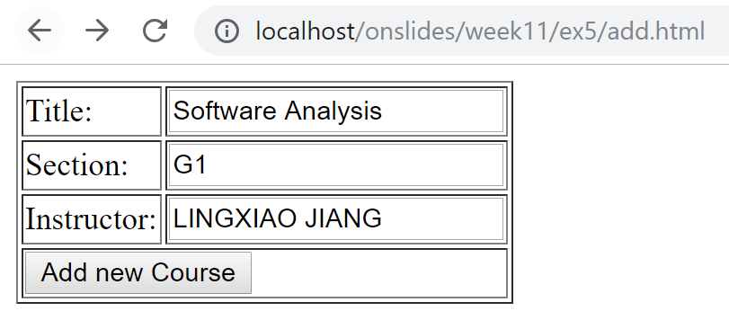
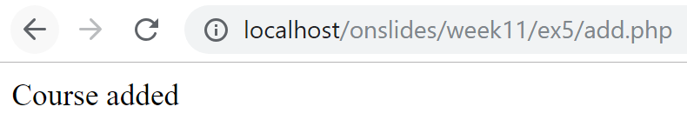
Exercise 4: Best Practice – II (add.html/php)

Slide 48
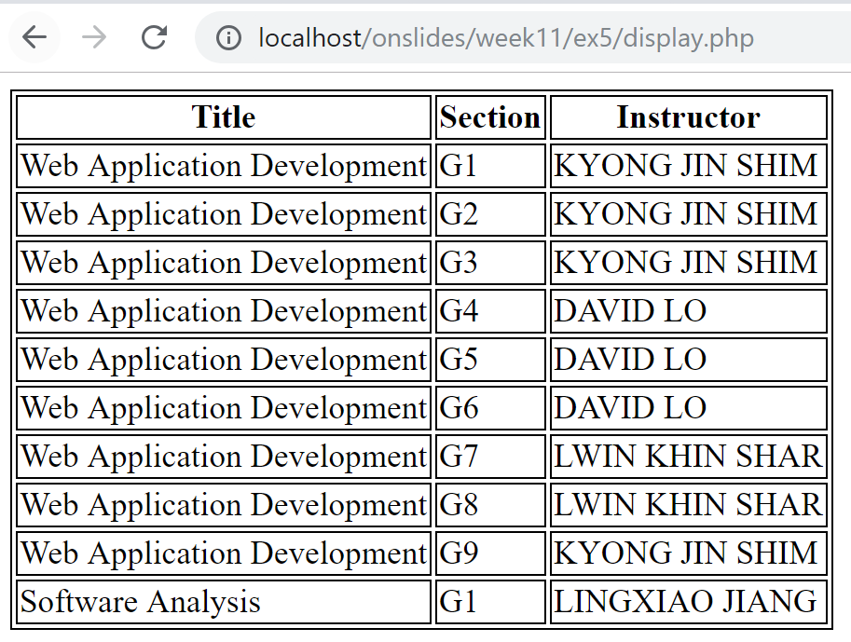

Slide 49
C. (Out of Scope) PHP Init. (.ini) File
Used to configure parameters and initial settings
Benefit:
  Put all customization options in one place
Format:
Example:
key1 = value1
; lines that starts with ; are comments
; file name is usually xx.ini, e.g. week11.ini
host = localhost
username = root
password =
dbname = week11
week11.ini

Slide 50
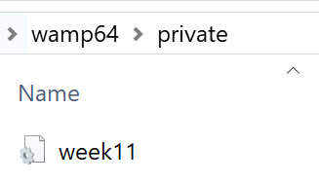
C. Create PHP Initialization (.ini) File
Never expose sensitive configuration files publicly
  E.g., files containing username and password
  Never allow this: http://example.com/week11.ini
  Place it outside the publicly accessible document root on the server

Slide 51
PHP Initialization File
Read the .ini file as an associative array
Get the individual value out
$conf = parse_ini_file($_SERVER["DOCUMENT_ROOT"] . "/../private/week11.ini");
$dsn = "mysql:host={$conf['host']};".
dbname={$conf['dbname']}";
$pdo = new PDO($dsn,$conf['username'],$conf['password']);
Key | Value
host | localhost
username | root
password
dbname | week11
$conf

Slide 52
Read .ini File in ConnectionManager class
-- ConnectionManager.php --
<?php
class ConnectionManager {
public function getConnection() {
// store the ini file outside of www folder
$conf = parse_ini_file($_SERVER["DOCUMENT_ROOT"] . "/../private/week11.ini);
$dsn="mysql:host={$conf['host']};" .
"dbname={$conf['dbname']}";
return new PDO($dsn,$conf['username'],$conf['password']);
}
}
?>

Slide 53
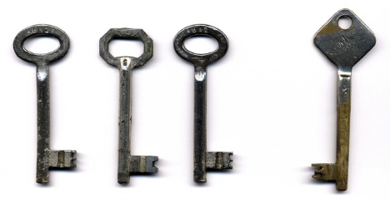
Key Points
PHP-DB interaction
  Connect to DB
    Specify DSN
    Instantiate PDO object
  Prepare SQL statement
    prepare, bindParam
  Execute SQL statement
    execute
  Retrieve results
    setFetchMode
    fetch
  Free up resources
    $stmt = null, $pdo = null
Data Access Object (DAO)
ConnectionManager
Initialization file
(Out of scope)
  .ini file
  parse_ini_file(…)

