Slide 1

Web Application Development I
Introduction
Optimism is the faith that leads to achievement. Nothing can be done without hope and confidence.
Helen Keller

Slide 2
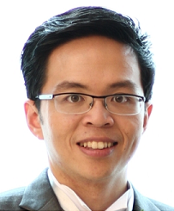
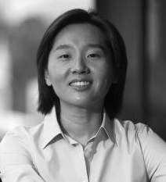
Lecturers and Instructors
David LO
Office: LKCSB Level 4, Room 4088
Phone: 6828 0599
Email: davidlo@smu.edu.sg
Kyong Jin SHIM
Office: SIS Level 5, Room 5027
Phone: 6808 5275
Email: kjshim@smu.edu.sg

Slide 3

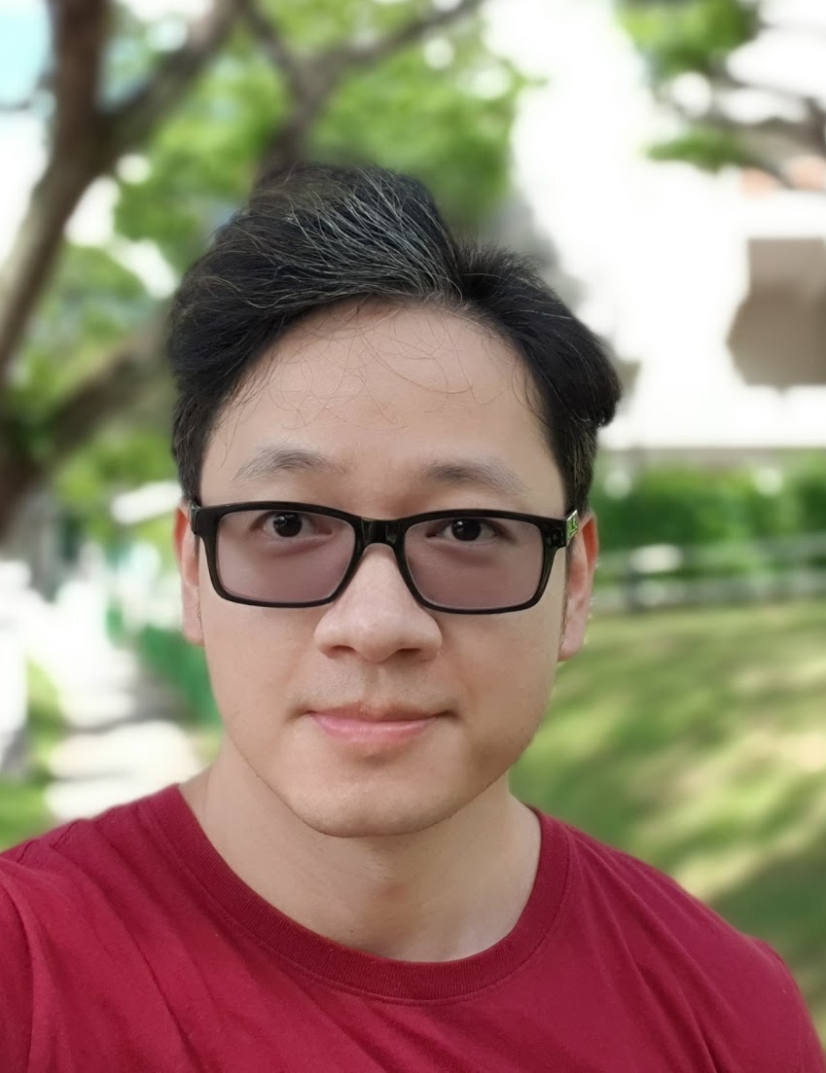
Lecturers and Instructors
SHAR Lwin Khin
Office: LKCSB Level 4, Room 4090
Phone: 6828 0019
Email: lkshar@smu.edu.sg
MAI Anh Tien
Office: SIS Level 5, Room 5014
Phone: 6826 4806
Email: atmai@smu.edu.sg

Slide 4
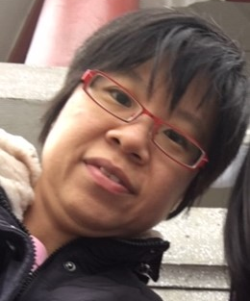
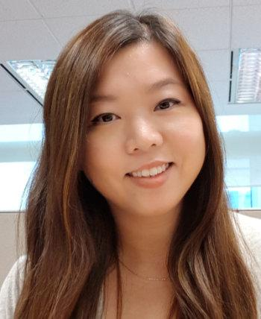
Lecturers and Instructors
LAU Yi Meng
Office: SIS Level 2 Instructors Office
Phone: 6828 0556
Email: ymlau@smu.edu.sg
Coen CHUA
Office: SIS Level 2 Instructors Office
Phone: 6828 9677
Email: coenchua@smu.edu.sg

Slide 5
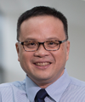
Lecturers and Instructors
LEE Kok Khing
Office: SIS Level 2 Instructors Office
Phone: 6828 0669
Email: kklee@smu.edu.sg

Slide 6
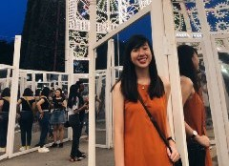
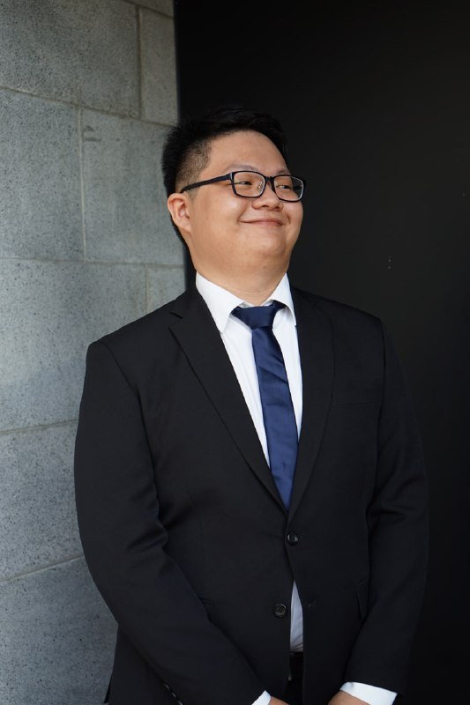
Teaching Assistants – G10 (Thu, 8:15-11:30am)
Emily ANG Siu Hui
emily.ang.2019@sis.smu.edu.sg
ONG Jia Le
jiale.ong.2019@sis.smu.edu.sg

Slide 7
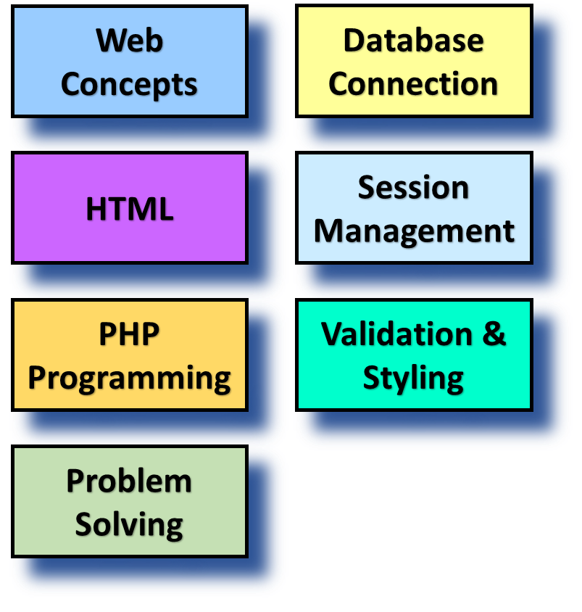

Course Objectives
Concepts covered
Upon completion of the course, students will be able to:
Understand how Web works
Develop static and dynamic web applications
Connect web applications to a database to persist data
Manage sessions

Slide 8

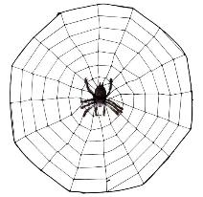

Course Linkages
Intro to
Programming
- Basic Programming
- Web concepts
- Web programming
Web Application Development I & II
Software Project Management
- Build a larger web project
- Manage project progress

Slide 9
Course Structure
Week | Topic
1 | Understanding Web Concepts + Tool Installations
2 | Building Static Webpages using HTML
3 | Building Dynamic Webpages using PHP - I
4 | Building Dynamic Webpages using PHP - II
5 | Building Dynamic Webpages using PHP - III
6 | Trial Lab Test 1
7 | Lab Test 1 (no class; lab test on Friday at 4 pm; 1.5 hours)
8 | Term Break
9 | Classes and Objects – I
10 | Classes and Objects - II
11 | Database Interaction
12 | Selected Topics
13 | Trial Lab Test 2
14 | Lab Test 2 (lab test on Tuesday at 7 pm; 2 hours)

Slide 10

Assessment
Week | Output Assessments | Weighting in % | Group Weighting
1 |  |  | Continuous Assessment : 50% Lab Test 1 (20%) Lab Test 2 (30%) Class Participation : 10% Exam : 40%
2
3
4
5
6
7 | Lab Test 1 (Fri, Feb 26, 4-5.30 pm, 1.5 hrs) | 20
8
9
10
11
12
13
14 | Lab Test 2 (Tue, Apr 13, 7-9 pm, 2 hrs) | 30
16 | Exam (Tue, Apr 27, 8.30-10.30am, 2 hrs) | 40
Any material that has been covered in slides/lectures/labs/ in-class exercises/etc can be included in the assessments!

Slide 11

Class Participation
"Delivering an interactive, participative and technologically-enabled learning experience"
You (as a student)
Be prepared for class
Have a positive impact on collaborative learning
Ask questions and clarify doubts
Contribute and share what you know
Be professional
No hijacking the airwaves
Give due respect to your peers (listen when they talk)
Me (as an instructor)
My responsibility and professional duty to assess you

Slide 12
Course Policies: Attendance
1 point (of final grade) will be taken off for each absence without a valid reason
Fail if you miss 3 classes (even with valid reasons)
Inform us early if you need to attend the other section with valid reasons
Email your lecturer, instructor and TAs with your reasons
We will need to check if there is space available in the other section (safe distancing requirements)
Grades
If you appeal for a re-grading, marks may be taken off
Final grade appeal window (tests / final) is 3 days

Slide 13
Class Timings
Day of Week | Time |  |  | Section | Faculty | Venue
Wed | 15:30 | - | 18:45 | 1 | David Lo | SIS SR 3.1
Thu | 15:30 | - | 18:45 | 2 | David Lo | SIS SR 2.1
Fri | 12:00 | - | 15:15 | 3 | David Lo | SIS SR 2.1
Fri | 08:15 | - | 11:30 | 4 | Kyong Jin Shim | SIS SR 3.1
Fri | 12:00 | - | 15:15 | 5 | Kyong Jin Shim | SIS SR 3.1
Mon | 08:15 | - | 11:30 | 6 | SHAR Lwin Khin | SIS SR 3.1
Mon | 15:15 | - | 18:45 | 7 | SHAR Lwin Khin | SOE/SOSS SR 3.2
Mon | 15:30 | - | 18:45 | 8 | MAI Anh Tien | SIS SR B1.1
Thu | 15:30 | - | 18:45 | 9 | MAI Anh Tien | SOA SR 1.1
Thu | 08:15 | - | 11:45 | 10 | LAU Yi Meng | SIS SR B1.1

Slide 14
Make Up Classes (G3)
Put it in your calendar!
Original Date | Make-up Date | Venue
Fri, Feb 12 | Mon, Feb 15, 7-10.15 pm | SIS SR 3.1
Fri, Apr 2 | Mon, Apr 5, 7-10.15 pm | SIS SR 3.1
14
Notes:
14

Slide 15
Lab Test / Exam
‘I’ grade if you have a MC / official reason.
You will attempt the assessment in the next offering of the course -- likely to be next year.

Slide 16
Incomplete ("I") Grade
A student must fulfill ALL criteria listed below before an 'I' grade can be awarded.
The student is unable to fulfill the course requirement either because of an illness or extenuating circumstances beyond his/her control (relevant documentary evidence must be submitted).
Student must achieve at least 75% attendance in the course. Student with poor attendance record is not eligible for an 'I' grade.
The student's academic performance to date must be satisfactory (accumulated score for all attempted components must be at least be 45% of total possible score).
The student must have attempted 2 out of the 3 main assessment components (LT1, LT2, Final Exam).
Notes:
Highlight: accumulated score for all attempted components must be at least be 45% of total possible score.

Slide 17

Academic Integrity
All acts of academic dishonesty (including, but not limited to, plagarism, cheating, fabrication, facilitation of acts of academic dishonesty by others, unauthorized possession of exam questions, or tampering with the academic work of other students) are serious offences.
All work (whether oral or written) submitted for purposes of assessment must be the student’s own work. Penalties for violation of the policy range from zero marks for the component assessment to expulsion, depending on the nature of the offence.
When in doubt, students should consult the instructors of the course.
Details on the SMU code of Academic Integrity may be accessed at: https://oasis.smu.edu.sg/Documents/Downloads/DOS-WKLSWC/code_of_academic_integrity.pdf

Slide 18
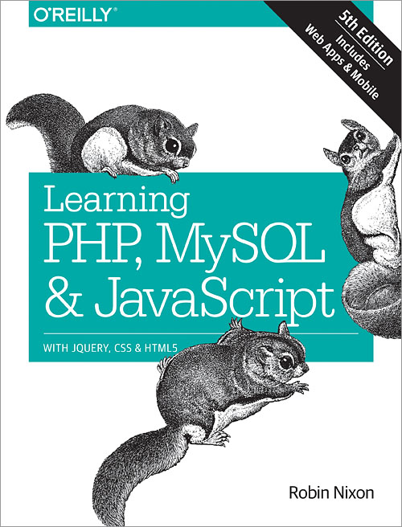
Learning Resources
Reference Text
Learning PHP , MySQL and JavaScript - 5th Edition
eBook Link through SMU Library

Slide 19
Survival Tips
Before class
Read the slides/reference text before class!
In class
Pay attention
Do in-class exercises
Clarify doubts and participate
Take notes
http://www.youtube.com/watch?v=WtW9IyE04OQ
After class
Revise your notes
Practice, practice & practice

Slide 20
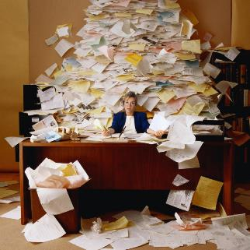

Most Importantly
Work hard but have fun!

