Slide 1
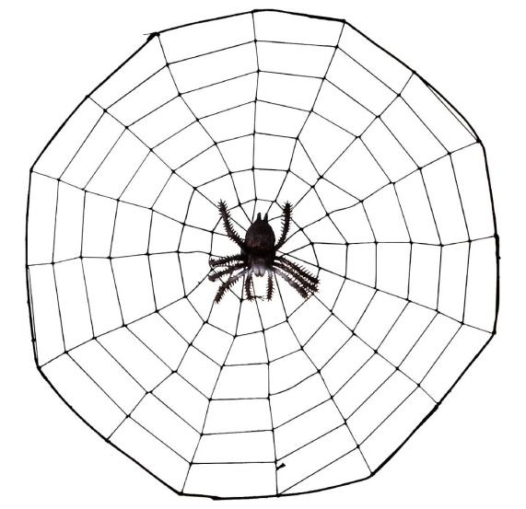
Web Application Development
Building Static Webpages using HTML
If you think you can, you can. Henry Ford

Slide 2

Overview
Objective
To read and modify HTML code
Content
Common HTML Tags
After this module, you should be able to
Create and modify HTML pages

Slide 3


HTML
Uses markup tag elements that tell the Web browser how to present the information.
Each tag will appear as letters or words between a < (less than sign) and a > (greater than sign).
Most tags come in pairs
<html> </html>
End Tag
Start Tag

Slide 4

<!DOCTYPE html>
Inform the web browser that the document is an HTML version 5 (HTML5) file
Must be the first line of an HTML file
Notes:
Picture taken from: https://en.wikipedia.org/wiki/HTML5#/media/File:HTML5_logo_and_wordmark.svg

Slide 5
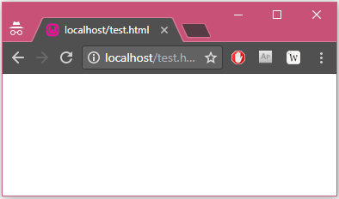
HTML Tag
Indicates to the Web browser that this is the beginning of an HTML document
<html></html>

Slide 6
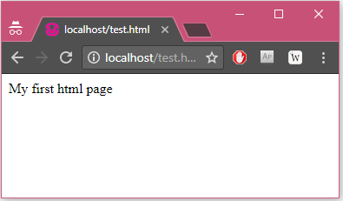
Body Tag
Indicates to the Web browser that this is the beginning of the Web page content
Everything you want to say and see on your page will follow this tag.
<!DOCTYPE html>
<html>
<body>
My first html page
</body>
</html>

Slide 7
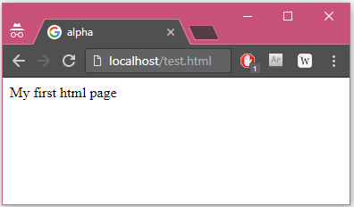
Head & Title Tag
<head>: tells the Web browser that this is the header for the page
<title>: tells the Web browser that this is the title of the page
<!DOCTYPE html>
<html>
<head><title>alpha</title></head>
<body>My first html page</body>
</html>

Slide 8
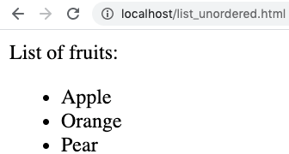
Un-ordered List
<ul>: a list of items (order of the items is NOT important)
<li>: an item in a list
<!DOCTYPE html>
<html>
<head><title>List Example</title></head>
<body>List of fruits:
<ul>
<li>Apple</li>
<li>Orange</li>
<li>Pear</li>
</ul>
</body>
</html>

Slide 9
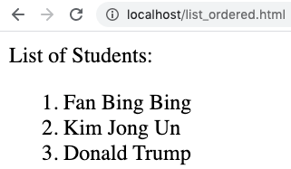
Ordered List
<ol>: a list of items (order of the items is important)
<li>: an item in a list
<!DOCTYPE html>
<html>
<head><title>List Example</title></head>
<body>List of Students:
<ol>
<li>Fan Bing Bing</li>
<li>Kim Jong Un</li>
<li>Donald Trump</li>
</ol>
</body>
</html>

Slide 10
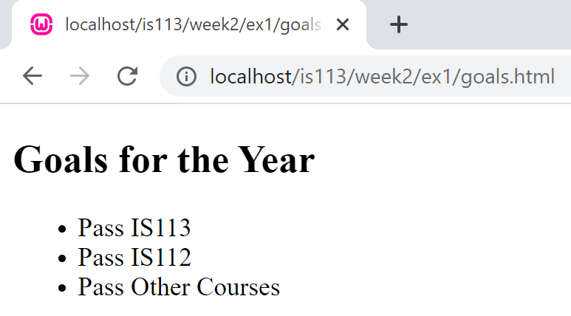
Exercise 1: List
Create goals.html such that the following will be displayed:
Hint: Explore by yourself the use of <h2>

Slide 11
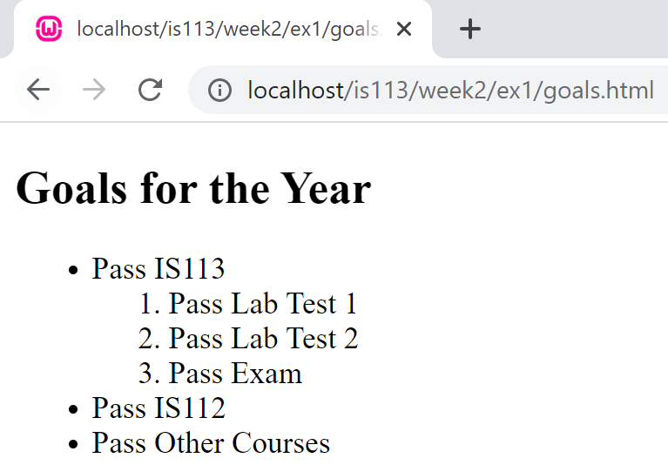
Exercise 1: List
Modify goals.html to produce the following output:

Slide 12
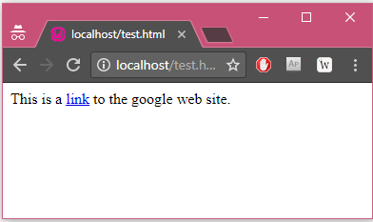

Anchor Tag
Creates a link to another page
Use the href attribute
<!DOCTYPE html>
<html>
<body>
This is a
<a href="http://www.google.com">link</a>
to the google web site.
</body>
</html>

Slide 13


Anchor Tag (Relative Links)
www
-- index.html --
<!DOCTYPE html>
<html> <head> <title>Index Page</title> </head> <body> <a href="./is113/lecture1.pptx"> Lecture 1 </a> </body> </html>
index.html
is113
lecture1.pptx
A dot stands for the current directory

Slide 14

Anchor Tag (Relative Links)
project.html
www
<!DOCTYPE html>
<html> <head> <title>Index Page</title> </head> <body> <a href="../is113/lecture1.pptx"> Lecture 1 </a> </body> </html>
is113
lecture1.pptx
is114
project.html
Two dots stands for the parent directory

Slide 15

Anchor Tag (Relative Links)
How about this?
project.html
<!DOCTYPE html>
<html> <head> <title>Index Page</title> </head> <body> <a href="/is113/lecture1.pptx"> Lecture 1 </a> </body> </html>
www
is113
lecture1.pptx
project.html
is113
A slash means starting from the root (i.e., www) directory
lecture1.pptx

Slide 16
Anchor Tag (Relative Links)
How about this?
project.html
<!DOCTYPE html>
<html> <head> <title>Index Page</title> </head> <body> <a href="is113/lecture1.pptx"> Lecture 1 </a> </body> </html>
www
is113
lecture1.pptx
project.html
is113
What if it is without a slash?
lecture1.pptx

Slide 17
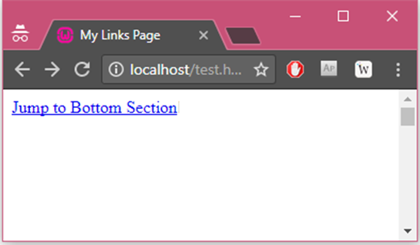
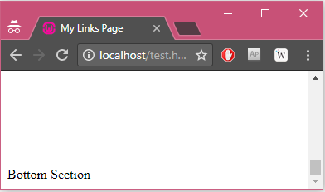
Anchor Tag & the id Attribute
Can jump directly into a specific section on a page, instead of letting the user scroll around to find what he/she is looking for
<!DOCTYPE html>
<html>
<head><title>My Links Page</title></head>
<body>
<a href="#bottom-section">Jump to Bottom Section</a> <br /><br /><br /> <br /><br /><br /> <br /><br /><br /> <br /><br /><br /> <br /><br /><br /> <br /><br /><br /> <br /><br /><br /> <br /><br /><br /> <br /><br /><br /> <br /><br /><br /> <br /><br /><br /> <br /><br /><br /> <br /><br /><br /> <br /><br /><br /> <br /><br /><br /> <br /><br /><br /> <br /><br /><br /> <br /><br /><br /> <a id="bottom-section">Bottom Section</a>
</body>
</html>

Slide 18

Image Tag
To display images in your Web page
<!DOCTYPE html>
<html>
<body>
<img src="images/keith.png"
width="170"
height="227"/>
<br/>
Hi there.<strong>My name is Keith</strong>, and I am a junior in Singapore Management University. You might be interested to know more about my education, interest, life and working experience ... Connect with me on Facebook!
</body>
</html>

Slide 19
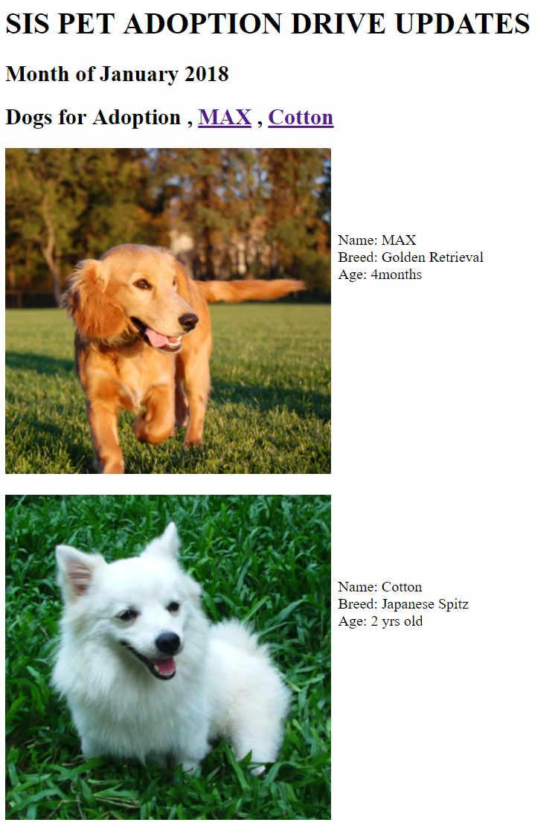
Exercise 2: Anchor and Image
Copy folder ‘images’ from the resource folder into your WAMP’s www folder.
Create the page on the left using <img> and <a> tags.
When clicked on the link MAX , The page will ‘jump’ to the Name field of Max.
Image ref : http://www.freeimages.com/photo/dog-1-1363113
http://www.freeimages.com/photo/dog-1-1409533

Slide 20
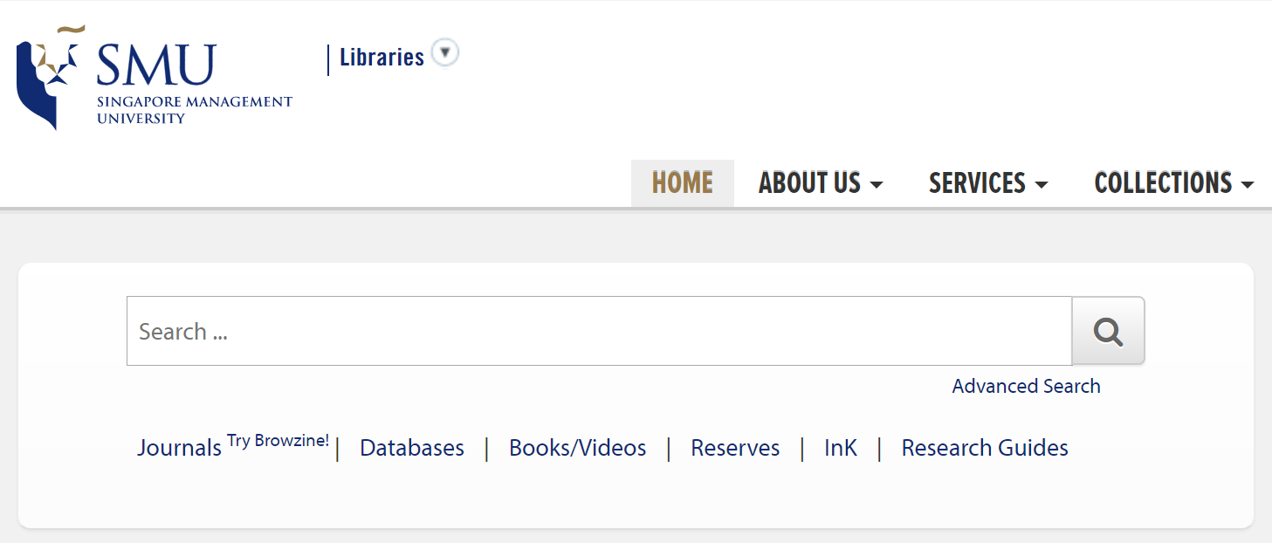
Form Tag
Provides a means to make web pages interactive

Slide 21

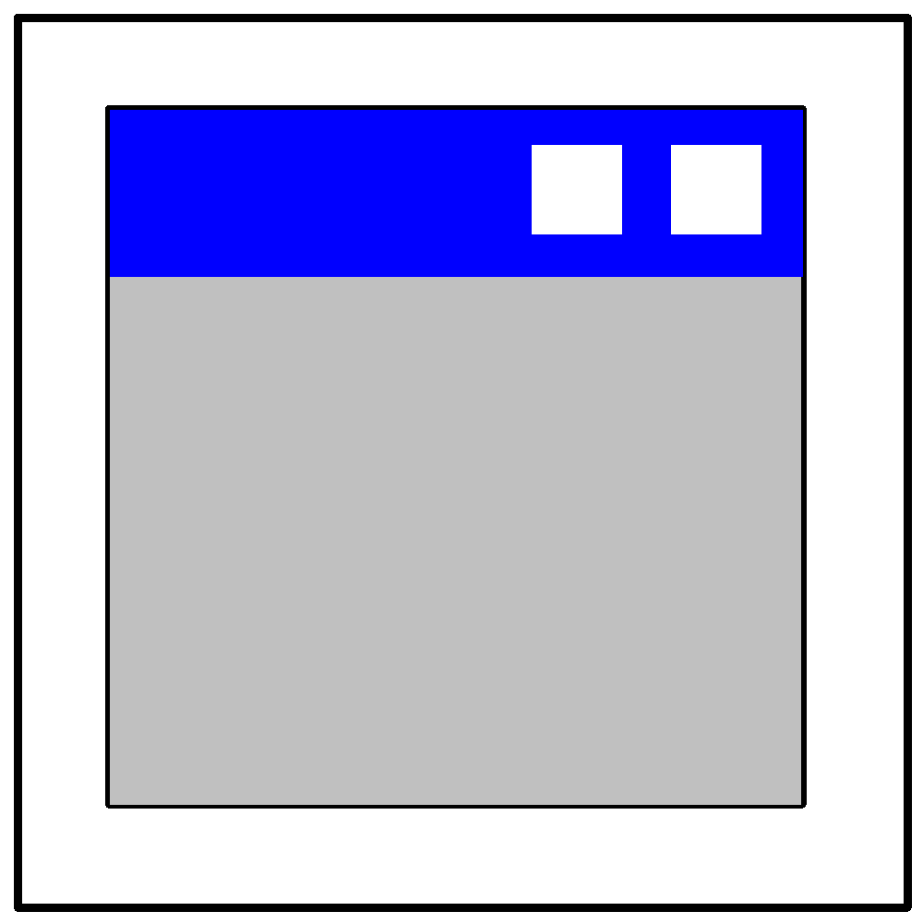

Form Tag
Provides a means to make web pages interactive
Server-side application
Client's Browser
Web Server

Slide 22
Form Tag
Provides a means to make web pages interactive
Server-side application
Client's Browser
User fills in the form and clicks on the submit button. The data on the form is send to the server
Web Server

Slide 23
Form Tag
Provides a means to make web pages interactive
Server-side application
Client's Browser
A program on the web server parses the request and invokes the relevant application to process it.
Web Server

Slide 24
Form Tag
Provides a means to make web pages interactive
Server-side application
Client's Browser
The program creates the output and returns it to the server
Web Server

Slide 25
Form Tag
Provides a means to make web pages interactive
Server-side application
Client's Browser
The server sends the output returned by the application to the client
Web Server

Slide 26










Form Components
Text Field
Submit Button
Reset Button
Checkbox
Radio Button
Password Field
Hidden Field
Select Dropdown List
Text Area
Label | 123

Slide 27
HTML Form Tag
Tells the client where to send the request to
<!DOCTYPE html>
<html> <body> <form action="/test.php" method="post"> </form </body> </html>
Tells the server the kind of request that's being made, and how the message will be formatted. Common values are post & get.

Slide 28
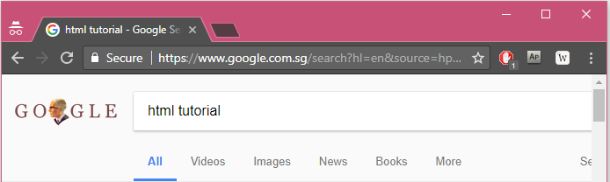
Differences between HTTP GET and POST
Data sent with the GET is appended to end of the URL up in the browser, so whatever you send is exposed.
Can be bookmarked

Slide 29

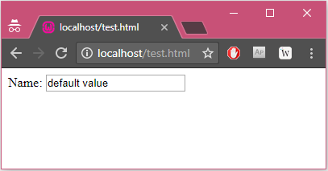
Text Field
Allows the user to enter a single line of text.
<!DOCTYPE html>
<html>
<body>
<form>
Name:
<input type="text"
name="aName"
value="default value"
size="20" />
</form>
</body>
</html>

Slide 30
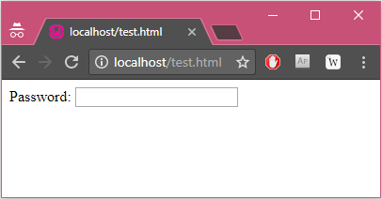

Password Field
Allows the user to enter a single line of text.
<!DOCTYPE html>
<html>
<body>
<form>
Password:
<input type="password"
name="pwd"
size="20" />
</form>
</body>
</html>

Slide 31
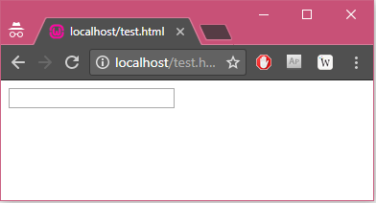
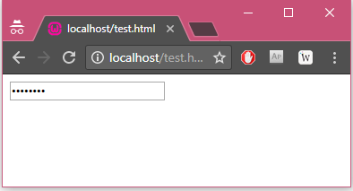
Password Field
Similar to a textfield, but the characters entered are obscured.
Before the characters "password" is typed in
After the characters "password" is typed in

Slide 32

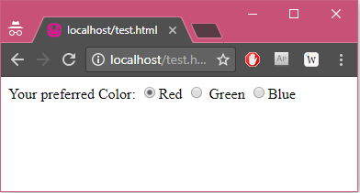
Radio Button
A set of radio buttons with the name.
When one is selected, the rest are automatically deselected
<!DOCTYPE html>
<html><body>
<form>
Your preferred Color:
<input name="color" type="radio" value="r" checked />Red
<input name="color" type="radio" value="g" /> Green
<input name="color" type="radio" value="b" />Blue </form>
</body></html>

Slide 33

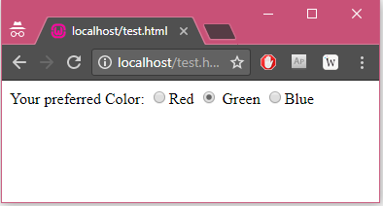
Radio Button
Notice that Red is unchecked after Green is checked.
Green is selected

Slide 34

Label
Associates a label with a form control
<!DOCTYPE html>
<html><body>
<form>
Your preferred Color:
<input name="color" type="radio" value="r" checked />Red
<input name="color" type="radio" value="g" id="color_g" />
<label for="color_g">Green</label>
<input name="color" type="radio" value="b" />Blue
</form>
</body></html>
Click on the word "Red", "Green" & "Blue". What do you notice?

Slide 35
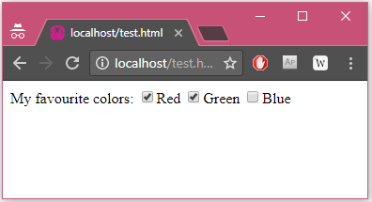
Checkbox
The item it places on the page is square and it is marked with a check when chosen.
You can check as many as you like.
<!DOCTYPE html> <html><body>
<form>
My favourite colors:
<input name="color[]" type="checkbox" value="r" checked />Red
<input name="color[]" type="checkbox" value="g" checked />Green
<input name="color[]" type="checkbox" value="b" />Blue
</form>
</body></html>

Slide 36
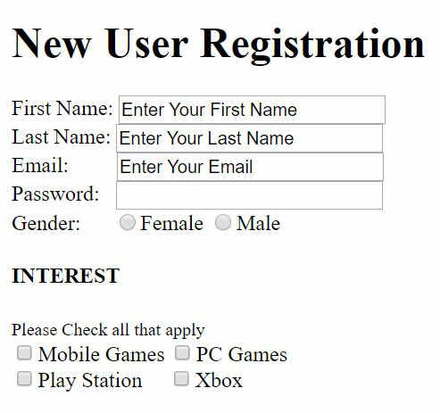
Exercise 3: Form - I
Create a New User Registration Form as shown on the right.
You have text input for FirstName, LastName, and Email. You have password input for password and radio buttons for Gender female and male.
Next they fill in their interest in games. Use check boxes for Mobile Games, PC Games Play Station and Xbox.
Remember to create relevant Labels for each input and fill in the values for the radio buttons and checkboxes.

Slide 37
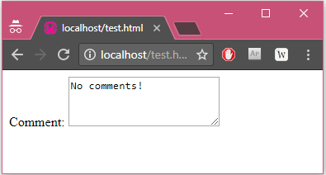
Text Area Component
Unlike a text box that only allows one line, the text area allows as many lines as you wish.
<!DOCTYPE html>
<html>
<body>
<form>
Comment:
<textarea name="comment" rows="2" cols="10">
No comments!
</textarea>
</form>
</body>
</html>

Slide 38

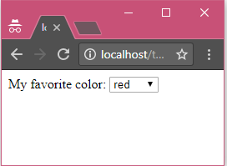
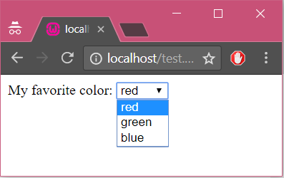
Select Dropdown List
Allows selection out of the list specified.
<!DOCTYPE html> <html>
<body>
<form> My favorite color:
<select name="color">
<option value="R" selected>red</option>
<option value="G">green</option>
<option value="B">blue</option>
</select>
</form>
</body>
</html>
When clicked

Slide 39
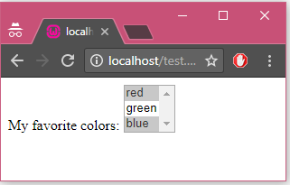
Select Dropdown List
Size attribute specifies the number of options that should be visible at a time. Default value is 1.
MULTIPLE will allows more than one option to be selected.
<!DOCTYPE html> <html>
<body>
<form>
My favorite colors:
<select name="color[]"
SIZE="3" MULTIPLE>
<option value="R" selected>red</option>
<option value="G">green</option>
<option value="B" selected>blue</option>
</select>
</form>
</body>
</html>

Slide 40

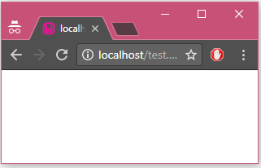
Hidden Field
To submit information that is not entered by the visitor.
<!DOCTYPE html> <html>
<body>
<form>
<input type="hidden"
name="language"
value="english" />
</form>
</body>
</html>

Slide 41
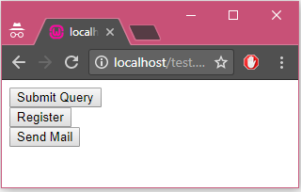
Submit Button
Triggers the browser to send the information to the server.
<!DOCTYPE html> <html>
<body>
<form action="/test.php">
<input type="submit" name="operation" value="Submit Query"/><br/>
<input type="submit" name="operation" value="Register"/><br/>
<input type="submit" name="operation"
value="Send Mail"/><br/>
</form>
</body>
</html>

Slide 42
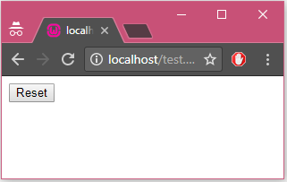

Reset Button
It does not send any form data to the server.
When selected, this button resets all of the GUI components in the HTML form to their default values.
<!DOCTYPE html>
<html>
<body>
<form action="/test.php">
<input type="reset" />
</form>
</body>
</html>

Slide 43
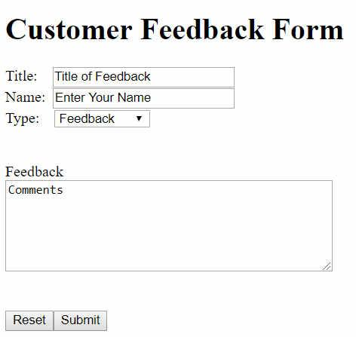
Exercise 4: Form - II
Create a customer feedback form as shown on the left.
You have text input for title and name. There is a dropdown list for the type of feedbacks.
Type includes: Inquiries, Feedback and Suggestions.
Next you have a text area for customer to enter their comments.
Remember to create relevant Labels for each input.
Lastly create a reset input type and a submit input type.
Notes:
Use <h1> for the heading

Slide 44

Table
Allows data to be arranged in rows and columns
<table> | Defines a table
<tr></tr> | Defines a new Table Row.
<th></th> | Used to create the titles of your table data (Table Header)
<td></td> | Denotes Table Data. Enclose your data within the tags.
</table> | Indicates the end of the table

Slide 45
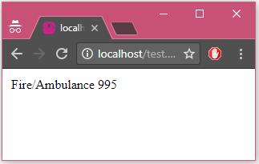
Table
<!DOCTYPE html> <html>
<body>
<table>
<tr>
<td>Fire/Ambulance</td>
<td>995</td>
</tr>
</table>
</body>
</html>

Slide 46
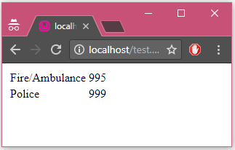
Table
<!DOCTYPE html> <html>
<body>
<table>
<tr>
<td>Fire/Ambulance</td>
<td>995</td>
</tr>
<tr>
<td>Police</td>
<td>999</td>
</tr>
</table>
</body>
</html>

Slide 47
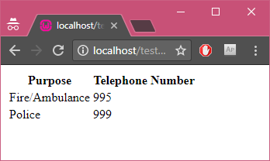
Table
<!DOCTYPE html> <html>
<body>
<table>
<tr>
<th>Purpose</th>
<th>Telephone Number</th>
</tr>
<tr>
<td>Fire/Ambulance</td>
<td>995</td>
</tr>
<tr>
<td>Police</td>
<td>999</td>
</tr>
</table>
</body>
</html>

Slide 48
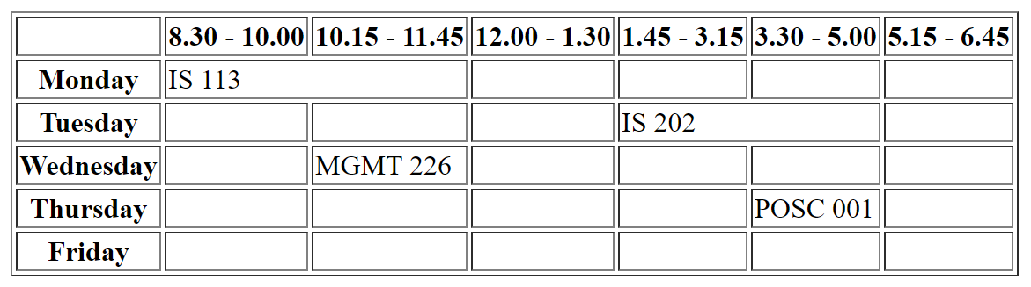
Exercise 5: Table
Create a HTML page that contains your academic timetable. An example is shown below.

Slide 49
Exercise 5: Table
Hints:
Use the border attribute of <table> tag:
<table border="1">
Or the following CSS (out of scope for WAD1):
<style>
table{border: 1px solid black;}
th,td{border: 1px solid black;} </style>
Explore by yourself the use of colspan attribute of <td>

Slide 50
References
HTML Tutorial
http://www.w3schools.com/html
More?
Type "html tutorial" in Google search engine

Slide 51

Key Points
HTML
Stands for Hyper Text Markup Language
Tags comes in pair
HTML Tags
Link: <a>
Image: <img>
Form: <form>, <input>, <select>, <option>
Table: <table>, <tr>, <th>, <td>
Etc.

