Slide 1

Web Application Development
Building Dynamic Webpages using PHP
Knowing is not enough; we must apply. Willing is not enough we must do.
- Goethe

Slide 2
Part III: Arrays and Classes

Slide 3

Overview
Objective
Understand what are arrays and classes
Understand how arrays and classes can be used
Content
Arrays: Indexed, Associative, Multidimensional
Classes
After this module, you should be able to
Solve programming problems involving arrays and classes

Slide 4
Arrays
A collection of values
Values can be of different types
Types of arrays:
Indexed Arrays
Associative Arrays
Multidimensional Arrays

Slide 5
Arrays
Indexed Arrays
Arrays with numeric index
Example:
Note: Since PHP 5.4, we can also use:
$cities = ["London", "Paris", "Washington"];
<!– indexed_array.php -->
<?php
$cities = array("London", "Paris", "Washington"); //Initialize
echo $cities[1];
$cities[1] = "Amsterdam"; //Update
echo $cities[1];
$cities[] = "Bangkok"; //Append
echo $cities[3];
?>

Slide 6
Arrays
Associative Arrays
Arrays that contain key-value pairs
Example:
<!– associative_array.php -->
<?php
$capitals = array( "USA" => "Washington",
"France" => "Paris"); // Initialize
echo $capitals["USA"];
$capitals["USA"] = "Washington, D.C."; // Replace
echo $capitals["USA"];
$capitals["Singapore"] = "Singapore"; // Add
echo $capitals["Singapore"];
?>

Slide 7
Arrays
Multidimensional Arrays
Arrays containing one or more arrays
Example:
<!– multidimensional_array.php -->
<?php
$capitals = array(
array("Manchester","London"),
array("France", "Nice"),
array("San Francisco")
);
echo $capitals[2][0]; // prints "San Francisco"
?>

Slide 8
Getting the Size of an Array + For Loop
Use count() or sizeof() function
Indexed/associative: Number of elements in the array
Multidimensional: Number of inner arrays
<!– count.php -->
<?php
$cities = array("London", "Paris", "Jakarta");
$numCities = count($cities);
echo $numCities . " cities.";
for ($i = 0; $i < $numCities; $i++ ) {
echo $cities[$i] . "<br/>";
}
?>

Slide 9
Foreach
Runs a block of code repeatedly for each entry in an array
Syntax ::
foreach (array to iterate) {
action to take
}

Slide 10
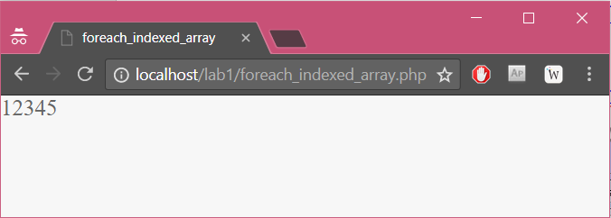
Foreach
Executes a block of code repeatedly for each entry in an array
- foreach_indexed_array.php -
<?php
$arr = array(1, 2, 3, 4, 5);
foreach ($arr as $arr_entry){
echo $arr_entry;
}
?>
Output in a browser

Slide 11
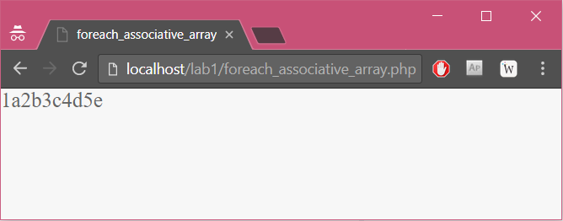
Foreach
- foreach_associative_array.php -
<?php
$arr = array(1 => "a", 2 => "b", 3 => "c", 4 => "d", 5 => "e");
foreach ($arr as $key => $value){
echo $key.$value;
}
?>
Output in a browser

Slide 12
Exercise 8: Arrays
Edit ex8.php from the given resources.
Instructions are in the php file.

Slide 13
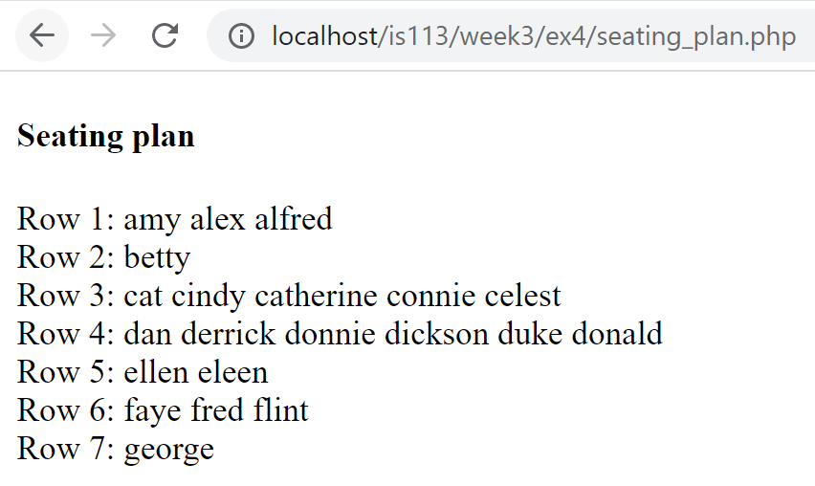
Exercise 8: Arrays
Expected
output:

Slide 14
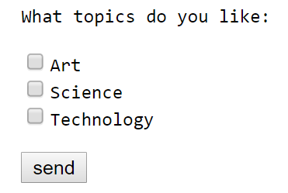
Form Handling + Array
1. Checkbox for the form
2. Submit button for the form
- form.html -
<html><head><title>A simple form</title></head><body>
<form method="post" action="process_form.php" >
What topics do you like:<br>
<input type="checkbox" name="topics[]" value="Art" />Art
<input type="checkbox" name="topics[]" value="Science" />Science
<input type="checkbox" name="topics[]" value="Tech" />Technology
<input type="submit" value="send" />
</form>
</body></html>

Slide 15
Form Handling + Array
- form.html -
<html><head><title>A simple form</title></head><body>
<form method="post" action="process_form.php" >
What topics do you like:<br>
<input type="checkbox" name="topics[]" value="Art" />Art
<input type="checkbox" name="topics[]" value="Science" />Science
<input type="checkbox" name="topics[]" value="Tech" />Technology
<input type="submit" value="send" />
</form>
</body></html>
$_POST
– process_form.php –
<html><body>
Topics you like:<br>
<?php
foreach ($_POST["topics"] as $topic){
echo "$topic <br>";
}
?>
</body></html>
Key | Value
topics | array("Art", "Science")

Slide 16
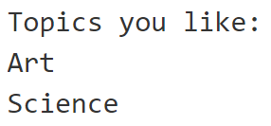
Form Handling + Array
$_POST
- process_form.php -
<html><body>
Topics you like:<br>
<?php
foreach ($_POST["topics"] as $topic){
echo "$topic <br>";
}
?>
</body></html>
Name | Value
topics | array("Art", "Science")

Slide 17
Exercise 9: Indexed and Associative Arrays
Edit ex9.php and process_form.php from the given resources.
Instructions are in the php files.

Slide 18
Exercise 10: Multidimensional Array
Edit ex10.php from the given resources.
Instructions are in the php file.

Slide 19
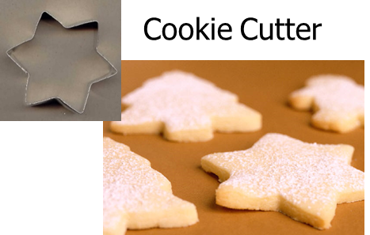
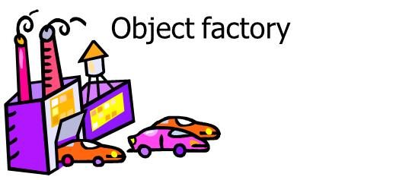
Classes
A class is a template from which individual objects are created
An object is an instance of a class

Slide 20
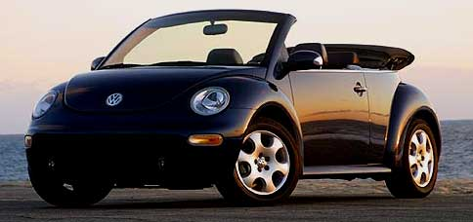
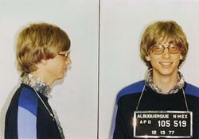
What is an Object?
Informally, an object represents an entity, either physical, conceptual, or software.
Physical entity
Conceptual entity
Software entity
Tom’s Car
US$100,000,000,000
Bill Gate’s bank account
100
Linked list starting at address 100
Notes:
Picture of Bill Gates taken from http://en.wikipedia.org/wiki/Bill_gates.

Slide 21
What is an Object?
All the objects share the same properties and methods with other objects of the same class
Each object has its own value for each of the attribute
harry:Person
+ greet()
name
Harry
Person
+ name + dateOfBirth
+ greet()
dateOfBirth
8/12/1975
mary:Person
+ greet()
name
Mary
dateOfBirth
8/12/1980

Slide 22
Class Definition + Properties and Methods
- Person.php -
<?php
class Person{
public $name;
…
function greet(){
echo "Hi! My name is $this->name.";
}
…
}
?>
Property
Method

Slide 23
Constructor
Constructor
Method that creates an instance of a class (an object)
Can accept parameters to initialize class properties
- Person.php -
<?php
class Person{
public $name;
function __construct($name){
$this->name = $name;
}
…
}
?>

Slide 24
Instantiation
Creating an object based on a class definition
Use keyword new
- Person.php -
<?php
class Person{
public $name;
function __construct($name){
$this->name = $name;
}
…
}
$albert = new Person("Albert");
?>

Slide 25
Calling a Method and Accessing a Property
Use -> operator
- Person.php -
<?php
class Person{
public $name;
function __construct($name){
$this->name = $name;
}
function greet(){
echo "Hi! My name is $this->name.";
}
}
$albert = new Person("Albert");
echo $albert->name;
$albert->greet();
?>

Slide 26
Separating Class Definitions into Different Files
- Person.php -
<?php
class Person{
public $name;
function __construct($name){
$this->name = $name;
}
function greet(){
echo "Hi! My name is $this->name.";
}
}
?>
- calling_method.php -
<?php
require_once "Person.php";
$albert = new Person("Albert");
echo $albert->greet();
?>

Slide 27
Autoloading Classes
Used to define locations of classes to be loaded
Use spl_autoload_register() function
- calling_method.php -
<?php
spl_autoload_register(function($class){
require_once $class . ".php";
});
$albert = new Person("Albert");
echo $albert->greet();
?>

Slide 28
Constants
Defined using keyword const
How to use a constant?
Inside: self::GST_RATE
Outside: SalesItem::GST_RATE
- SalesItem.php -
<?php
class SalesItem{
public $amount;
const GST_RATE = 0.07;
…
}
?>

Slide 29
Exercise 9: Classes
Edit ex9.php and model/Product.php from the given resources.
Instructions are in the php file.

Slide 30

Key Points
Arrays
Indexed arrays
Associative arrays
Multidimensional arrays
Processing form input fields allowing multiple values (e.g., checkboxes)
Classes
Properties
Methods
Constructors
new keyword
Autoloading
Constants

