Slide 1

Web Application Development
Selected Topics: Passing Control and Data +
User Authentication
If everyone is moving forward together, then success takes care of itself. Henry Ford
Notes:
Image from: https://pixabay.com/en/spaceship-starship-spacecraft-3141006/

Slide 2
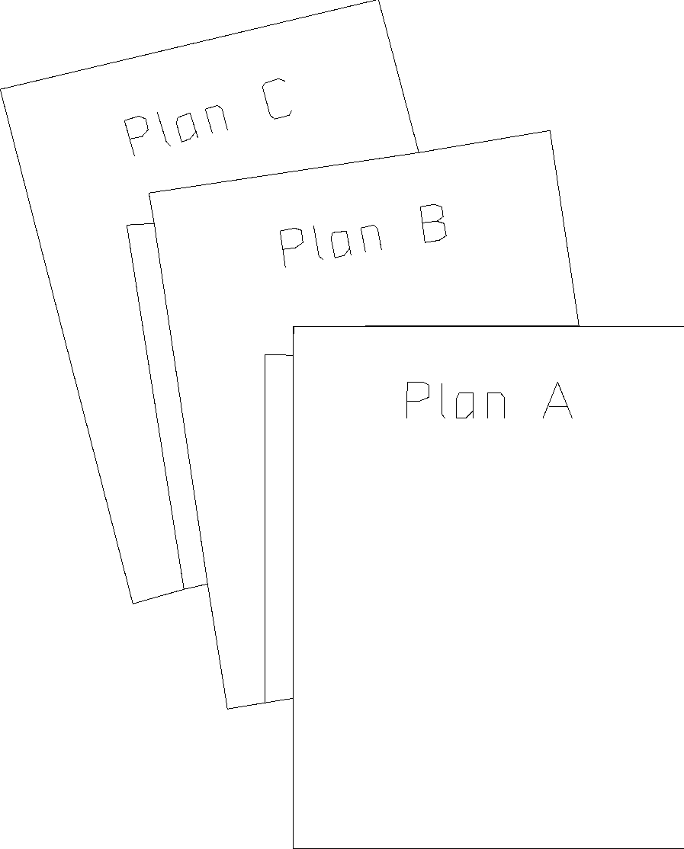
Overview
Objective
Learn about some additional PHP concepts
Content
Passing data across pages
Authenticating users
After this module, you should be able to
Write code that pass data from a page to another
Write code that authenticate users
2

Slide 3
I. Passing Control Across Pages
Method 1: Form Submission
Method 2: Hyperlink
<html>
<body>
<form action='another.php'>
<input type="submit“/>
</form>
</body>
</html>
first.php
<html>
<body>
<a href='another.php'>Go to another page</a>
</body>
</html>
first.php

Slide 4
I. Passing Control Across Pages
Method 3: Automatic page redirection
header("Location: second.php");
exit;
first.php
Server
1.HTTP Request
first.php
2.HTTP Response (I have moved to …)
Browser
3.HTTP Request
second.php
4.HTTP Response
4

Slide 5
Exercise 1: Passing Control
Modify the code in slide 4 so that first.php redirects to
http://www.google.com
Put the code in your WampServer
Check if it works
5

Slide 6
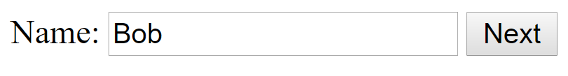

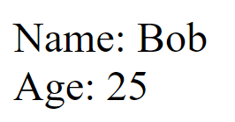
II. Passing Data Across Pages (Practice 1)
Method 1: Through form fields, including hidden fields
page1.php
page2.php
summary.php

Slide 7
Hidden Fields
<html><body>
<form method="post" action="page2.php">
Name: <input type="text" name="name"/>
<input type="submit" value="Next"/>
</form>
</body></html>
page1.php
<html><body>
<form method="post" action="summary.php">
Age: <input type="text" name="age"/>
<?php
echo "<input type='hidden' name='name'
value='". $_POST['name'] . "'/>";
?>
<input type="submit" value="Next"/>
</form>
</body></html>
page2.php

Slide 8
Hidden Fields
<?php
echo "Name: " . $_POST["name"];
echo "<br>";
echo "Age: " . $_POST["age"];
?>
summary.php

Slide 9
Exercise 2: Hidden Fields
Given (in ex2 folder):
page1.php
page2.php
page3.php (incomplete)
summary.php (incomplete)
To do:
Modify the incomplete PHP pages to realize the behavior shown in the next slide.
9

Slide 10

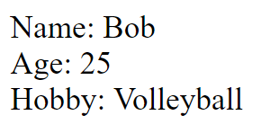
Exercise 2: Hidden Fields
page1.php
page2.php
page3.php
summary.php
10

Slide 11
II. Passing Data Across Pages (Practice 2)
Method 2: Through URL
<html>
<body>
<a href="view_object.php?src=a.jpg&width=500">
View Object
</a>
</body>
</html>
main.php
<?php
echo "<img src='{$_GET['src']}' width='{$_GET['width']}'/>";
?>
view_object.php

Slide 12

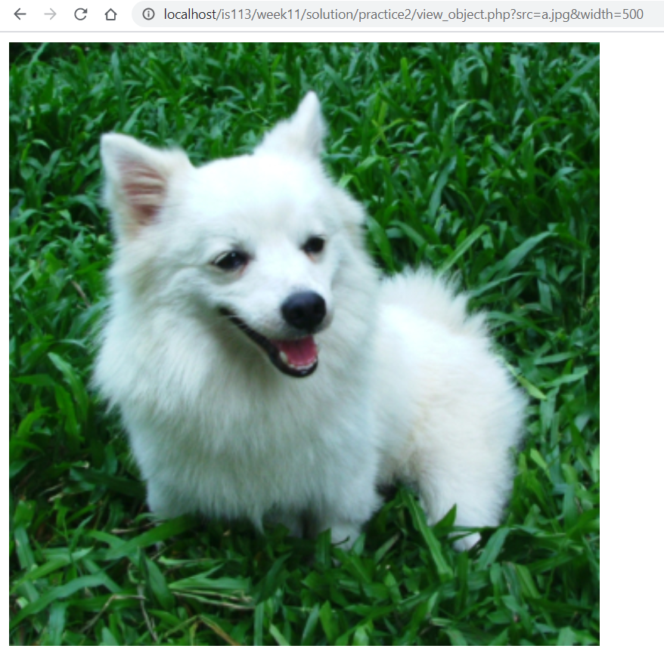
II. Passing Data Across Pages (Practice 2)

Slide 13
II. Passing Data Across Pages
Method 3: Using HTTP Session
What is HTTP Session?
Stores data shared between a user and a website (e.g., eLearn)
Data available across multiple pages (e.g., IS112, IS113, and other pages in eLearn) or multiple instances of the same page
Data will automatically be reset after a period of time

Slide 14
II. Passing Data Across Pages
Why we need it?
Identify a user across more than a page in a site
Pass data between web pages in the same site
Why we need it?
Pass data between web pages in the same site
Identify a user across more than a page in a site
info1.php
info2.php
info3.php
$_SESSION
key | value
… | …
… | …

Slide 15
HTTP Session
How to use HTTP Session?
Call session_start()
Initialize a session OR
Resume an existing session
Use $_SESSION superglobal to add new key-value pairs into the HTTP Session
Note: Make sure session_start() is called before accessing $_SESSION superglobals

Slide 16
HTTP Session
session1.php
session2.php
summary-session.php
16

Slide 17
HTTP Session (Practice 3)
<html><body>
<form method="post" action="session2.php">
Name: <input type="text" name="name"/>
<input type="submit" value="Next"/>
</form>
</body></html>
session1.php
<?php session_start(); ?>
<html><body>
<form method="post" action="summary-session.php">
Age: <input type="text" name="age"/>
<?php
$_SESSION['name'] = $_POST['name'];
?>
<input type="submit" value="Next"/>
</form>
</body></html>
session2.php

Slide 18
HTTP Session
<?php
session_start();
echo "Name: " . $_SESSION["name"];
echo "<br>";
echo "Age: " . $_POST["age"];
?>
summary-session.php

Slide 19
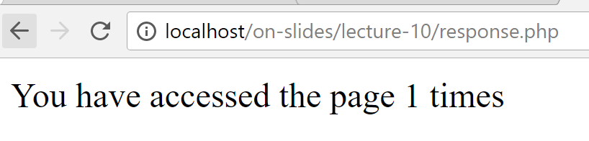
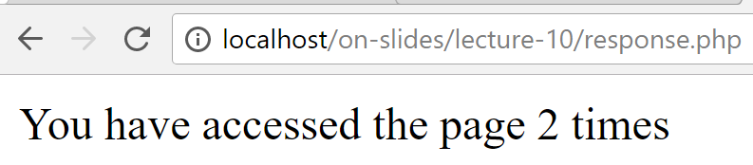
HTTP Session: Another Example

Slide 20
HTTP Session: Another Example
<?php
session_start();
if(!isset($_SESSION["count"])){
$_SESSION["count"] = 0;
}
$_SESSION["count"]++;
echo "You have accessed the page ".$_SESSION["count"]." times";
?>
response.php

Slide 21

HTTP Session: Another Example
1. Client sends HTTP request
2. Server creates a session and generates a unique session id
3. Session id is returned to the client
HTTP/1.1 200 OK
Connection: Keep-Alive
Date: Sun, 3 Jan 2018 11:02:15 GMT
Set-Cookie:PHPSESSID=12345;path=/
12345
Session
count
1
Client
Server
21

Slide 22
HTTP Session: Another Example
5. Server retrieves the session and use value stored in the session during previous request.
4. Client sends another HTTP request
GET / HTTP/1.1
Host: blue.smu.edu.sg
Cookie: PHPSESSID=12345
6. Increment count.
12345
Session
6. Server sends response.
count
1
2
Client
Server
22

Slide 23
HTTP Session: Clearing Contents
Session would be cleared automatically after some period of time has lapsed
What can we do to clear it earlier?
On server side (i.e. PHP file):
We can set $_SESSION to an empty array, or
We can use unset($_SESSION[<key>]), e.g., unset($_SESSION["count"])
23

Slide 24
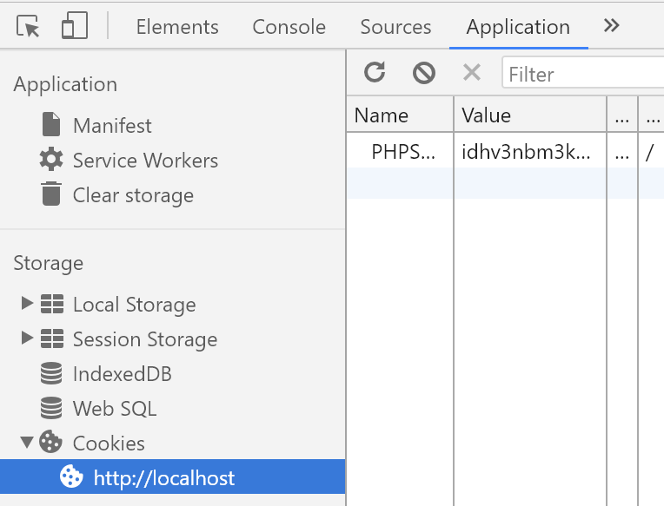
HTTP Session: Clearing Contents
On client side (i.e., web browser):
Session id can be forced to be cleared using, e.g., Chrome Dev Tools (Ctrl+Shift+I)
24

Slide 25
Exercise 3: Session
Given (in ex3 folder):
session1.php
session2.php
session3.php (incomplete)
summary-session.php (incomplete)
To do:
Modify the incomplete PHP pages to realize the behavior shown in the next slide.
25

Slide 26
Exercise 3: Session
session1.php
session2.php
session3.php
summary.php
26

Slide 27
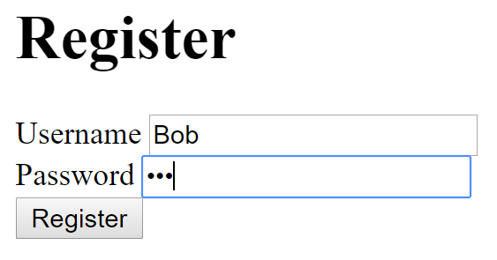
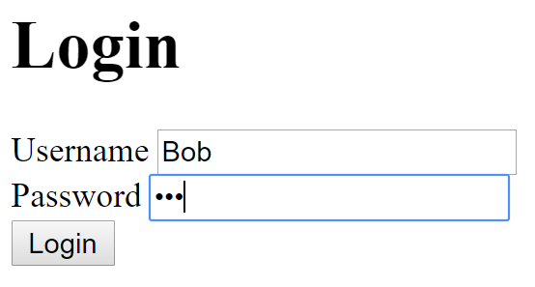
III. Authenticating Users

Slide 28
III. Authenticating Users
The user creates an account and his/her password is stored in the database.
For security reasons, we do not want to store plain text password in the database.
PHP
DB
register.php
process_register.php

Slide 29
Solution: Password Hashing
A one-way transformation on a password
Turn the password into another string
Password can be transformed to its hashed string
But, not the other way round
We want to store hashed password in the DB

Slide 30
II. Authenticating Users
User
- $username - $hashedPassword
+ __construct($username,$hashedPassword) + getUsername() + getHashedPassword()
UserDAO
+ add($username,$hashedPassword) + retrieve($username)

Slide 31
Register a New User
<!DOCTYPE html>
<html>
<body>
<h1>Register</h1>
<form method="post" action="process_register.php">
Username <input type="text" name="username"/>
<br/>
Password <input type="password" name="password"/>
<br/>
<input type="submit" value="Register"/>
</form>
</body>
</html>
register.php

Slide 32
Register a New User
<?php
spl_autoload_register(
function($class){
require_once "model/$class.php";
}
);
$username = $_POST["username"];
$password = $_POST["password"];
$hashed = password_hash($password, PASSWORD_DEFAULT);
$dao = new UserDAO();
$status = $dao->add($username,$hashed);
if($status){
echo "Registered successfully";
}
else{
echo "Failed to register";
}
?>
process-register.php

Slide 33
Login with Password Hashing
When the user attempts to login:
Get the hash of the user’s real password from DB
It will be checked against the entered password.
UserDAO.php
PHP
DB
login.php
process_login.php

Slide 34
Login with Password Hashing
<!DOCTYPE html>
<html>
<body>
<h1>Login</h1>
<form method="post" action="process_login.php">
Username <input type="text" name="username"/>
<br/>
Password <input type="password" name="password"/>
<br/>
<input type="submit" value="Login"/>
</form>
</body>
</html>
login.php

Slide 35
<?php
spl_autoload_register(
function($class){
require_once "model/$class.php";
}
);
$username = $_POST["username"];
$password = $_POST["password"];
$dao = new UserDAO();
$user = $dao->retrieve($username);
$success = false;
if($user != null){
$hashed = $user->getHashedPassword();
$success = password_verify($password,$hashed);
if($success){
echo "Successful Login";
}
}
if (!$success){
echo "Failed Login";
}
?>
process-login.php

Slide 36
Practice 4: Register + Login
Given (practice4 folder):
week11.sql
model/ConnectionManager.php
model/User.php
model/UserDAO.php
register.php
process_register.php
login.php
process_login.php

Slide 37
Practice 4: Register + Login
To do:
Open and check the given files
Import week12.sql
Open register.php in your web browser and register a new user
Open login.php and login with the newly created user credentials

Slide 38
Homework: Why this code does NOT work?
<?php
spl_autoload_register(
function($class){
require_once "model/$class.php";
}
);
$username = $_POST["username"];
$password = $_POST["password"];
$dao = new UserDAO();
$user = $dao->retrieve($username);
$success = false;
if($user != null){
$hash = $user->getHashedPassword();
$success = (password_hash($password,PASSWORD_DEFAULT)===$hash);
if($success){
echo "Successful Login";
}
}
if (!$success){ echo "Failed Login";}
?>
process-login.php

Slide 39

Using Session to Protect Your Pages
UserDAO.php
PHP
DB
login.php
process_login.php
Successful login
welcome.php

Slide 40
<?php
spl_autoload_register(
function($class){
require_once "model/$class.php";
});
session_start();
$username = $_POST["username"];
$password = $_POST["password"];
$dao = new UserDAO();
$user = $dao->retrieve($username);
$success = false;
if($user != null){
$hashed = $user->getHashedPassword();
$success = password_verify($password,$hashed);
if($success){
$_SESSION["user"] = $username;
header("Location: welcome.php");
exit;
}
}
if (!$success){
echo "Failed Login";
}
?>
1
Create a session entry for successful login
process-login.php

Slide 41
Using Session to Protect Your Pages
For every page that needs to be protected
<?php
session_start();
// No session variable "user" => no login
if ( !isset($_SESSION["user"]) ) {
// redirect to login page
header("Location: login.php");
// stop all further execution
// (if there are statements below)
exit;
}
echo "<h1>Welcome to Secure System</h1>";
?>
2
welcome.php

Slide 42
Using Session to Protect Your Pages
To avoid repeating code everywhere:
<?php
session_start();
// No session variable "user" => no login
if ( !isset($_SESSION["user"]) ) {
// redirect to login page
header("Location: login.php");
exit;
}
?>
protect.php
<?php
require_once "protect.php";
echo "<h1>Welcome to Secure System</h1>";
?>
welcome.php

Slide 43
Practice 5: Register + Login + Protect
Given (practice5 folder):
model/ConnectionManager.php
model/User.php
model/UserDAO.php
register.php
process_register.php
login.php
process_login.php
welcome.php
protect.php

Slide 44
Practice 5 : Register + Login + Protect
To do:
Open and check the files highlighted in red
Try to access welcome.php without logging in
Login with a valid username and password
Clear your session using information on slide 21 to simulate logout
Repeat step 2

Slide 45
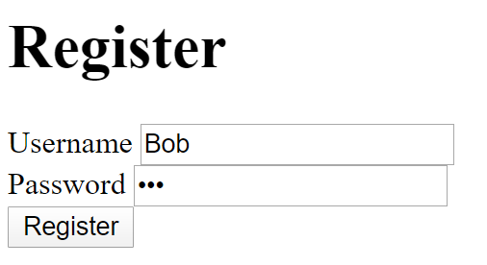
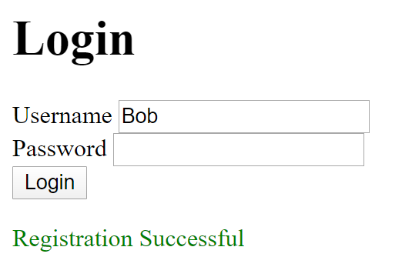
Exercise 4: Register + Login
Modify functionality of process_register.php and login.php when registration is successful.
process_register.php
PHP
DB
register.php
Successful registration
Redirect to login.php
Show newly registered username
Show success message

Slide 46
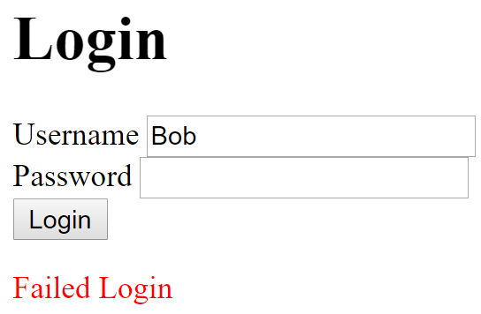
Exercise 4: Register + Login
Modify functionality of login.php and process_login.php when login fails
process_login.php
PHP
DB
login.php
Failed login
Redirect to login.php
Show previously entered username
Show error message

Slide 47
Exercise 4: Register + Login
Pass information from process_login.php to login.php through URL and session
Pass username through the URL given as part of the string argument of the header function
Pass error message (“Failed Login”) through session
$_SESSION["error"]
See comments in PHP files for more information
Use <p style='color: red'></p> to display text in red color

Slide 48
Exercise 4: Failed Login
Given (ex4 folder):
model/ConnectionManager.php,
model/User.php
model/UserDAO.php
register.php
process_register.php (incomplete)
login.php (incomplete)
process_login.php (incomplete)
welcome.php
protect.php

Slide 49
Exercise 4: Login
Modify functionality of process_login.php when login fails
process_login.php
PHP
DB
login.php
login.php

Slide 50
Exercise 4: Login
Pass data from process_login.php to login.php using both HTTP GET and Session
Pass username using HTTP GET (i.e., through the URL)
Pass error message (“Failed Login”) using Session

Slide 51
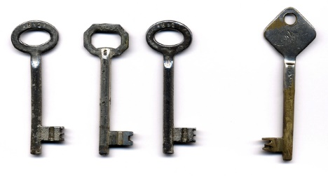
Key Points
Passing Controls
Automatic page redirection
Passing Data
Hidden fields
Through URL
Session
Authenticating Users
Password hashing
Using session to protect pages

