Slide 1

Web Application Development
Classes and Objects I
Knowing is not enough; we must apply. Willing is not enough we must do.
- Goethe

Slide 2
Part I
Basic Syntax

Slide 3
Overview
Objective
Understand how to create and use classes and objects
Content
Class definition
Methods, properties, constants
Object construction (aka. instantiation)
Object usage
After this module, you should be able to
Solve programming problems using classes and objects

Slide 4


Classes vs. Objects
A class is a template from which individual objects are created
An object is an instance of a class

Slide 5


What is an Object?
Informally, an object represents an entity, either physical, conceptual, or software.
Physical entity
Conceptual entity
Software entity
Tom’s Car
US$100,000,000,000
Bill Gate’s bank account
100
Linked list starting at address 100
Notes:
Picture of Bill Gates taken from http://en.wikipedia.org/wiki/Bill_gates.

Slide 6
Class
A set of related variables (aka. properties or attributes) and functions (aka. methods)
- Person.php -
<?php
class Person{
private $name;
private $age;
…
public function drive(){
echo "Hi! I am driving a car";
}
…
}
?>
Properties
Methods

Slide 7
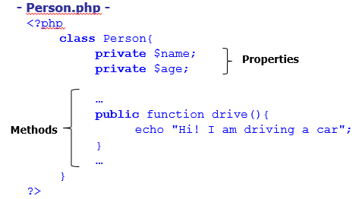
Class
Class diagram represents of a set of classes
Class Name
Person
- $name - $age
+ drive()
Properties
Methods
Class Name
- Vehicle.php -
<?php
# Add code here
class Vehicle{
. . . }
?>
Vehicle
- $plateNum - $type
+ printInfo()
Properties
Methods

Slide 8
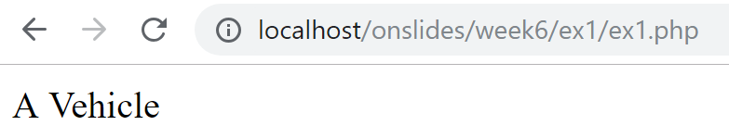
Exercise 1: Creating a Class
Download the resources from eLearn
Open ex1 folder
Complete Vehicle.php based on the class diagram shown in the previous slide.
The printInfo() method should echo "A Vehicle"
Upon successful completion of Vehicle.php, opening ex1.php on your web browser should result in the following output:

Slide 9
What is an Object?
All the objects share the same properties and methods with other objects of the same class
Each object has its own value for each of the attribute
harry:Person
+ drive()
name
Harry
Person
- name - age
+ drive()
age
35
mary:Person
+ drive()
name
Mary
age
27

Slide 10
Object Construction (aka. Instantiation)
Step 1: Create a constructor
Method that creates an instance of a class (an object)
Can accept parameters to initialize class properties
- Person.php -
<?php
class Person{
private $name;
private $age;
public function __construct($name,$age){
$this->name = $name;
$this->age = $age;
}
…
}
?>
newly constructed object’s name and age

Slide 11
Object Construction (aka. Instantiation)
Step 2: Call the constructor
Use keyword new
- person_test.php -
<?php
require_once "Person.php";
$harry = new Person("Harry",35);
$mary = new Person("Mary",27);
?>
$harry:Person
drive()
$mary:Person
drive()
$name
“Harry”
$name
“Mary”
$age
35
$age
27

Slide 12
Object Construction (aka. Instantiation)
- person_test.php -
<?php
require_once "Person.php";
$harry = new Person("Harry",35); …
?>
Local variable in person_test.php
:Person
- Person.php -
<?php
class Person{
private $name;
private $age;
public function __construct($name,$age){
$this->name = $name;
$this->age = $age;
}
…
}?>
$harry
$name
$age
Notes:
$harry is assigned with an object identifier that points to the actual object (in memory)

Slide 13
Object Construction (aka. Instantiation)
- person_test.php -
<?php
require_once "Person.php";
$harry = new Person("Harry",35); …
?>
Local variable in person_test.php
:Person
- Person.php -
<?php
class Person{
private $name;
private $age;
public function __construct($name,$age){
$this->name = $name;
$this->age = $age;
}
…
}?>
$harry
$name
null
$age

Slide 14
Object Construction (aka. Instantiation)
- person_test.php -
<?php
require_once "Person.php";
$harry = new Person("Harry",35); …
?>
Local variable in person_test.php
:Person
- Person.php -
<?php
class Person{
private $name;
private $age;
public function __construct($name,$age){
$this->name = $name;
$this->age = $age;
}
…
}?>
$harry
$name
null
$age
null

Slide 15
Object Construction (aka. Instantiation)
- person_test.php -
<?php
require_once "Person.php";
$harry = new Person("Harry",35); …
?>
$name
“Harry”
$age
35
Local variable in person_test.php
:Person
- Person.php -
<?php
class Person{
private $name;
private $age;
public function __construct($name,$age){
$this->name = $name;
$this->age = $age;
}
…
}?>
$harry
$name
“Harry”
null
$age
null

Slide 16
Object Construction (aka. Instantiation)
- person_test.php -
<?php
require_once "Person.php";
$harry = new Person("Harry",35); …
?>
$name
“Harry”
$age
35
Local variable in person_test.php
:Person
- Person.php -
<?php
class Person{
private $name;
private $age;
public function __construct($name,$age){
$this->name = $name;
$this->age = $age;
}
…
}?>
$harry
$name
“Harry”
null
$age
35
null

Slide 17
Exercise 2: Creating Objects
Open ex2 folder
Add a constructor for Vehicle.php stored in ex2 folder
Complete ex2.php by instantiating 2 vehicle objects following this memory state diagram:
Local variable in ex2.php
Local variable in ex2.php
:Vehicle
:Vehicle
$v1
$v2
$plateNum
“27"
$plateNum
“37"
$type
“car"
$type
"truck"

Slide 18
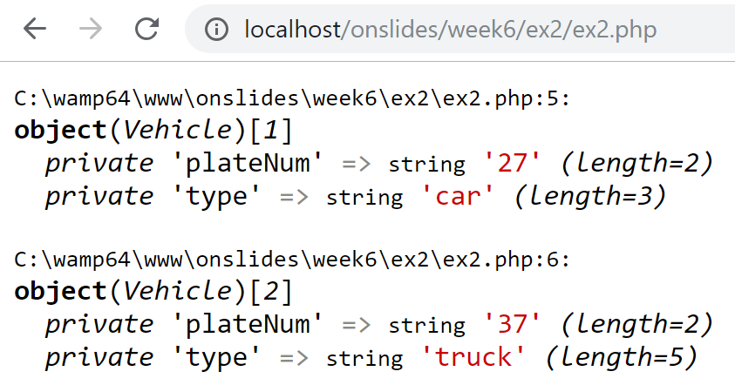
Exercise 2: Creating Objects
Opening ex2.php on your web browser should result in the following output:

Slide 19
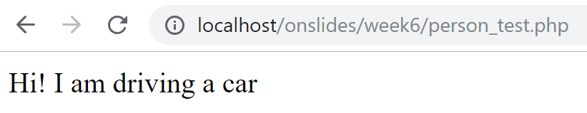
Calling a Method from an Object
Use -> operator
$harry:Person
drive()
$name
“Harry”
- person_test.php -
<?php
require_once "Person.php";
$harry = new Person("Harry",35);
$harry->drive();
?>
$age
35
Calling a method
- Person.php -
…
public function drive(){
echo "Hi! I am driving a car";
} …

Slide 20
Accessing a Property (from within the Class)
Use -> operator
- Person.php -
<?php
class Person{
private $name;
private $age;
public function __construct($name,$age){
$this->name = $name;
$this->age = $age;
}
…
public function printName() {
echo $this->name;
}
}
?>
Accessing a property

Slide 21
Accessing a private Property (from outside the Class)
Step 1: Create public methods
Getters allow external code to read private properties
Setters allow external code to modify private properties
- Person.php -
<?php
class Person{
private $name;
…
public function getName() {
return $this->name;
}
public function setName($name) {
$this->name = $name;
}
}
?>
Getter
Setter

Slide 22


Accessing a private Property (from outside the Class)
Step 2: Call the corresponding getter/setter method
Getters allow external code to read private properties
- person_test.php -
<?php
require_once "Person.php";
$harry = new Person("Harry",35);
echo "Name: " . $harry->getName() . " <br/>";
?>
- person_test.php -
<?php
require_once "Person.php";
$harry = new Person("Harry",35);
echo "Name: " . $harry->name . " <br/>";
?>

Slide 23
Accessing a private Property (from outside the Class)
Step 2: Call the corresponding getter/setter method
Setters allow external code to modify private properties
- person_test.php -
<?php
require_once "Person.php";
$harry = new Person("Harry",35);
$harry->setName("Hary");
?>
- person_test.php -
<?php
require_once "Person.php";
$harry = new Person("Harry",35);
$harry->name = "Hary";
?>

Slide 24
Complex/Curly Syntax
- person_test.php -
<?php
require_once "Person.php";
$harry = new Person("Harry",35);
echo "Name: " . $harry->getName() . " <br/>";
?>
- person_test.php -
<?php
require_once "Person.php";
$harry = new Person("Harry",35);
echo "Name: {$harry->getName()} <br/>";
?>
More information: https://bit.ly/2Soh1ay
Notes:
Notice: $ is omitted when using -> to access a property

Slide 25
Revisiting $this
- person_test.php -
<?php
require_once "Person.php";
$harry = new Person("Harry",35);
$mary = new Person("Marry",27);
echo $harry->getName();
echo $mary->getName();
?>
$harry:Person
getName()
$name
“Harry”
$age
35
- Person.php -
<?php
class Person{
private $name;
public function getName() {
return $this->name;
}
…
}
?>
$mary:Person
getName()
$name
“Mary”
$age
27
Notes:
Note: Meaning of animation is explained during class

Slide 26
Exercise 3: Calling Method, Assessing Property
Open ex3 folder
Add getters & setters to Vehicle.php in ex3 folder
Add: getType(), getPlateNum()
Add: setType($type), setPlateNum($plateNum)
So that external code can read/write to its private properties
Change the body of printInfo() method so that:
It echoes the plate number and type of the corresponding vehicle object:
" A [type] with plate number [plateNum] “
You may want to implement the above by either:
(1) Directly accessing the properties or
(2) Calling the corresponding getter methods

Slide 27
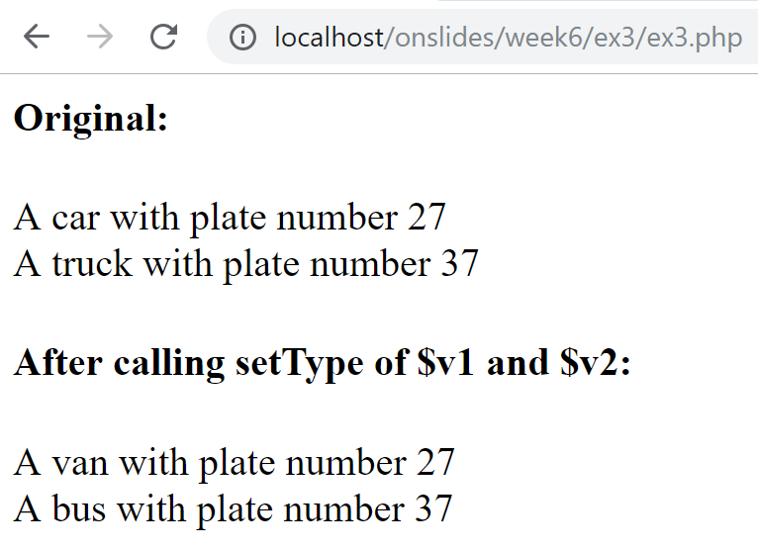
Exercise 3: Calling Method, Assessing Property
Complete ex3.php:
Call the printInfo() method of the Vehicle objects
Call the setType() method of the Vehicle objects
So that opening ex3.php on your web browser result in:

Slide 28
Object Assignments
Local variables in current program (assignment.php)
:Person
$harry
name
“Harry”
$mary
age
35
$another_mary
:Person
name
“Mary”
- assignment.php -
<?php
$harry = new Person("Harry", 35);
$mary = new Person("Mary", 27);
$another_mary = $mary;
?>
age
27

Slide 29
Object Assignments
Local variables in current program (assignment.php)
:Person
$harry
name
“Harry”
$mary
age
35
$another_mary
:Person
name
“Mary”
- assignment.php -
<?php
$harry = new Person("Harry", 35);
$mary = new Person("Mary", 27);
$another_mary = $mary;
$harry = $mary;
?>
age
27

Slide 30
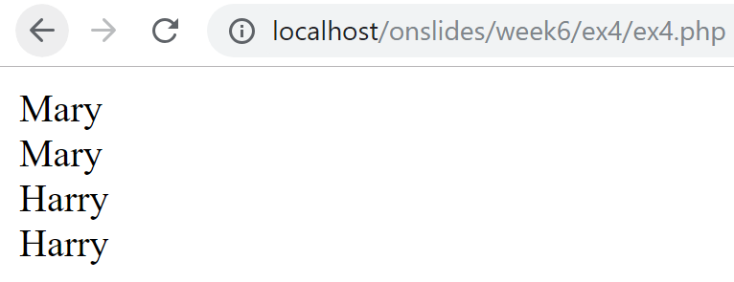
Exercise 4: Object Assignments
Open ex4 folder
Edit model/Person.php to include setName()
Edit ex4.php. Instructions are in the php file.
Opening ex4.php on your web browser should result in:

Slide 31
Class Constant
An identifier (name) for a value, that does not change during the execution
Define using keyword const
How to use a constant?
Within: self::GST_RATE
Outside: Sales::GST_RATE
- Sales.php -
class Sales{
const GST_RATE = 0.07; // Constant
…
}

Slide 32
Class Constant
Within
- Sales.php -
<?php
class Sales{
const GST_RATE = 0.07;
public function computeGST($price){
return self::GST_RATE * $price;
}
}
?>
Outside
- sales_test.php -
<?php
require_once "Sales.php";
echo "GST Rate is: " . Sales::GST_RATE;
?>

Slide 33
Difference between $this and self
$this | self
Represents an instance of the class (object) | Represents a class
Always begin with dollar ($) sign | Never begin with dollar ($) sign
Is followed by the -> operator | Is followed by the :: operator

Slide 34
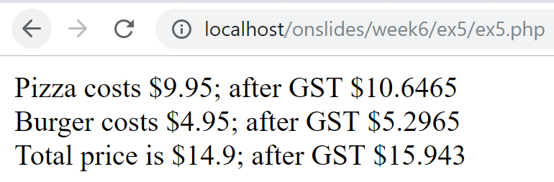
Exercise 5: Class Constant
Open ex5 folder
Edit ex5.php and model/Product.php from the given resources.
Instructions are in the php files.
Opening ex5.php on your web browser should result in:

Slide 35

Key Points
Classes
Properties
Methods
Constructors
Getters
Setters
Constants
Objects
Instantiation
new keyword
Assignment
Method invocation

