Slide 1

Web Application Development
Building Dynamic Webpages using PHP
Knowing is not enough; we must apply. Willing is not enough we must do.
- Goethe

Slide 2
Part I: Basic PHP

Slide 3

Overview
Objective
To read and write basic PHP code
Content
Operators
Variables
Decision statement
Looping statements
Functions
After this module, you should be able to
Create and modify basic PHP code

Slide 4

Introduction – What is PHP?
PHP: Hypertext Preprocessor
Open source scripting language for web development and can be used along with HTML codes
Easy to learn for quick creation of dynamic and interactive web pages
Executed on the web server which is configured to process PHP code (WAMP Server)
Websites written in PHP include Wikipedia (Media Wiki), Yahoo, YouTube etc.

Slide 5
Introduction to PHP Programming
PHP code files must have a ".php" extension to be parsed by the PHP engine
greeting.php
All PHP files will be stored in web server’s root folder:
c:\wamp64\www\
PHP code written in a file must be identified using a pair of tags. The pair of tags are used to mark the beginning and end of a block of PHP code.
Opening tag (Beginning of php block) | <?php
Closing tag (Ending of php block) | ?>

Slide 6
Introduction to PHP Programming
You can embed any number of PHP script blocks in a .php file
<?php
// write the php codes in this block
?>
<html> <!– header block --> <head> <?php
/* write your codes here
more codes */
?>
</head> <body> <?php
# php codes could be here
?>
</body>
</html>
single line comment
single line html comment
(i) start of the PHP block
multi line comment
(ii) end of the PHP block
single line comment

Slide 7
First PHP Page
<!-- greeting.php -->
<html>
<body>
<?php
echo "Good afternoon! <br/>";
?>
</body>
</html>
(i) echo statement is used to output data
(ii) each statement in PHP must end with a semicolon ;

Slide 8
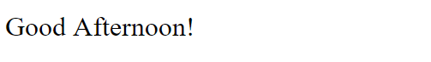
First PHP Page
PHP Processor returns the output in HTML syntax to the web server to be returned to the client’s web browser
parsed output to web server
output to client’s web browser
<!-- greeting.php -->
<html>
<body>
Good Afternoon! <br/>
</body>
</html>

Slide 9
Arithmetic Operations
<!-- two.php -->
<html>
<head>
<title> My Second PHP page </title>
</head>
<body>
One + One =
<?php
echo 1 + 1;
?>
</body>
</html>
PHP code block

Slide 10
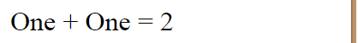
Arithmetic Operations
echo outputs the result of the arithmetic operation
PHP Processor returns the output in HTML syntax to the web server to be returned to the client’s web browser
parsed output to web server
output to client’s web browser
<!-- two.php -->
<html>
<head>
<title> Two PHP page </title>
<head>
<body>
One + One =
2
</body>
</html>

Slide 11
Arithmetic Operations
Operator | Name
+ | Addition
- | Subtraction
* | Multiplication
/ | Division
% | Modulo
** | Exponentiation

Slide 12
Variables
Store values like strings, numbers, etc.
Can be re-used
Variable symbol: $
Naming convention:
Case sensitive
First Character | Only Contain | Cannot Contain
Letter or _ | Alpha-numeric characters and underscores (a-z, A-Z, 0-9, and _) | Spaces
Separate words with an underscore ($trans_date) or with capitalization ($transDate)

Slide 13
Variables
<!-- fruit.php -->
<?php
$fav_fruit = "mango"; //assigning string
echo "Favourite is ";
echo $fav_fruit; //prints value in $fav_fruit
echo "<br/>"; // single line break html tag
echo "Let's buy ";
$qty = 2; //assigning number
echo $qty;
echo "<br/>";
echo "Change favourite fruit to ";
$fav_fruit = "apple"; //re-using variable
echo $fav_fruit;
?>

Slide 14
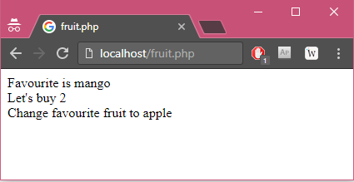
Variables
PHP processor returns the output in HTML syntax to the web server to be returned to the client’s web browser
- parsed fruit.php -
Favourite is mango
<br/>
Let's buy 2
<br/>
Change favourite fruit to apple
http://localhost/fruit.php
Output in a browser

Slide 15
Printing Variables
Double Quote Print
<?php
$module = "Web Application Development";
//print with double quote
echo "Print value of variable: $module <br/>";
?>
Variable $module assigned with the text “Web Application Development"
Print Statement with double quotes will replace $module with the text “Web Application Development”
Output on the web browser of the PHP Print statement:
Print value of variable: Web Application Development

Slide 16
Printing Variables
Single Quote Print
<?php
$module = "Web Application Development";
//print with single quote
echo 'Print name of the variable: $module <br/>';
?>
Variable $module assigned with the text “Web Application Development"
Print Statement with single quote will NOT replace $module with the text “Web Application Development”.
It will show $module as the output.
Output on the web browser of the PHP Print statement:
Print name of the variable: $module

Slide 17
Printing Variables
Concatenate with Print
<?php
$module = "Web Application Development";
//example 1
echo 'String 1 and ' . 'String 2’;
echo </br>;
//example 2
echo 'String 1: ' . $module;
?>
Concatenate two strings
Example 1 output on the web browser:
String 1 and String 2
Concatenate a variable and a string
Example 2 output on the web browser:
String 1: Web Application Development

Slide 18
Constant Variables
Used for storing value that cannot be changed
By convention, constant is always uppercase
Case sensitive
Example:
<!– constant.php -->
<?php
define("CONSTANT1","PHP");
define("CONSTANT2","7");
echo CONSTANT1;
echo CONSTANT2;
?>

Slide 19
Conditional Statement
If statement
Tests a condition and executes the following statements based on the condition result
If the condition is TRUE, the block of statement is executed
Otherwise, the block of statement will be not executed
Syntax :: if (condition) {action to take}
elseif (condition) {action to take}
else {action to take}

Slide 20
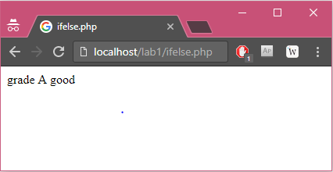
Conditional Statement
- ifelse.php -
<?php
$grade = "A";
echo "grade ";
echo $grade;
if ($grade == "A") {
echo "good";
} else {
echo "you can do better";
}
?>
- parsed ifelse.php -
grade A
good
Output in a browser
Output in a browser

Slide 21
Comparison Operators
Operator | Name
== | Equal
!= | Not equal
<>
=== | Identical
!== | Not identical
< | Less than
<= | Less than or equal to
> | Greater than
>= | Greater than or equal to
<=> | Spaceship (since PHP7)
?? | Null coalescing (since PHP7)

Slide 22
Comparison Operators
== vs. ===
== performs implicit type conversion
Example:
1.0 == "1.0" returns true since "1.0" is implicitly converted to 1.0
1.0 == 1.0 returns true
=== compares whether both types and values of two operands are the same
Example:
1.0 === "1.0" returns false since "1.0" is not implicitly converted to 1.0
1.0 === 1.0 returns true

Slide 23
Comparison Operators
Spaceship
Compares two operands, and returns -1, 0, or 1 if the left operand is less than, equal to, or greater than the right operand, respectively.
Example:
1 <=> 2 returns -1
1 <=> 1 returns 0
2 <=> 1 returns 1

Slide 24
Comparison Operators
Null coalescing
Used for an assignment
Behaves like if condition
Example:
$a = $b ?? $c;
If $b is not NULL, $b is assigned to $a
Otherwise, $c is assigned to $a

Slide 25
Logical Operators
Operator | Name
&& | And
|| | Or
! | Not

Slide 26
Operator Precedence
Higher
Operators | Type
! | logical
* / % | arithmetic
+ - . | arithmetic
< <= > >= | comparison
== != === !== <> <=> | comparison
&& | logical
|| | logical
?? | comparison
Lower

Slide 27
Operator Associativity
Determine the direction in which operators are evaluated.
Usually from left to right.
Example:
1+2+3 evaluates (1+2) first.
Some operators such as ** are evaluated from right to left.
Example:
2**3**4 evaluates (3**4) first.

Slide 28
Looping Statements
For loop
Runs a block of code repeatedly given: (1) an initialized variable, (2) repetition condition, and (3) variable increment/decrement statement
Syntax ::
for (init; condition; increment) {
actions to take
}

Slide 29
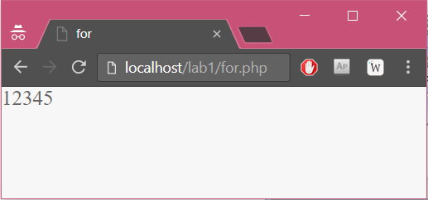
Looping Statements
- for.php -
<?php
for($i=1; $i<=5; $i++){
echo $i;
}
?>
Output in a browser

Slide 30
Looping Statements
While loop
Runs a block of code repeatedly as long as a repetition condition is true
Syntax ::
while (condition) {
actions to take
}

Slide 31
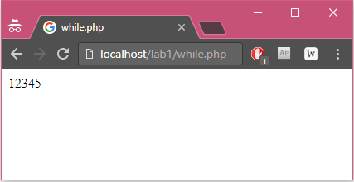
Looping Statements
- while.php -
<?php
$i = 1;
while ($i < 6) {
echo $i;
$i++;
}
?>
Output in a browser

Slide 32
Looping Statements
Do-while loop
Run a block of code; Repeat running it as long as a repetition condition is true
Syntax ::
do{
actions to take
}while (condition)

Slide 33
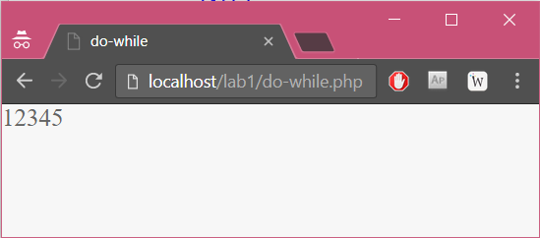
Looping Statements
- do_while.php -
<?php
$i = 0;
do{
$i++;
echo $i;
}while ($i < 5);
?>
Output in a browser

Slide 34
Functions
Functions are created when you are in need of using a block of code more than once
PHP allows you to build a function which you can call repeatedly to perform a task
A function name can start with a letter or underscore but not a number
Syntax ::
function name(parameters)
{
action to take
}

Slide 35
Functions
<?php
function favourite_module() //declare a function
{//beginning of function
echo "Web Application Development";
}//end of function
echo "My favourite module is ";
favourite_module(); //call the function
?>
Output on the web browser:
My favourite module is Web Application Development

Slide 36
Functions
<?php
//declare a function with a parameter
function favourite_course_code($code)
{
echo "My favourite course code is $code";
}
//call the function with an argument
favourite_course_code("IS113");
?>
Output on the web browser:
My favourite course code is IS113

Slide 37
Functions
<?php
//declare a function with a return value
function subtract($num1, $num2)
{
$num3 = $num1 - $num2;
return $num3;
}
//call the function
echo "10 – 3 = " . subtract(10,3);
?>
Output on the web browser:
10 – 3 = 7

Slide 38
Built-in Functions
isset($var)
Determine if $var is set and is not NULL
<!– isset.php -->
<?php
$var = '';
if (isset($var)){
echo "This var is set.";
}
?>

Slide 39
Exercise 1: Basic PHP - I
Write the PHP code to output the
total number of letter 'a' (case sensitive) and
total number of letters that are not 'a'
in the text string "Web Application Development"

Slide 40
Exercise 1 - Basic PHP - I
<?php
$course = "Web Application Development";
$i=0; $totalA=0; $totalNA=0;
// Enter missing code here
echo 'Total a chars : ' . $totalA . '<br/>';
echo 'Total non-a chars : ' . $totalNA . '<br/>';
?>
Hint: Explore the use of strlen, substr, and $course[$i]?

Slide 41
Exercise 2: Basic PHP - II
Given a string that represents a number (e.g. "456", "-66"), print the sum of digits.
If the number is negative, it will ignore the minus sign and sums the numbers.
String is hardcoded.
For example:
$mystring = "456"
Sum of numbers in 456 is 15
$mystring = "-66"
Sum of numbers in -66 is 12

Slide 42
Exercise 3: Basic PHP - III
Write a function call print_sign that takes in 2 parameter sign and an int named num. The function should then print the sign for as many times as indicated by num.
Invoke the function to create the Text Art as show below.
You may declare more functions to keep the code short.
___$$$___$$$___
__$$$$$_$$$$$__
__$$$$$$$$$$$__
___$$$$$$$$$___
____$$$$$$$____
______$$$______
_______$_______
To explore:
How would you rewrite the function using PHP function str_repeat()?

Slide 43
Exercise 4: Basic PHP - IV
Write a program that checks if a password is valid.
It will return True if the following conditions are met:
The password must be at least 6 characters and at most 20 characters
It must contain at least one lowercase letter, one uppercase letter and one number.
Otherwise, it returns False.
To explore: How would you solve the above using PHP function preg_match()?

Slide 44

Key Points
PHP
Open source scripting language for web development
Can be combined with HTML code
Basic constructs
echo
Operators
Variables
Conditional statement
Looping statements
Functions

