Slide 1

Web Application Development
Building Dynamic Webpages using PHP
Knowing is not enough; we must apply. Willing is not enough we must do.
- Goethe

Slide 2
Part II: Form Handling

Slide 3

Overview
Objective
Form handling
Content
Revision: How form works?
Revision: Building a form using HTML
Revision: HTTP GET and POST methods
Retrieving data sent using a form
After this module, you should be able to
Able to retrieve and process simple information sent through a form

Slide 4

How a Form Works?
Provides a means to make web pages interactive

Slide 5

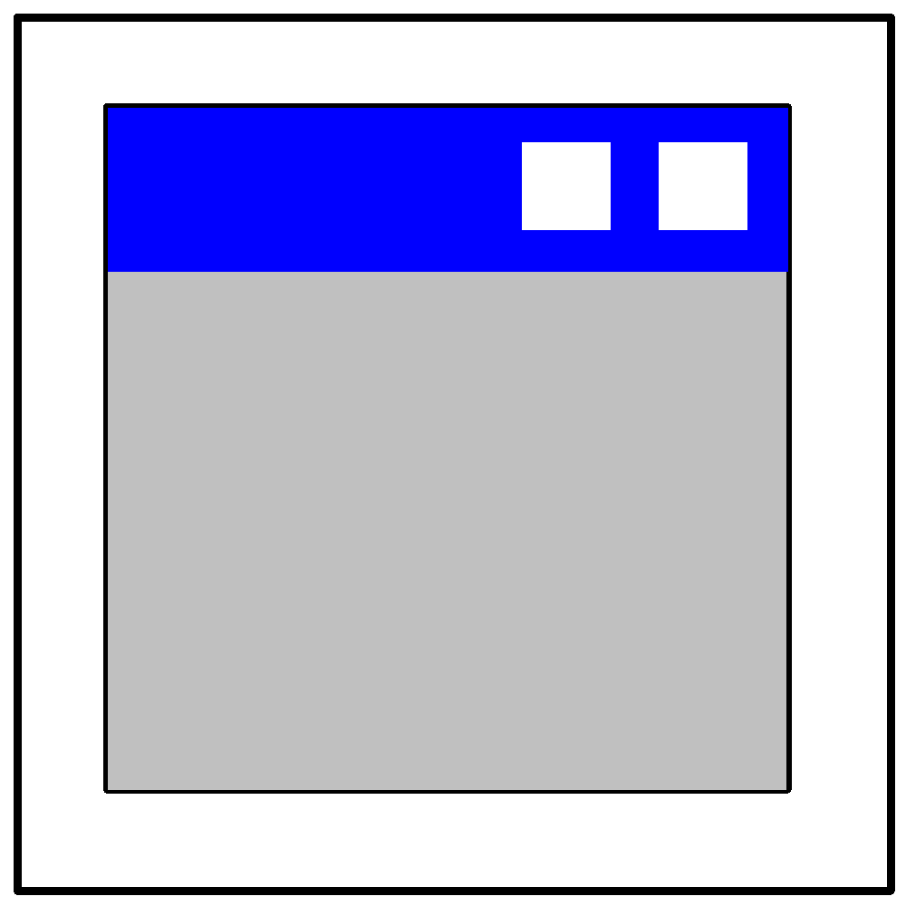

How a Form Works?
Provides a means to make web pages interactive
User fills in the form and clicks on the submit button. The data on the form is sent to the web server
User’s Browser
Server-Side Application (e.g., a PHP code)
Web Server (Apache)

Slide 6
How a Form Works?
Provides a means to make web pages interactive
A program on the web server processes the request.
User’s Browser
Server-Side Application (e.g., a PHP code)
Web Server (Apache)

Slide 7
How a Form Works?
Provides a means to make web pages interactive
The web server sends the output to the user’s browser
User’s Browser
Server-Side Application (e.g., a PHP code)
Web Server (Apache)

Slide 8
Building a Form using HTML
A simple HTML form requesting for user’s name with a send button
Textfield requesting for user’s name
Submit button labelled as “send” to send the user’s data to the
web server

Slide 9
Building a Form using HTML
HTML codes of a simple html form
Opening and closing of form tag
- form.html –
<html>
<head><title>A simple form</title></head>
<body>
<form method="post" action="process_form.php" >
Enter your name:
<input type="text" name="fullname" />
<input type="submit" value="send" />
</form>
</body>
</html>
Various types of form elements

Slide 10
Building a Form using HTML
1. Textfield for the form
2. Submit button for the form
- form.html – <html>
<head><title>A simple form</title></head>
<body>
<form method="post" action="process_form.php" >
Enter your name:
<input type="text" name="fullname" />
<input type="submit" value="send" />
</form>
</body>
</html>

Slide 11
Building a Form using HTML
- form.html –
<html><head><title>A simple form</title></head><body>
<form method="post" action="process_form.php" >
Enter your name:
<input type="text" name="fullname" />
<input type="submit" value="send" />
</form>
</body></html>
Method attribute to indicate how the form data is being sent to the web server
Action attribute to indicate the form handler of the collected user input data

Slide 12
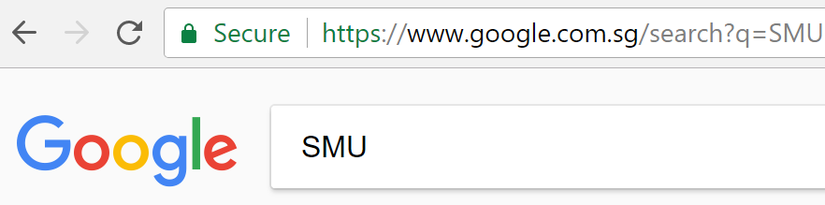
HTTP GET and POST Methods
<form method="GET"…>
Default method
Data entered into the form is sent via the URL
Visible to all
Can be bookmarked
Non-sensitive data
Limit on URL length (especially for IE)

Slide 13
HTTP GET and POST Methods
<form method="POST"…>
Data entered into the form is sent behind-the-scenes
Not visible in the address bar
More sensitive data
No size limitation
Cannot be bookmarked

Slide 14
Retrieving Data Sent using a Form
- form.html -
<html><head><title>A simple form</title></head><body>
<form method="post" action="process_form.php" >
Enter your name:
<input type="text" name="fullname" />
<input type="submit" value="send" />
</form>
</body></html>
$_POST
Key | Value
fullname | Alex
In PHP, superglobals $_POST, $_GET, $_REQUEST are used to retrieve form data which is stored as key-value pairs
- process_form.php –
<?php
$username = $_POST["fullname"] ;
echo "Hi $username. Welcome to IS113!<br />";
?>

Slide 15

Retrieving Data Sent using a Form
$_POST
- process_form.php -
<html><body>
<?php
$username = $_POST["fullname"];
echo "Hi $username. Welcome to IS113!<br />";
?>
</body></html>
Name | Value
fullname | Alex

Slide 16
Exercise 5: Form Handling - I
Try out form.html and process_form.php as presented in the previous two slides.

Slide 17
Exercise 6: Form Handling - II
Open form.html in resource.zip
For form.html, add in:
Form method and action attributes.
Reset and submit buttons
Write process_form.php that echoes the information keyed in by a user in exe6.html, in the following format:
Name: John Joe
Email: johndoe@abc.com
Password: 12345
Gender: M

Slide 18
Exercise 7: Simple Form Handling
Edit register.php from the given resources.
It processes inputs received from register.html.
register.html has been completed for you.

Slide 19
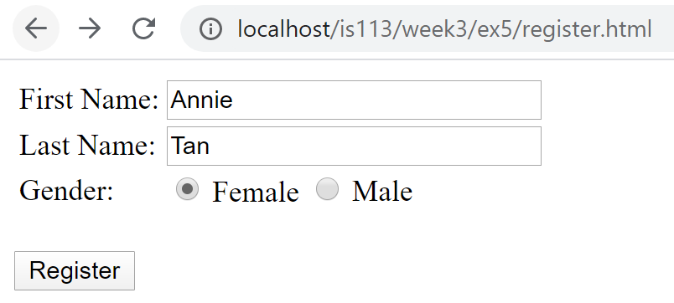
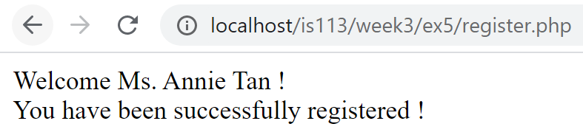
Exercise 7: Simple Form Handling
Expected Behavior

Slide 20
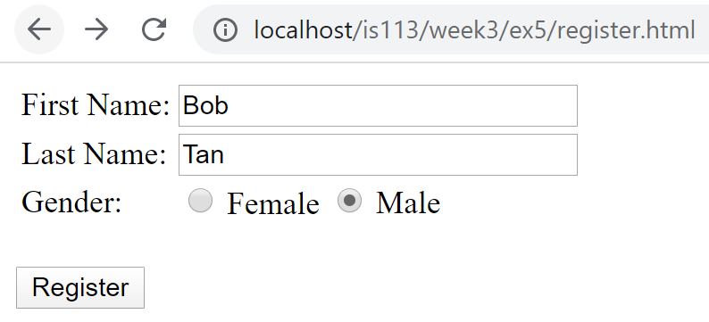
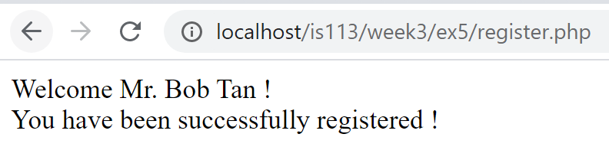
Exercise 7: Simple Form Handling
Expected Behavior

Slide 21
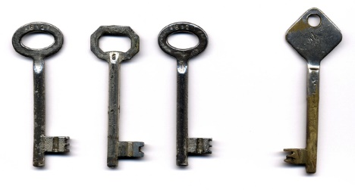
Key Points
Form
A means to make web pages interactive
<form>, <input>, <select>, etc.
Methods: GET, POST
Superglobals
$_GET
$_POST
$_REQUEST

