Slide 1
FINAL PROJECT PRESENTATION
Funding Flow Insights
A Comparative Funding Dashboard of Indian Startups
An Interactive Data Visualization Dashboard built on Indian Startup Funding data
Presented by: Team STCS | Big Data & Business Management
(Mar Baselios College of Engineering and Technology , Govt. Model Engineering College, Amrita Vishwa Vidyapeetham, TKM College of Engineering )

Slide 2
What We'll Cover
Agenda for today's final project presentation
01
Introduction & Problem Statement
05
Dashboard Features & Visualizations
02
Project Objectives
06
Key Insights
03
Dataset Description
07
Expected Outcomes & Conclusion
04
Data Cleaning Highlights

Slide 3
India's Startup Funding Landscape
A high-volume, fast-moving funding ecosystem (2015–2020)
The Indian startup ecosystem attracted large and varied capital inflows between 2015 and 2020, spanning thousands of deals across hundreds of cities and industries. Understanding this scale and distribution is essential for investors, founders and policy analysts alike.
$32.9B
2,138
3,044+
2015–2020
Total Funding Raised
Startups Funded
Funding Deals
Data Coverage
Source: Indian Startup Funding dataset (Kaggle) — cleaned and standardized for analysis

Slide 4
Problem Statement
Funding data is rich, but hard to access, interpret and compare
!
i
The Challenge Today
Our Approach
Raw funding records are messy — inconsistent dates, city names and industry labels
Difficult for founders, investors and researchers to interpret at a glance
No quick way to compare cities, industries or funding trends over time
Manual spreadsheet analysis is slow, error-prone and hard to scale
An interactive platform that turns raw funding data into clean visuals
Makes large, inconsistent datasets easy to understand at a glance
Enables quick comparisons across cities, industries and years
Supports informed, evidence-based investment and research decisions

Slide 5
Project Objectives
What the dashboard is designed to achieve
1
Interactive Dashboard — Develop an interactive dashboard built on real-world Indian startup funding data.
2
Geographic Visualization — Visualize funding distribution across Indian cities and (where present) international hubs.
3
Comparative Analysis — Compare industries, investors and investment types using key indicators.
4
Trend Analysis — Present year-over-year funding trends through dynamic, filterable charts.
5
Pattern Discovery — Help users spot funding patterns, leading sectors and regional concentration via interactive filters.

Slide 6
Dataset Description
Real-world Indian startup funding data powering the dashboard
“Indian Startup Funding”
SOURCE
COVERAGE
FORMAT
Kaggle (Public Dataset)
3,000+ deals, 2015–2020
Raw, unstructured CSV
The dataset offers a real-world view of India's startup investment landscape — capturing funding date, startup identity, industry classification, city location, investor names, investment type and funding amount for each recorded deal. Its raw form required substantial cleaning before it could support reliable analysis.

Slide 7
Data Cleaning Highlights
Turning a messy, real-world dataset into an analysis-ready source
Funding Amount Errors
Inconsistent Naming
Detected and corrected a 1000x data-entry error using outlier analysis and cross-verification.
Standardized duplicate startup and city names (e.g. “Flipkart” vs. “Flipkart.com”).
Messy Date Formats
Unstructured Industries
Parsed inconsistent date entries and extracted a clean, analyzable Year field.
Grouped 500+ free-text industry descriptions into 15 broad, comparable categories.

Slide 8
Dataset Variables
Key fields captured for every funding deal, after cleaning
Date / Year
Startup Name
Industry Vertical
Industry Category
SubVertical
City Location
Investors Name
Investment Type
Amount (USD)
Country

Slide 9
Dashboard Feature: KPI Cards
At-a-glance summary metrics shown at the top of the dashboard
$32.9B
2,138
3,044+
Total Funding
Total Startups Funded
Total Funding Deals
Each KPI card surfaces a single headline number, refreshed instantly as filters change.

Slide 10
Dashboard Features: Map & Bar Charts
Geographic and comparative views of funding activity
M
B
Funding by City (Map)
Funding by Industry (Bar Chart)
Total funding shown geographically across Indian cities — shaded and sized by deal value, with international hubs included for context.
Total funding compared across 15 industry categories
Top investors ranked by total capital contributed
Sortable and filterable for quick side-by-side comparison

Slide 11
Dashboard Features: Trend & Treemap
Time-based and proportional views of funding activity
L
T
Funding Trend by Year (Line Chart)
Startup Share by Industry (Treemap)
Total funding tracked from 2015 to 2020, highlighting the 2017 peak driven by large late-stage rounds and the effect of incomplete 2020 data.
A proportional view of how total funding is distributed across industry categories, making the biggest sectors visually obvious at a glance.

Slide 12
Key Insights
What the dashboard reveals about India's startup funding landscape
✓
E-Commerce/Marketplace leads all sectors with ~$11B in funding, followed by Technology/SaaS (~$5B) and FinTech (~$3.7B).
✓
Funding activity is heavily concentrated in a small number of metro hubs — Bengaluru, Mumbai and the Delhi-NCR region.
✓
2017 was a peak funding year (~$10.4B), driven by a handful of very large, late-stage rounds rather than broad deal growth.
✓
Softbank and SoftBank Group are the two most prominent investors by capital deployed in this period.
✓
The apparent 2020 decline reflects incomplete data coverage for that year, not an actual funding downturn.

Slide 13
Expected Outcomes & Conclusion
What this project delivers
Simplifies interpretation of complex, unstructured startup funding data for a general audience
Enables meaningful comparisons of funding activity across Indian cities and industries
Supports investor research, academic study and startup ecosystem policy planning
Demonstrates practical application of data cleaning, BI and visualization techniques on a real, messy dataset
The Funding Flow Insights dashboard transforms raw, unstructured startup funding records into an interactive decision-support tool — enabling users to explore India's startup investment landscape efficiently while promoting evidence-based analysis for entrepreneurial, investment and policy-related purposes.

Slide 14
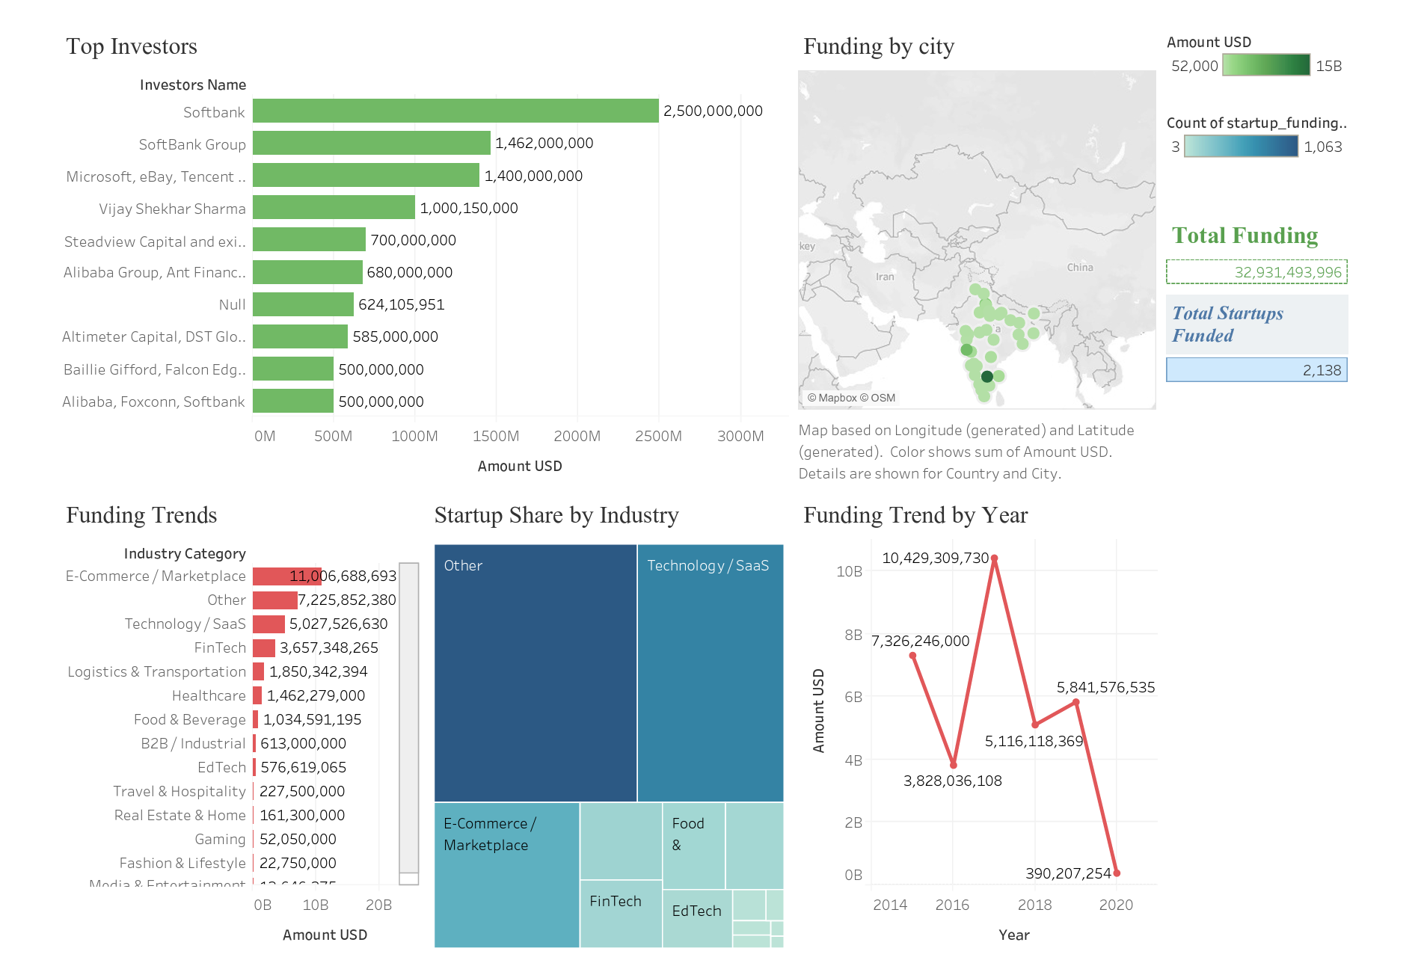
Live Dashboard Demonstration
Explore the full interactive dashboard on Tableau Public
L
Link
https://public.tableau.com/views/Indian_Startup_Funding_Dashboard/Dashboard2?:language=en-US&:sid=&:redirect=auth&:display_count=n&:origin=viz_share_link

